Slide 1
Philosophy Of Life
Romans 8:26-37
You Are As You Think?

Slide 2
Everyone Has An Opinion!
Music
Food
Movies, Life?

Slide 3
3 Basic Philosophies
Optimist – (It’s going to be better!)
Pessimist – (It’s going to get worse!)
Realist – (It Is What It Is.)
*

Slide 4
What Is Life? Good or Bad?
Titus 2:11-14 John 5:28-29
OR Just Here Today and Gone Tomorrow?

Slide 5
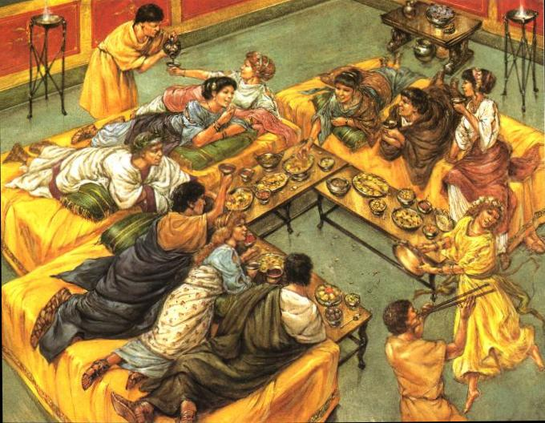
Life Is Good?
Ecclesiastes 2:1-11
Solomon Found out that is was NOT as good as he hoped!

Slide 6
Isaiah 5:20
God defines what is good
Genesis 1:31
James 1:17
2 Timothy 3:16-17

Slide 7
Pessimist Philosophy Where is the hope?
“This hope we have as an anchor of the soul, both sure and steadfast...” Hebrews 6:19

Slide 8
“Realist ” Has no Need for A Solid Foundation
Matthew 7:24-27
Luke 8:15

Slide 9
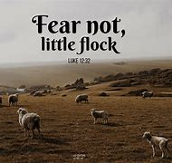
What Is Your Desire?
Proverbs 11:23
1 Thessalonians 5:15 & 21
Romans 12:9
Luke 12:32-34
Romans 12:21

Slide 10
What Do You Consider to be Valuable?
Proverbs 22:1

Slide 11
May This Be Our Philosophy!
Philippians 4:8

