Slide 1
Building a Personal Relationship with god
Romans 5:6-11

Slide 2
You Must Spend Time with God
Jeremiah 29:12-14
12 Then you will call upon Me and come and pray to Me, and I will listen to you. 13 And you will seek Me and find Me when you search for Me with all your heart. 14 I will let Myself be found by you,’ declares the Lord

Slide 3
Those with that Relationship with God
Abraham
James 2:21-23
21 Was our father Abraham not justified by works when he offered up his son Isaac on the altar? 22 You see that faith was working with his works, and as a result of the works, faith was perfected; 23 and the Scripture was fulfilled which says, “And Abraham believed God, and it was credited to him as righteousness,” and he was called a friend of God.

Slide 4
Those with that Relationship with God
David
Acts 13:22
After He had removed him, He raised up David to be their king, concerning whom He also testified and said, ‘I have found David, the son of Jesse, a man after My heart, who will do all My will.’

Slide 5
Those with that Relationship with God
Enoch
Hebrews 11:5
By faith Enoch was taken up so that he would not see death; and he was not found because God took him up; for before he was taken up, he was attested to have been pleasing to God.

Slide 6
We can have that Same Relationship
Deuteronomy 4:29-30
29 But from there you will seek the Lord your God, and you will find Him if you search for Him with all your heart and all your soul. 30 When you are in distress and all these things happen to you, in the latter days you will return to the Lord your God and listen to His voice.

Slide 7
Spend Time with the Lord: Pray
Psalm 4:1
Jeremiah 29:11-14
Psalm 19:14
James 5:16
Psalm 78:1
Answer me when I call, God of my righteousness! You have relieved me in my distress; Be gracious to me and hear my prayer.

Slide 8
Spend Time with the Lord: Pray
Psalm 4:1
Jeremiah 29:11-14
Psalm 19:14
James 5:16
Psalm 78:1
For I know the plans that I have for you,’ declares the Lord, ‘plans for prosperity and not for disaster, to give you a future and a hope. 12 Then you will call upon Me and come and pray to Me, and I will listen to you. 13 And you will seek Me and find Me when you search for Me with all your heart. 14 I will let Myself be found by you,’ declares the Lord,

Slide 9
Spend Time with the Lord: Pray
Psalm 4:1
Jeremiah 29:11-14
Psalm 19:14
James 5:16
Psalm 78:1
May the words of my mouth and the meditation of my heart Be acceptable in Your sight, Lord, my rock and my Redeemer.

Slide 10
Spend Time with the Lord: Pray
Psalm 4:1
Jeremiah 29:11-14
Psalm 19:14
James 5:16
Psalm 78:1
Therefore, confess your sins to one another, and pray for one another so that you may be healed. A prayer of a righteous person, when it is brought about, can accomplish much.

Slide 11
Spend Time with the Lord: Pray
Psalm 4:1
Jeremiah 29:11-14
Psalm 19:14
James 5:16
Psalm 78:1
Listen, my people, to my instruction; Incline your ears to the words of my mouth.

Slide 12
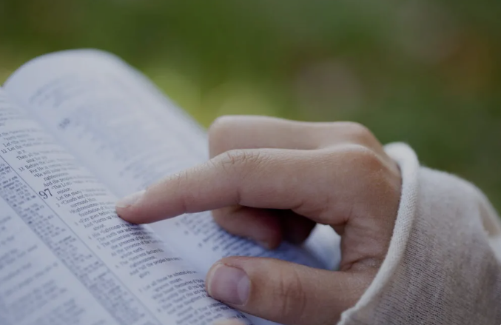
Spend Time with the Lord: Read The Bible
2 Timothy 2:15
Luke 6:46-47
Psalm 86:11-12
James 1:5
Phil. 4:8
Deut. 6:6
Be diligent to present yourself approved to God as a worker who does not need to be ashamed, accurately handling the word of truth.

Slide 13
Spend Time with the Lord: Read The Bible
2 Timothy 2:15
Luke 6:46-47
Psalm 86:11-12
James 1:5
Phil. 4:8
Deut. 6:6
“Now why do you call Me, ‘Lord, Lord,’ and do not do what I say? 47 Everyone who comes to Me and hears My words and acts on them, I will show you whom he is like:

Slide 14
Spend Time with the Lord: Read The Bible
2 Timothy 2:15
Luke 6:46-47
Psalm 86:11-12
James 1:5
Phil. 4:8
Deut. 6:6
11 Teach me Your way, Lord; I will walk in Your truth; Unite my heart to fear Your name. 12 I will give thanks to You, Lord my God, with all my heart, And I will glorify Your name forever.

Slide 15
Spend Time with the Lord: Read The Bible
2 Timothy 2:15
Luke 6:46-47
Psalm 86:11-12
James 1:5
Phil. 4:8
Deut. 6:6
But if any of you lacks wisdom, let him ask of God, who gives to all generously and without reproach, and it will be given to him.

Slide 16
Spend Time with the Lord: Read The Bible
2 Timothy 2:15
Luke 6:46-47
Psalm 86:11-12
James 1:5
Phil. 4:8
Deut. 6:6
Finally, brethren, whatever things are true, whatever things are noble, whatever things are just, whatever things are pure, whatever things are lovely, whatever things are of good report, if there is any virtue and if there is anything praiseworthy—meditate on these things.

Slide 17
Spend Time with the Lord: Read The Bible
2 Timothy 2:15
Luke 6:46-47
Psalm 86:11-12
James 1:5
Phil. 4:8
Deut. 6:6
These words, which I am commanding you today, shall be on your heart.

Slide 18
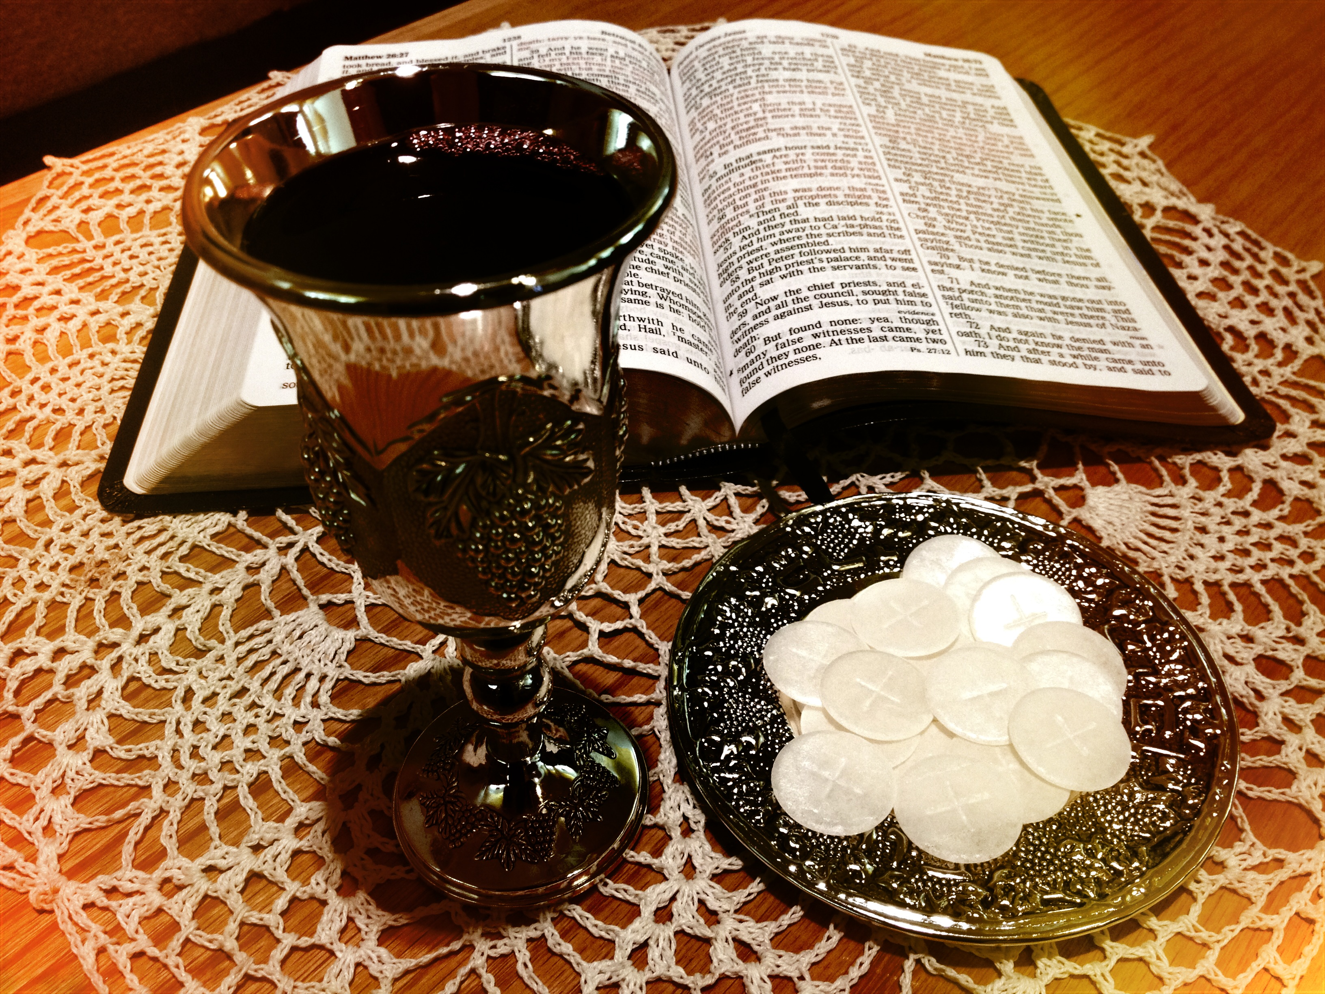
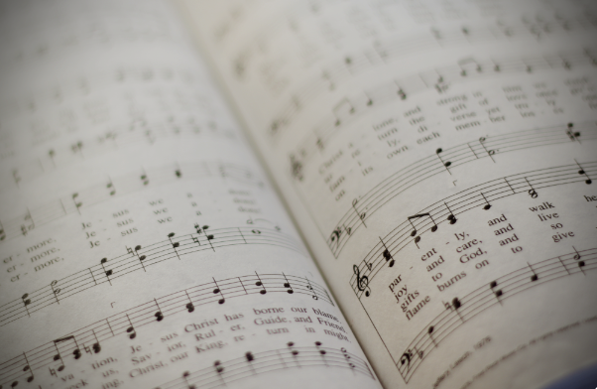
Spend Time with the Lord: Attend Bible Class & Worship
Hebrews 10:23-25
Matthew 26:26-28
Colossians 3:16
Let’s hold firmly to the confession of our hope without wavering, for He who promised is faithful; 24 and let’s consider how to encourage one another in love and good deeds, 25 not abandoning our own meeting together, as is the habit of some people, but encouraging one another; and all the more as you see the day drawing near.

Slide 19
Spend Time with the Lord: Attend Bible Class & Worship
Hebrews 10:23-25
Matthew 26:26-28
Colossians 3:16
26 Now while they were eating, Jesus took some bread, and after a blessing, He broke it and gave it to the disciples, and said, “Take, eat; this is My body.” 27 And when He had taken a cup and given thanks, He gave it to them, saying, “Drink from it, all of you; 28 for this is My blood of the covenant, which is being poured out for many for forgiveness of sins.

Slide 20
Spend Time with the Lord: Attend Bible Class & Worship
Hebrews 10:23-25
Matthew 26:26-28
Colossians 3:16
Let the word of Christ richly dwell within you, with all wisdom teaching and admonishing one another with psalms, hymns, and spiritual songs, singing with thankfulness in your hearts to God.

Slide 21
Maintain a relationship with god
Matthew 18:13-14
James 4:7-8a
Therefore, submit to God. Resist the devil and he will flee from you. 8 Draw near to God and He will draw near to you.

