Slide 1
$ome Things Money Can’t Buy
<logo>
Reading – 1 Timothy 6:1-10

Slide 2
Money Can’t Buy Everything
One who is wealthy is considered successful and wise by the world's standards.
Luke 16:15
Let's consider some things which money cannot buy.
Proverbs 23:5
Matthew 6:19-21
Luke 12:16-21

Slide 3
Good Character & Reputation
He who has a bad name is half hanged.
Proverbs 22:1
Ecclesiastes 7:1
The best present parents can give to their children is to give them a good name to take into society.

Slide 4
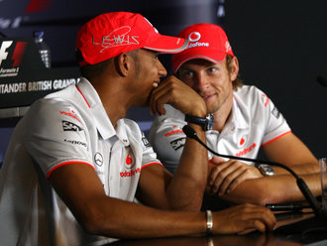
True Friends
Proverbs 17:17
"We make a living by what we get. We make a LIFE by what we GIVE."

Slide 5
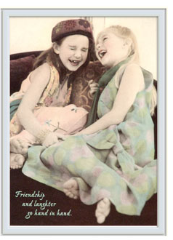
True Friends
Proverbs 17:17
Proverbs 18:24
Philippians 2:3-4
"We make a living by what we get. We make a LIFE by what we GIVE."

Slide 6
True Friends
Proverbs 17:17
Proverbs 18:24
Philippians 2:3-4
Acts 9:36 & 39
"We make a living by what we get. We make a LIFE by what we GIVE."

Slide 7
Happiness
Ecclesiastes 5:10-12
"We make a living by what we get. We make a LIFE by what we GIVE."

Slide 8
Happiness
1 Timothy 6:6
Psalm144:15 "Happy are the people whose God is the Lord."
"We make a living by what we get. We make a LIFE by what we GIVE."

Slide 9
Entrance In The Kingdom
Acts 8:20-23
Matthew 5:3
John 3:3-5

Slide 10
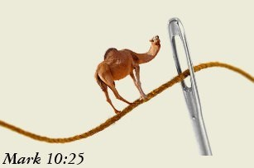
Entrance In The Kingdom
Mark 10:23-25
Wanted: A very large needle and a very small camel.

Slide 11
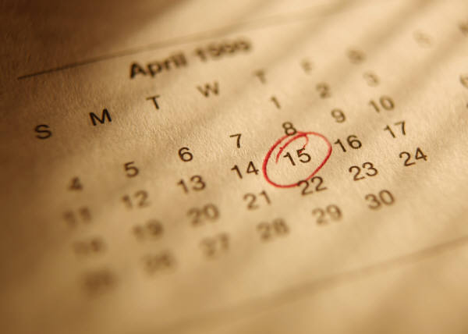
One Day of Life
Ecclesiastes 8:8
“Earth holds no treasures, but perish with using….”

Slide 12
Invitation
2 Corinthians 6:1-2
“Earth holds no treasures, but perish with using….”

Slide 13
Balance Sheet
What is your attitude toward material things?
Are you seeking things money can buy, or things money cannot buy?
Are you striving to lay up treasures on earth, or treasures in heaven?

