Slide 1
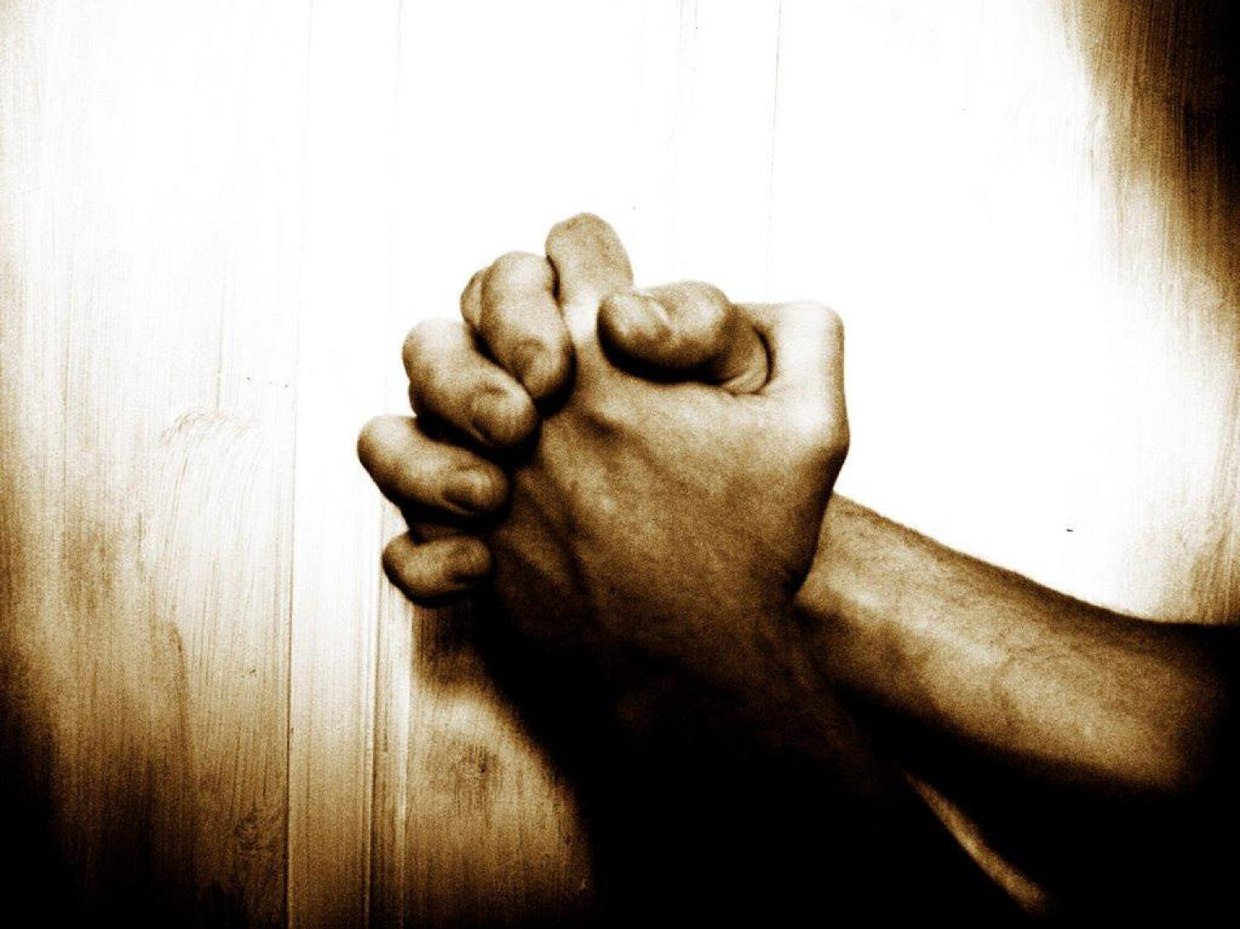
Did You Think to Pray Today?
Luke 18:10-14

Slide 2
Ere you left your room this morning,
Did you think to pray?
In the name of Christ our Savior,
Did you sue for loving favor,
As a shield today?

Slide 3
When you met with great temptation,
Did you think to pray?
By His dying love and merit,
Did you claim the Holy Spirit
As your guide and stay?

Slide 4
When your heart was filled with anger,
Did you think to pray?
Did you plead for grace my brother,
That you might forgive another
Who had crossed your way?

Slide 5
When sore trials came upon you,
Did you think to pray?
When your soul was bowed in sorrow,
Balm of Gilead did you borrow
At the gates of day?

Slide 6
Oh how praying rests the weary!
Prayer will change the night to day;
So when life seems dark and dreary,
Don’t forget to pray!

Slide 7
The Publican
Luke 18:10-14
What He Wasn’t What He Was What He Did

Slide 8
The Publican
Luke 18:10-14
What He Wasn’t What He Was What He Did

Slide 9
The Publican
Luke 18:10-14
What He Wasn’t What He Was What He Did
Scholar

Slide 10
Worldly Knowledge
1 Corinthians 8:1-3
Proverbs 4:5
Hosea 4:6

Slide 11
The Publican
Luke 18:10-14
What He Wasn’t What He Was What He Did
Scholar
Superior

Slide 12
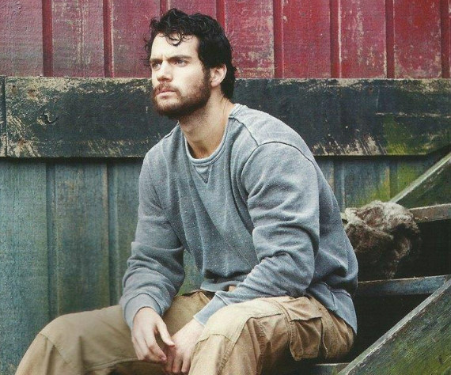
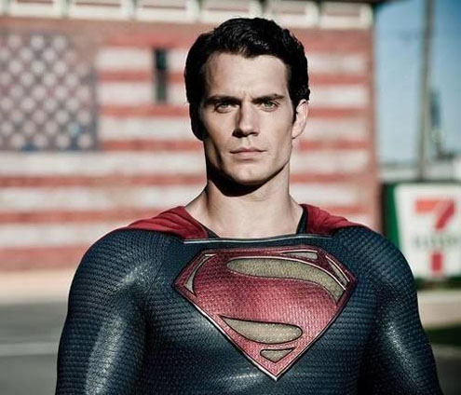
Just A Normal Guy
James 5:17
Acts 14:14-15

Slide 13
The Publican
Luke 18:10-14
What He Wasn’t What He Was What He Did
Humble
Scholar
Superior

Slide 14
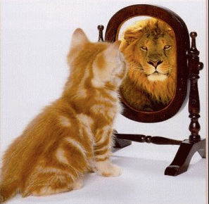
Self Esteem
Romans 12:3
1 Peter 5:6-7

Slide 15
The Publican
Luke 18:10-14
What He Wasn’t What He Was What He Did
Humble
Scholar
Penitent
Superior

Slide 16
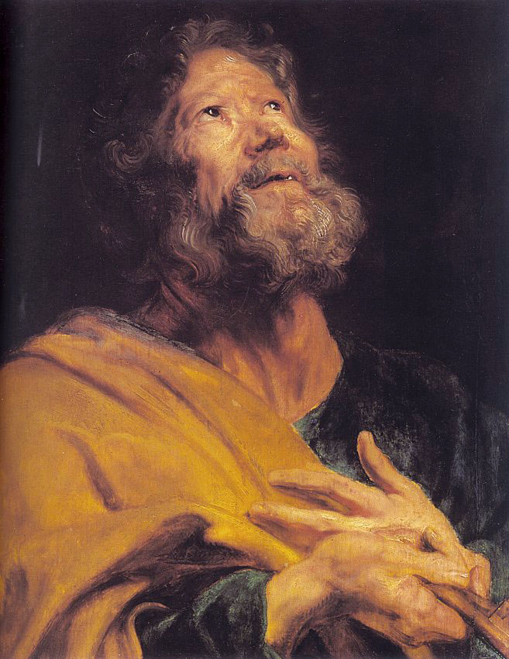
Penitent
Psalm 66:18
Proverbs 28:13
1 John 1:10
Luke 13:3

Slide 17
The Publican
Luke 18:10-14
What He Wasn’t What He Was What He Did
Humble
Scholar
Penitent
Superior
Normal

Slide 18
The Publican
Luke 18:10-14
What He Wasn’t What He Was What He Did
Humble
Trusted God
Scholar
Penitent
Superior
Normal

Slide 19
Trusted God
Ephesians 3:20-21
James 1:5-8

Slide 20
The Publican
Luke 18:10-14
What He Wasn’t What He Was What He Did
Humble
Trusted God
Scholar
Penitent
Prayed
Superior
Normal

Slide 21
Pray For Forgiveness
1 John 1:9
Matthew 7:7-11

Slide 22
The Publican
Luke 18:10-14
What He Wasn’t What He Was What He Did
Humble
Trusted God
Scholar
Penitent
Prayed
Superior
Normal
Impacted God

Slide 23
Impacted God
1 John 5:14-15
James 5:13-16

Slide 24
Did You Think to Pray?
Isaiah 59:1-2

Slide 25
What Can We Do About It?
Acts 2:38

