Slide 1
Qualities Of A Hero
Reading – 1 Kings 17:8-16

Slide 2
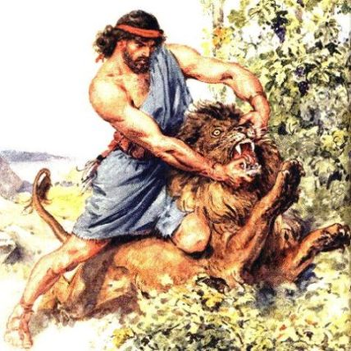
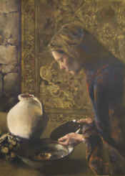
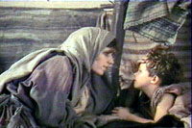
What makes this account heroic?
No displays of power.
No events for the crowd to view.
Just a poor widow and her son.
Just a prophet in exile needing a place to stay and something to eat.

Slide 3
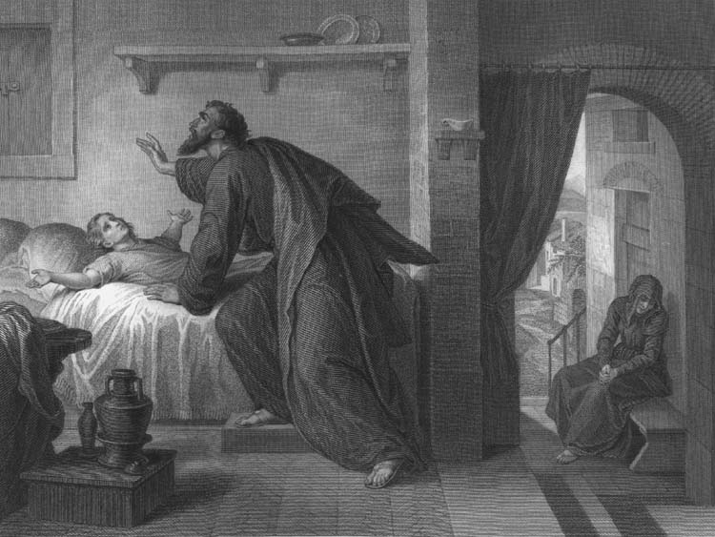
1 Kings 17:17-23
This could be categorized as being heroic.

Slide 4
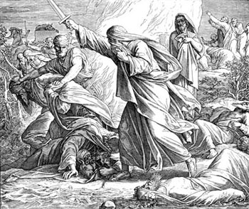
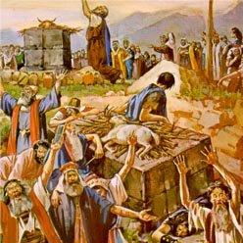
1 Kings 18:20-40
This is even more heroic.

Slide 5
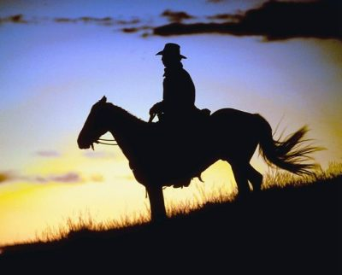
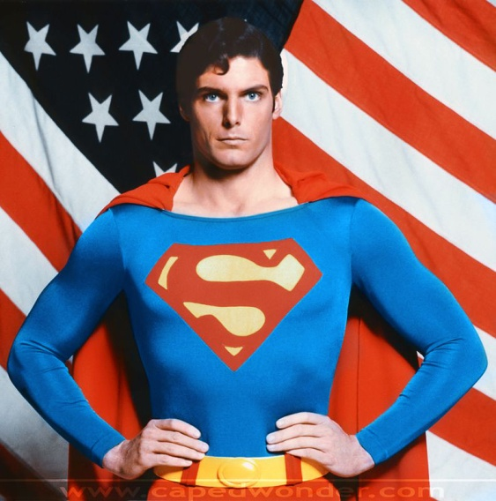
We All Have Heroes in our lives
Think of the heroes in your life.
Who were they?
Why were they heroes?
Child Hero
Tween Hero
Teen Hero
Adult Hero

Slide 6
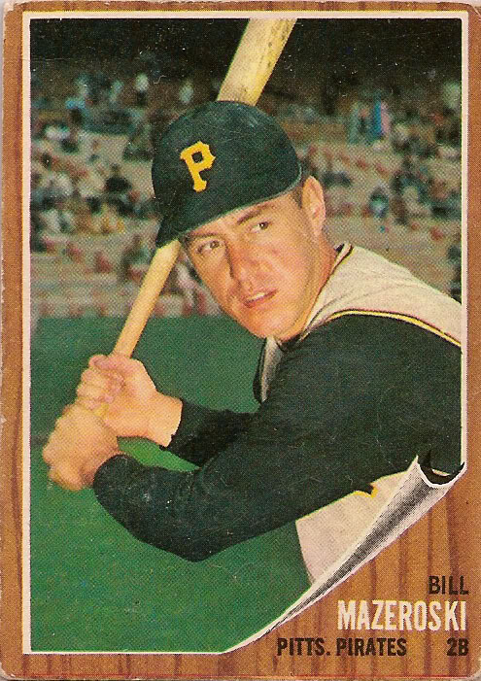
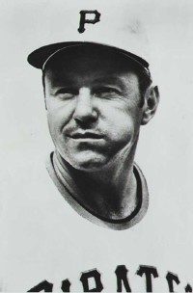
Children Are Impressionable

Slide 7
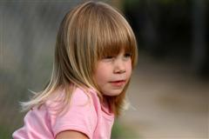
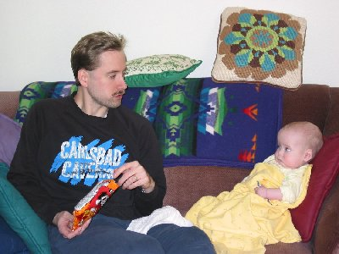
Luke 17:1-2 - Someone is Watching!
What You Do
What You Say
How You Act
How You React
What You Wear
How You Worship
What You Listen To
What You Think Is Funny
How You Spend Your Money

Slide 8
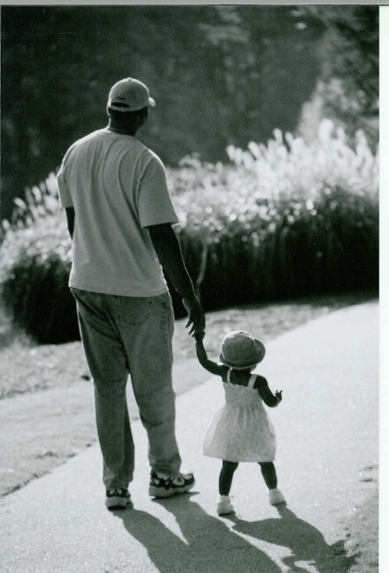
Ephesians 6:1-4 - Someone is Watching!
Dad is usually the first hero a child has.
Today’s “Enlightened” society says a father figure is no longer necessary.
Could you categorize that as child abuse?

Slide 9
Who Are America’s Heroes?
Sports Stars
Entertainers
Wealthy
Artists

Slide 10
On The Contrary – A Hero Is…
A Person of Inner Fears and Doubts who does not give in to them
An Ordinary Person Doing Extraordinary Things with God’s help
Someone who does not bail out when the situation gets rough
Someone who makes sacrifices for another’s benefit. Usually anonymously
Normally does not see himself as a hero

Slide 11
In Our Text
The widow had Inner Fears and Doubts and did not give in to them
She was her son’s hero

Slide 12
In Our Text
She was an Ordinary Person who with God’s providence did Extraordinary Things.
She did not bail out when the situation got rough.
She was willing to makes sacrifices for another’s benefit.
Certainly she did not see herself as a hero.

Slide 13
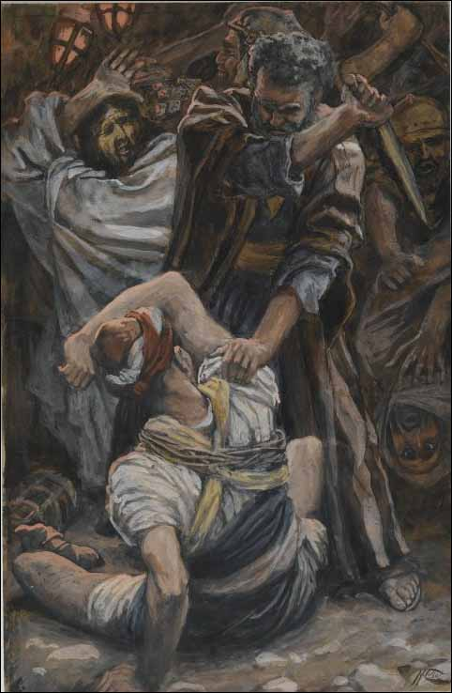
Heroic People May Not Always Behave Heroically!
No one will doubt that Peter was a great hero of the faith.
He was ready to fight for Jesus in the Garden.
John 18:3-10

Slide 14
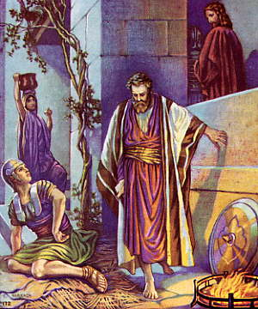
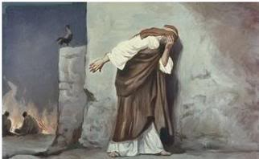
Heroic People May Not Always Behave Heroically!
Just a few hours later it was a different story.
Luke 22:54-62

Slide 15
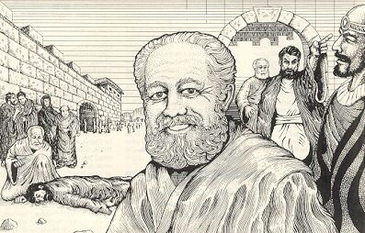
My Hero
Son of Encouragement
Fellow Soldier
Mentor
Barnabas

Slide 16
The Son of Encouragement
Acts 4:32-37
Barnabas was a Levite and native of the island of Cyprus
He introduced Saul of Tarsus to the Jerusalem church (9:26-27).

Slide 17
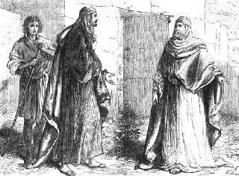
The Son of Encouragement
John Mark had a chance to redeem himself with Barnabas’ help
Colossians 4:10-11

Slide 18
The Son of Encouragement
He was not afraid of doing manual labor to support himself while preaching.
1 Corinthians 9:3-7

Slide 19
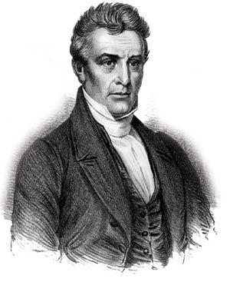
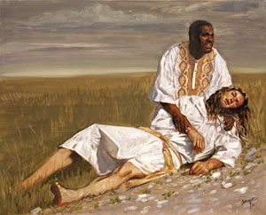
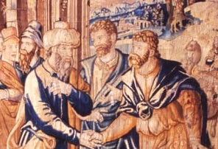
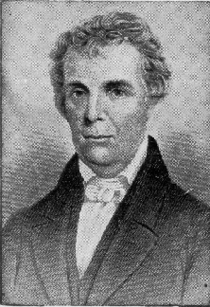
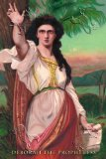
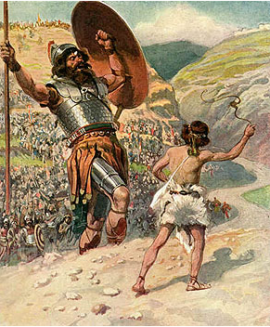
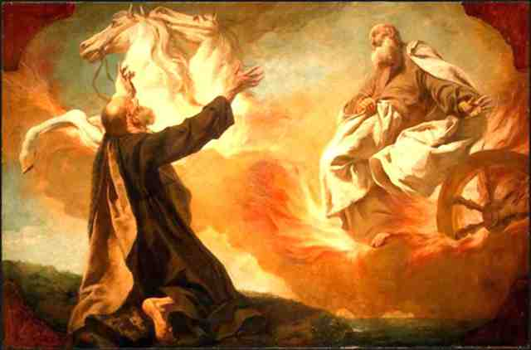
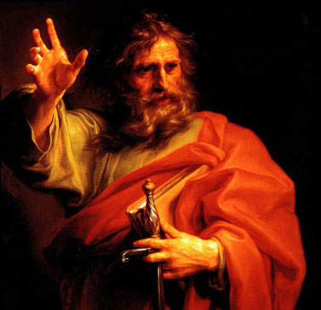
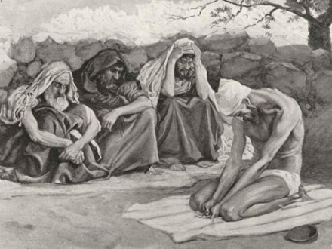
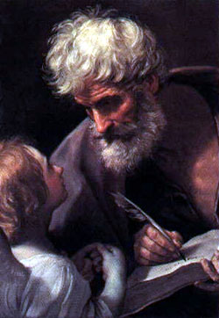
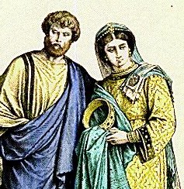
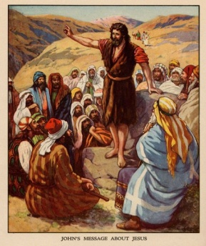
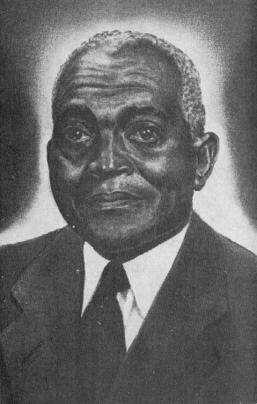
And There Are So Many More ---
*

Slide 20
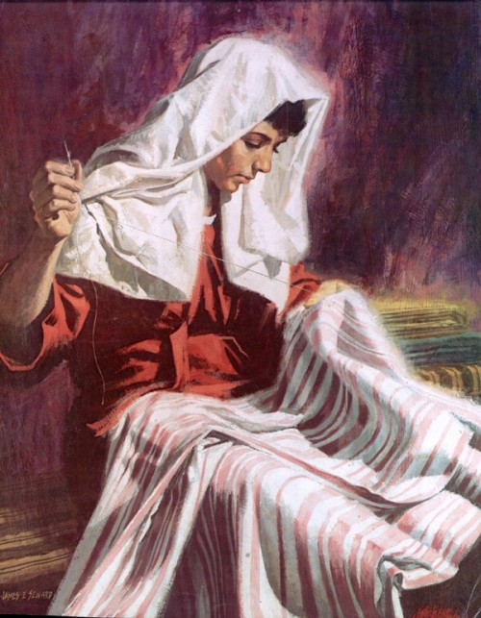
A Defining Characteristic
Heroes never see themselves as such.
They are just ordinary people going about doing good wherever they can.
Acts 9:36-39

Slide 21
How To Become A Bona-Fide Hero
James 5:16-20 --- ¹⁹My brethren, if any among you strays from the truth and one turns him back, ²⁰let him know that he who turns a sinner from the error of his way will save his soul from death and will cover a multitude of sins.

Slide 22
What Can Be more heroic Than saving a Life?
Galatians 6:1-3

