Slide 1

Are We At Liberty To Dance?
Reading - Galatians 5:16-26

Slide 2

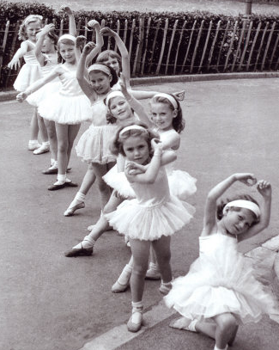
Dancing is one of the social graces.
It is seen as an innocent pastime.
Children are actually encouraged to attend dance classes.
School Dances are “chaperoned” activities that go on at the school.

Slide 3

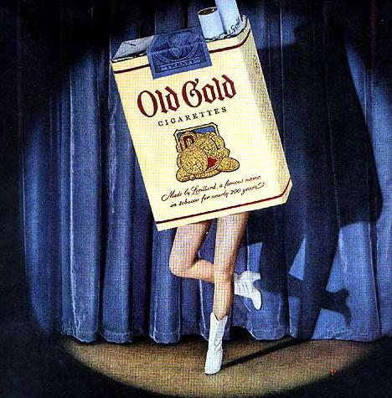
Dancing can be found everywhere.
TV Commercials: Everything from Soft drinks, to potato chips, to long-distance telephone.
Really - how exciting can potato chips be?

Slide 4
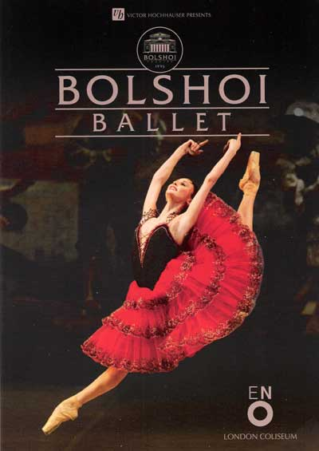
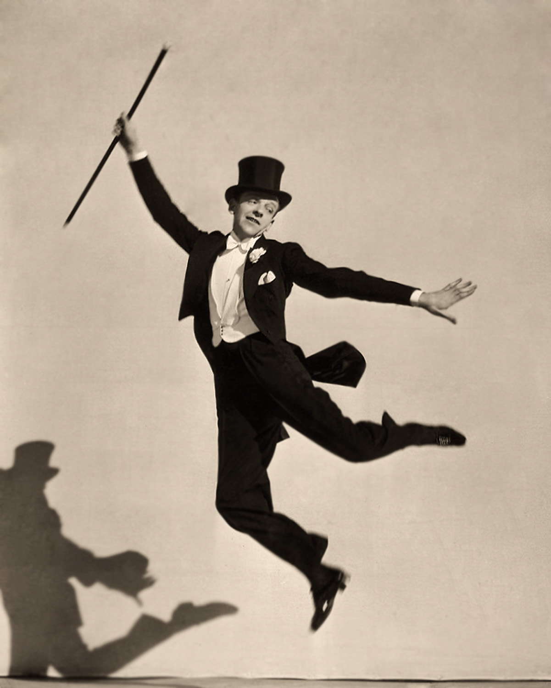
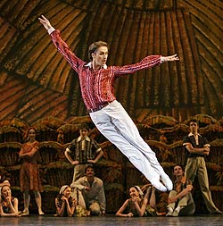
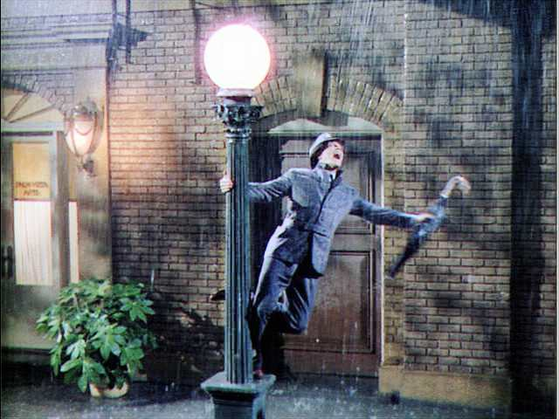
Classic Dancers
The Entertainment field is saturated with dancing.
The Bolshoi Ballet performances are continually sold out

Slide 5
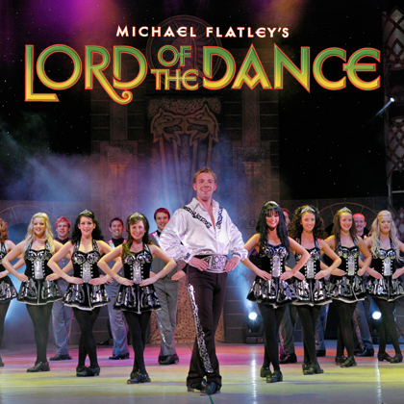
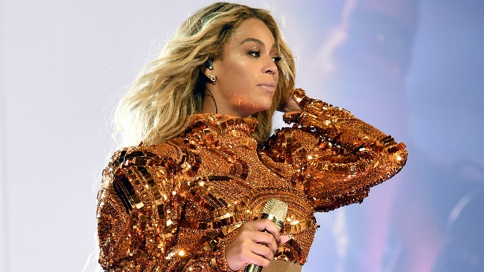
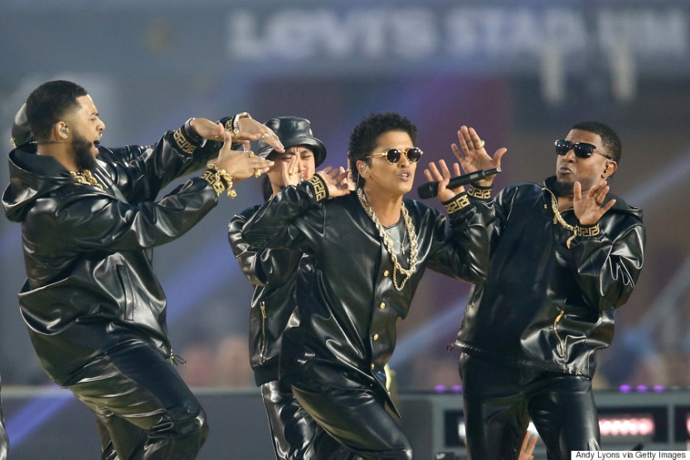
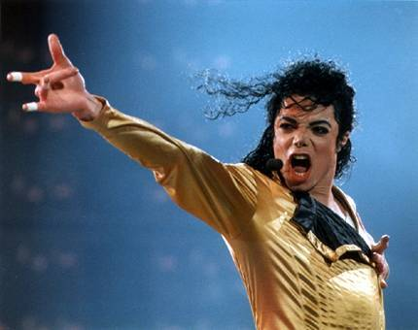
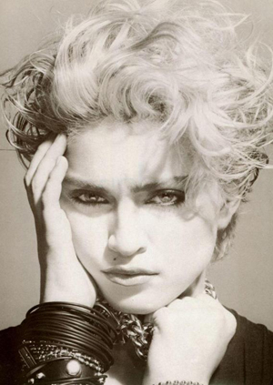
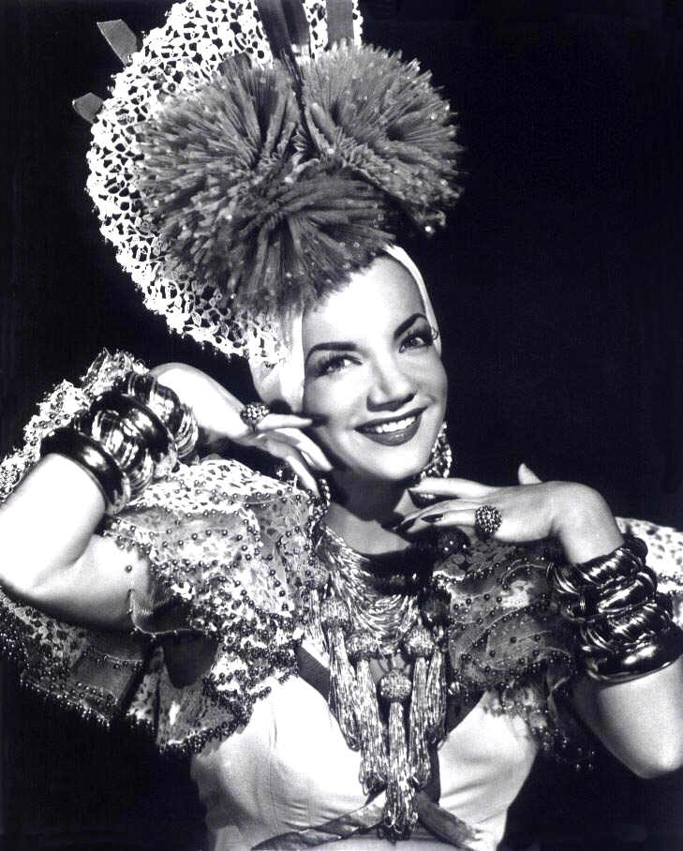
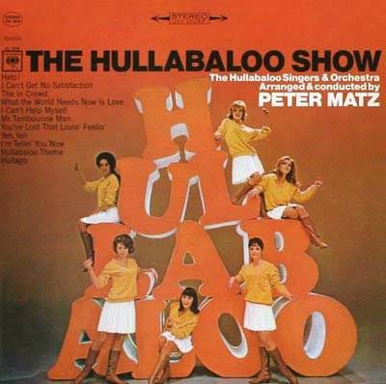
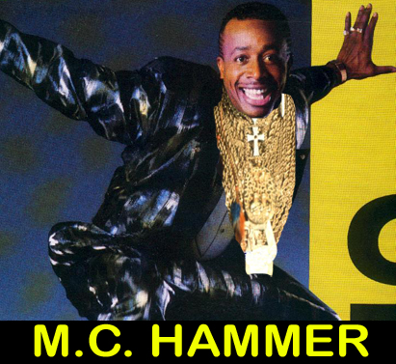
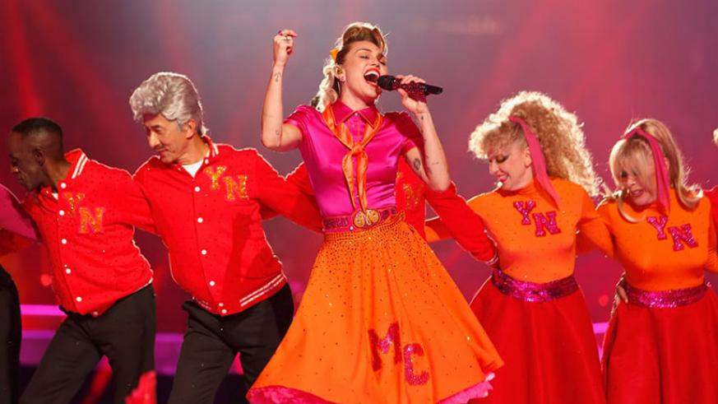
Pop Culture Icons
Do you know any of these?

Slide 6
“Artistic Dance”
Then, there are shows, which use dancers for only one purpose – Lasciviousness
Clubs for both men & women to go to appreciate the “talents” of the dancers.

Slide 7
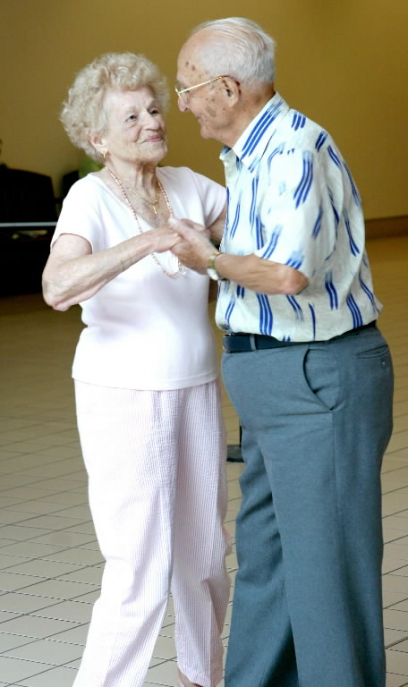
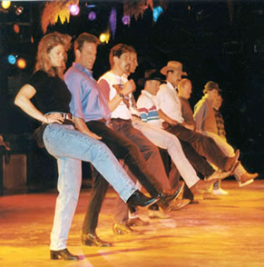

Dancing can be found everywhere.
People dance at weddings and anniversaries.
Country line dancing
Discos and Rave Clubs
Disney had a complex called “Pleasure Island”
Break Dancing
“Mosh Pits” - Slam Dancing & Crowd Surfing.

Slide 8
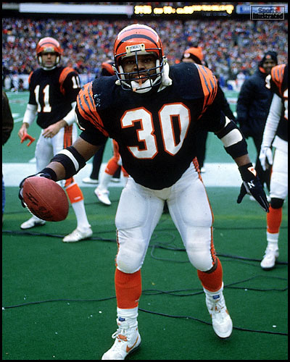
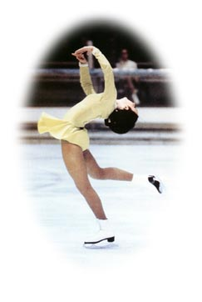
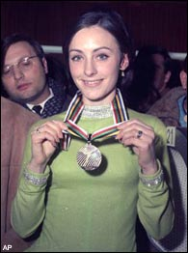
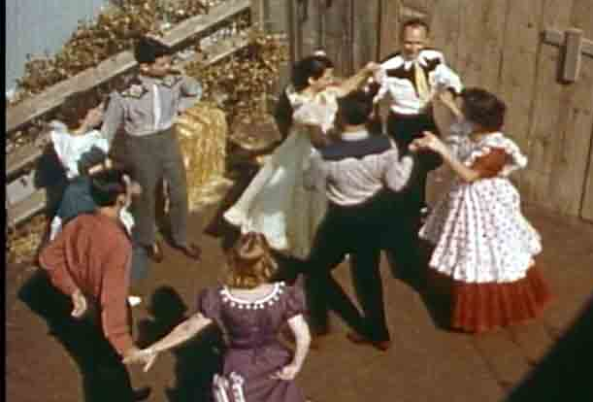
Dancing can be found everywhere.
Football games
Peggy Fleming became a national heroine winning the Olympic gold medal
Folk Dancing
Square Dancing

Slide 9

Can we conclude that ALL dancing is sinful?
Simply defined dancing is: To move rhythmically usually to music, using prescribed or improvised steps and gestures. To leap or skip about excitedly.

Slide 10
For dancing to be right or wrong we need to make 3 Basic Considerations:
1. WHERE the dancing is taking place.
2. WHY the dancing is taking place.
3. HOW the dancing is performed.

Slide 11
Dancing was used as an expression of joy.
(2 Samuel 6:12-16)
Psalms 149:3-4)
(Ecclesiastes 3:4) A time to weep, And a time to laugh; A time to mourn, And a time to dance;
End Zone Celebrations:
Is it logical to think that the Lord would approve and give us time to do something sinful on purpose?

Slide 12
(Luke 15:25)
… “he heard music and dancing.”
There are some dance melodies like the Hora which doesn’t have to be seen to know what’s going on.
Would the righteous father allow something sinful to go on in celebration over the return of the prodigal from sin?
We must remember the WHEN, WHY & HOW of these references.

Slide 13
Dancing was used to stimulate lusts of the flesh
(Exodus 32:19 &25)
Maybe the Israelites were just mimicking some of the lusty practices of the Egyptians
Mark 6:22 -- The daughter of Herodias danced in such a way as to please Herod into making a foolish oath.
Probably a form of a striptease.
The WHERE, why & how if these cases showed the dancing to be sinful.

Slide 14
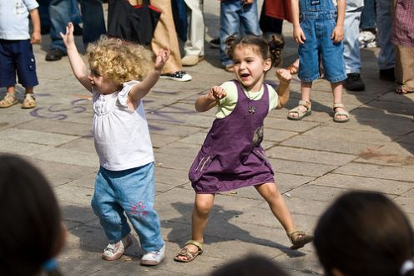
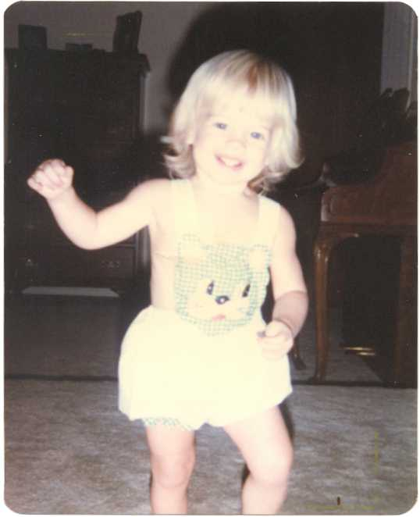
the natural thing to do
Hard-Wired into every one of us!

Slide 15
Go Out Dancing is the “Natural Thing to Do”
(Galatians 5:16-21) ... {19} Now the works of the flesh are evident, which are: adultery, fornication, uncleanness, lewdness, {20} idolatry, sorcery, hatred, contentions, jealousies, outbursts of wrath, selfish ambitions, dissension, heresies, {21} envy, murders, drunkenness, revelries, and the like;
How many of the things mentioned can be connected to the dance halls?
(1 Corinthians 15:33)

Slide 16
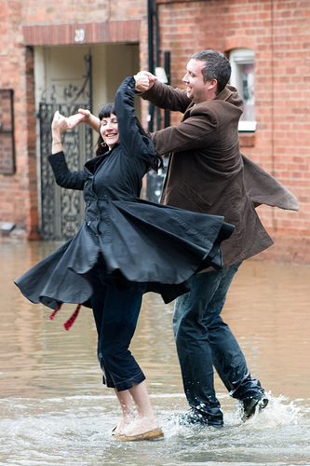
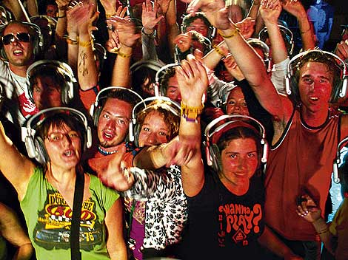
but I just love to dance!
There’s no commandment that says, “Thou shalt not go to a dance”

Slide 17
Biblical applications that apply to social dancing.
(1 Thessalonians 5:22)
(Matthew 5:16)
(1 Corinthians 10:32)
(1 John 2:15-16)
Do you suppose social dancing is of the Father or of the world?

Slide 18
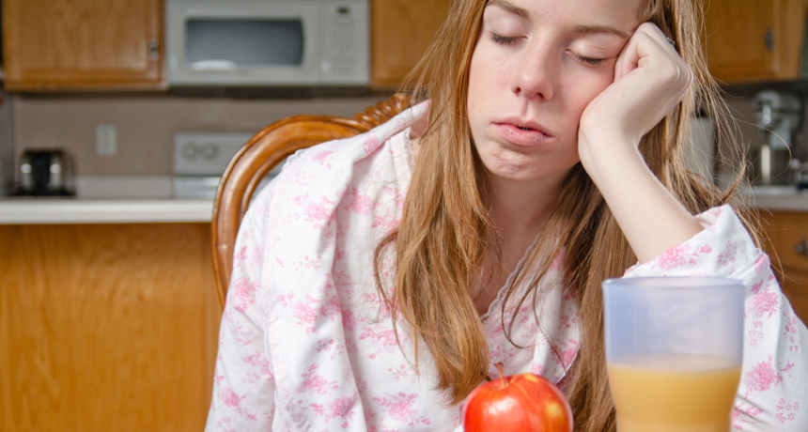
Biblical applications that apply to social dancing.
(Hebrews 10:25)
How many have stayed up too late on Saturday night and were too tired to remember Jesus on the Lord’s day?

Slide 19
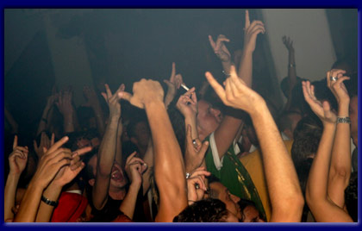
flee youthful lusts
2 Timothy 2:22

Slide 20
What About Chaperoned Dances?
(Job 21:11-14)
Dances at school are just a prelude to college & adult social dancing.
Prom dresses could hardly be worn to church services.
If you would be embarrassed to worship in these clothes why does it make it all right to wear them elsewhere in public?

Slide 21
Fathers, do you know why some boys go to the dances?
Some boys don’t go to the dances to dance, but to LOOK.
She may be you sweet little girl, but there are other guys who don’t see her in that light.
(Matthew 5:28)
Fathers, do you really want your daughters in that position?

Slide 22
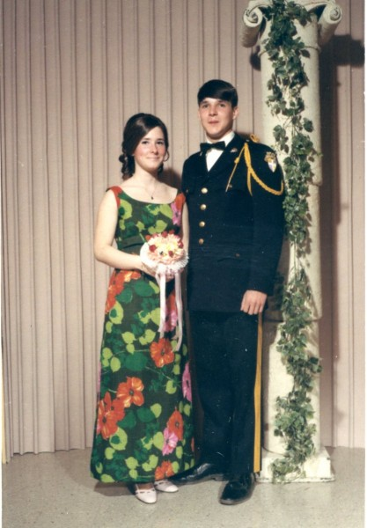
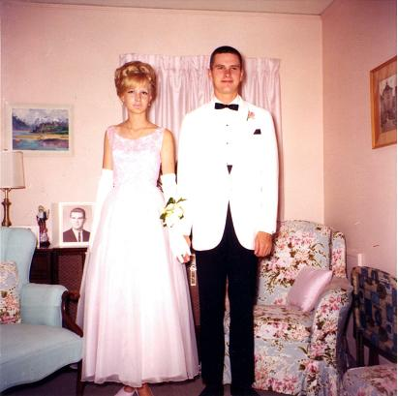
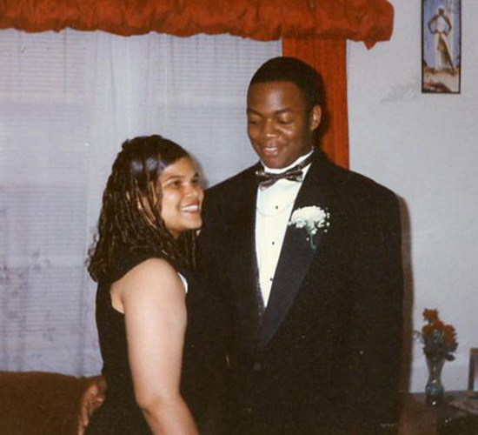
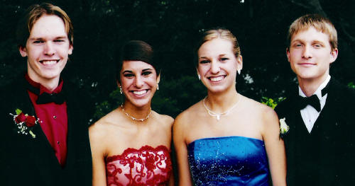
in spite this, will they still want to go?
What Do You Think?

Slide 23
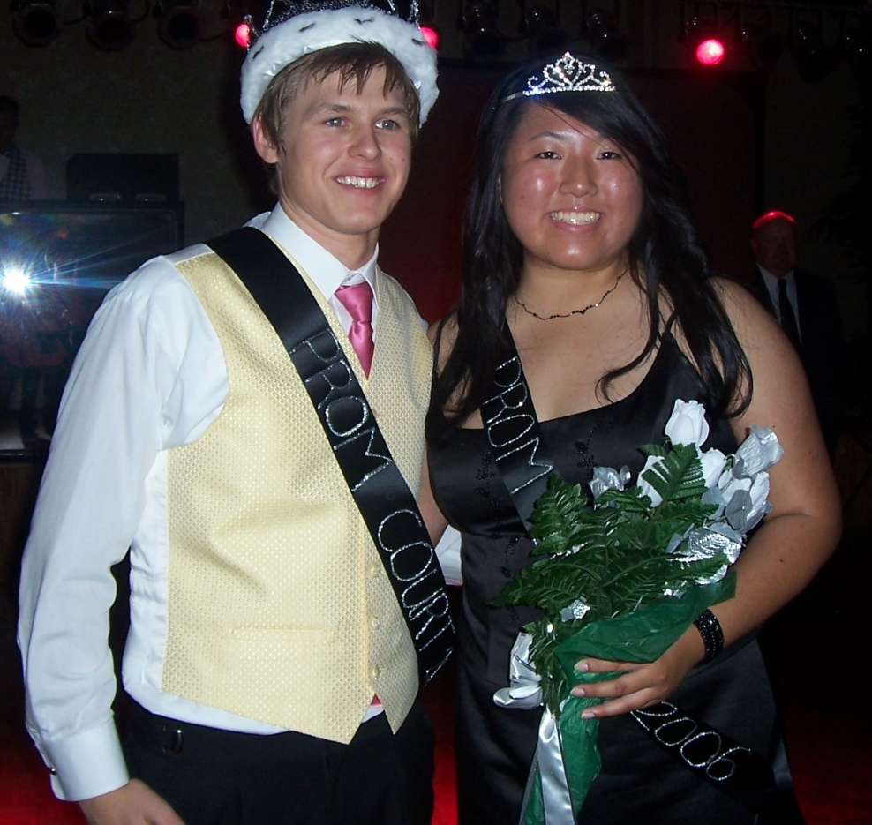
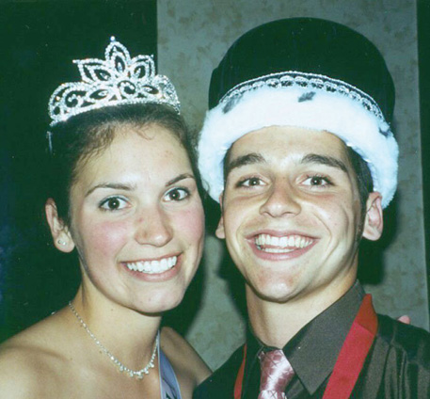
All their friends are going to be there.
Only the POPULAR kids ever get asked to attend these functions.
What about the prestige to be on the King & Queen’s court.

Slide 24
Offer An Alternative
Denying your children by quoting.... (1 Peter 4:16) Yet if anyone suffers as a Christian, let him not be ashamed, is not much consolation.
As parents & responsible adults we must be ready to provide adequate substitutes.
A party at your home, a hayride or a trip to some place special.
Our children need to know there is always an alternative that can be just as enjoyable, if not more enjoyable than the dance.

Slide 25

Christianity is NOT for wimps!
What Are You Going To DO About It?

