Slide 1
The Hall Of Heroes
Reading – Hebrews 11:1-6; 31-40

Slide 2
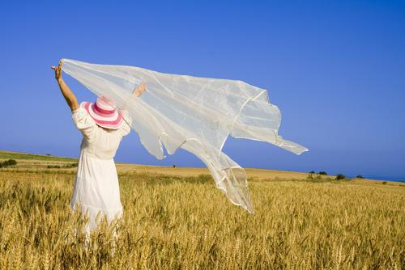
Evidence of the unseen
The wind blowing is proof that there is something of substance in the unseen.

Slide 3
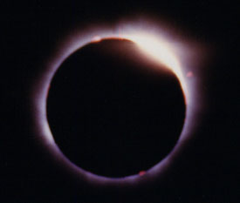
Logical Conclusion of the uncaused cause.
Hebrews 11:3 By faith we understand that the universe was created by the word of God, so that what is seen was not made out of things that are visible.

Slide 4
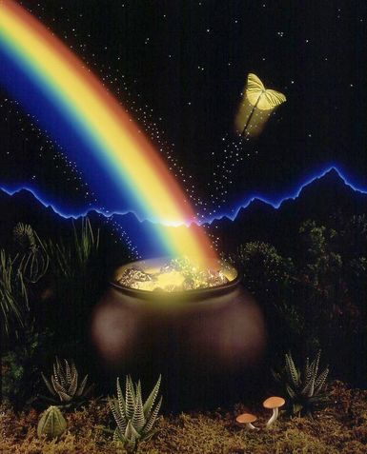
No Reward Without Faith
Faith does not die with an individual.
It lives on with others who share it
We are recipients of the rewards of the faith of Abraham.
Galatians 3:23-29
Abraham
Isaac
Jacob
Me, etc

Slide 5
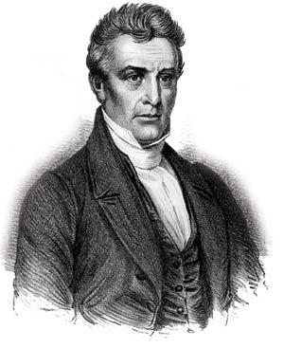
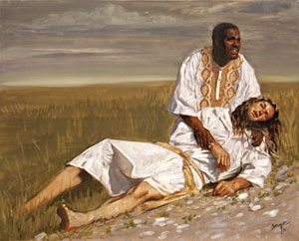
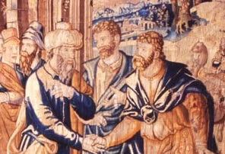
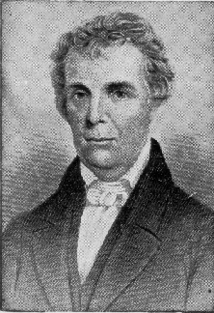
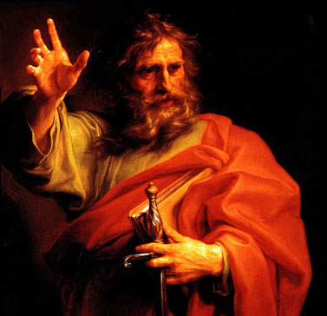
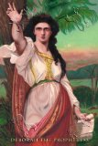
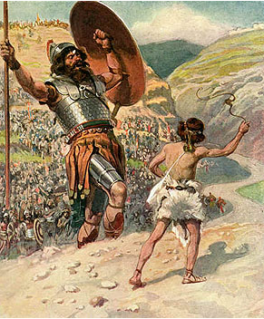
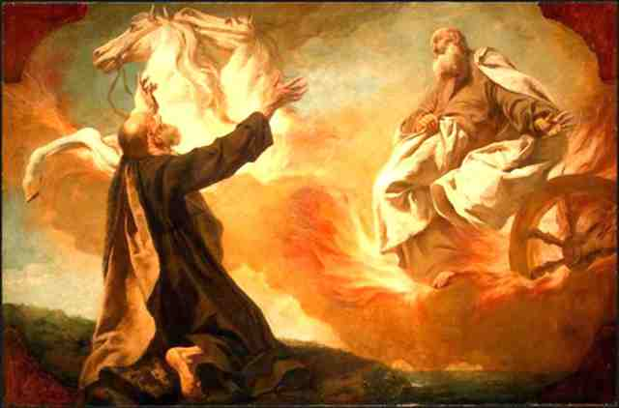
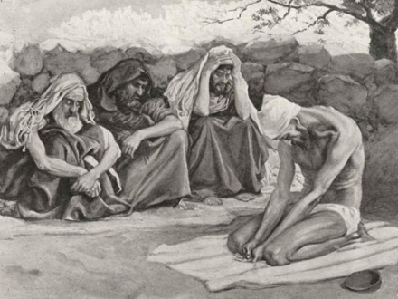
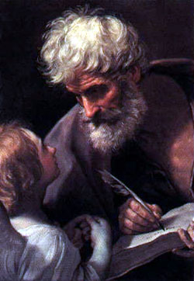
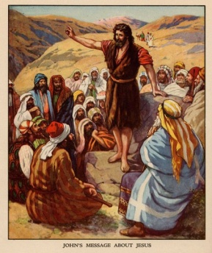
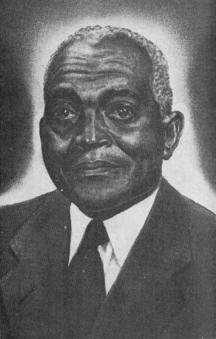
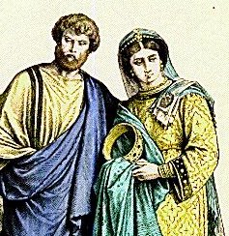
There Are More Stories To Share
*

Slide 6
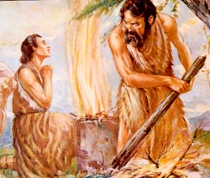
The Faith of Abel – vs. 4
1 John 3:12 We should not be like Cain, who was of the evil one and murdered his brother. And why did he murder him? Because his own deeds were evil and his brother’s righteous.
Why were his deeds righteous?
Genesis 4:2-7

Slide 7
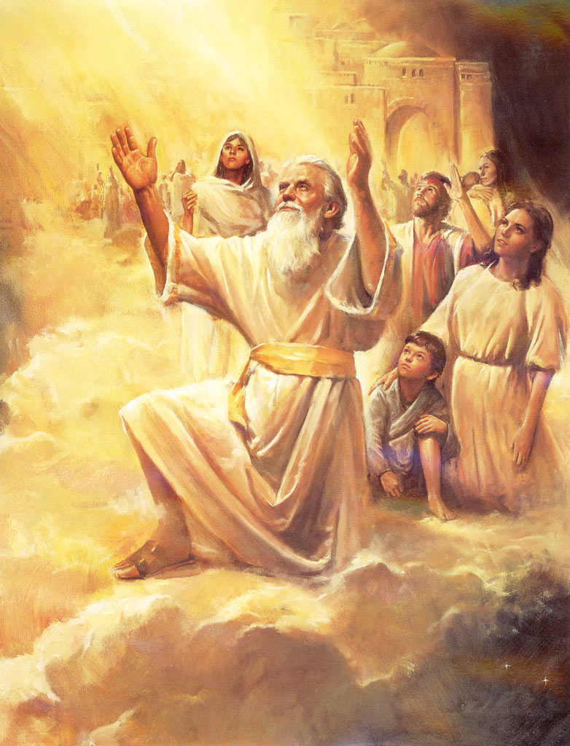
The Faith of Enoch – vs. 5
His story recorded in
Genesis 5:21-24
What greater a reward for diligently seeking God?

Slide 8
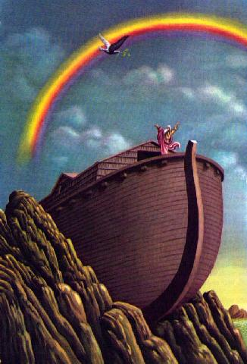
The Faith of Noah – vs. 5
The story is told in total in Genesis Chapters 6-9
His story recollected in
1 Peter 3:18-22

Slide 9
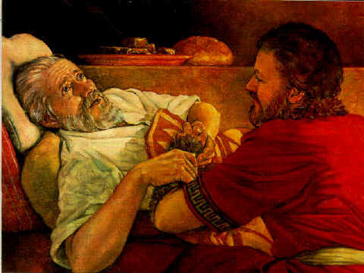
The Faith of Isaac – vs. 20
The initial blessing he gave his son is found in
Genesis 27:18-29
Isaac gave the blessing in faith to who he believed was his son, Esau

Slide 10
Isaac’s Finest Moment
Genesis 22:3-9
He was much younger and FASTER than his father.
He could have easily ran away.
He became a willing sacrifice, the ante-type of the Messiah.

Slide 11
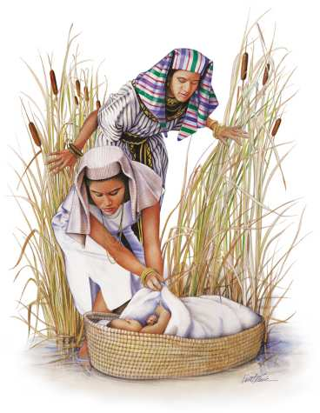
The Faith of Moses – vs. 23-29
His story begins with the faith of his mother.
Exodus 2:2-10 If she had not shared her faith with her son, Moses would have lived his entire life an Egyptian prince.

Slide 12
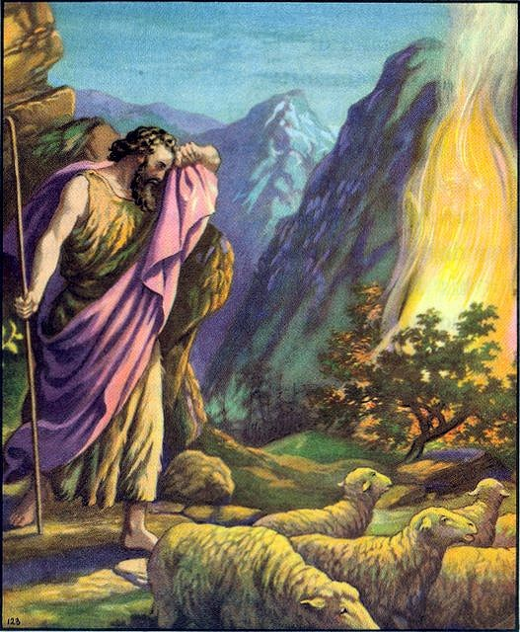
The Faith of Moses – vs. 23-29
His story continues when he continues in the faith of his mother while in the wilderness.
Psalms 84:10-11
By faith he travels back into Egypt to campaign for Israel’s release from Pharaoh.

Slide 13
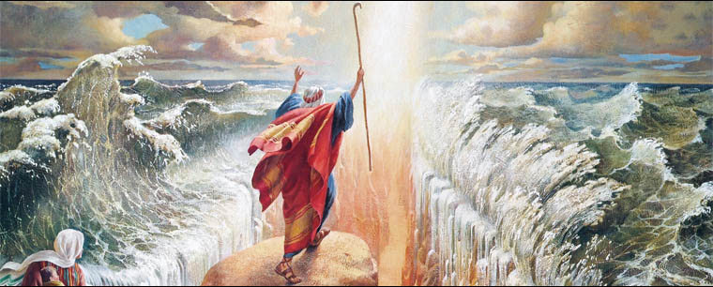
The Faith of Moses – vs. 23-29
His story continues with one act of faith after another.
Exodus 14:10-14

Slide 14
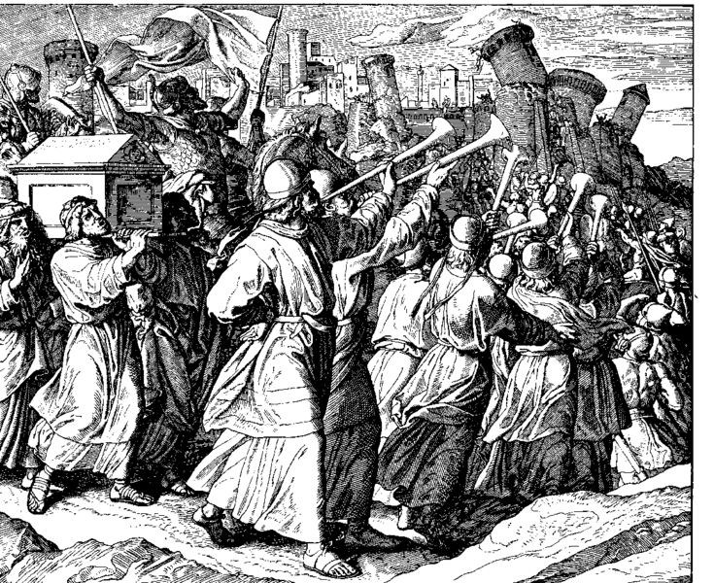
The Faith of Joshua – vs. 30
Joshua inherits the faith of Moses and becomes a great leader.
Joshua 24:11-15
After conquering the land he challenges Israel to remain faithful.

Slide 15
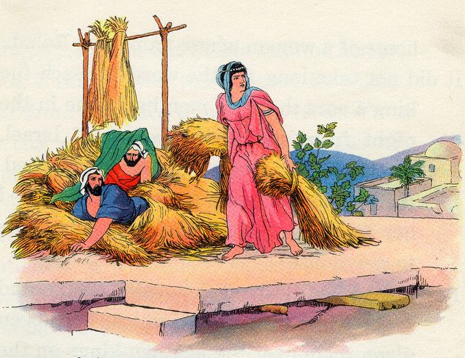
Back to Our Text – Vs. 31-35
There were many who received an earthly reward for having faith in God.

Slide 16
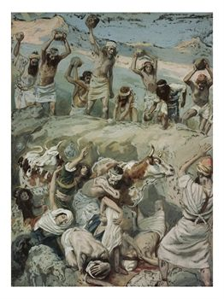
Our Text doesn’t stop there
What about the “OTHERS” vs. 36-39?
Certainly they did not deserve that treatment!
How can we say they were rewarded for diligently seeking Him?

Slide 17
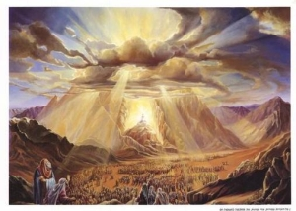
God’s rewards are not always temporal.
Hebrews 11:39-40 And all these, though commended through their faith, did not receive what was promised, ⁴⁰since God had provided something better for us, that apart from us they should not be made perfect.

Slide 18
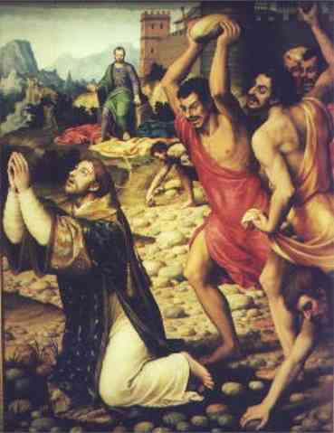
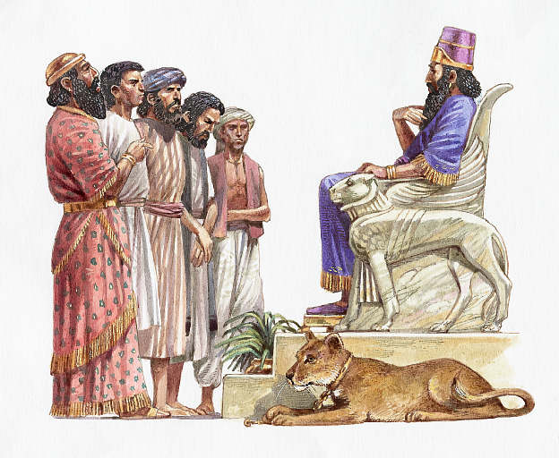
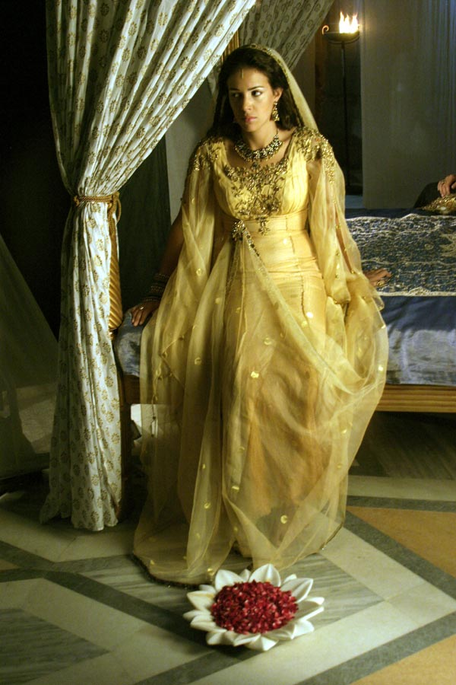
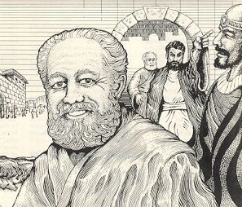
Other Heroes
Daniel
Stephen
Queen Esther
Barnabas

Slide 19
Do You have Faith to Diligently Seek and Hold your Reward?
John 14:1-7

Slide 20
What Can Be More Heroic Than Saving a Life?
Galatians 6:1-3

