Slide 1
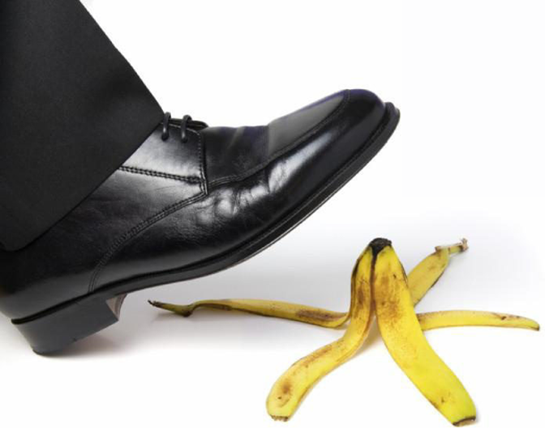
What A Christian Should NEVER Be
Reading: 1 Thessalonians 5:14-18

Slide 2
The Bible is packed with things a Christian SHOULD be.
There are some things a Christian Should NEVER be!

Slide 3
Unruly
2 Peter 2:9-10
Romans 6:1-4
Proverbs 15:10
1 Corinthians 9:24-27
“Warn those who are unruly”

Slide 4
Discouraging
Ephesians 4:29
Romans 12:15
Proverbs 16:24
“Comfort the fainthearted”

Slide 5
Too Busy To Help Others
James 2:14-17
Philippians 2:3-4
Galatians 6:10
“Uphold the weak”

Slide 6
Impatient
1 Corinthians 13:4
Galatians 5:22-23
Ephesians 4:1-3
“Be patient with all”

Slide 7
Vengeful
Romans 12:17-20
Matthew 5:43-45
“See that no ne renders evil for evil to anyone”

Slide 8
Without Joy
John 16:31-33
James 1:2-3
Psalm 32:10-11
“Rejoice always”

Slide 9
Ungrateful
Ephesians 2:8-10
James 1:17
Psalm 116:17
“In everything give thanks”

Slide 10
If any of these things apply to me….
What should I do about it?

Slide 11
Repent before you take the next step!
Hebrews 2:1-3

