Slide 1
WHAT IS WRONG WITH THE CHURCH OF CHRIST?
Reading - Ephesians 3:1-11

Slide 2
Direct your attention to the last 2 verses of our text.
3:10 'in order that the manifold wisdom of God might now be made known through the church... The Church as revealed in the Bible reflects the wisdom of God.
(3:11) This was in accordance with the eternal purpose which He carried out in Christ Jesus our Lord.'
This is the church that Jesus founded.
(Matthew 16:18)
The Church that submits to Jesus Christ as its Head (Ephesians 5:23-24) is far from being an embarrassment to God.

Slide 3
Part of the Plan
The Church wasn't the object of last minute planning.
He had eons to plan its work, worship, purpose, terms of entrance and exit, organizational structure, and what it would teach and practice.
There is nothing wrong with His plan.

Slide 4
Things are "right" with the Church when it is obeying the commands of Jesus
(Matthew 7:21)
(Luke 6:46)
There are those without the church and also from those within the church who are quick to point out what they believe is wrong with the Lord’s church.
Who is the clay to criticize the Potter?

Slide 5
RIGHT where we should be.
GOD'S POINT OF VIEW IS TAUGHT:
GOD'S POINT OF VIEW IS TAUGHT:
GOD'S POINT OF VIEW IS TAUGHT:
Quote from F. Lagard Smith ‘The Cultural Church'

Slide 6
‘The Cultural Church‘ [p.216]
'While we are tempted to downplay the significance of baptism, the denominational world is once again beginning to baptize!
While we are somewhat embarrassed by our lack of any formal organization, the most vibrant churches in the land are those locally-autonomous "community churches" which don't even have the extensive "brotherhood" ties that we have…

Slide 7
‘The Cultural Church‘ [p.216]
While we are starting to experiment with "high church styles" and production numbers in worship, others are exploring the idea of simple gatherings without the need of formalistic ceremony or a professional clergy.
And just when we are about to give up on traditional methods of Bible study, Evangelical churches from shore to shore are starting to dig back into "book, chapter, and verse."' (p. 216)

Slide 8
Problem still exists today. (1 Samuel 8:4-5)
While professed Christians are pushing for more conformity to what society views as acceptable, a large segment of the denominational world wants to become more like the biblical pattern.
All are cautioned against the love of this world, and against errors.
(1 John 2:15)
As long as we are holding to the Word of God, we are right where we need to be.

Slide 9
The Right Plan of Salvation Is Taught
GOD'S POINT OF VIEW IS TAUGHT:
GOD'S POINT OF VIEW IS TAUGHT:
GOD'S POINT OF VIEW IS TAUGHT:
Not from any man!

Slide 10
“Faith Only” doctrine is not supported by the Word.
(James 2:26)
(1 Peter 3:21)
We MUST teach that one needs to be baptized to be saved, because that is what Jesus and the apostles taught.
(Mark 16:16; Acts 2:38).

Slide 11
“Faith Only” doctrine is not supported by the Word.
The church that’s doing its job will tell you what you need to hear, instead of what you may selfishly want to believe.
(2 Timothy 4:2)
(Galatians 4:16)

Slide 12
My opinions are worthless and so are yours. We are all fallible.
(Proverbs 16:25)
(Jeremiah 10:23)
(1 Corinthians 2:9)
So let's be honest enough to admit that we all need to follow God's Word and not man.
Here is God’s view of the church:
1 Timothy 3:15

Slide 13
God's Point of View Is The Standard
GOD'S POINT OF VIEW IS TAUGHT:
GOD'S POINT OF VIEW IS TAUGHT:
GOD'S POINT OF VIEW IS TAUGHT:
God’s standard is the RIGHT standard!

Slide 14
The church is right in not identifying with any denomination.
(Ephesians 4:4)
And this one body is the church.
(Ephesians 1:22-23)
And this one body isn't composed of denominations, but of individual Christians
(Romans 12:5)
Men don't have the right to make their own "brand" of Christianity.

Slide 15
The church of Christ is right to teach God's Moral Standard.
Every member is expected to live a life that strives for moral purity.
(Ephesians 5:1-3)
The church is right to preach that the sinner must repent, even of the most addictive sins.
(1 Corinthians 6:9-11)

Slide 16
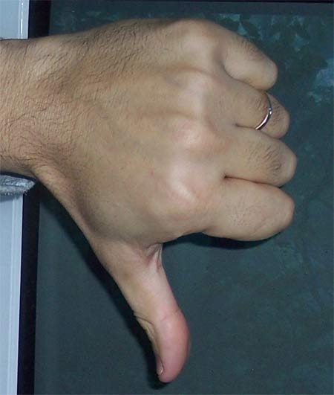
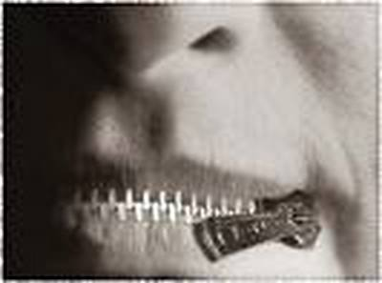
Right for Refusing To Accommodate
GOD'S POINT OF VIEW IS TAUGHT:
GOD'S POINT OF VIEW IS TAUGHT:
GOD'S POINT OF VIEW IS TAUGHT:
The RIGHT thing is not always politically correct!

Slide 17
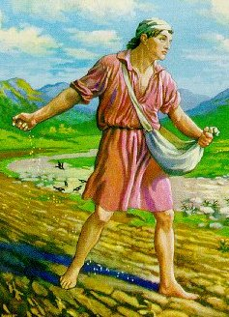
Consider the Parable of the Sower
Luke 8: 5-16

Slide 18
Is the Church wrong for refusing to line up with political correctness?
Woke Inclusion/Exclusion, evolution, homosexuality, and all other man-made theories.
We need to just concentrate on sowing the seed and trust it to grow in the good and honest heart.
(Luke 8:15)

Slide 19
The church is right to refuse to accommodate:
The wishes of the wayside hearer.
(Luke 8:12)
Claim salvation without obeying Christ, “Everyone is on the same road to heaven”, “Just as long as you are sincere, it doesn't matter what you believe.”
Pick your cliché of preference.

Slide 20
The church is right to refuse to accommodate:
The demands of the rocky soil hearer.
(Luke 8:13)
This religion is not a religion of convenience.
The church is right not to cater to the thorny soil.
(Luke 8:14)
The saddest of all “bring no fruit to maturity.”

Slide 21
WHAT IS WRONG WITH THE CHURCH OF CHRIST?
So – What is

Slide 22
Absolutely Nothing!!
So – What is

