Slide 1
Why Should I Be Called A Christian
Reading - Acts 11:19-26

Slide 2
Names are important:
Maiden Name:
changed to reflect a new family relationship.
Adopted children:
are given a name to legitimize a family identity.
Along with the new name comes new benefits and privileges.

Slide 3
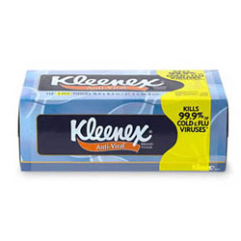
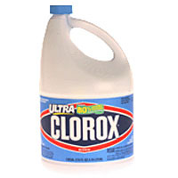
Goal and Objective
So you call yourself Christian!
1. “What kind of Christian are you?” (The name has become generic, like “Coke” "Kleenex" or "Clorox")
2. Are you an original or just a knockoff?
Notes:
Use multiple points, if necessary.

Slide 4
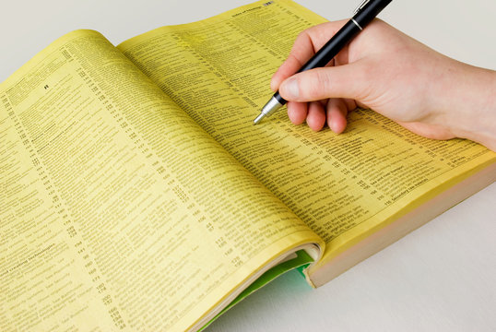
Local phone book reveals a lot of religious names.
Bible characters:
John Baptist, Paul, Peter, James, John, Matthew, Mark, Luke, Mary (Queen of the Universe), Joseph, Mary Magdalene, Stephen.
Notes:
Use brief bullets and discuss details verbally.

Slide 5
Local phone book reveals a lot of religious names.
Scholars:
St. Augustine, St. Frances of Assisi, Thomas Aquinas, John Knox, Martin Luther.
Notes:
Use brief bullets and discuss details verbally.

Slide 6
Local phone book reveals a lot of religious names.
Geographic places:
Flat Shoals, Bethel, Bethlehem, Shiloh, Antioch, Jerusalem, Canaan, Mount Zion.
Notes:
Use brief bullets and discuss details verbally.

Slide 7
Local phone book reveals a lot of religious names.
Catchy Titles:
Voices of Faith,
Grace Community,
Chrystal Cathedral,
Victory Life Center
Notes:
Use brief bullets and discuss details verbally.

Slide 8
What should followers of Christ call themselves?
With what/whom do we wish to be identified?

Slide 9
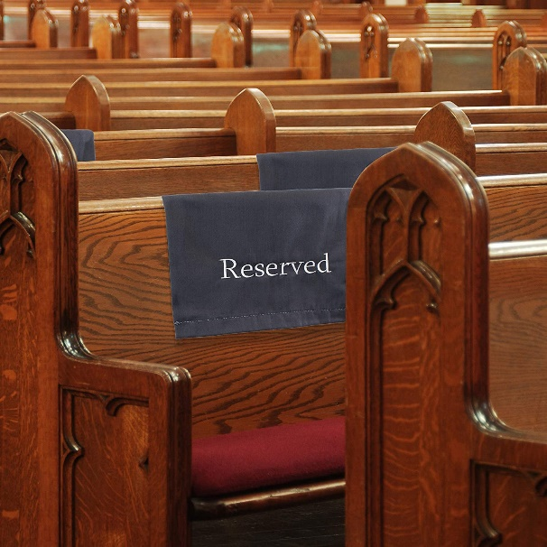
Ownership
We often put our names on our possessions to identify them.
Baseball glove, test papers, pew ...
(“I don’t see your name on it!”).
Jesus wants to put His name on us.

Slide 10
Ownership
As much as I am thankful for the freedom by being an American, being an American doesn't make me a free man.
I really can't come and go as I please even in government buildings.
“Permits” are proof of our servitude

Slide 11
Ownership
In reality we own NOTHING!
We have ALWAYS been slaves in practically every sense.
[Romans 6:15-23]
[1 Corinthians 7:22-23]
Notice that you were bought by Christ and purchased by His blood (Acts 20:28)

Slide 12
HONOR (For sacrifice offered)
The Holy Spirit says it is inappropriate to be called by the name of someone who didn’t provide the sacrifice for sin.
[1 Corinthians 1:10-13]
This is an undeserved honor to the one who didn’t die and a dishonor to the one who did.

Slide 13
AUTHORITY (For salvation)
[Acts 4:7-12]
^{…12}Nor is there salvation in any other, for there is no other name under heaven given among men by which we must be saved.”
No other name provides entry into realm of spiritual blessings.

Slide 14
MARRIAGE
Feminist ideology tells women to follow their own agenda and keep or hyphenate maiden name.
[Romans 7:1-4]
We are Married to the one raised from the dead.
Do we declare our independence by not wearing His name?
Are we embarrassed to wear it? Selfish?

Slide 15
PROMINENCE
Because of the price, sacrifice, suffering, authority, resurrection, etc. Christ has been given the highest name
[Philippians 2:5-10]
To wear any other name is a step down.
When we can wear the name of the King of the Universe, who wants an inferior name?

Slide 16
DIVINE DESIGNATION
Acts 11:26 - The disciples were first called “Christians” in Antioch:
Term “called” most often refers to God’s calling.
The context can infer that the call was applied from outside influences.
It is certain that the word was approved by the Spirit and used throughout history from this point forward.

Slide 17
COMMENDATION
Jesus commends the church at Pergamos for “holding fast to My name”
[Revelation 2:12-13]
I want to be commended of the Lord, don't you?

Slide 18
Observations:
If people are not content with authority for a Bible name, they will not be content with Bible authority for other things.
Having the right name doesn’t guarantee right relationship.
But not having right name guarantees not having a right relationship!

Slide 19
We are Christians individually, and collectively we are the body of Christ.

