Slide 2
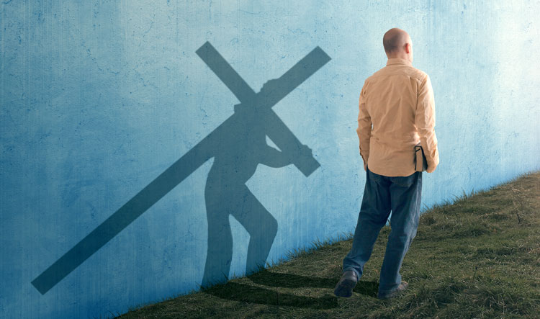
Luke 14: 25-33
5 Easy Steps to Become a Better Disciple

Slide 3
Disciple : A student of a teacher or teaching who studies and applies the teachings in their own lives.
Matthew 10:24-25
John 8:31-32
Matthew 28:19-20
Notes:
What I am about to tell you. You already know. But it is helpful to hear and be reminded of simple habits that we all need to doing to be more pleasing to God.
There is a lot of confusion in the world, believer vs disciple
a

Slide 4
Read
I Timothy 4:13 Until I come, give attention to the public reading of scripture, to exhortation and teaching.
We have to find time and devote ourselves to reading daily.
At least “5 minutes a day” to start out with.
Find someone to read with to hold you accountable.
Don’t get fooled by the world “reading the Bible is to hard to understand, why bother”.
The NKJ written on a 7th grade reading level.
Notes:
Try to form a habit of looking at your Bible app when you’re waiting in line instead of social media.

Slide 5
Reread
You are not going to get everything on the first try or the second.
You are going to find something you missed, just like you would your favorite book or movie.
Notes:
The prodigal son
Story of David and Goliath Dialog
Hard time reading? Audio Bible

Slide 6
Study
2 Timothy 2:15
Learn to use commentary, parallel passages, cross-references, concordance, and other translations to aid in your study.
Hebrews 5:11-14
Be able to explain with confidence what you are reading.
Proverbs 2:6 For the LORD gives wisdom; from His mouth come knowledge and understanding.
Notes:
Cheat sheet example
Blue letter app.

Slide 7
Pray
1 Thessalonians 5:17 pray without ceasing
1 Timothy 2:8 Therefore I want the men in every place to pray, lifting up holy hands, without wrath and dissension.
As in reading, we have to devote time with discipline to prayer.
Luke 5:15-16 But Jesus Himself would often slip away to the wilderness and pray.
Things to pray for in becoming a better disciple
James 1:5
Wisdom, understanding, better discipline, more opportunities to serve the Lord.
Notes:
Jesus had to make time to be by himself. He drew a crowd every where he went.

Slide 8
Be Engaged
We must have Interaction with the saints
Attending worship as much has you can.
Bible study
Use these opportunities to learn and to share what you have learned.
You need the encouragement, and they need yours.
1 Thessalonians 5:11 Therefore encourage one another and build up one another, just as you also are doing.
Notes:
Be ready for Bible class. Be ready to make comments. It helps the teacher out so much.
It’s quite disappointing when a teacher ask a question and he gets crickets.
Find opportunity to serve

