Slide 1
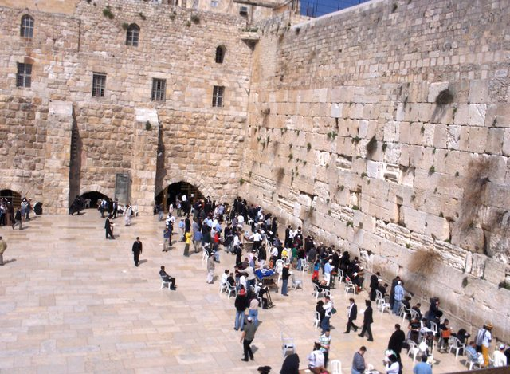
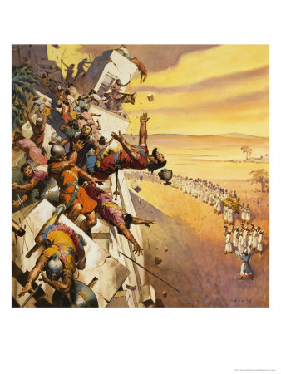
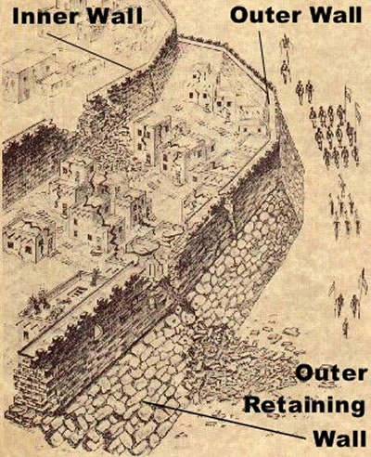
Tearing Down The Walls
Reading: Joshua 6:1-20

Slide 2
This is a story about doing hard things.
vs. 6... Now Joshua had commanded the people, saying, "You shall not shout or make any noise with your voice, nor shall a word proceed out of your mouth, until the day I say to you, 'Shout!' Then you shall shout.“
The people were told not to make a sound for 6 days.
There are a lot of us who can’t be still for 6 minutes.

Slide 3
This is a story about the reward for being obedient.
The entire congregation had to obey or else they would not have been successful.
God is asking us to show Him the same type of obedience today.

Slide 4
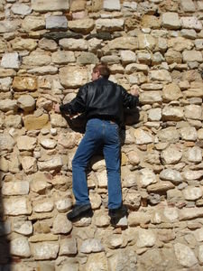
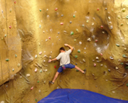
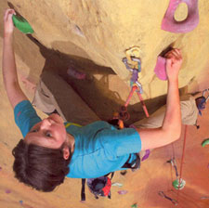
everybody has walls
How high is YOUR wall?

Slide 5
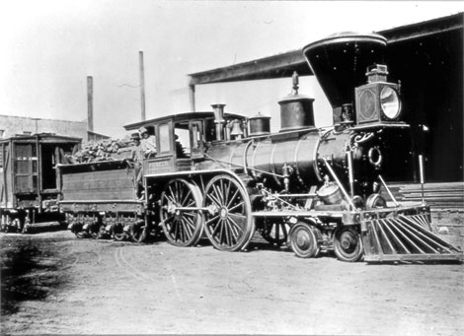
Some of us seem to have more walls than others.
We call these people Pessimists.
“You’ll never get it to go!”
You’ll never get it to STOP!”

Slide 6
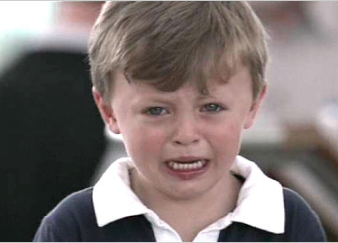
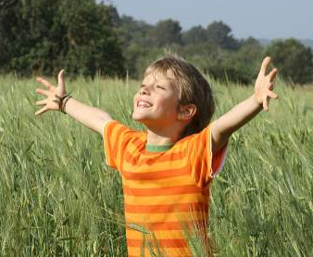
The difference
An optimist doesn’t see the walls, he sees challenges.
Illus: The king who tried to teach his optimistic son a lesson.

Slide 7
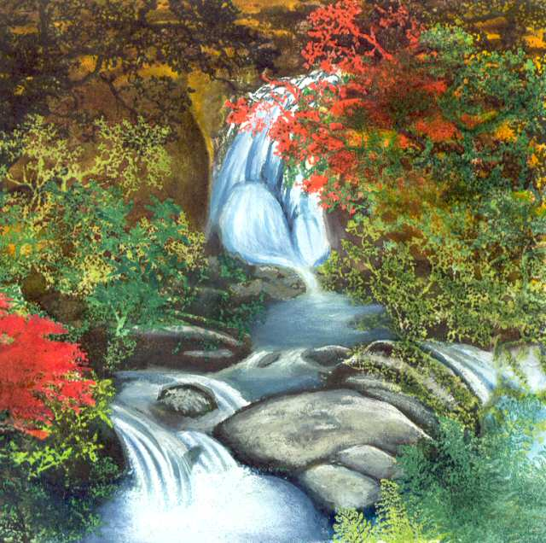
a wall is an opportunity for god to do something good.
“God puts rocks in brooks so we can hear them sing.” [S.M. Roberts]

Slide 8
What if you are given a truckload of scrap metal?

Slide 9
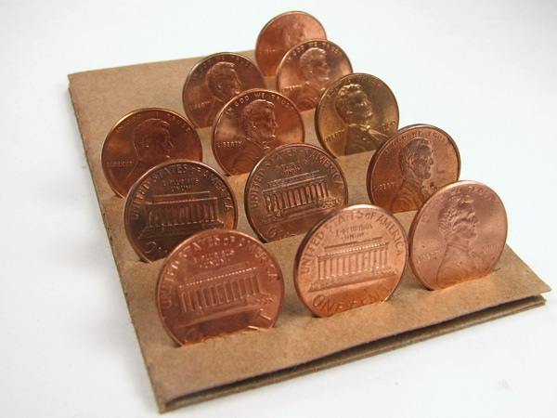
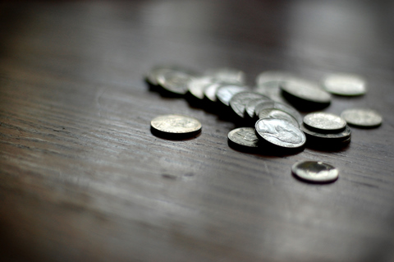
What if you are given a truckload of scrap metal?
If we see junk we take it to the salvage yard and get 12 cents a pound.

Slide 10
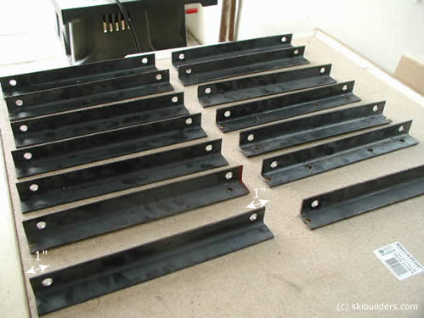
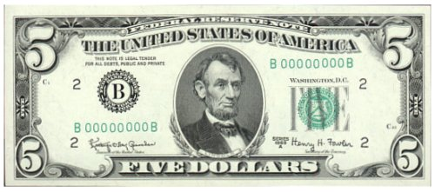
What if you are given a truckload of scrap metal?
We can melt it down and make angle iron that we can get $5 per pound.
.

Slide 11
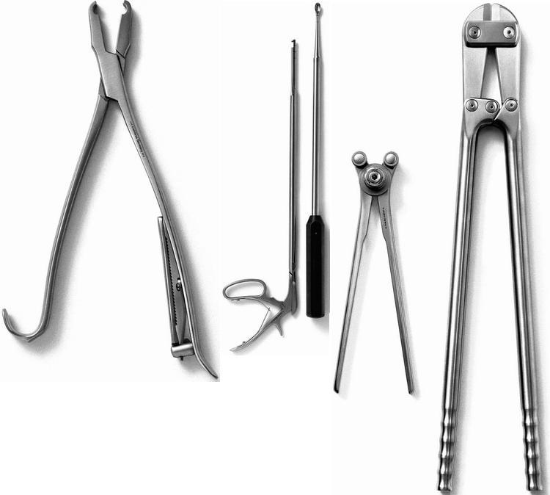
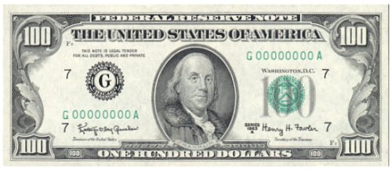
What if you are given a truckload of scrap metal?
We could fashion surgical instruments for $100 a pound.

Slide 12
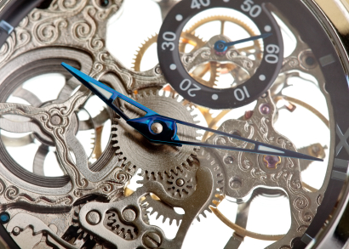
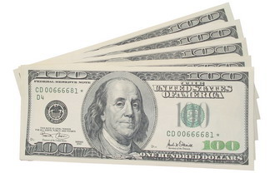
What if you are given a truckload of scrap metal?
We could make watch parts that could bring us over $500 a pound.

Slide 13
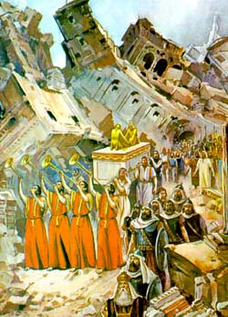
faith is what brings the walls down
Now Jericho was securely shut up because of the children of Israel; none went out, and none came in.

Slide 14
God gives you the eye of faith to see the result.
Verse 2... And the LORD said to Joshua: "See! I have given Jericho into your hand, its king, and the mighty men of valor.
Remember when Moses stood before the Red Sea and Egypt in hot pursuit?
Faith is what prompted him to say..."Do not be afraid. Stand still, and see the salvation of the LORD, which He will accomplish for you today. For the Egyptians whom you see today, you shall see again no more forever. (Exodus 14:13)

Slide 15
We all have 5 common senses:
Touch, Taste, Smell, Hearing & Sight.
The Christian through faith receives Insight.
[2 Kings 6:16-17] So he answered, “Do not fear, for those who are with us are more than those who are with them.” ¹⁷And Elisha prayed, and said, “Lord, I pray, open his eyes that he may see.” Then the Lord opened the eyes of the young man, and he saw. And behold, the mountain was full of horses and chariots of fire all around Elisha.

Slide 16
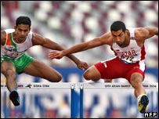
What we consider walls, the Lord looks upon as hurdles to jump.
Track team tryouts:
“You can go a lot faster if you run to the outside of the hurdle, then you don’t have to waste your time jumping.”
(Matthew 7:21-23)

Slide 17
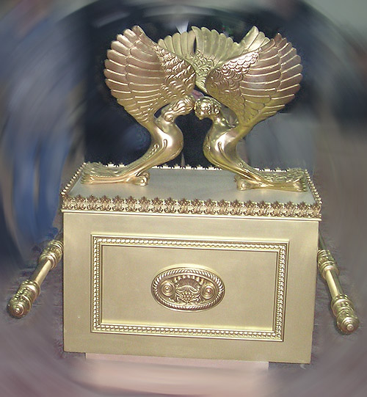
we’re never alone
God was always present in Israel.

Slide 18
Verses 6-13:
The ark of the Covenant was always in the middle of the congregation.
It contained the 10 commandments, a pot of manna & Aaron’s rod,
Why did they carry that thing around?
It was God’s way of showing them that He was constantly in their midst.

Slide 19
Today we have no visual representation nor do we need one.
We can see Jesus thru faith... (2 Corinthians 5:7)
(Matthew 18:20)
Can you see Him today? If not, this is the faith you may be missing
If we have this kind of faith to see Him, we truly are blessed...
(John 20:29)

Slide 20
God does not want Spectators - He requires Doers
That’s why God doesn’t want us to just ask [faith only] but He also wants us to work for our salvation as well.
(Philippians 2:12)

Slide 21
Poem
“You Are Important”

Slide 22
We all have a place in the world it’s said; Some are the leaders, and some are the led. We all are parts of a big great machine; Wheels great and small work in places unseen.

Slide 23
Consider your watch, which part would you choose? What are more necessary, the springs or the screws? The nuts or the bearings; the large gears, or the small; Which makes it go, which part most of all?

Slide 24
Take your car, could you do without the wheels or the tires; Or maybe you could get by without spark plugs or wires. If you take off the steering wheel or take off the clutch, Or if you take off the brakes, would it still be worth as much?

Slide 25
The greatest flywheel couldn’t spin without grease; And it’s held in place by a simple small piece. So don’t be dismayed when you seem in a rut, You’re Important, though you may only be a nut.

Slide 26
The Lord’s ways to victory may not be our ways.
Do you know how ridiculous God’s plan must have sounded to the people?
Better yet, can you see how ridiculous this plan would have seemed to the people of Jericho?

Slide 27
Could it be that you have not obeyed the gospel by being immersed because it sounds like a silly idea? All I can say is that it is God’s way.
(Isaiah 55:8)

