Slide 1
When Jesus Says “FEW” --- What Does That Mean?
Matthew 7:12-14 and Luke 13:23-25

Slide 2
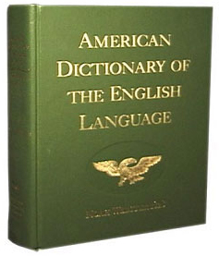
“Few”
Webster – Not many of a thing; Consisting of or amounting to only a small number
Matthew 9:37
Matthew 15:34

Slide 3
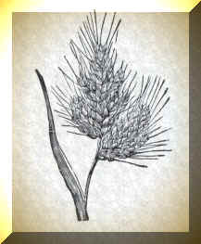
Parable of the Wheat & Tares
Matthew 13:24-30
Not everyone makes it to heaven even though they may be associated with good people all their lives.

Slide 4
Bible Examples of the “FEW”
Gideon’s army - (Judges 7:2-7)
Moses and the Israelites –
(Numbers 14:26-36)
(Numbers 1:1-3,45-46
Days of Noah (1 Peter 3:20)

Slide 5
Bible Examples of the “FEW”
Of the five cities of the plain – 3 people made it to safety. (Genesis 19:28-29)
(1 Corinthians 1:26-31) -- not many wise according to the flesh, not many mighty, not many noble, are called.

Slide 6
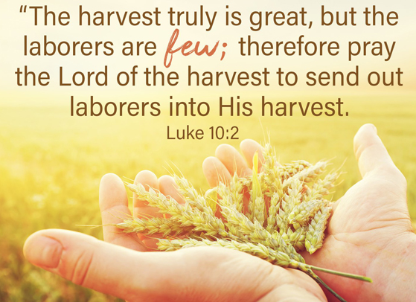
Are you in company with the obedient “few”?
(Luke 10:2)
You have been called to work.
Are you up to the challenge?

Slide 7
Wake up call to Christians
Matthew 20:16
Matthew 22:11-14

Slide 8
Wake up call to Christians
What do you suppose the holy Spirit means when he talks about the righteous being scarcely saved?
(1 Peter 4:18)

Slide 9
Performance Review
How long would you keep someone in your employ if all they did was to show up for work and just sit there for 8 hours?
How much salary have they earned?

Slide 10
Enter in at the narrow gate
Where the few go in
Narrow – literally: “to groan”

Slide 11
Won’t you enter in today?

