Slide 1
A Famine For The Word
Reading - Amos 8:11-14

Slide 2
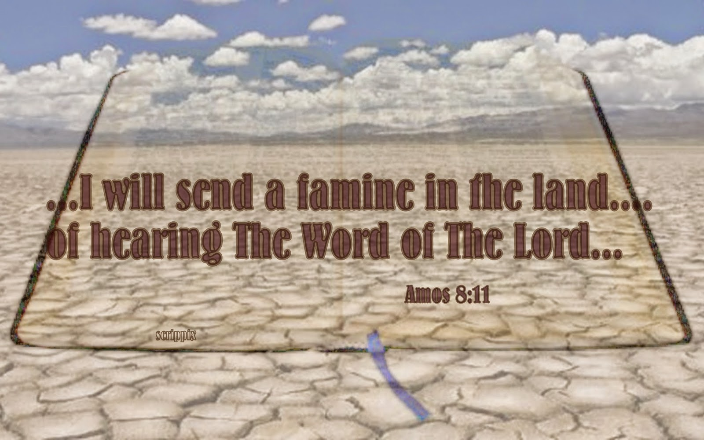
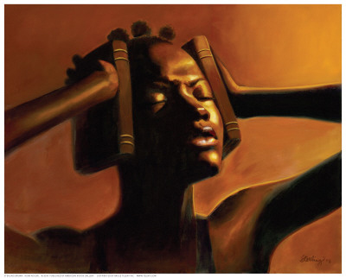
How the famine today is different...
Not imposed on us by God
God has provided for a feast, not famine
Today’s famine is self-imposed
People choose not to feed on the Word of God

Slide 3
Diary Of The Bible
January - A busy time for me. Most of the family decided to read me through this year. They kept me busy for the first two weeks. I'm now forgotten.
February - My owner used me for a few minutes last week. He had an argument and was checking references.
March - Grandpa visited us. He kept me on his lap for an hour, reading 1 Corinthians 13.

Slide 4
Diary Of The Bible
April - I had a busy day. My owner was appointed a leader of something and used me. I got to go to church the first time this year...Easter Sunday.
May -I have a few grass stains on my pages. Had some early spring flowers pressed in me.
June - I look like a scrap book. They have stuffed me full of clippings. One of the girls got married.

Slide 5
Diary Of The Bible
July - They put me in a suitcase today. I guess we're off on a vacation. I wish I could stay at home, as I will have to stay in this thing for a month.
August - Still in the suitcase.
September - Back home again, and in my old place. I have lots of company. Two "True Stories” and four "Funny Books" are on top of me. I wish I could be read as much as they are.

Slide 6
Diary Of The Bible
October - They used me a little today. One of them is sick. Right now I'm all shined up and in the center of the table...I think the preacher is coming.
November - Back in my old place.
December - They are getting ready for Christmas. I'll be covered under wrapping papers and packages.

Slide 7
Similar Causes today
Material luxury
Amos 6:1-8
Deuteronomy 8:11-14 & 17
Luke 8:14

Slide 8
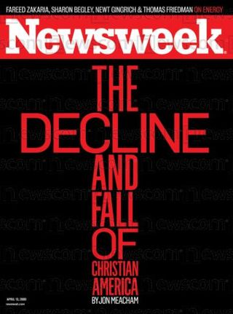
Similar Causes today
Moral Corruption
Amos 2:6-7
Hebrews 4:12-13

Slide 9
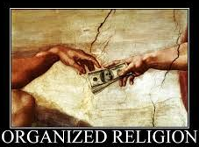
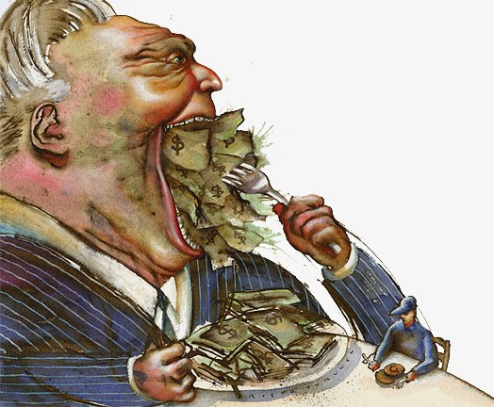
Similar Causes today
Religious Corruption
Philippians 3:18-19
Amos 8:4-10

Slide 10
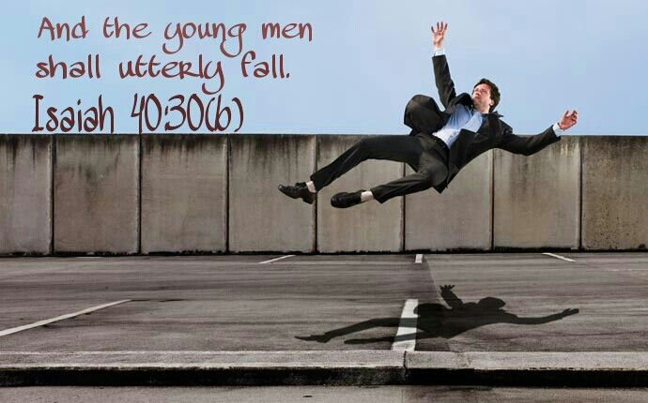
Similar Results today
Young People Shall Faint
Amos 8:13
Isaiah 40:28-31

Slide 11
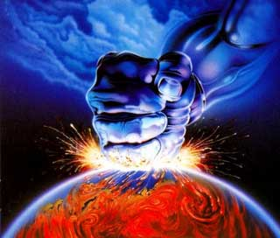
Similar Results today
Those who trust in false hopes shall fall and not rise
Amos 8:13
2 Chronicles 36:16

Slide 12
End the famine in your life...
Your soul is more important than your body.
Matthew 16:26
1 Peter 2:1-3
Meditate on it as you read Psalm 1:1-3
Psalm 119:33-40

Slide 13
Make It A Feast For The Word
End The Famine In Your Life!

