Slide 1
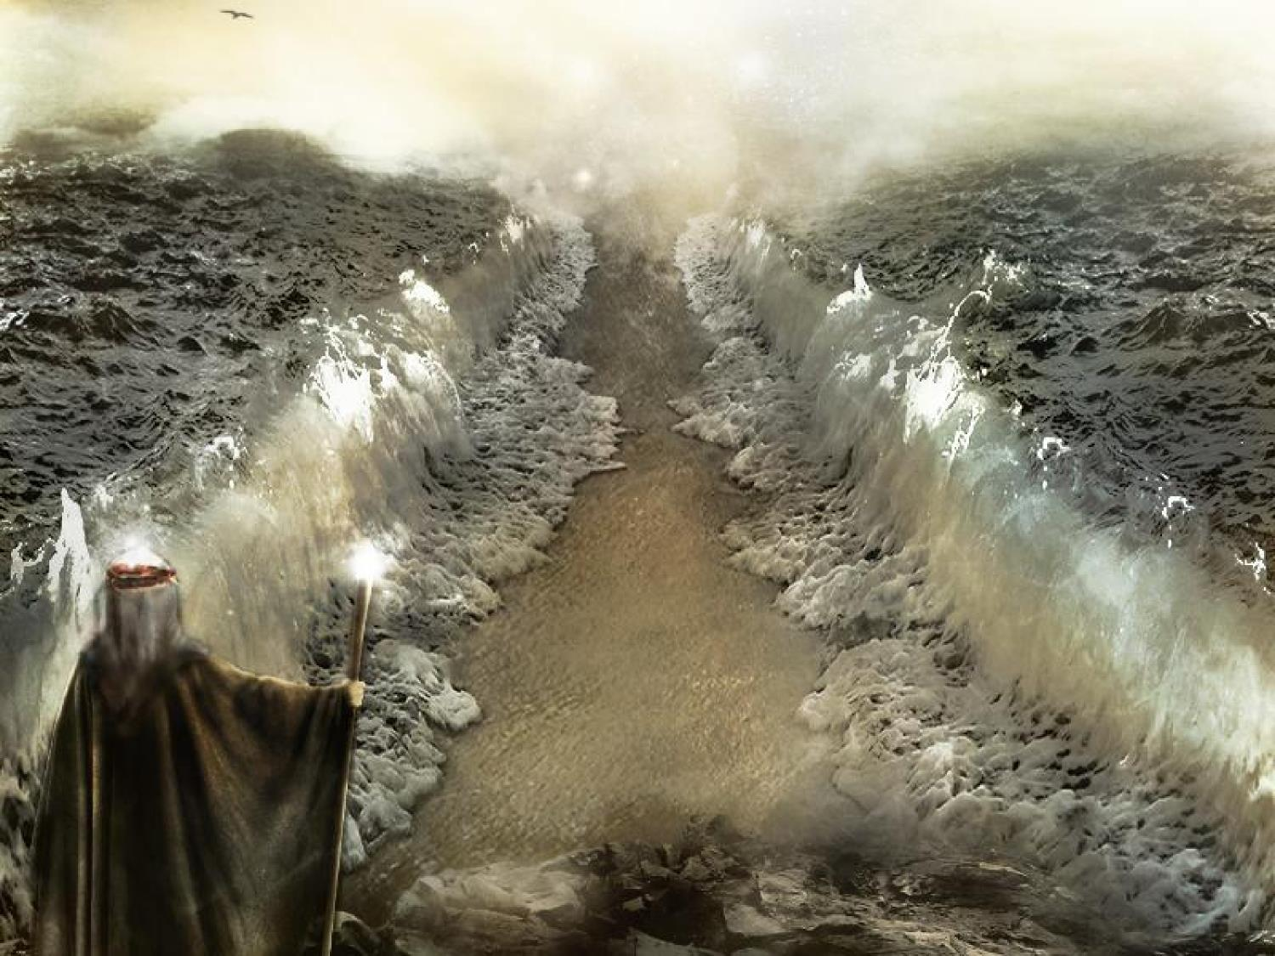
A Holy Nation
Readings – Ephesians 4:1-3 and 1 Peter 2:9-10

Slide 2
Israel Was To Be A Holy Nation
So Are We:
Galatians 6:14-16
Galatians 3:26-29
Hebrews 3:1-6
Ephesians 2:19-22
1 Corinthians 3:16-17

Slide 3
Israel Was A Nation of Slaves
So Are We:
John 8:34
Romans 6:16

Slide 4
Israel Needed An Atoning Sacrifice
So Do We:
John 1:29
Hebrews 10:1-4
Hebrews 9:11-14
1 Peter 1:17-19

Slide 5
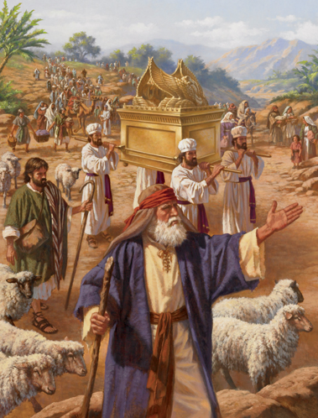
Israel Was A Nation Of Pilgrims In A Weary Land
So Are We:
1 Peter 2:11-12
Although we may be pilgrims, we are not destitute
2 Peter 1:2-4
1 Peter 2:25

Slide 6
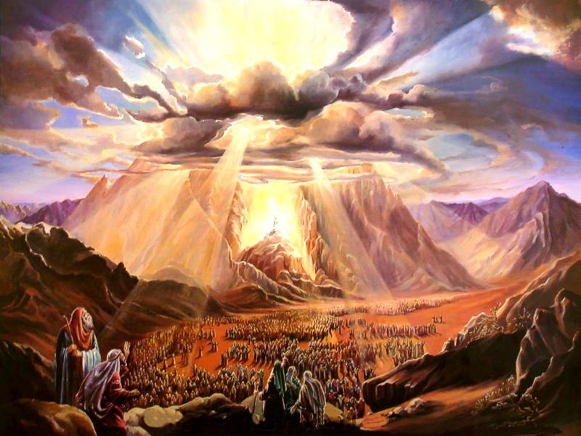
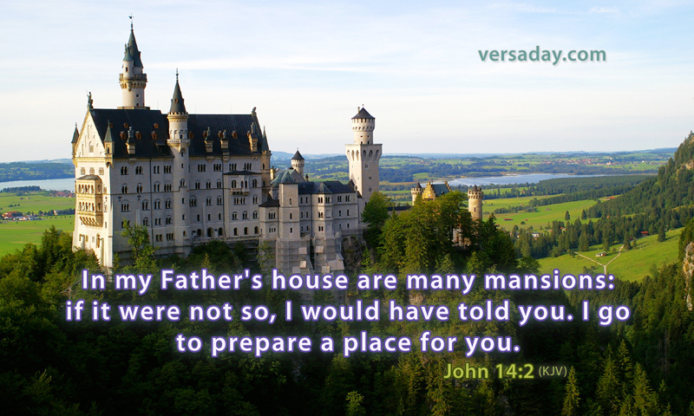
Israel Looked For A Promised Land
So Do We:
Hebrews 12:22-24
John 14:1-3

Slide 7
Israel Found Salvation Through Water
So Do We!

Slide 8
Once Saved Always Saved?
[Hebrews 3:16-19] For who, having heard, rebelled? Indeed, was it not all who came out of Egypt, led by Moses? ¹⁷Now with whom was He angry forty years? Was it not with those who sinned, whose corpses fell in the wilderness? ¹⁸And to whom did He swear that they would not enter His rest, but to those who did not obey? ¹⁹So we see that they could not enter in because of unbelief.

