Slide 1
True Worship
Reading – John 4:7-24

Slide 2
Attitude of True Worship
Psalm 122:1
Psalm 29:1-2
Hebrews 10:24-25

Slide 3
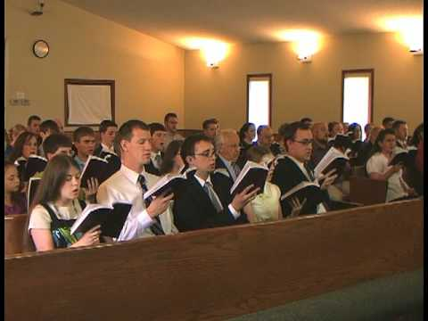
In The Presence of The Lord
Psalm 95:1-2
Matthew 18:20

Slide 4
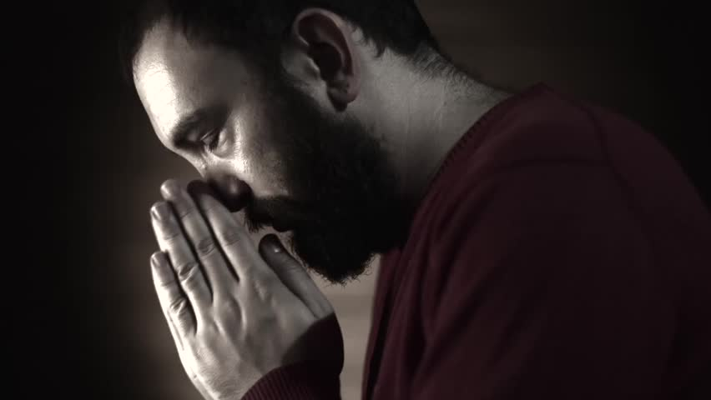
True Worship Has His Authorization
Colossians 3:17
Matthew 15:9
Leviticus 10:1-2

Slide 5
The Lord’s Supper
I can’t wait until lunch...

Slide 6
The Lord’s Supper
This bread has no taste...

Slide 7
The Lord’s Supper
I think this grape juice has expired...

Slide 8
The Lord’s Supper
1 Corinthians 11:23-26

Slide 9
Singing
I’m not a good singer. I’ll just listen.

Slide 10
Singing
This would sound a lot better with a band.

Slide 11
Singing
Wow...sister [insert name] is way off key!

Slide 12
Singing
I sound phenomenal!

Slide 13
Singing
Ephesians 5:19
1 Corinthians 14:15

Slide 14
Prayer
Ahh, time to think about

Slide 15
Prayer
Brother [insert name] isn’t folding his hands.
I’m so much holier than he is!

Slide 16
Prayer
Now to impress everyone with my vocabulary!

Slide 17
Prayer
Matthew 6:5-7

Slide 18
Giving
I think I have a few dollars in my pocket.

Slide 19
Giving
Didn’t we just do this last week?

Slide 20
Giving
Maybe if I give a little extra, God will reward me.

Slide 21
Giving
2 Corinthians 9:7
1 Timothy 6:17-19

Slide 22
Teaching
The teacher’s tie is crooked...

Slide 23
Teaching
I already know this stuff. No need to listen.

Slide 24
Teaching
James 1:22-25
Acts 17:11

Slide 25
Why Are We Here?
John 6:26-27
Hebrews 3:15
Oft we come together,
Oft we sing and pray;
Here we bring our offering
On this holy day.
Help us Lord Thy love to see,
May we all in truth and spirit
Worship Thee.

Slide 26
True Worship
John 14:6
Galatians 3:27

