Slide 1
What Is The Value?
Reading – Hebrews 10:22-27

Slide 2
attendance
This is our attempt to evangelize.
We should never Forsake an opportunity to exhort your brethren. (Hebrews 10:25) Not forsaking the assembling of ourselves together, as the manner of some is; but exhorting one another: and so much the more, as ye see the day approachin

Slide 3
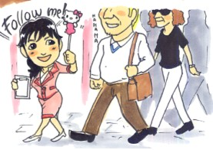
Bring Others With You
How do we know where Jesus is going to be? (Matthew 18:20) For where two or three are gathered together in my name, there am I in the midst of them.

Slide 4
dedication
(Romans 12:1) I beseech you therefore, brethren, by the mercies of God, that ye present your bodies a living sacrifice, holy, acceptable unto God, which is your reasonable service.
This effort is going to call on you to sacrifice some of your time for the Lord.
All that we have to schedule time for is 2 extra days.
2 Corinthians 13:5

Slide 5
Interest?
(Acts 17:11) These were more noble than those in Thessalonica, in that they received the word with all readiness of mind, and searched the scriptures daily, whether those things were so.

Slide 6
Sing Together
(Ephesians 5:19-20) speaking to one another in psalms and hymns and spiritual songs, singing and making melody in your heart to the Lord, {20} giving thanks always for all things to God the Father in the name of our Lord Jesus Christ,
Our singing can either impress or depress those who attend with us.

Slide 7
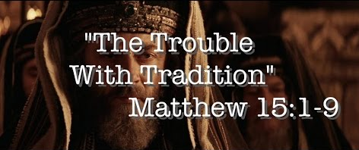
meaningful
make this meeting worthwhile
Matthew 15:9
Even if no one else gets anything from this, make sure that you do.

Slide 8
Self Resolution
There are a LOT of worldly things that you could be doing.
Make up your mind to do something spiritual.
(Colossians 3:1-2) If then you were raised with Christ, seek those things which are above, where Christ is, sitting at the right hand of God. {2} Set your mind on things above, not on things on the earth.

Slide 9
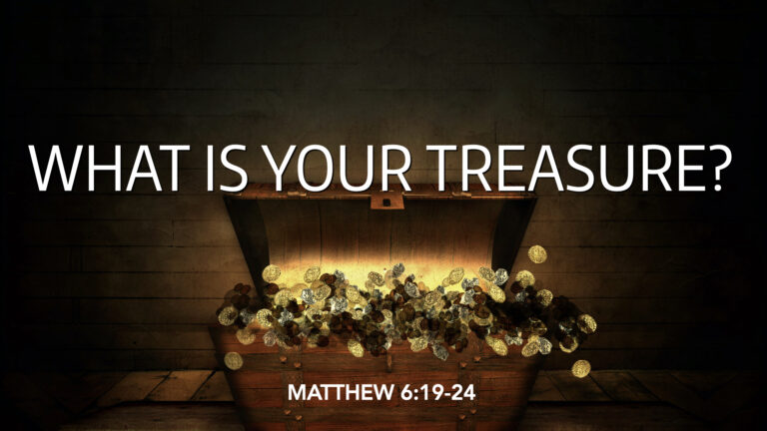
It is a Matter of what we treasure
(Matthew 6:20-21) But lay up for yourselves treasures in heaven, where neither moth nor rust corrupts, and where thieves do not break through nor steal: {21} For where your treasure is, there will your heart be also.
Don’t let a baseball or football game come between you and heaven.
Don’t let the temptation to make extra money separate you from serving God. (Mark 8:36) For what shall it profit a man, if he shall gain the whole world, and lose his own soul?
We rarely do this, so when it comes we ought to treasure it.

Slide 10
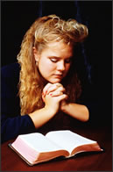
Pray for Workers
(Matthew 9:37-38) Then He said to His disciples, "The harvest truly is plentiful, but the laborers are few. {38} "Therefore pray the Lord of the harvest to send out laborers into His harvest.“
We need to pray for the conviction & the opportunity to do our part.

Slide 11
Accept the Challenge
“ All You Can Do IS All You Can Do.”
(Joshua 24:15) And if it seem evil unto you to serve the LORD, choose you this day whom ye will serve; whether the gods which your fathers served that were on the other side of the flood, or the gods of the Amorites, in whose land you dwell: but as for me and my house, we will serve the LORD.

Slide 12
This is a Period of services
Don’t just go through the motions.
(John 4:23-24) But the hour comes, and now is, when the true worshippers shall worship the Father in spirit and in truth: for the Father seeks such to worship him. {24} God is a Spirit: and they that worship him must worship him in spirit and in truth.

Slide 13
Do not yield to temptation
(James 4:7-8) Submit yourselves therefore to God. Resist the devil, and he will flee from you. {8} Draw nigh to God, and he will draw nigh to you.
You will be tempted to make excuses.
The devil would like nothing better than for you to stay at home.
He doesn’t care if you’re not practicing sin as long as you’re not practicing Christianity.

Slide 14
Are You Growing Spiritually?
Our zeal must be accompanied with knowledge. (Romans 10:1-3) Brethren, my heart's desire and prayer to God for Israel is, that they might be saved. {2} For I bear them record that they have a zeal of God, but not according to knowledge. {3} For they being ignorant of God's righteousness, and going about to establish their own righteousness, have not submitted themselves unto the righteousness of God.

Slide 15
Decision Time!
If you know someone who is zealous of God why don’t you do them a favor and introduce them to Jesus?
If you are zealous of doing the right thing then why not commit to the Lord now?
(2 Corinthians 5:10)

