Slide 1
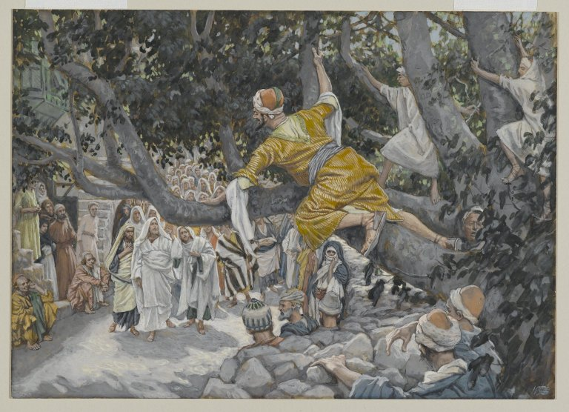
Come Down From Your Tree
Reading – Luke 19:1-10

Slide 2
Zacchaeus was a chief publican
Verse 2 tells us plainly that Zacchaeus was “rich”. How do you define “rich”?
The way he obtained his riches maybe was the reason others considered him a sinner.
He could have inherited his wealth or he could have earned it by being industrious.

Slide 3
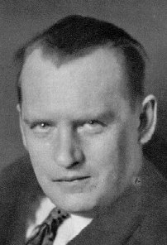
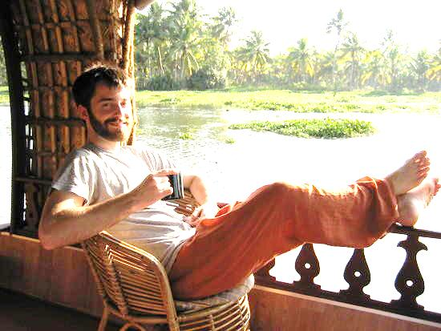
Fisherman vs. Industrialist
Being Industrious Can Have Disadvantages Too

Slide 4
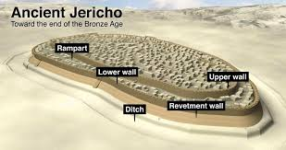
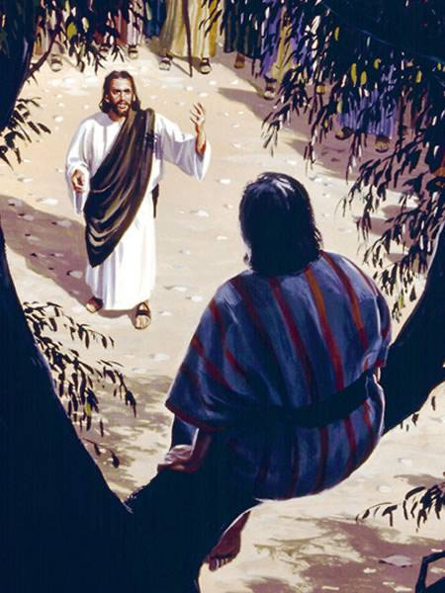
Jericho was considered to be a rich city.
Comparable to Beverly Hills in our time.
Consider some lessons we can learn from Zacchaeus in (Luke 19:1-10)

Slide 5
God does not play Favorites
"...a man that is a sinner." (v. 7)

Slide 6
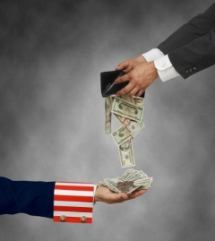
Tax collectors were notoriously crooked
Stereotypes are justified by the majority.
After collecting the Roman tax, Rome asked no questions.
Tax collectors could (and did) exact more taxes than necessary and merely pocketed the excess.
Note John the Baptist's words to them: (Luke 3:13)
The Jews would have had Jesus to play favorites in verse 7.
Note what was said in (Acts 10:34-35)

Slide 7
Pride Will Block Our View of Jesus
(Luke 19:3-4)

Slide 8
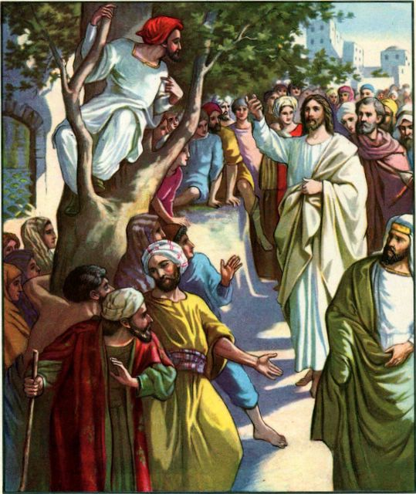
If Zacchaeus had been prideful; he would have never climbed the tree.
The scripture says he was rich.(Matthew 19:23-24)
Imagine the indignity of a man of his stature climbing a tree like some child.
Zacchaeus threw decorum out the door.
He didn’t want to miss seeing Jesus.

Slide 9
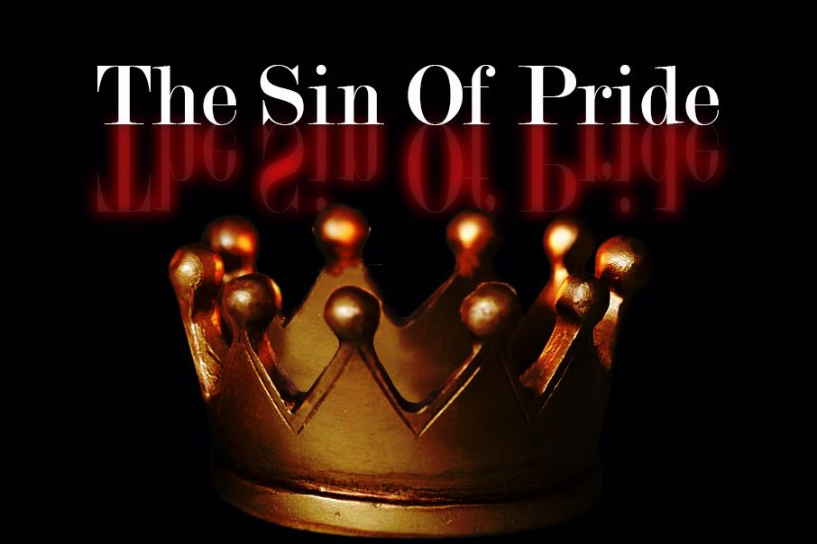
Pride can be a barrier that would deter our way to heaven.
Let us take heed, lest when we have brought others so far, the gates should prove too narrow for ourselves.
Pride is at the root of all other sins: envy, contention, discontent, and all hindrances that would prevent renewal.
Are you too “good” to repent?
(1 John 2:16)

Slide 10
We Must Climb Above The Crowd to See Jesus
(Luke 19:4)

Slide 11
Lessons from Colossians 3
Vs. 1-3 Is where our mind SHOULD be
Vs. 4 We MUST kill the earthly practices of the world.
Vs. 6-9 We have to “put off” our personal issues with sin.
Vs. 12 We “put on” the attributes of Jesus.
Vs. 14-15 Above all else is Love, peace & thankfulness
Zacchaeus made the necessary effort by climbing a tree, with low-lying limbs to provide him with a vantage point to see the Lord.
(Matthew 6:1-5)
(2 Corinthians 10:12)

Slide 12
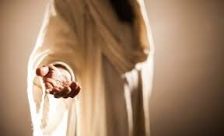
Being Invited Is a Joyous Thing
(Luke 19:6)

Slide 13
Gospel" means "good news."
(Romans 14:17)
The gospel contains the power to save. (Romans 1:16)
(Romans 15:13)

Slide 14
“Show me your faith without your works” [James 2:18]
Zacchaeus shows his character as he is trying to follow the “Law of Moses”
If he cheated anyone, he repented of his sins and made the necessary four-fold restitution as required. (Exodus 22:1-2) (2 Samuel 12:6)
Repentance is an active thing. IF Zacchaeus’ former life was ruled by greed for money; now he will live for the Lord.

Slide 15
Jesus looked at Zacchaeus and called him by name (Luke 19:5)
Were they ever introduced?
Jesus, who knew all things, knew his name as well as his heart.
Jesus looks upon a short, despised, tax collector and takes the time to go to his house.
How special Zacchaeus must be! How special we are, for we are no better than Zacchaeus — we have all sinned and fallen short of God's glory.
We should think of ourselves as least of all the saints [Ephesians 3:8], and especially privileged to be numbered among those of whom the world is not worthy.

Slide 16
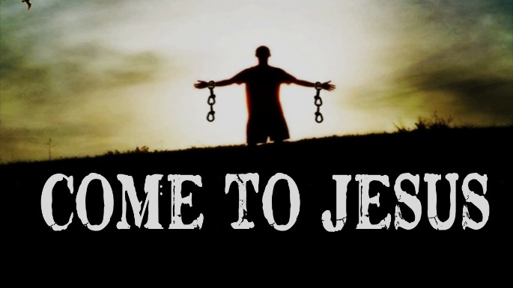
Jesus is calling YOUR name!
(Matthew 11:28-29)

