Slide 1
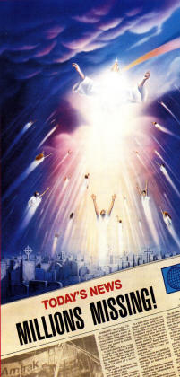
“Rapture”
As it relates to Daniel 2
Reading - 1 Thessalonians 4:13-18

Slide 2
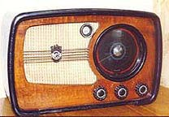
Pilot of the Airwaves
I used to listen to a program in the mornings with a man who was teaching from the book of Daniel as it relates to Revelation.
This program was on WJLU at 7:00 am.
It is amazing how easily we can let ourselves get caught up in fables.
(2 Timothy 4:3-4)

Slide 3
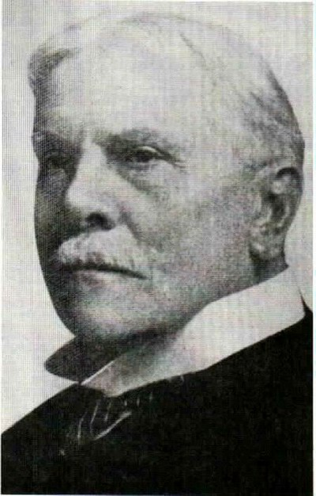
“Rapture” Conceived
Introduced in America with the Plymouth Brethren
Promoted by a man named Cyrus Scofield.

Slide 4
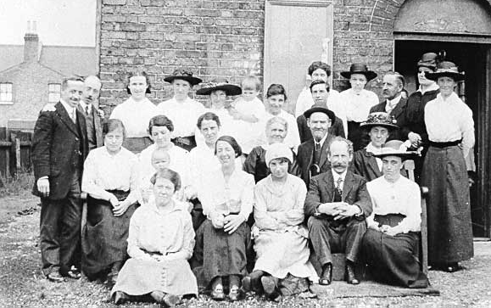
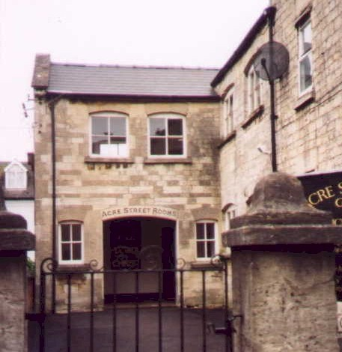
Plymouth Brethren
Several small sects of common origin--found in Britain, Europe, and the United States--that are conservative in theology and millenarian in outlook.
Beginning in Ireland and England in the 1820s, Plymouth being a main center of activity.

Slide 5
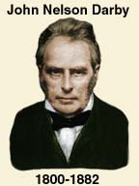
Plymouth Brethren
The most prominent early leader was John Nelson Darby, who taught that Christ might return at any moment and in a "secret rapture" would take away the members of the true church to dwell in heaven

Slide 6
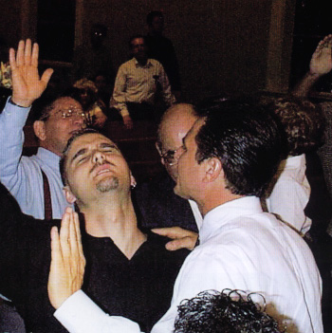
Rapture Defined
Extreme joy, ecstasy, or bliss
Derived from a Latin word raptum, which means to snatch away.
Probably how this term is being applied in the religious sense.

Slide 7
There are NO occurrences of the word Rapture in the entire Bible.
There are some places where the word Rapture has been substituted to explain the Passages.
(Matthew 24:37-41)
(1 Thessalonians4:13-18)
(1 Corinthians15:51-52)

Slide 8
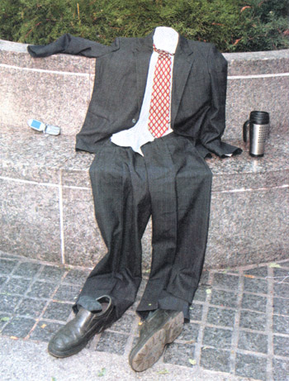
Matthew 24 applied to Daniel 2
This links Rapture with a Tribulation.
(Matthew 24:15-18)
The abomination of desolation spoken of by Daniel is found in Chapter 2 of the Book of Daniel, which we want to explore in more detail in this lesson.

Slide 9
modern proponents of a rapture

Slide 10
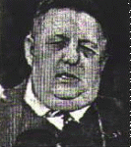
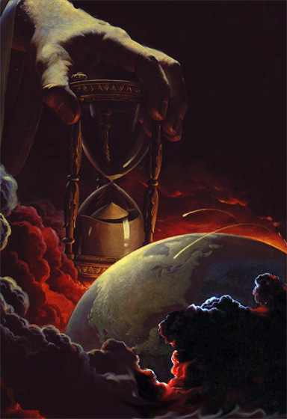
The Rapture Adventists
Many people have been influenced by the writings of NASA Scientist, Edgar Whisenant in relation to the course of events that will lead up to this proposed Rapture/Tribulation.
An Adventist group in Florida held a 3-day seminar to explain or forecast these happenings.
They used Mr. Whisenant’s writing; "On Borrowed Time" as the study text where he "proves" how Daniel Chapter 2 is to be fulfilled.

Slide 11
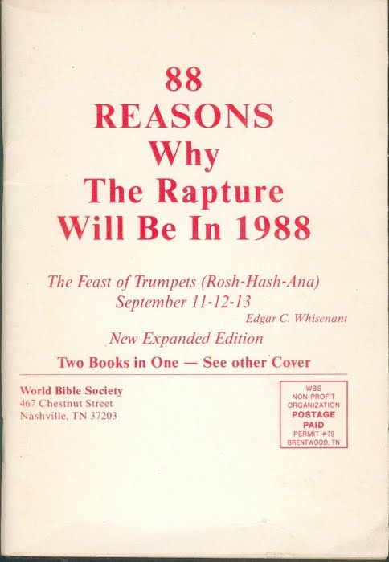
A word of caution about Mr. Whisenant and his writings:
(Deuteronomy18:20-22)
Mr. Whisenant is the same man who wrote a book “88 Reasons Why the Rapture Will Occur In 1988”.
Mr. Whisenant Was WRONG!!!!
If this prophet’s words didn’t come true, he - by God’s definition - is a false prophet; we should not listen to him whatsoever.

Slide 12
His Prophecy
The Rapture would happen on September 13th, 1988 because that’s when Rosh Hashanah coincides with all the events of prophecy.
He predicted this day after [he claims] 14 years of studying Old & New Testament prophecies.
Using a calculator he figured up a Sabbath of Sabbaths
Using Daniel Chapter 2 as the keystone [because Jesus gave us the hint in Matthew 24] he claimed that Rosh Hashanah in 1988 could be the only date that the Rapture could occur.
Listen to Jesus: But of that day and hour knows no man, no, not the angels of heaven, but my Father only. [Matthew 24:36]

Slide 13
Challenges of this lesson
ALL of the testimonies and the prophecies of the Old Testament were fulfilled by and through Jesus in the establishment of His church.
Your challenge: Find any prophecy or testimony of the Old Testament and show where it has NOT been fulfilled.
The events found in Daniel 2 lead to Jesus and the establishment of His church.
Challenge #2: Find as much as a hint of any passages that even come close to a “Rapture” as you read Daniel 2.

Slide 14
Daniel Chapter 2
Read vs. 1-14
READ ON. Vs 14-19.
Vs 20-30
Something was about to happen in the latter days. This means that they were at an end of a system -- the Old Testament system.
The Old Testament was going to be in existence for another 300-400 years but they would have their conclusion at the cross.
(Colossians2:14)

Slide 15
Daniel Chapter 2
Read vs. 31-35.
Even man with his ability to split the atom cannot muster enough power to turn gold into dust.
This stone made without hands can only be Jesus.
(Mark 14:58)
This stone grew until it became a great mountain. The church started out with a little more than 3,000 and has grown until you can find Christians all over the world.
We don’t need to guess what this dream is all about because Daniel will plainly spell out what it means.

Slide 16
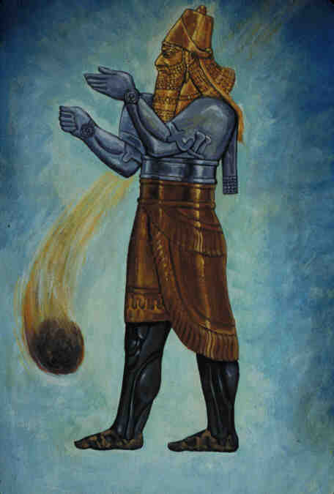
the interpretation vs. 36-45

Slide 17
The Interpretation
Vs 38 Nebuchadnezzar represented the head of Gold.
Vs 39 the silver kingdom represented the Medes & Persians.
Then came the Macedonian kingdom under Alexander the Great.
Vs 40 Details the iron, killing machine of the Roman Empire under Caesar.

Slide 18
Any atheistic history professor could give you the same list of events.
The Roman Empire was so large that Rome could not rule it alone.
Vassal kings were set up to rule in the Provinces.
Verse 43: Men like the Herods were this “clay” that was mingled with the “iron” of the Romans.

Slide 19
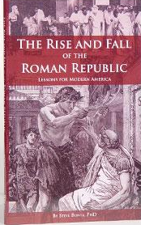
Edward Gibbons book
The Rise & Fall Of The Roman Empire states:
Vassal kings over time grew in power.
The people became a lazy & corrupt welfare state to where the Empire collapsed from within.
And Great Was That Fall!
The Book of Revelation tells us all about that fall in the same type of symbolic language.
The reason for that is because they are describing the SAME EVENT -- Not some FUTURE EVENTS into which we stick a Rapture.

Slide 20
Verse 44 is the key to the entire Chapter
And in the days of these kings shall the God of heaven set up a kingdom, which shall never be destroyed: and the kingdom shall not be left to other people, but it shall break in pieces and consume all these kingdoms, and it shall stand for ever.
Jesus’ kingdom was not an earthly kingdom that had to defeat another kingdom with military might.
John 18:36

Slide 21
(Matthew 16:28)
Verily I say unto you, There be some standing here, which shall not taste of death, till they see the Son of man coming in his kingdom.
His kingdom was to be established in the Apostles’ lifetime. And that fits the time line established in Daniel 2 perfectly.
The church grew just like the little snowball that rolls down the hill and gets larger & larger.
There is not a country in the world where Jesus is not known.
He may not be preached, but He most certainly is known.

Slide 22
A vague hint of a Rapture in the book of Revelation.
The beast and a false prophet.
(Revelation 19:19-20)

Slide 23
Time IS Running Out
What difference does it make what happens on earth 200 years from now?
What does make a difference is your relationship to God right now.
These are the last days for you!

