Slide 1
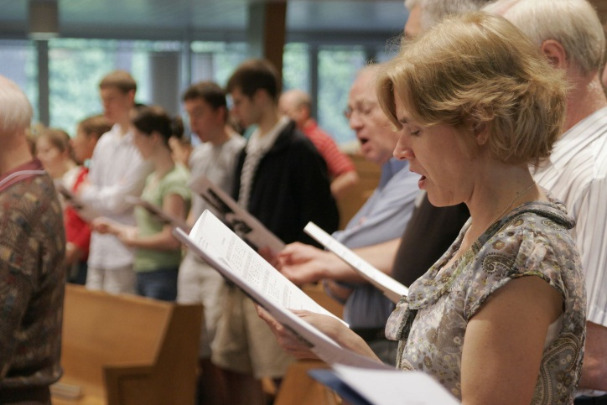
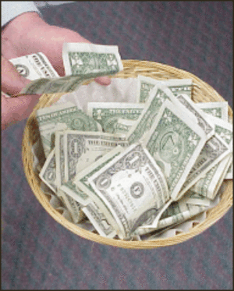
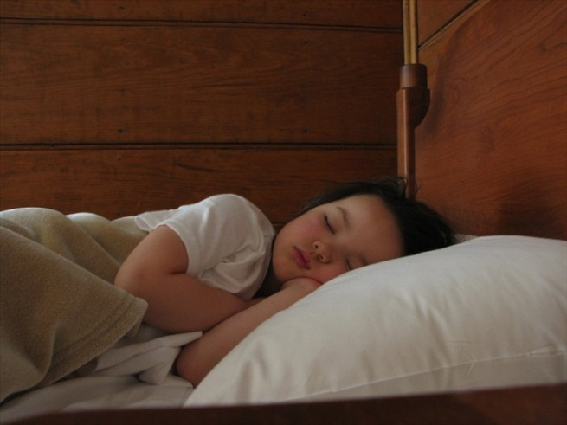
Do I Have To?
Reading – Acts 16:25-33

Slide 2
Most of the time this is a question asked by those who are immature.
Better translation is, “I don’t want to.”
The immature usually have selfish reasons.
Laziness is another motive.

Slide 3
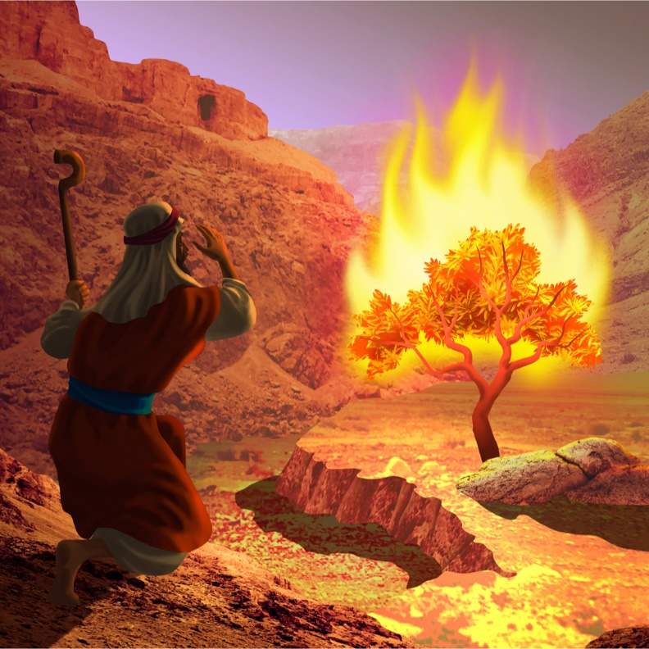
There were times when great men of the Bible asked the same question.
Moses asked that question at the burning bush.
Jesus asked that question in the Garden of Gethsemane.
Paul asked the Lord 3 times.
[2 Corinthians 12:7-9]
There was much more at stake than just a minor inconvenience.
Let’s examine what the Lord says we HAVE to do.

Slide 4
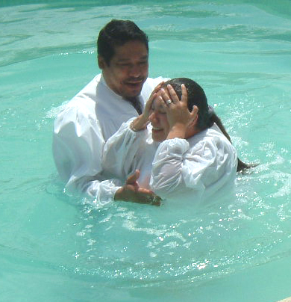
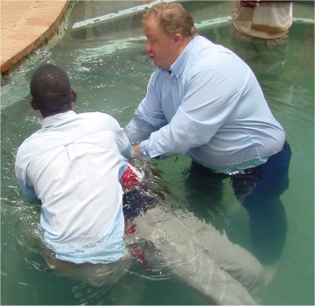
Do I Have To?
Be Baptized

Slide 5
What is your definition of “must”?
To be obliged or required by morality, law, or custom: Citizens must register in order to vote.
To be compelled, as by a physical necessity or requirement: People must have oxygen in order to live.
Used to express a command or admonition: You must not go there alone. You simply must be careful.

Slide 6
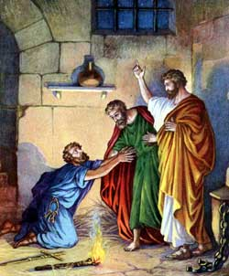
This is the question that the Philippian jailor asked Paul & Silas.
“What must I do to be saved?”
He didn’t make the argument, “Do I have to?”

Slide 7
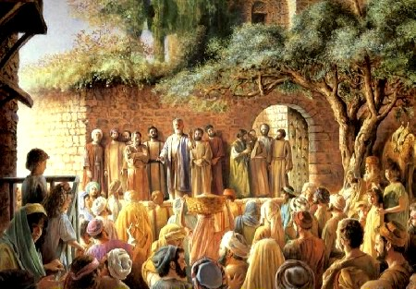
It may be that many of the devout Jews asked that on the day of Pentecost.
[Acts 2:36-41]

Slide 8
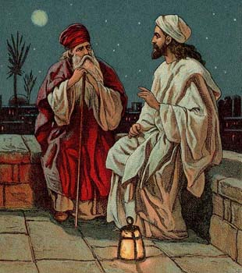
Nicodemus John 3:1-7
Nicodemus was not given alternatives to choose from.
He was told he MUST be born again of the “water and the Spirit”.

Slide 9
Nicodemus John 3:9-15
Nicodemus did have a “Do I have to” moment, and Jesus answers with another MUST.

Slide 10
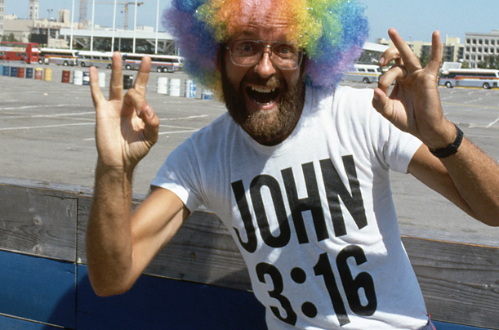
Put Back Into Context John 3:16-21
Salvation is found in OBEDIENT faith.
Jesus says that you MUST be baptized [Mark 16:16, Matthew 28:19-20]
Will you “accept” Him on His terms?
He will not accept you on men’s terms. [Matthew 15:8-9]

Slide 11
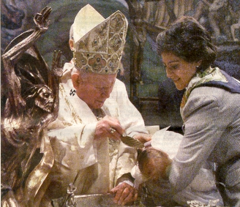
Do I Have To?
Get Baptized Again

Slide 12
[Acts 18:24- Acts 19:7]
The case for immersion.
Sprinkling babies is not baptism.
Belief, Confession & Repentance are a MUST!
Babies can’t do any of those.

Slide 13
Being baptized because you are already saved defies logic or faith.
[1 Peter 3:20-21]
Any other practice other than immersion is not baptism.
[Romans 6:1-5]
[Ephesians 4:4-6]

Slide 14
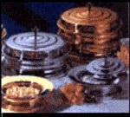
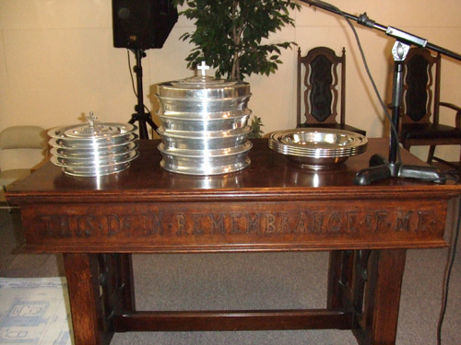
Do I Have To?
Remember Our Lord’s Command

Slide 15
Many in the world apparently do not believe that you MUST.
Regarding salvation Jesus has several commands, but regarding worship He has only this command:
[1 Corinthians 11:23-26]

Slide 16
Remembering Jesus is a Big Deal with the Godhead.
[Hebrews 10:24-3] … ²⁵not neglecting to meet together [to remember Jesus] , as is the habit of some, but encouraging one another, and all the more as you see the Day drawing near. ²⁶For if we go on sinning deliberately after receiving the knowledge of the truth …. ²⁸Anyone who has set aside the law of Moses dies without mercy … ²⁹How much worse punishment, “Vengeance is mine; I will repay.” And again, “The Lord will judge his people.” ³¹It is a fearful thing to fall into the hands of the living God.
Heaven help anyone who does NOT remember Jesus!

Slide 17
Observing The Lord’s Supper
Taking this memorial feast is something that Christians do together but it is still something that is received individually.
[1 Corinthians 11:27-29]

Slide 18
Do I Have To?
Sing Praises to God

Slide 19
Colossians 3:16 and Ephesians 5:19 says you should.
Why would you want to withhold praise to God?
Is Jesus not worth your effort?
IF you don’t like to sing then it makes it all the more a sacrifice that you are making.

Slide 20
Do I Have To?
Make Sacrifices

Slide 21
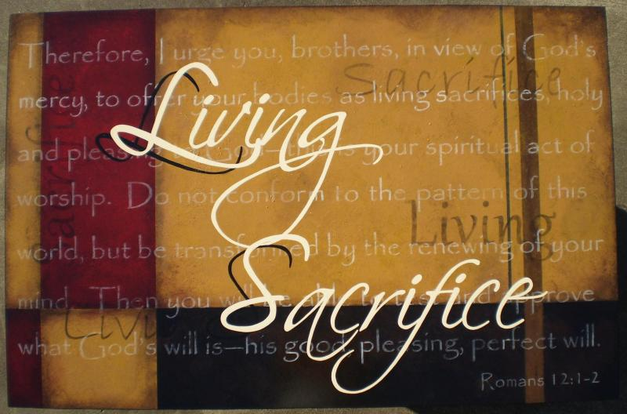
[Romans 12:1]
[Luke 14:27] Whoever does not bear his own cross and come after me cannot be my disciple.
[Luke 9:23-25]

Slide 22
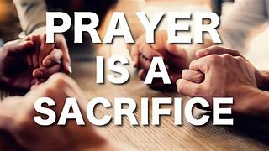
What sacrifices will you be making for the Lord today?
The context of Hebrews 10:25 has you here today to remember Jesus.
Assembling tonight constitutes sacrifice.
What you gave back to the Lord was a sacrifice of your life.
Your prayers and your songs were a sacrifice. [Hebrews 13:15-16]

Slide 23
What sacrifices will you make tomorrow and the rest of the week?
Will God be getting your FIRST & the BEST?

Slide 24
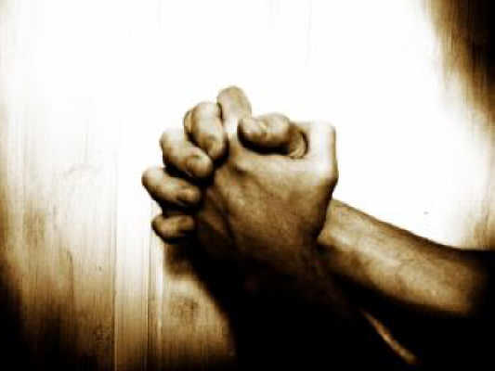
Do I Have To?
Yes!

