Slide 1
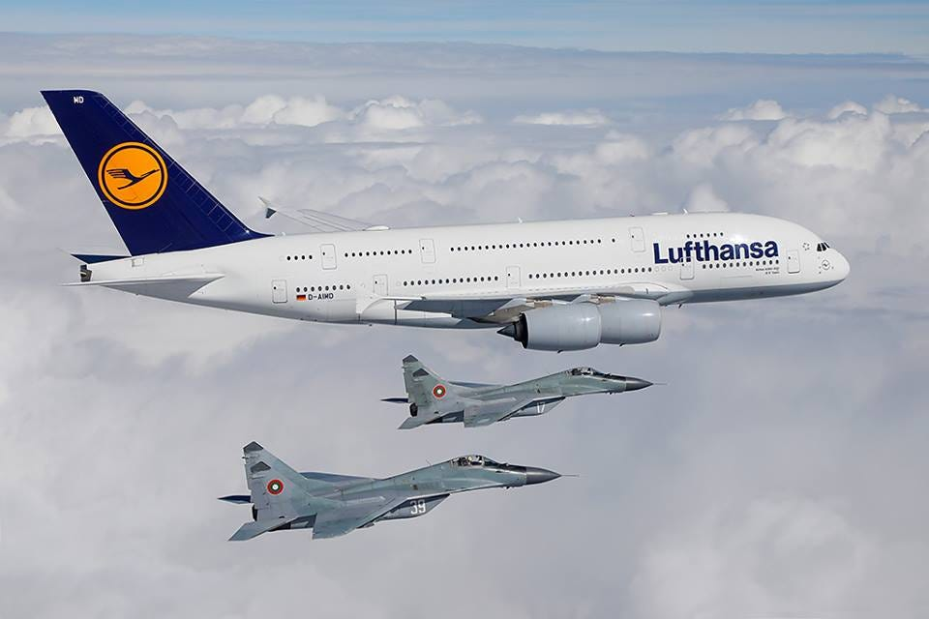
Is It Really Possible?
Reading - Psalm 90:1-8

Slide 2
The Airbus A380
The A380 is the largest and heaviest passenger aircraft in the world.
It seats 509 passengers and is 73 meters long, 24 meters high, and has a takeoff weight of up to 560 tons.
It is the world's largest passenger airliner and only full-length double-deck jet airliner.

Slide 3
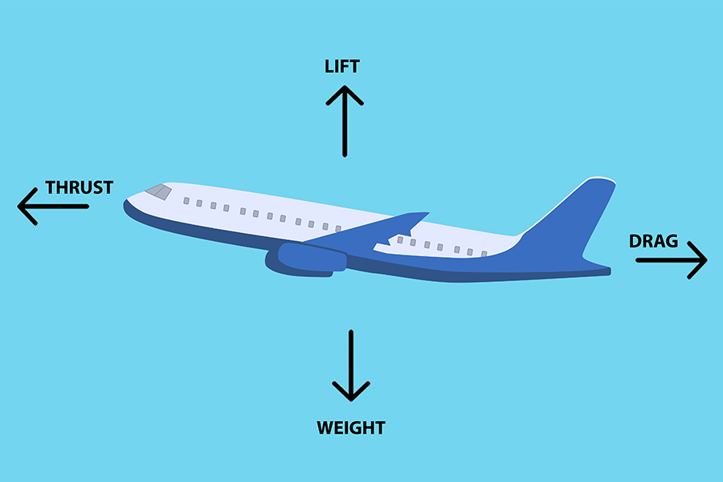
What Does It Take to Get off the Ground?
Lift
Weight
Drag
Thrust

Slide 4
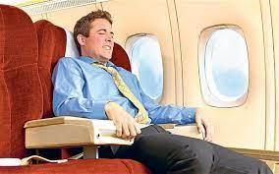
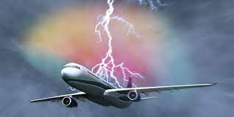
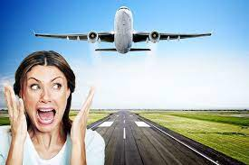
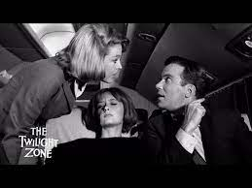
Afraid of Flight?
Lack of Control
Possibility of crashing
Want To Play It Safe
Not prepared to die

Slide 5
Lack of Control a.k.a Faith
You have to understand that you are NEVER completely in control in any aspect of life on earth.
We need to give up the wheel [humility] to the pilot of our soul.
Proverbs 3:5-6
Psalm 23 [excerpts]
James 4:10 Note the word “LIFT”

Slide 6
Possibility of Crashing a.k.a Sinning
You cannot live a sinless life Romans 3:23 & Romans 6:23
That is why we NEED a Savior!
Hebrews 12:1-2 Note the word “Weight”
1 Timothy 6:9-10 Don’t let the world “Drag” you down!
2 Peter 2:20-22

Slide 7
Want To Get To a Destination but “Want to Play it Safe”
1 Corinthians 9:27 Don’t believe the Devil’s lie that once you are saved you are always saved.
Philippians 3:12-14 Note the word “Press a.k.a.Thrust’’
1 Corinthians 15:58
Earnestly “Contend” for the faith [Jude 3]

Slide 8
But I Don’t Want To Die!
If you’re not prepared to die then you Better Be Afraid!
Hebrews 9:27
Hebrews 10:26-31

Slide 9
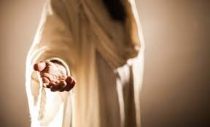
Is It Really Possible To Go To Heaven?
That’s what God wants 2 Peter 3:9-10
Why not accept His invitation and find a “Peace that passes Understanding? [Philippians 4:7]
Matthew 11:28-30

