Slide 1
Rules For Social Media
Reading – James 3:1-12

Slide 2
In the World, But NOT Of the World
Social media is such a big part of our world now. While we shouldn't overreact to the dangers of it, we must not ignore them either.
How we use social media should be discussed among Christians.
Here are some good rules for social networking that I'd like to share with you:

Slide 3
Be careful before you hit “send” James 1:19-20 --- Proverbs 15:2
Could be taken the wrong way.
Does this information need to be kept private?
Will this needlessly offend anyone?

Slide 4
Don’t use Technology to Vent Anger Ephesians 4:26-27
Don’t air family problems.
If you are angry with someone, pick up the phone.
Don't broadcast it to the world

Slide 5
Do Not lie Colossians 3:9-10
Revelation 21:8
Consequences!
Embellishment is the SAME as lying

Slide 6
Do Not Glorify Yourself Matthew 6:5, 7 & 16
Hide The Good You Do
Advertise what is done FOR you.
Always give GOD the glory

Slide 7
Watch Out For Ungodly Influences 1 Corinthians 15:33
Lemonade?
Beware of worldly thoughts
Not Everything is seen as funny.
Gossip

Slide 8
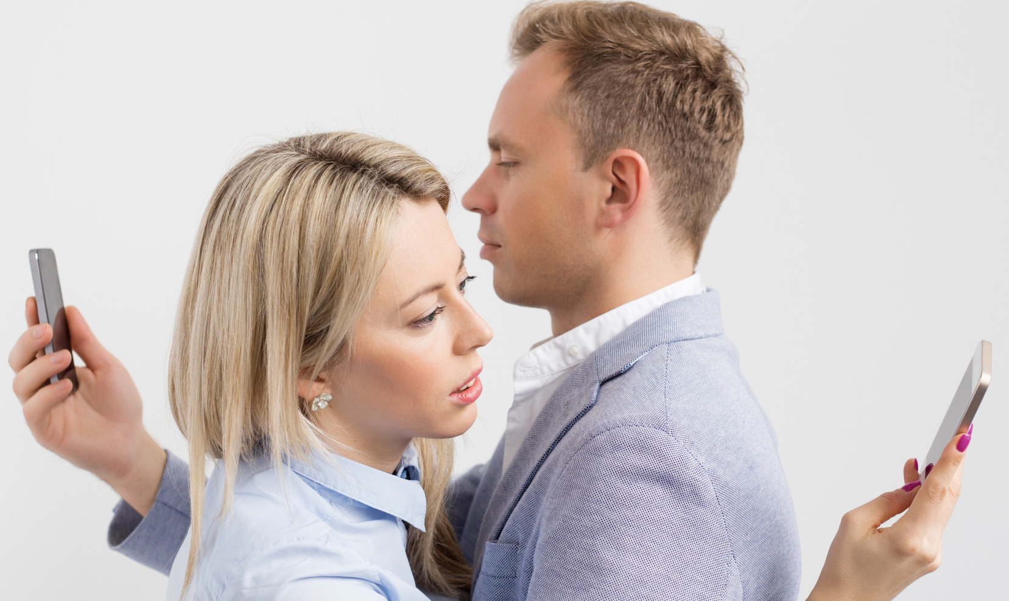
Beware of Addiction to technology 1 Corinthians 6:12
With smart phones we're almost always connected.
It can take over you life.
Give GOD first place in everything

Slide 9
Use social networking in a positive way Ephesians 4:29
Colossians 4:6
Matthew 5:14-16
Always give GOD the glory

Slide 10
Think before you ACT
When your ultimate desire is the glory of God you can't go wrong.

