Slide 1
Tact
Proverbs 16:21-25

Slide 2
Tact: Cleverness or skill and sensitivity in dealing with others or with difficult issues.

Slide 3
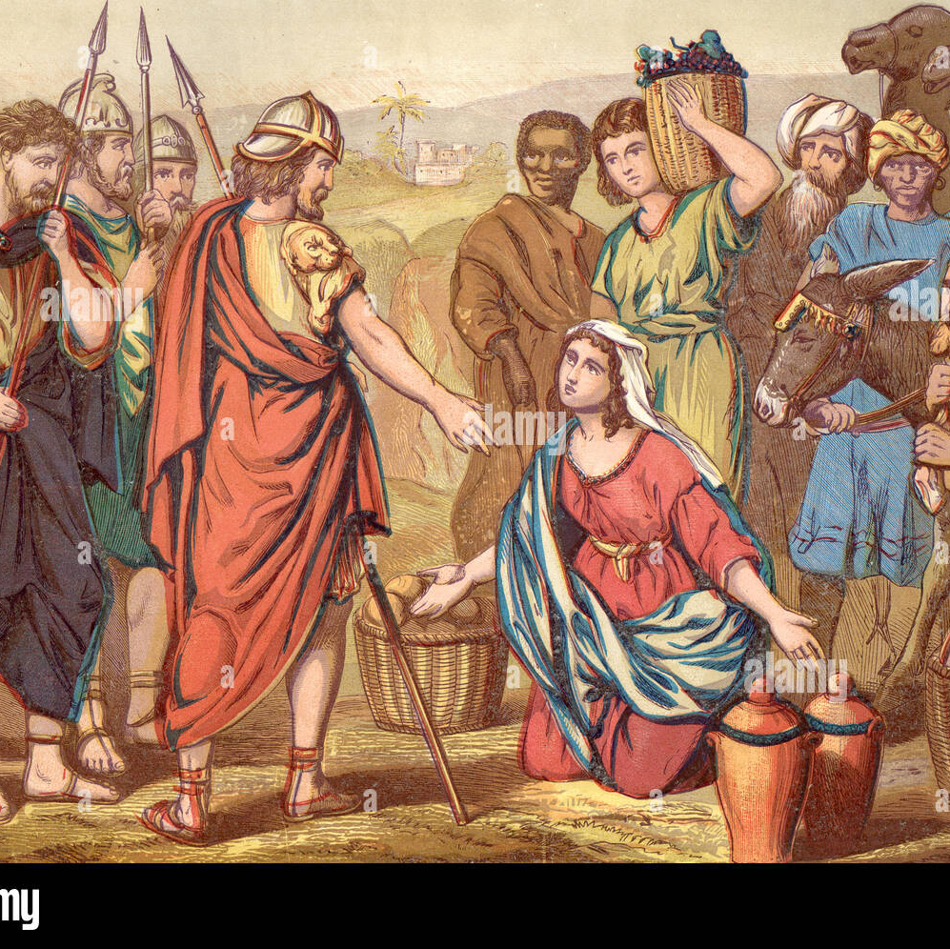
Example 1: David and Abigail.
1 Samual 25:2-40
Vs 5-12
Vs 13-17
Vs 21-22
Vs 23-31
Vs 32-35

Slide 4
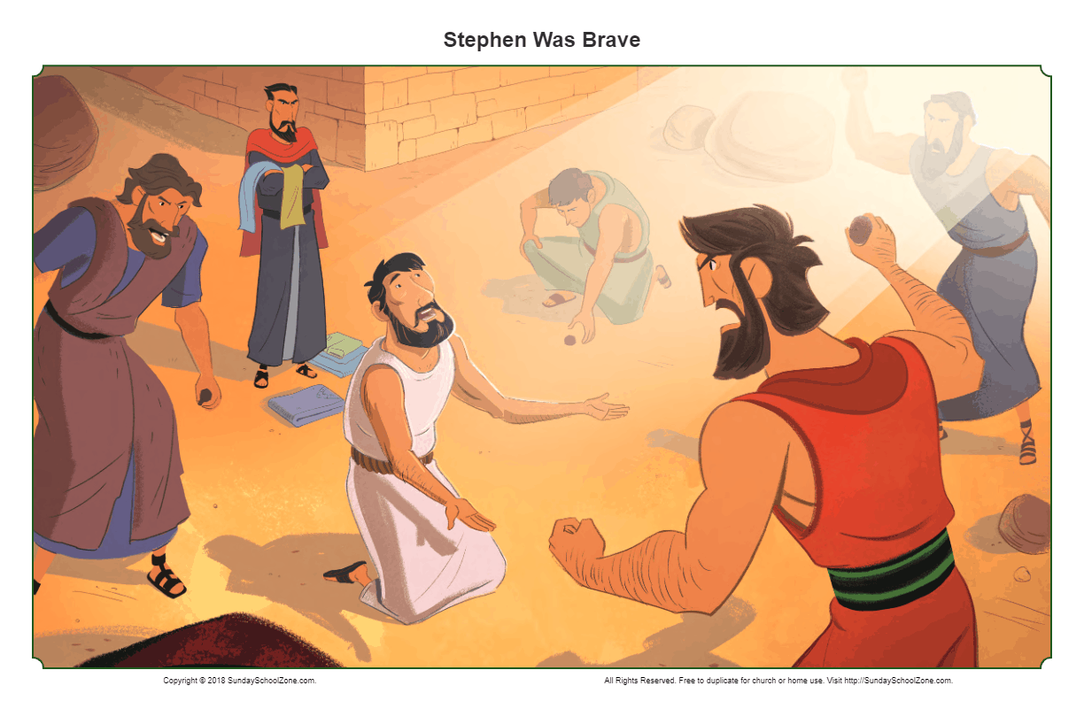
Example 2:Peter and Stephen Acts 2:14-37, Acts7:2-53
Hebrews 4:12
For the word of God is living and active and sharper than any two-edge sword and piercing as far as the division of soul and spirit, of both joints and marrow, and able to judge the thoughts and intentions of the heart.
Galatians 6:1
Brethren, even if anyone is caught in any trespass, you who are spiritual, restore such a one in a spirt of gentleness; each one looking to yourself, so that you too will not be tempted.
Notes:
Peter’s sermon:
If he would have led with Vs 37, would he have been as effective.
Both started with Scripture to establish some commonality. Then the hard truth was told at the end.
Both use the sword of the spirt (the word of God correctly) both times it cute deep to the audience.
Stephen’s Sermon:
Was he led by the spirt in Vs 51. His comments were blunt but honest.
Sometimes it’s necessary for to be blunt, but we must be prepared for the consequences.
Gal 6:1 the goal is to Restore
Paul used the same technique
When studding with someone with a different doctrine, start with scripture.
Gal

Slide 5
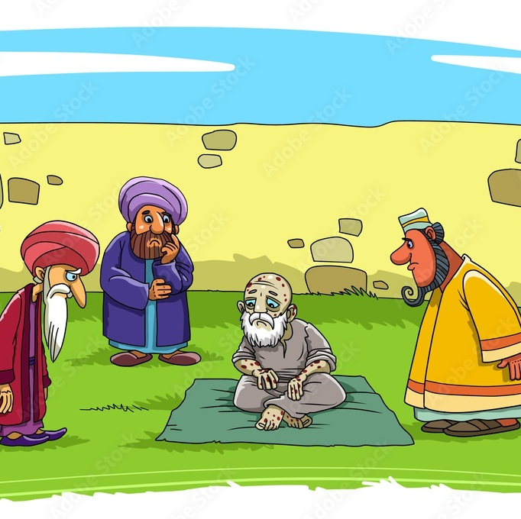
Example 3: Job and his friends Job 2:11-13
What to say when someone is in pain.
Vs 13
I’m praying you.
I’m here for you.
Is there anything I can do to help?
Where would you like me to put the food that I brought for you?

Slide 6
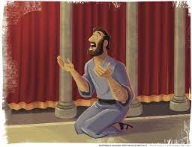
Example 4: Petition to God Psalm 57
There is a common theme to most of David’s prayers
Petition
Praise
Gratitude
Do we remember these when we pray?

