Slide 1
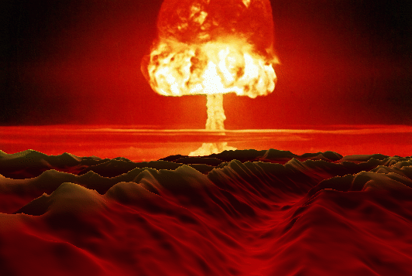
The End Times
Reading – 1 Corinthians 15:19-26

Slide 2
The End
Reading – 1 Corinthians 15:19-26

Slide 3
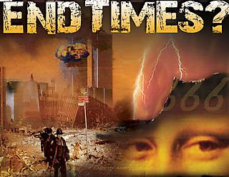
People are preoccupied with the end of the world.

Slide 4
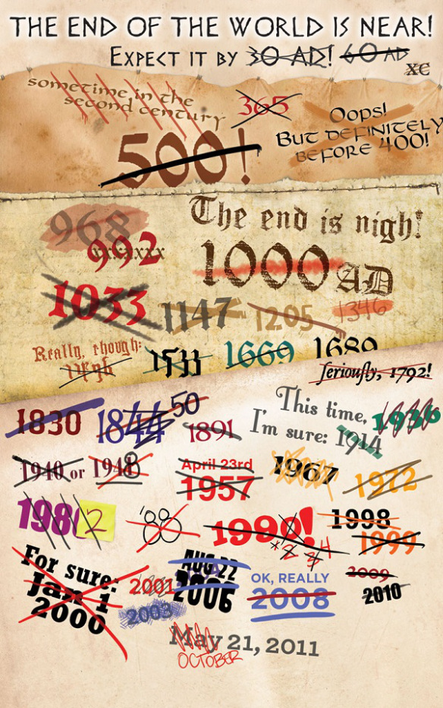
Even if we could know about the end of the world, what could we do to stop it?
We are only interested in the truth
(John 8:32) "And you shall know the truth, and the truth shall make you free."

Slide 5
Why All The Speculation?
Perhaps - If I can get you to believe that I have a corner on the happenings of future events, then I must have a grasp of what you need to know now.
(Matthew 24:36) "But of that day and hour no one knows, not even the angels of heaven, but My Father only.

Slide 6
Why All The Speculation?
(Matthew 24:36) "But of that day and hour no one knows, not even the angels of heaven, but My Father only.
The end of the world is not a matter of IF but WHEN, and NO ONE KNOWS when that will be.

Slide 7
The Bible indicates 7 things that will happen at the end of the World.

Slide 8
Jesus shall return: 1 Corinthians 15:23-24
No passage states that Jesus will return back to earth.
(1 Thessalonians 4:17)
If Christ was returning to earth what would he do? "It is finished" John 9:4
(Hebrews 9:28)
A man wrote a book titled "88 reasons why rapture will be in 1988."(Mark 13:32)

Slide 9
The dead will be raised:
Every time one goes to the silent city of the Dead, Jesus assures us they will rise again. (John 5:28-29)
(Acts 24:15)
Some say that 1 Thessalonians 4:16 teaches two resurrections. (1 Thessalonians 4:16)

Slide 10
Context of 1 Thessalonians 4
They were worried about their departed loved ones.
The context shows that the dead will not proceed the living, but that "both shall be caught up together in the air-and so shall we ever (forever) be with the Lord."

Slide 11
the Living will be changed:
(1 Corinthians 15:50-52)
When we pass from this earthly existence it will take place quickly.
It’s the Devil who says, “Don't worry about being saved now. Wait until end of time to be saved in moment twinkling of an eye.”

Slide 12
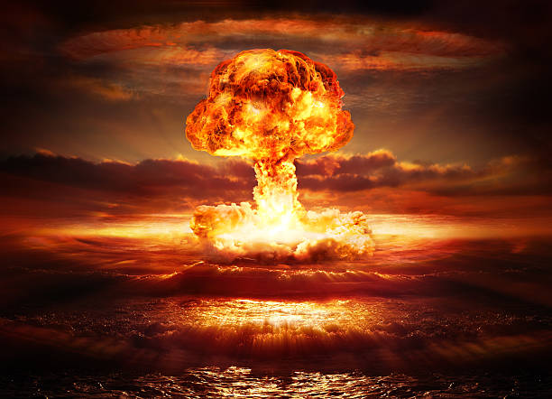
This present earth will come to a close:
It will not last forever-
(2 Peter 3:9-17)

Slide 13
A judgment of all men:
(Hebrews 9:27)
(Ecclesiastes 12:13-14)
(2 Corinthians 5:10)
(Romans 14:11-12)
(John 5:22)

Slide 14
“That’s nobody’s business but mine. I demand my privacy”!
I have a clue for you, you NEVER have any privacy because someone is always watching.
Think about it!

Slide 15
Christ will give up his earthly Reign:
(Matthew 16:18-19)
What Jesus alluded to was the prophecy of Daniel concerning His earthly kingdom. (Daniel 7:14)
(1 Corinthians 15:25-28)
When Jesus does come again, His earthly reign will end, not begin.

Slide 16
the final point is…
Christ will receive the church, the kingdom and deliver it to the Father that the Father may be all in all.
(Ephesians 5:22-27)
The church is the bride of Christ.
Some day the bridegroom will take His bride home to present her to the Father.
This will happen when Jesus comes again.
(Colossians 1:13-14)

Slide 17
Did you notice that we don’t have to go to the book of Revelation to prove anything about the end of the world?

Slide 18
The end of the world has already come in various forms.
Noah saw the end of the world with the great flood.
Jerusalem saw the end of their world with the destruction of Jerusalem in 70 AD.
Rome was told of the end of their world in the Book of Revelation.
The day you take your final breath will mark the end of your world.

Slide 19
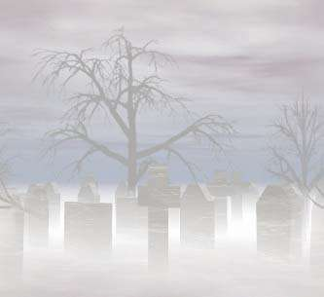
Should the end of your world come right now, how will you stand?
(1 Thessalonians 5:4-11)

