Slide 1
The Spirit & The Understanding Part 35
Reading -- 1Corinthians 14:1-15

Slide 2
Singing Is Not An Afterthought
Exodus recalls the song of freedom
The Psalms were all meant to be sung.
Isaiah has 17 references to singing in various ways.
Ephesians 5:17-20 Therefore do not be unwise, but understand what the will of the Lord is. And do not be drunk with wine, in which is dissipation; but be filled with the Spirit, speaking to one another in psalms and hymns and spiritual songs, singing and making melody in your heart to the Lord, giving thanks always for all things to God the Father in the name of our Lord Jesus Christ,
See also Colossians 3:16

Slide 3
Let’s Examine 5 Songs We Sing
Sweet Hour Of Prayer # 827
Because He Lives # 464
Low In The Grave He Lay # 344
He Lives # 346
Victory In Jesus # 470

Slide 4
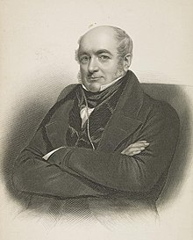
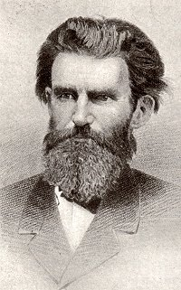
Sweet Hour Of Prayer - 827
Words By William W Walford (1845)
Music By William B Bradbury (1861)
Scriptures:
Deuteronomy 34:1; Matthew 7:11;Matthew 21:22; Ephesians 6:18

Slide 5
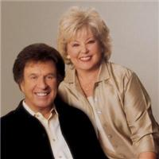
Because He Lives -- 464
Words & Music By William & Gloria Gaither (1971)
Scriptures:
John 14:29; Ephesians 2:4-7; Philippians 3:10

Slide 6
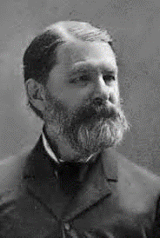
Low In The Grave He Lay -- 344
Words & Music by Robert Lowrey (1874)
Scriptures:
Luke 24:6-7; John 19:41-42; Acts 2:22-24; Romans 6:8-9

Slide 7
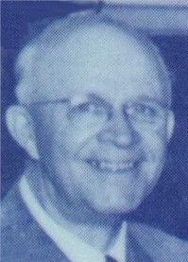
He Lives – 346
Words & Music by Alfred H Ackley (1933)
Scriptures:
Matthew 28:6; Philippians 3:10; Revelation 1:18

Slide 8
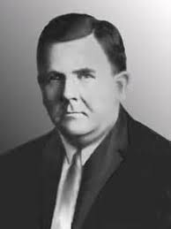
Victory In Jesus -- 470
Words & Music by Eugene M Bartlett (1939)
Scriptures:
John 15:16; Romans 5:8:1Corinthians 15:57; 1 John 5:4

