Slide 1
What Part Of NEW Covenant Don’t you Understand?
Reading- Jeremiah 31:31-34​

Slide 2
The Bible Dictionary
“The gospel is so arranged that principles and ordinances are received by covenant, placing the recipient under strong obligation and responsibility to honor the commitment.”
[1] The importance of covenants is emphasized by the fact that some form of the word covenant is found 555 times .​

Slide 3
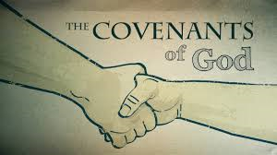
First Covenant
The Marriage Covenant – Genesis 2:24
Reinforced twice by Jesus in Matthew 5:31-31 & 19:5-6
Second Covenant
Genesis 9:8-13
Promise of NO GLOBAL WARMING!
BTW God sanctioned Capital Punishment in verse 6

Slide 4
1. Land Promise – Joshua thru David established Israel 2. Nation Promise – Isaac, Jacob/Israel, etc. 3. World Promise – All Nations will be blessed
Abraham 3-fold Covenant
Book of Genesis (11:27-25:11)

Slide 5
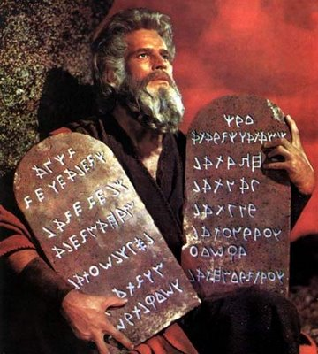
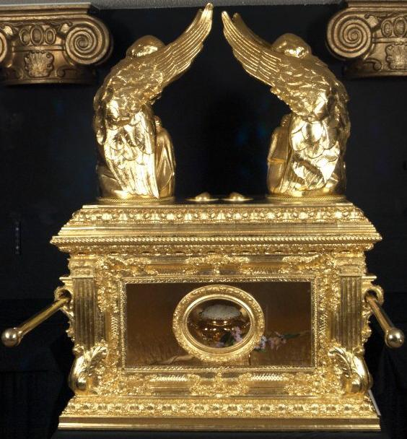
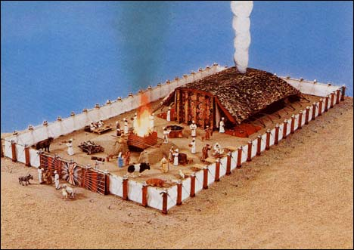
The “Law”
Did not Apply to Abraham, Isaac or Jacob/Israel
Did not apply to the “Nations” [a.k.a. Gentiles]
Circumcision Covenant with Abraham Genesis 17:10-14
Bound ONLY on Israel
Dietary Restrictions – Fasting – Tithing – Ark of Covenant
Levitical Priesthood -- Animal Sacrifices -- Tabernacle
Feast Days “Holy Days of Obligation” – Sabbath!!!
No Working on the Sabbath... And MANY more!
Colossians 2:12-16

Slide 6
“It Is Finished” – John 19:30
Matthew 27:51-52
Hebrews 9:24-26
Hebrews 9:16-17
Hebrews 10:25-31
Acts 20:7

Slide 7
Then, Why?
Galatians 1:6-8
Willingly go back to the OLD covenant
Continue to observe the 10 Commandments
The New Covenant improves them Ephesians 4:28
1 Corinthians 16:1-2 & 2 Corinthians 9:7
Demand Tithing
John 14:6
Pray to another god, saint or goddess
Continue to Say the “Lord’s Prayer”
Matthew 6:9-13, Luke 11:1-4

Slide 8
Area of Focus​
Matthew 6:9-13 - "This, then, is how you should pray: "Our Father in heaven, hallowed be your name, your kingdom come, your will be done, on earth as it is in heaven. Give us today our daily bread. And forgive us our debts as we also have forgiven our debtors.
Establish meaning by way of:
ROI​
​
Context,
Context,
Context​

Slide 9
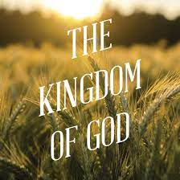
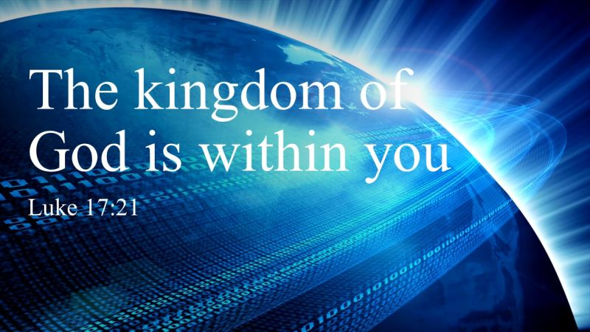
Jesus was on a Mission
He was preaching and teaching about the “Kingdom of God”
His parables were meant to teach that the Kingdom was like…
He repeats often that the Kingdom of God is “At Hand”
His audiences were instructed to look for and pray for this Kingdom.
Matthew 16:28, Mark 9:1, Luke 9:27 – They would live to see this happen!
The Kingdom was established /fulfilled on the day of Pentecost [Acts 2]
The kingdom of God is “within you” Luke 17:21

Slide 10
Why Pray for something that is already here?
Galatians 3:26-27
When you are IN CHRIST, you are a SAINT and part of a ROYAL PRIESTHOOD.
Romans 6 instructs us of the process of being born again with Christ in baptism.
“We should also walk in newness of life.”

Slide 11
What Part Of the NEW Covenant Don’t you Understand?

