Slide 1
Biblical Christianity Is Unique
Reading – John 14:1-11

Slide 2
Is Christianity unique among world religions?
OR - Is it only a variation on a basic theme running through all religions?
"Does not the sincere Muslim, Buddhist, Hindu or Jew worship the same God as we do, but under a different name?“
OR - "Is Jesus Christ the only way to God”?

Slide 3
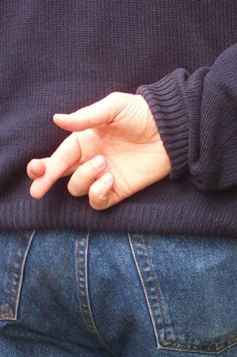
The Question of TRUTH
“What Is Truth?”

Slide 4
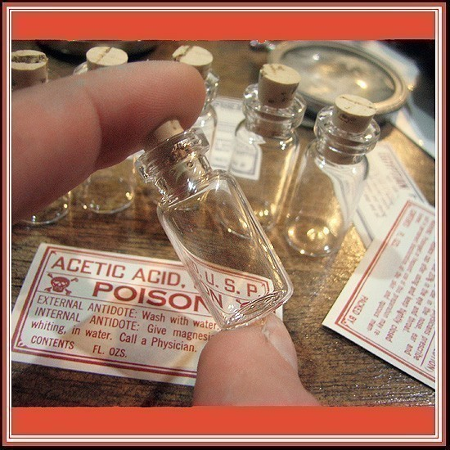
Sincerely believing something does not make it true.
False religion is like picking the wrong bottle out of a medicine cabinet in the dark, no matter how sincere or how intense the faith is.

Slide 5
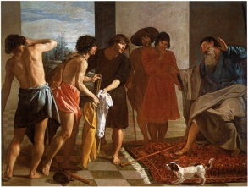
Believing something doesn't make it true
Failing to believe truth does not makes it false.
(Genesis 37:31-35)

Slide 6
Believing something doesn't make it true
Failing to believe truth does not makes it false.
(Genesis 37:31-35)
(Proverbs 14:12)
(Acts 26:9-11)

Slide 7
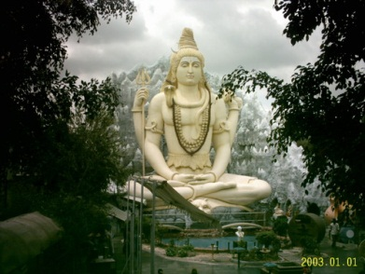
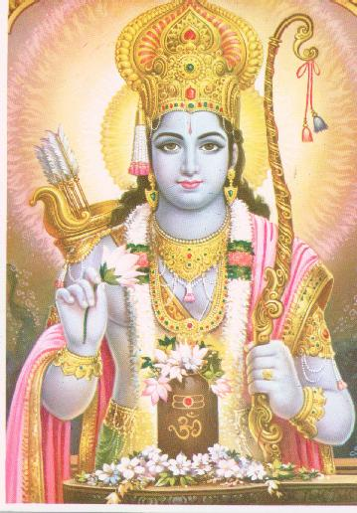
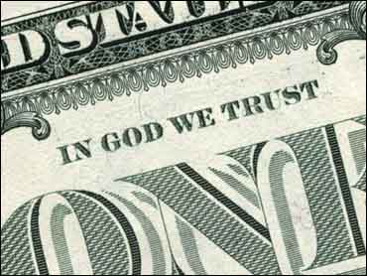
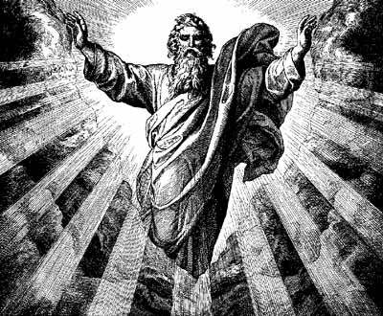
The Concept of God
Who or What?

Slide 8
The Bible presents God distinct and separate from the Creation
(Hebrews 1:10-12)
(Nehemiah 9:6)
The Bible states simply and plainly in (Genesis 1:1) In the beginning God created the heavens and the earth.
The God of the Bible is self-sufficient (Acts 17:25)

Slide 9
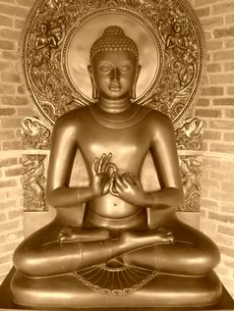
Buddhist CONCEPT OF GOD:
: 'God in the objective, personal sense does not fit into the 'Buddhist system'...the founder taught neither prayer nor praise; he offered neither redemption, nor forgiveness, nor heaven; he warned of no judgement and no final hell. He refused to speculate on ultimate reality or the First Cause…He was silent regarding any future life.
Buddha was agnostic about the whole question of whether God even existed'.
This presents a big problem with (Hebrews 11:6)

Slide 10
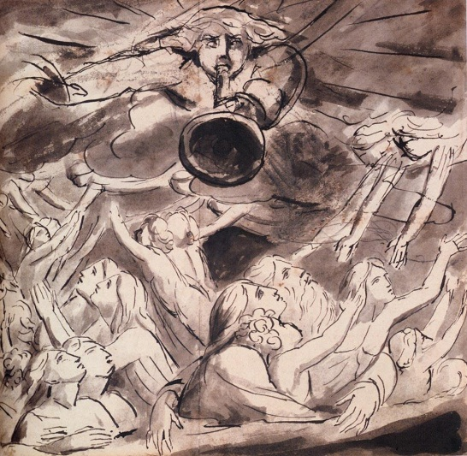
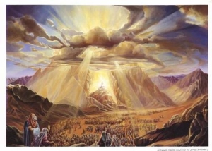
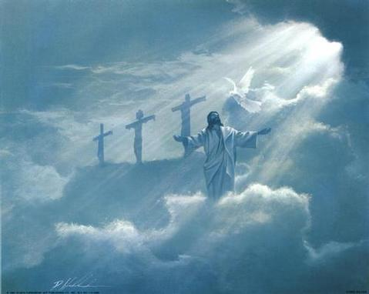
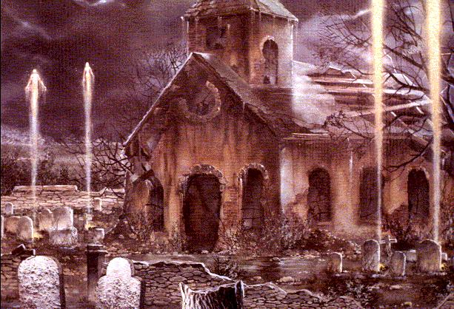
The Resurrection
“We shall be changed”

Slide 11
“There is no place whatever for the idea of the resurrection of the body in the Hindu scheme of things.”
Hinduism & Buddhism: Both religions are based upon the concept of reincarnation, which eliminates the need for a resurrection.
(John 5:28-29)

Slide 12
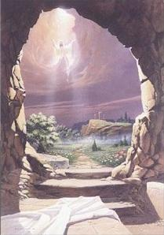
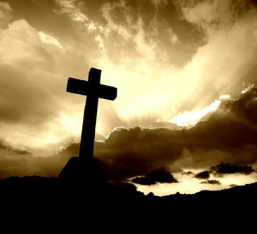
Death of the Christ
Matthew 16:21

Slide 13
The Koran denies that Jesus died upon the cross
"and have said, verily we have slain Christ Jesus the son of Mary, the apostle of God; yet they slew him not, neither crucified him, but he was represented by one in his likeness, and verily they who disagree concerning him were in a doubt as to this matter, and had no sure knowledge thereof, but followed only an uncertain opinion. They did not really kill him" (Koran. pp. 78-79)

Slide 14
(Luke 24:46)
What is left of Christianity, if you remove a crucified Jesus from it?
(1 Corinthians 1:23)
(1 Corinthians 15:1-4)

Slide 15
Hindu philosophy has no need for a Savior:
'Sin for the Hindu, is not the personal moral guilt it is for the Christian and the Jew. It is a sin (in Hinduism) to call a man a sinner'. (The World's Religions. Edited by Sir Norman Anderson pp. 144-145)
If you accept the Hindu definition of sin then Jesus sinned, for He called people 'sinners'. (Matthew 9:13)
(John 8:24)

Slide 16
Deity of Jesus
1 Corinthians 15:1-4; 17-18

Slide 17
Preaching any 'other gospel' brings upon one the curse of God (Galatians 1:6-9).
Islam denies Jesus of deity.
Obviously, one of these views must be wrong, Islam and Christianity cannot both be true.

Slide 18
The Koran makes the following statements:
'They are infidels, who say, Verily God is Christ the son of Mary' (p. 84)
'Christ, the son of Mary is no more than an apostle' (p. 92)
'Christians say, Christ is the Son of God. This is their saying in their mouths, they imitate the saying of those who were unbelievers in former times. May God resist them' (p. 152)
(John 1:1) In the beginning was the Word, and the Word was with God, and the Word was God.

Slide 19
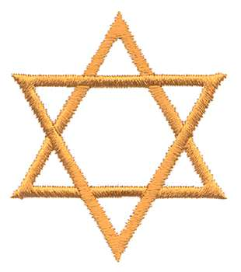
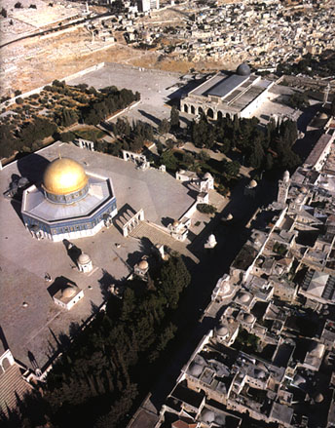
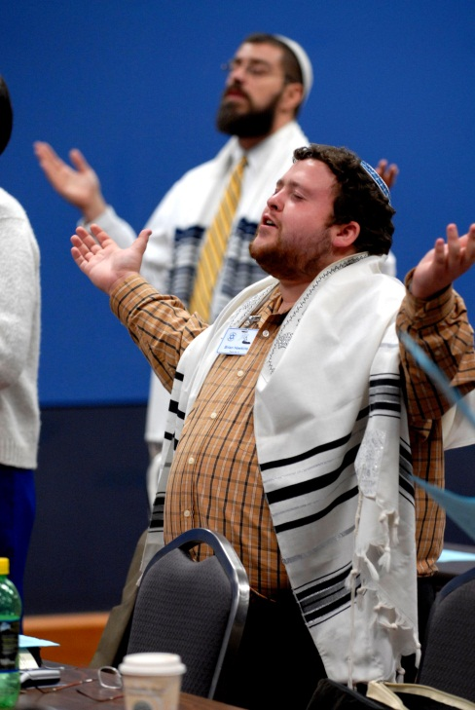
Judaism
Judeo-Christian Ethics

Slide 20
“Isn't the God they worship the God of the Old Testament, which we accept?”
Surely we can get together on this!
On a closer examination, we find that the Jews would not admit that their God was the Father of Jesus the Christ.
(John 8:42)
Jesus plainly asserts that accepting Him determines whether God is Father or not.
You cannot accept the God of the OT without accepting Jesus as well as being God. (Matthew 10:40)

Slide 21
The Old Testament Scriptures spoke of Jesus
(John 5:46)
The Psalms & the prophets are filled w/prophecy.
There are too many 'evidences' that link Jesus with Jehovah. (Matthew 3:17)
Jesus didn't give us a choice of many religious roads which all lead to God. Jesus presented only one road. (Matthew 7:13-14)

Slide 22
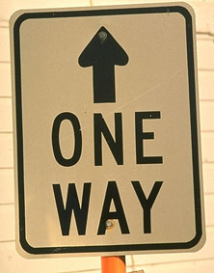
A Unique Road TO Heaven
There are two ways from the grave -- the way to Paradise/ Heaven and the way to Torments/Hell.
On the other hand, there is only "one way" to Heaven, and that is the Lord Jesus Christ.

Slide 23
(John 14:6)
If you want to be sure of a home in Heaven, obey Him today.

