Slide 1
Endurance
James 1:2-3

Slide 2
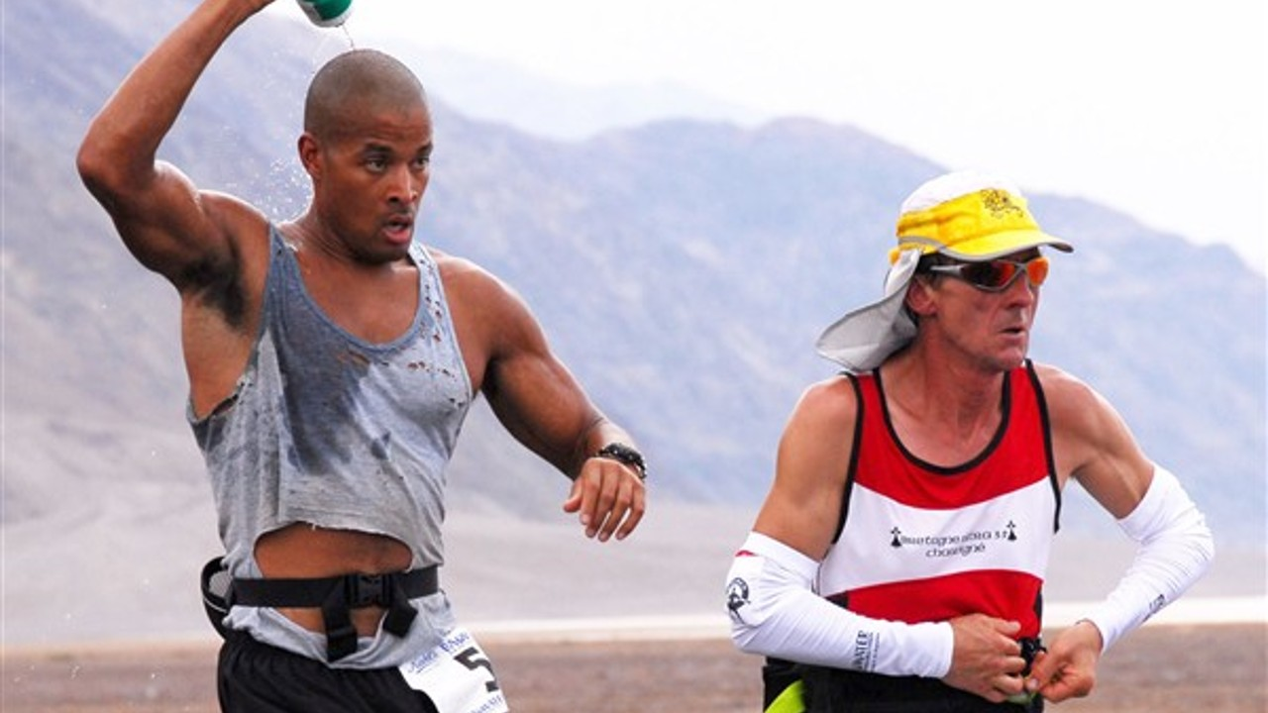
Endurance Defined
Badwater 135
Oxford Definition: “The fact or power of enduring an unpleasant or difficult process or situation without giving way.”
NSCA Definition: “A group of muscles that can generate sub-maximal force over a sustain amount of time or through repeated movements.”
Self-Transcendence 3100
Grand-to-Grand 147
Hurt 100

Slide 3
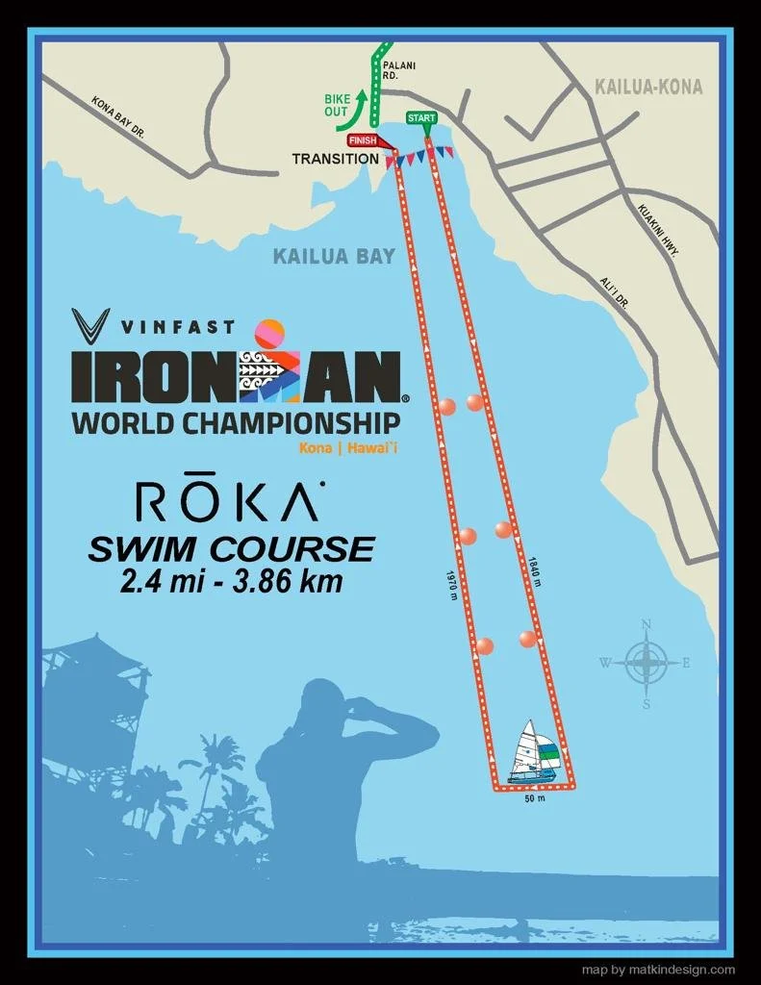
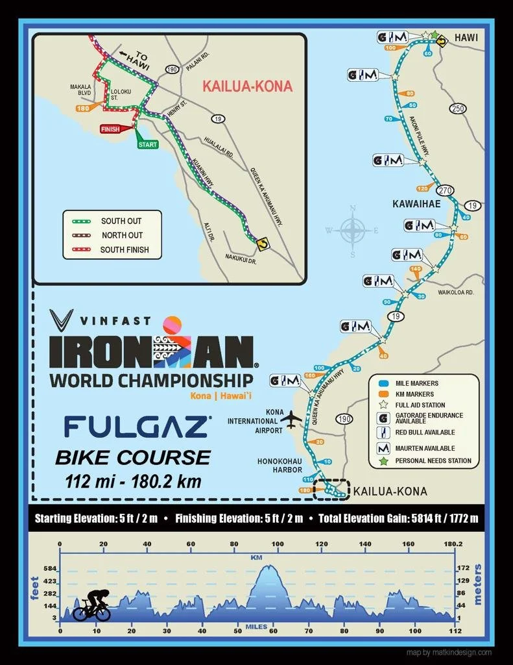
Endurance Defined

Slide 4
Biblical Endurance
Defined: “ὑπομονὴ” (hoop-om-on-ay’) Hupomonē :
1) steadfastness, constancy, endurance
a) in the NT the characteristic of a man who is not swerved from his deliberate purpose and his loyalty to faith and piety by even the greatest trials and sufferings
b) patiently, and steadfastly
2) a patient, steadfast waiting for
3) a patient enduring, sustaining, perseverance

Slide 5
Endurance Applied
There are 32 verses that use or reference the word hupomonē:
Luke 8:15, Luke 21:19, Romans 2:7, Romans 5:3-4, Romans 8:25, Romans 15:4-5, 2 Corinthians 1:6, 2 Corinthians 6:4, 2 Corinthians 12:12, Colossians 1:11, 1 Thessalonians 1:3, 2 Thessalonians 1:4, 2 Thessalonians 3:5, 1 Timothy 6:11, 2 Timothy 3:10, Titus 2:2, Hebrews 10:36, Hebrews 12:1, James 1:3-4, James 5:11, 2 Peter 1:6*, Revelation 1:9, Revelation 2:2-3, Revelation 2:19, Revelation 3:10, Revelation 13:10, Revelation 14:12
*Used twice in same verse.

Slide 6
Endurance Applied
James 1:2-4 “Count it all joy, my brothers, when you meet trials of various kinds, for you know that the testing of your faith produces steadfastness. And let steadfastness have its full effect, that you may be perfect and complete, lacking in nothing.”
Do we count our sufferings as blessings?

Slide 7
Endurance Applied
Hebrews 12:1-17 ““Therefore, since we are surrounded by so great a cloud of witnesses, let us also lay aside every weight, and sin which clings so closely, and let us run with endurance the race that is set before us, looking to Jesus, the founder and perfecter of our faith… Consider Him who endured from sinners such hostility against Himself, so that you may not grow weary or fainthearted… but He disciplines us for our good, that we may share his holiness. For the moment all discipline seems painful rather than pleasant, but later it yields the peaceful fruit of righteousness to those who have been trained by it. Therefore lift your drooping hands and strengthen your weak knees, and make straight paths for your feet, so that what is lame may not be put out of joint but rather be healed.

Slide 8
Endurance Applied
2 Peter 1:3-11 “His divine power has granted to us all things that pertain to life and godliness, through the knowledge of him who called us to his own glory and excellence, by which he has granted to us his precious and very great promises, so that through them you may become partakers of the divine nature, having escaped from the corruption that is in the world because of sinful desire. For this very reason, make every effort to supplement your faith with virtue, and virtue with knowledge, and knowledge with self-control, and self-control with steadfastness, and steadfastness with godliness, and godliness with brotherly affection, and brotherly affection with love. For if these qualities are yours and are increasing, they keep you from being ineffective or unfruitful in the knowledge of our Lord Jesus Christ. For whoever lacks these qualities is so nearsighted that he is blind, having forgotten that he was cleansed from his former sins. Therefore, brothers, be all the more diligent to confirm your calling and election, for if you practice these qualities you will never fall. For in this way there will be richly provided for you an entrance into the eternal kingdom of our Lord and Savior Jesus Christ.”

Slide 9
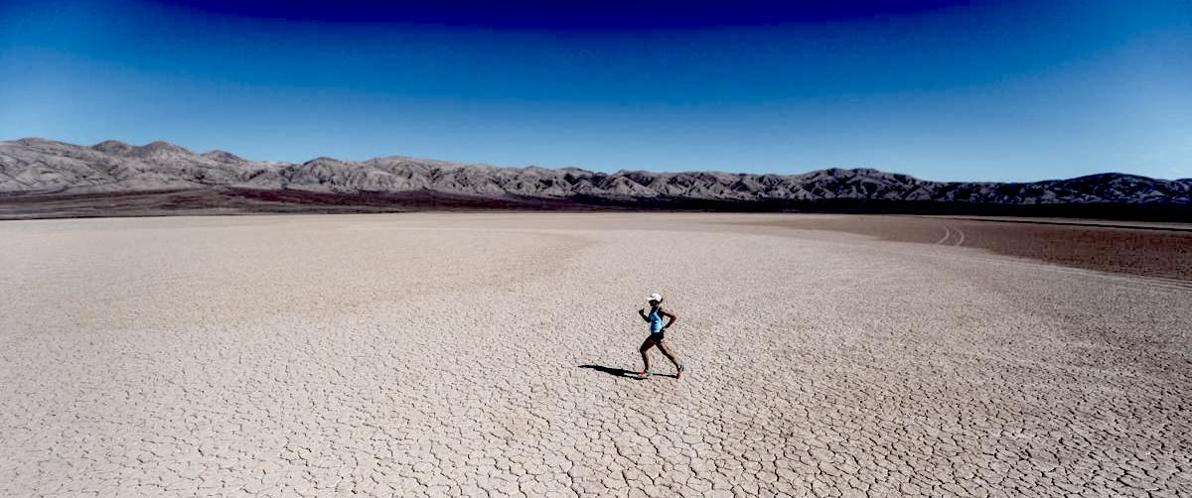
Endurance is running the race regardless of the finish line.
“Lazy people do a little work and think they should be winning. Winners work as hard as possible and still worry if they're being lazy.” - Lewis Caralla
Keep Running The Race.

