Slide 1
Role of The Individual and The Collectivity
Reading: Galatians 6:1-10

Slide 2
Misunderstanding over the meaning of “church”
Similar misunderstanding over the nature of the church’s actions and that of individual’s actions.
Slogan #1:“Whatever the individual does, the church does.
Slogan #2:“Whatever the individual can do, the church can do”

Slide 3
“Whatever the individual does, the church does.”
The church is a collective noun,
Although it is comprised of individual members, they don’t always do everything in unison
The legs can’t do anything that the lungs can do; neither can the kidneys support the weight of the body as the feet do.

Slide 4
Perfect Example
Matthew 18:15-17

Slide 5
Individual vs. Collective
If your brother trespasses against you, go and tell him his fault between you and him alone: [individual action]
if he shall hear you, you have gained your brother. But if he will not hear you, then take with you one or two more, that in the mouth of two or three witnesses every word may be established. [plurality of action]
And if he shall neglect to hear them, tell it unto the church: but if he neglect to hear the church, let him be unto you as a heathen and a publican. [Collective action]

Slide 6
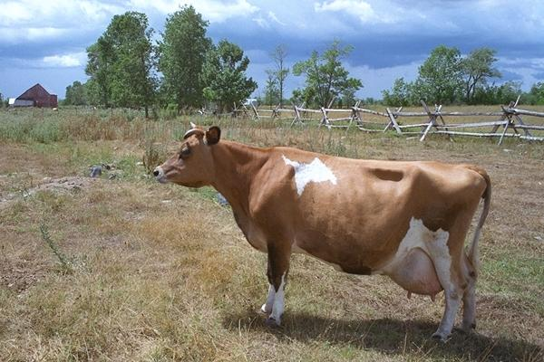
The word “church” by nature must be a collective noun
If there is no difference in the terms then one person can be a church.
One cow can be a herd.
One bird constitutes a flock, etc.

Slide 7
Determining the Purpose
1 Corinthians 8

Slide 8
Corinthians 8 RE: eating meat offered to idols.
In one situation you should eat it. [Verses 4-6]
In another situation you should avoid it. [Verses 7-13]
The purpose for which it is done makes a difference.

Slide 9
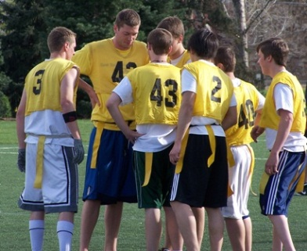
Example
If I were to play ball this afternoon, would this be a work of the church? [No]
If several brethren got together and played ball, would this be considered a work of the church? [ No]
Even if every member of the church played ball, that still would not be a work of the church because it was not the purpose of coming together.

Slide 10
the Difference
1 Timothy 5

Slide 11
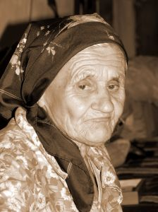
Read verses 4, 8 & 16
Individual responsibility comes first in all cases.
The church can only provide for widows indeed.

Slide 12
What is a Widow Indeed?
A man or woman who has no visible means of support
Who is too old to be gainfully employed [Vs 9] Do not let a widow be taken into the number under 60 years old, having been the wife of one man.
Who also deserves relief because of a life of service to the Lord. [Vs 10] Well reported of good works: if she have brought up children, if she had lodged strangers, if she had been hospitable, if she had relieved the afflicted, if she had diligently followed every good work.

Slide 13
Regarding Finances
The Individual is not as limited

Slide 14
[Ephesians 4:28]
The individual is to work not only to provide for himself, but also for someone he encounters who needs help.
In fact 2 Thessalonians 3:10 says If any would not work neither should he eat.

Slide 15
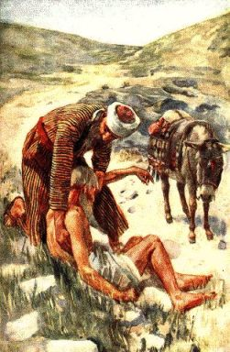
[James 2:15-16]
Notice the individual’s responsibility:
This verse does not suggest that you call the treasurer to take care of it.
Refer to the parable of the Good Samaritan-- the church was not called to act, but the individual.

Slide 16
[1 Corinthians 16:1-2]
Although the individual can earn his treasury in several legal ways, the church as a collectivity has only one source of revenue.
It is the individuals who lay by in store “On the first day of the week” As they are prospered
No bingo, raffles, car washes, bake sales, dinners, concerts or rummage sales.
The Bible does not allow for churches to embark in revenue producing businesses: CD sales, book sales, pictures, clothing, etc.

Slide 17
If there is a difference in the gathering of funds, how can we say there is no difference in the use of funds?

Slide 18
Proper Application
Galatians 6:10

Slide 19
The individual is authorized to do anything good for anybody
The collectivity can only operate in the arena of Bible authority.
Galatians 6:10 does not put the church in the realm of a general Benevolence society. Why?
1. 1 Corinthians 16 said the collection was for needy SAINTS
2. Widow indeed and elders are the only ones mentioned specifically (to the exclusion of all else)
3. The Thessalonians, Ephesians and Timothy were all instructed to take care of their own business and families So the church would not be burdened

Slide 20
If the church was not to be burdened by supporting its own why can we think that the church can be burdened in regard to strangers?

Slide 21
If Galatians 6:10 talks about church action instead of individual action then consider:
The church is to support “good” things.
1. Little League Baseball is a good thing.
2. Then the church can support Little League Baseball
3. That same reasoning can apply to the Girl Scouts, Red Cross, etc.

Slide 22
This passage does not tell us to do benevolence to all men, it tells us to do good.
What is the ultimate good?
To teach the truth.
To save the lost soul from an eternal hell.

Slide 23
Argument: “Well, how can we teach a hungry person? We must take care of his immediate needs.”
Whatever you convert a person with, that’s what you have converted him to.
If you convert a person with hamburgers, when the hamburgers stop coming, so will they.
Jesus was not ignorant that man had immediate needs yet he said, Man does not live by bread alone, but by every word that proceeds from the mouth of God [Matthew 4:4]
[Matthew 6:33]

Slide 24
Why Are There Benevolent Societies
And Other Related Organizations?

Slide 25
Possible Reasons
Laziness -- I don’t want to be bothered with someone else.
Affluence -- Why not pay someone to take care of it for me?
Selfishness -- I’m not willing to share with anyone else.

Slide 26
Possible Reasons
Hypocrisy -- I love my fellow man, it’s just that I don’t want to get my hands dirty in their dirty little lives.
Apathy -- I really don’t care what the Bible would have me do, nor do I care what happens to the peons of this world.
Expediency -- I don’t want to be bothered getting personally involved. Here’s an extra contribution -- You take care of it.

Slide 27
Possible Reasons
Lack of respect for God’s word -- I know what the Bible says, BUT........
[Matthew 7:21-23]

