Slide 1
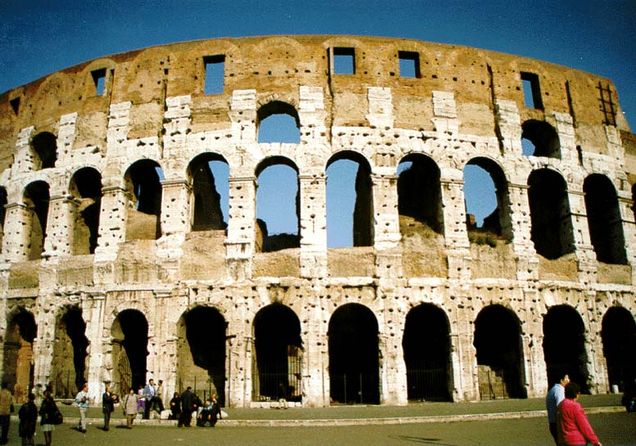
Society of the Early Church
Reading – Romans 1:24-32

Slide 2
A World At War!!!!
We are involved in warfare we may doubt we have the ability to win. Many wonder if there is any hope in bringing any change.
It is easy for us to start feeling like giving up.
After all, the majority of people don’t seem to be interested in the truth anymore.
In view of how society seems to be more resistant to Christianity we sometimes wonder where it is all heading.
1. Can we teach today?
2. Can we even expect to live the Christian’s life today?

Slide 3
Before you allow Satan to discourage you into giving up, meditate on these verses:
1 John 5:4-5
2 Corinthians 10:3-5
Romans 8:37 Yet in all these things we are more than conquerors through Him who loved us.

Slide 4
We are living in perilous times!
Sin is everywhere: Drinking, Lying, Fornication, Drugs, Theft, etc.
Many believe we are living in the “Last Days” because everything is so wicked.
We think we have problems and we do!
Still, we need to understand the society of early Christianity to better understand how we should be living today.

Slide 5
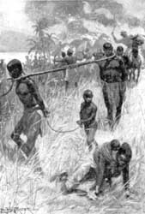
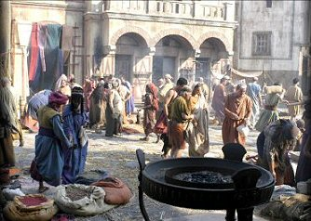
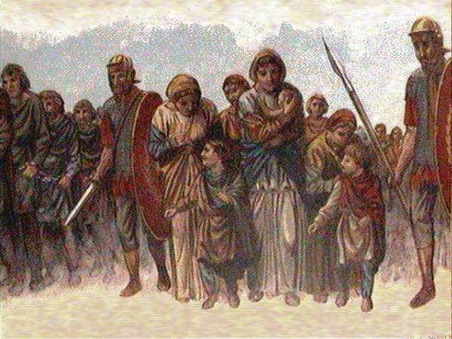
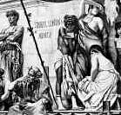
A World Filled With Slavery

Slide 6
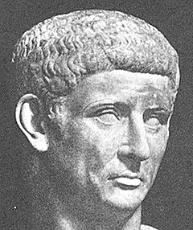
A World Filled With Slavery
Slaves were acquired from war, piracy, kidnapping, slave breeding and debt. There may have been 60 million in the Roman Empire
Pergamum had one slave for every 2 freeman.
One census in Corinth counted 460,000
In Rome, Edward Gibbons estimated half slave - half free in city of nearly one million during the reign of Claudius Caesar. (Acts 18:2)

Slide 7
Abortion & Exposure
Abortion was very common because of poverty among the poorer classes. The more affluent practiced abortion because of fear of pain and disfigurement. Plato and Aristotle recommended it.
Exposure displaced much of the human refuse: Aristotle and Plato said this was a good way to control population. (Claimed they were overpopulated).
Seneca: "We destroy monstrous births; infants also if weak or misshapen we drown. It is not anger by reason to separate the useless from the healthy.“

Slide 8
Divorce and Breakdown of the Family
Seneca: "Women marry to divorce and divorce to marry. Women don't count time by passing of years but in husbands.“
Men lent their wives to others or borrowed other men's wives.
Children belonged to the state instead of the family. Parents didn't want the responsibility.

Slide 9
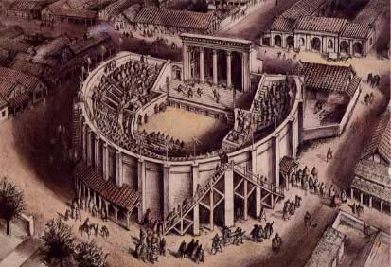
Corrupt Entertainment Is Everywhere
Quote From: Meyer's Rise & Fall of the Roman Empire
“Almost from the beginning the Roman stage was gross and immoral. It was one of the main agencies to which we attribute the undermining of the moral fiber of the Roman society.”

Slide 10
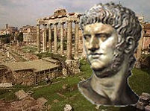
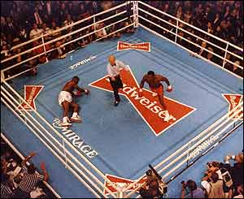
Sport???
The Games became so popular that Augustus and Tiberius had to restrict the numbers attending.
1. Nearly every town had an Amphitheater where Gladiators fought. They were as common as football stadiums today.
2. During reign of Nero, even Senators and affluent women would fight for the thrill of the kill.
How Much Have WE Improved?

Slide 11
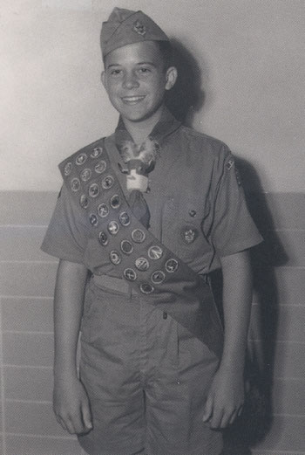
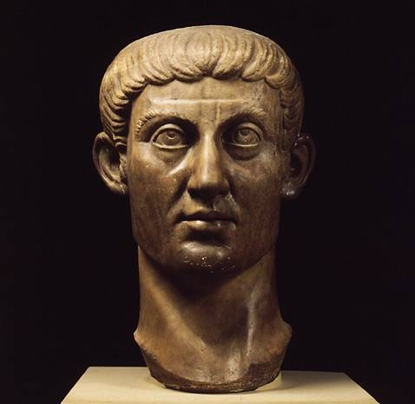
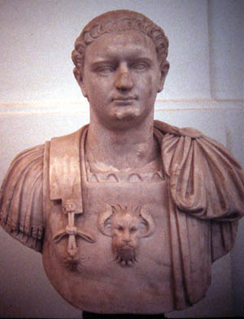
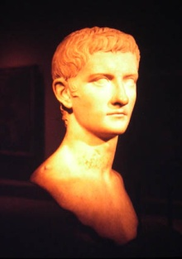
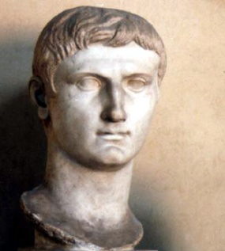
The rulers who were in power in the days of the early church make our world leaders look like Boy Scouts by comparison.
=
Racial tensions, rising crime rate, high unemployment, Inflation, gambling, alcoholism, Pornography, false religion, interest in occult and astrology:
This was LIVING in the First Century?

Slide 12
Can you see why the Holy Spirit inspired Paul to write Romans 1:24-32?

Slide 13
Power of the Gospel - Then
What happened when the gospel was brought to these people?
1. Paul came to one of the worst cities in Empire - Corinth - Acts 18:1-11
2. To call one a "Corinthian" was an insult.
3. Paul spent 1 1/2 years there so he knew the type of background that the members were coming out of. –
1 Corinthians 6:9-11

Slide 14
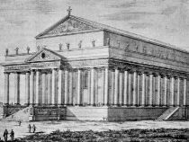
Power of the Gospel - Then
Then there was Ephesus (city of 300,000) Acts 19.
1. The Temple of Diana was a refuge for any criminal within certain distance.
2. Then the Gospel came in and book burning of 50,000 pieces of silver. Acts 19:20 So mightily grew the word of the Lord and prevailed.

Slide 15
Power of the Gospel - Then
The Gospel Prevailed in Jerusalem and Judea - Acts 5:28, 6:7
1. In spite of all the opposition of the Pharisees – hypocritical & legalistic.
2. In spite of the false religion of the Sadducees - liberals, who had no faith in God's Word.
The Gospel Prevailed in Samaria - Acts 8:6, 9:31
1. This was a region of intense hatred, jealousy ignorance.

Slide 16
Power of the Gospel - Then
The Gospel Prevailed in the Uttermost Parts of the Earth
The book of Acts [Acts 11:21, 26, 12:24, 14:1, 21, 16:5, 19:20, 26-27] tells of churches thriving in Antioch, Asia Minor, Corinth, Athens, Ephesus & Rome.
Acts 13:1 Now in the church that was at Antioch there were certain prophets and teachers: Barnabas, Simeon who was called Niger, Lucius of Cyrene, Manaen who had been brought up with Herod the tetrarch, and Saul.

Slide 17
Power of the Gospel - Then
Philippians 4:22 All the saints greet you, but especially those who are of Caesar's household.

Slide 18
Power of the Gospel - Then
Philippians 1:12-13 But I want you to know, brethren, that the things which happened to me have actually turned out for the furtherance of the gospel, so that it has become evident to the whole palace guard, and to all the rest, that my chains are in Christ.

Slide 19
Power of the Gospel - Then
Colossians 1:5-6 because of the hope which is laid up for you in heaven, of which you heard before in the word of the truth of the gospel, which has come to you, as it has also in all the world, and is bringing forth fruit, as it is also among you since the day you heard and knew the grace of God in truth.

Slide 20
Imagine: No radio, TV, Internet, church bulletins, correspondence courses, just people dedicated to spreading the gospel to a lost world.

Slide 21
Power of the Gospel – NOW!
We are promised power to overcome the world, not the spirit of fear. 1 John 4:4 You are of God, little children, and have overcome them, because He who is in you is greater than he who is in the world.

Slide 22
Power of the Gospel – NOW!
2 Corinthians 2:14 Now thanks be to God who always leads us in triumph in Christ, and through us diffuses the fragrance of His knowledge in every place.

Slide 23
Power of the Gospel – NOW!
We are to be "More than conquerors". We are to be bold - not frightened children hiding in a corner.
The first ones mentioned in Revelation 21:8 are the "fearful" (KJV). Revelation 21:8 But the cowardly, unbelieving, abominable, murderers, sexually immoral, sorcerers, idolaters, and all liars shall have their part in the lake which burns with fire and brimstone, which is the second death.

Slide 24
Power of the Gospel – NOW!
Philippians 2:14-15 Do all things without complaining and disputing that you may become blameless and harmless, children of God without fault in the midst of a crooked and perverse generation, among whom you shine as lights in the world.
1. Are you being a light where you live? Being faithful to the Lord?
2. Times may be difficult, but we can succeed in what our Lord has commanded.

Slide 25
Isn’t it time we got busy and stopped making excuses?

