Slide 1
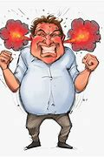
WHO’S In Control?
Text –
James 3:1-18

Slide 2
We OPERATE UNDER THE DELUISION THAT WE ARE ALWAYS IN CONTROL.
Times we feel out of control are not usually pleasant.
No one can be in total control all of the time.
We can only strive to be in control MOST of the time.
One area where we show who’s in control is in regard to our speech.

Slide 3
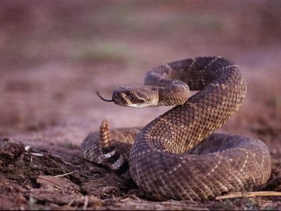
God is longsuffering (2 Peter 3:9)
The one serving God should be longsuffering.
(James 1:19)
A Cornered Rattlesnake will bite itself

Slide 4
Our Venom can come back to Bite Us!
We think we are injuring someone with our speech, but the real harm is inflicted deep within our own soul.

Slide 5
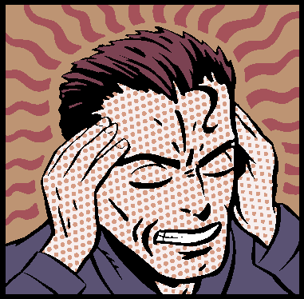
The Power Of The Tongue
Text –
James 3:1-6

Slide 6
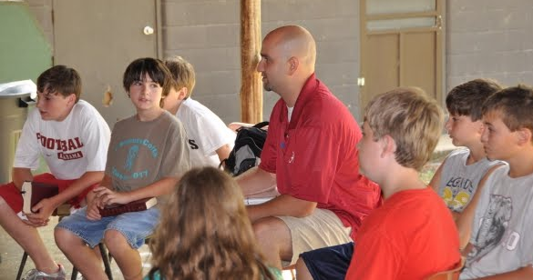
Verse 1
God holds teachers of His truth doubly responsible because those who lead are in a position where we can either draw people toward Christ or drive them away from Him.

Slide 7
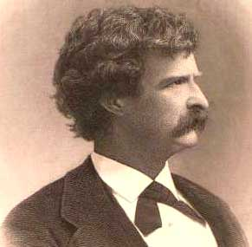
Illustrated in the life of the famous author Mark Twain.
He knew elders and deacons who owned slaves and abused them.
He heard men using foul language and saw them practice dishonesty during the week after speaking piously on Sunday.
That feeling toward the “clergy” is reflected in many of his stories.

Slide 8
It is a privilege to be an elder, a deacon, a Bible schoolteacher
It is also an extreme responsibility that can have extreme consequences.
(Luke 17:1)

Slide 9
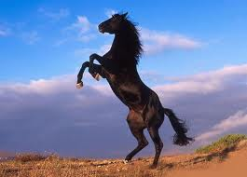
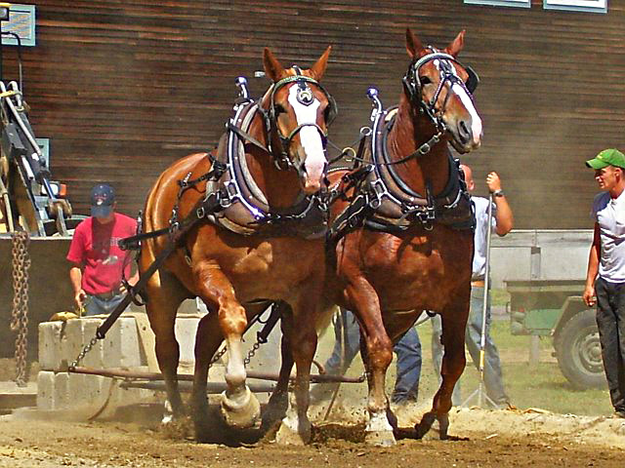
Verses 3&4
Addresses great potential and ability.
Horses have long been considered to be an animal of strength and power.
Was a source of military strength.
Today when we discuss the power of an automobile we refer to its horsepower.

Slide 10
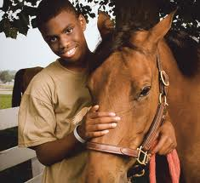
Harnessed power
Man was given authority to control these creatures for his benefit.
Control their whole bodies by placing bits in their mouths.
Man can control horses, he can control elephants, and he can control whales ---
Why can’t he control his tongue?

Slide 11
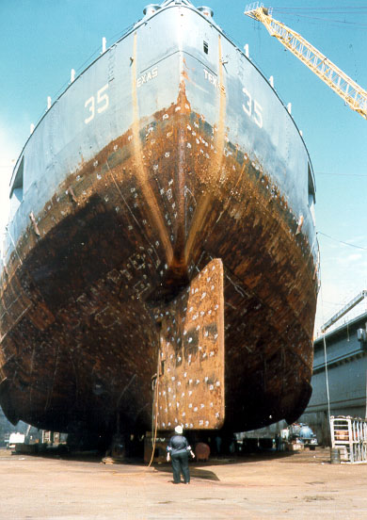
Power that can be yoked together in small packages
You control an enormous ship with a very small helm.

Slide 12
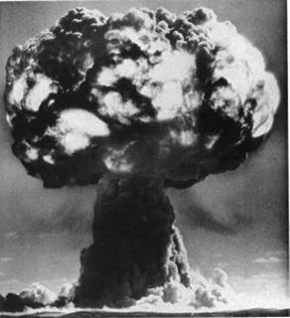
Power that can be yoked together in small packages
The powers that be, just by giving the word, can unleash enough raw power to rearrange the face of the earth.
It only takes 2 keys and one toggle switch to issue in a nuclear holocaust.

Slide 13
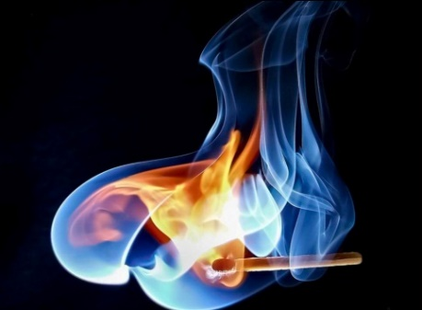
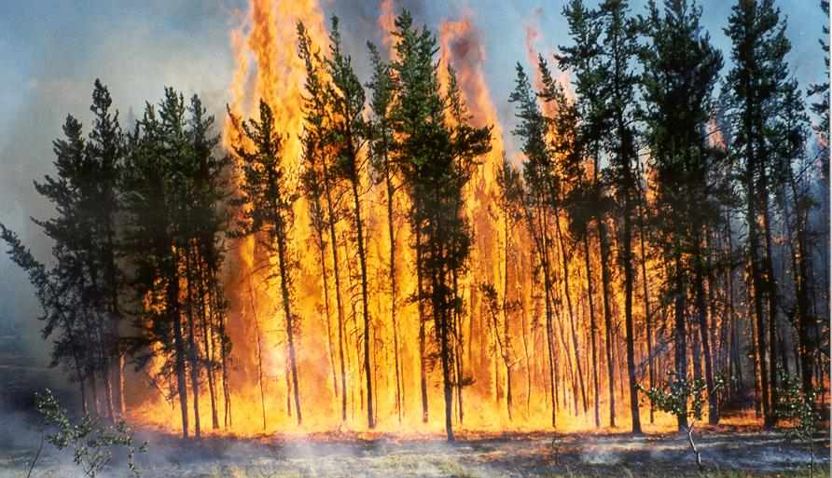
Read Verses 5&6
What conditions make a discarded match such a potentially dangerous occurrence?
When it is discarded into dry brush a fire can quickly spread out of control.
The same match thrown onto a swampy bog quickly goes out, not for lack of fuel, but for lack of favorable conditions.

Slide 14
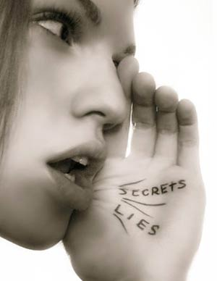
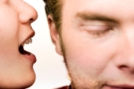
Adding Fuel To The Fire?
The attitude that you have when you hear gossip, an uncharitable word, or an angry word will either fuel a fire or put it out.

Slide 15
Letting gossip happen without stopping it
Makes you guilty of gossip & its consequences as well.
Consider this:
You witness someone purposely start a fire in a wastebasket in a restroom of a restaurant.
The place burns down and many people get hurt as a result of that fire.
You did nothing except walk out. Could you say you were innocent of that restaurant fire?
You have a duty to put the fire out whether you started it or not.

Slide 16
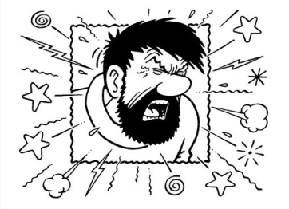
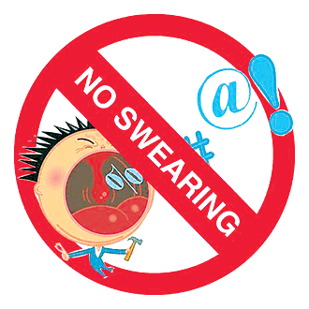
The Potential The Tongue
Text –
James 3:7-12

Slide 17
A Channel Of Blessing
(Psalm 34:13)
Through proper exercise and control, man can bless God and allow himself to be used as a channel of blessings.
A man's life will be far more enjoyable, rich and rewarding, when he keeps his tongue harnessed.
(Matthew 12:36)

Slide 18
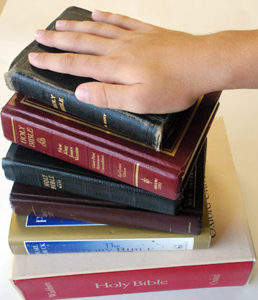
The Bible cautions against rash swearing.
(James 5:12)
Why do we have to ‘swear to God’ in order to get someone to believe us?

Slide 19
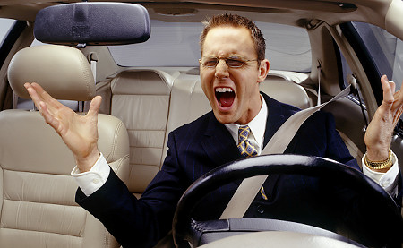
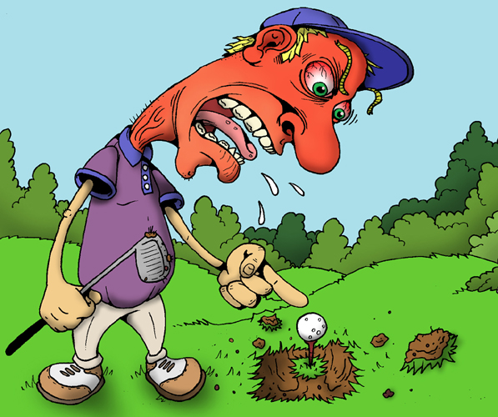
When do we give up control?
Why is it that we can let others get to us?
Words have no power until we give them power.
Never wrestle with a pig
(Proverbs 20:3)

Slide 20
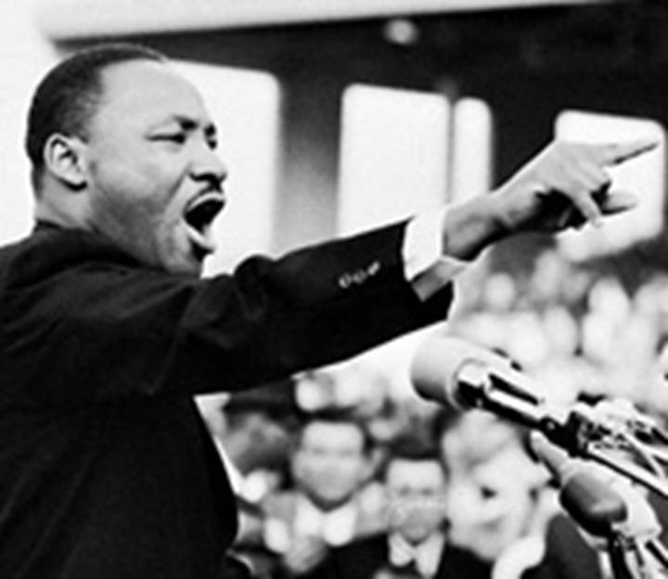
The Tongue has power
Chap 3:13-18

Slide 21
Results of a tongue under control
When controlled by God’s word it will manifest purity from above.
When it doesn’t, it magnifies the impurities from below.
A Christian whose heart is focused on Jesus will diligently try to use his tongue as salt to create a thirst for righteousness.
(Matthew 5:13)

Slide 22
It will be the pure in heart who see God.
How we show our purity of heart
(Matthew 15:18-20)
(Colossians 4:6)

Slide 23
Our tongue can be used for good or evil
It’s our choice what we think and what we say.
We CAN and SHOULD be in Control!

