Slide 1
Why Don't You........?
Reading: 1 John 1:3-7

Slide 2
Other Passages from John
(1 John 4:7-8) Beloved, let us love one another: for love is of God; and every one that loves is born of God, and knows God. {8} He that loves not knows not God [has no fellowship with God]; for God is love.
(1 John 4:11-13) Beloved, if God so loved us, we ought also to love one another. {12} No man has seen God at any time. If we love one another, God dwells in us, and his love is perfected in us. {13} Hereby know we that we [have fellowship] dwell in him, and he in us, because he has given us of his Spirit.
(2 John 1:9-11) Whosoever transgresses, and abides not in the doctrine of Christ, has not [fellowship with] God. He that abides in the doctrine of Christ, he has both the Father and the Son. {10} If there come any unto you, and bring not this doctrine, receive him not into your house, neither bid him God speed: {11} For he that bids him God speed is partaker of [has fellowship in] his evil deeds.

Slide 3
1 Peter 3:15
But sanctify the Lord God in your hearts: and be ready always to give an answer to every man that asks you a reason of the hope that is in you with meekness and fear:
1 Peter 2:9
1 Peter 4:11
Colossians 3:17

Slide 4
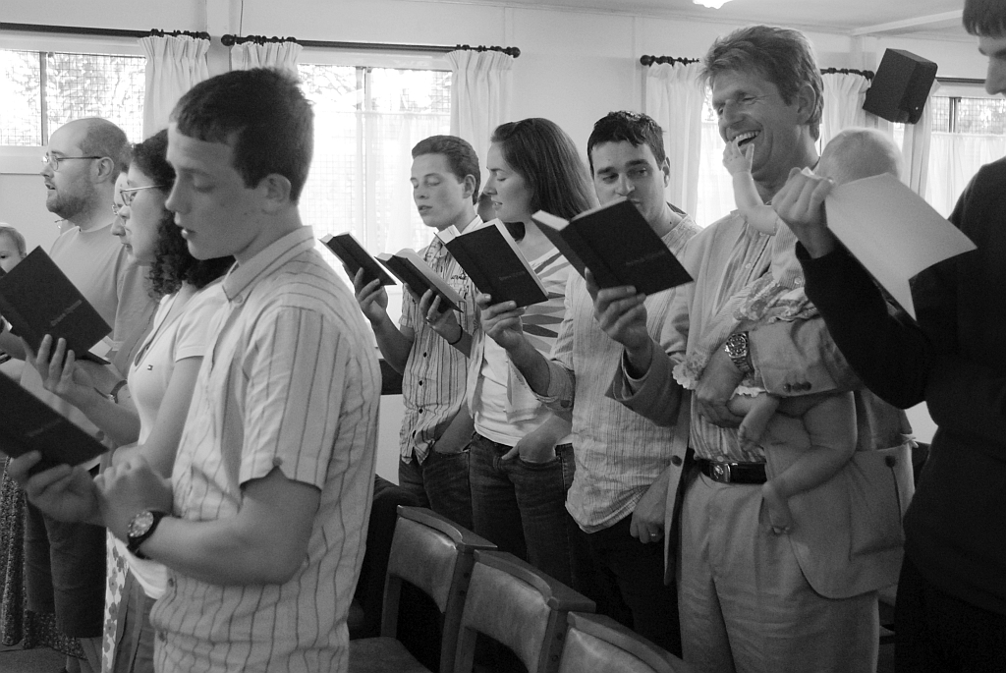
Why Don't You........ Use musical instruments in your worship services?
Ephesians 5:19
Colossians 3:16

Slide 5
You Need Authority To Make The Pieces Fit
God has a right to determine how HE is to be worshipped.

Slide 6
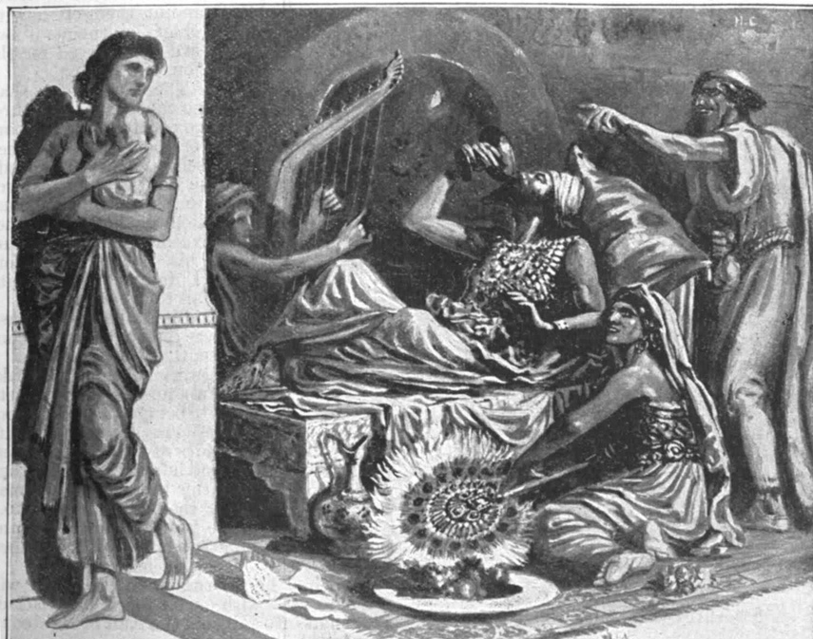
“The instrument is just an AID” No, It is an ADDITION
Can we add things to God’s word and be completely certain that it is pleasing to Him?
Can you be sure that all instrumental music was pleasing to God in the Old Testament?
Amos 6:3-5

Slide 7
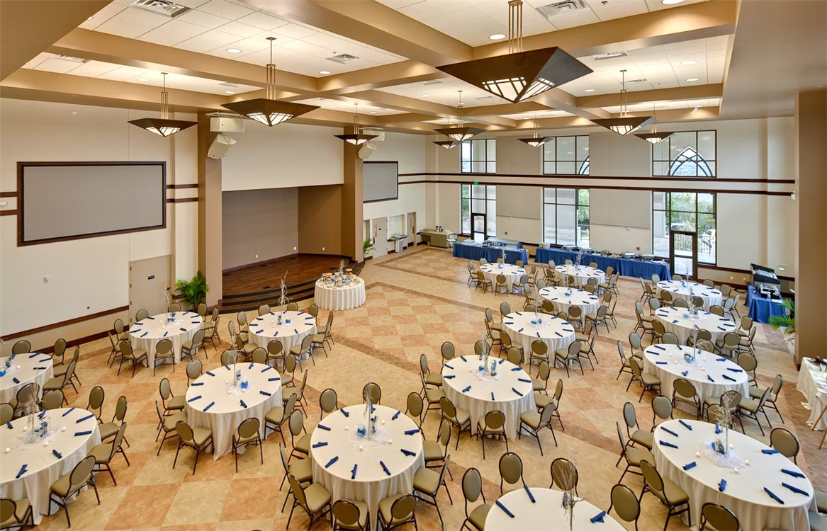
Why Don't You........ Have Fellowship Halls & Church Functions?
.
“Fellowship in the church” is not coffee & donuts but mutual participation in spreading the Gospel

Slide 8
Why Don't You........ Have Fellowship Halls & Church Functions?
What exactly is the church’s function?
To Teach Matthew 28:19
2 Timothy 2:2
To Worship John 4:24
“Fellowship in the church” is not coffee & donuts but mutual participation in spreading the Gospel.

Slide 9
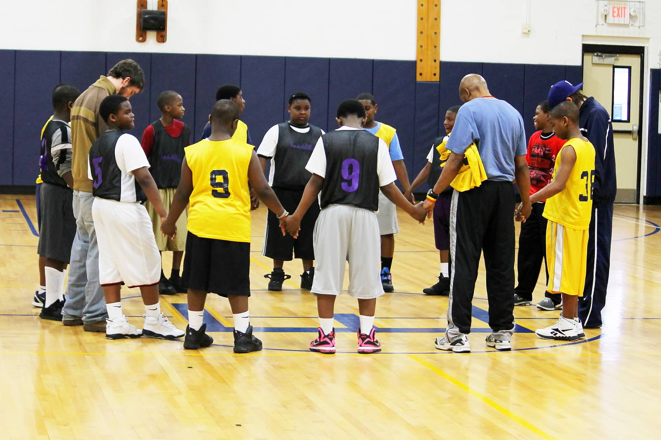
Why Don't You........ Have Fellowship Halls & Church Functions?
Jesus died to save men’s souls - NOT to have a ball team named after him. John 18:36
The physical needs of man are to be satisfied at home. 1 Corinthians 11:22-33&34
Instead of a spiritual feast, man is opting for a physical feast. Luke 4:4
The spiritual needs of man are fed by the Fellowship of Christ through His word.

Slide 10
“I know what the Bible says but...
“I Don’t think........”
“I Don’t believe.....”
And That’s The Trouble.........

Slide 11
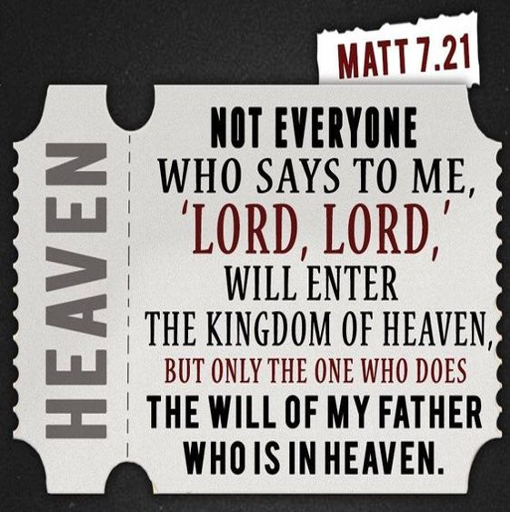
TOO MANY PEOPLE DON’T THINK AND DON’T BELIEVE!

Slide 12
Let’s Get Back to the Pre-Denominational Church! It’s all there in the Bible.
Come To Jesus!

