Slide 1
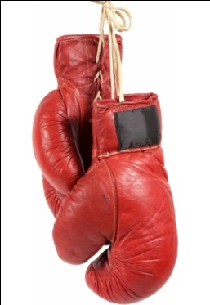
Don’t Hang Them Up Just Yet! Are You Ready To Contend?
Reading – Ephesians 6:10-13

Slide 2
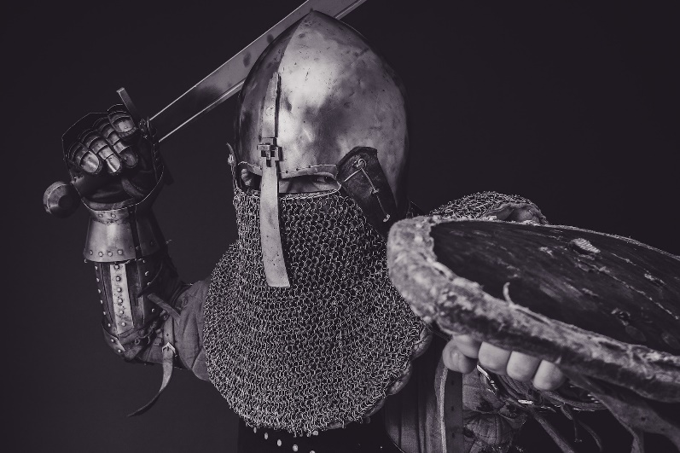
Have We Conquered All of Our Enemies?
There is still one formidable foe to go.
His name is Satan!

Slide 3
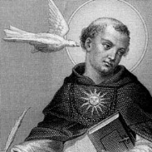
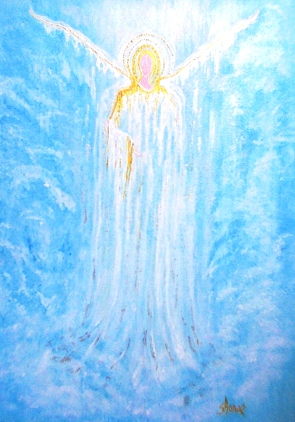
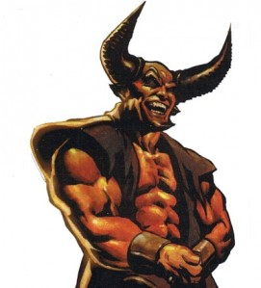
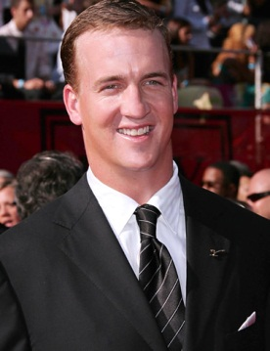
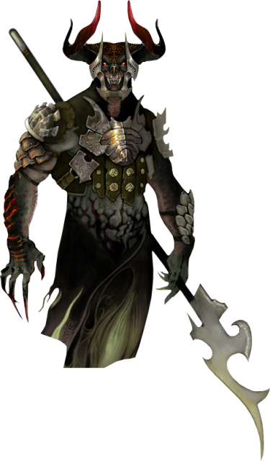
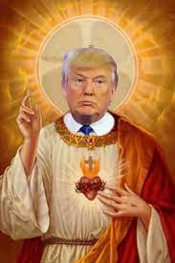
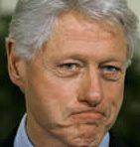
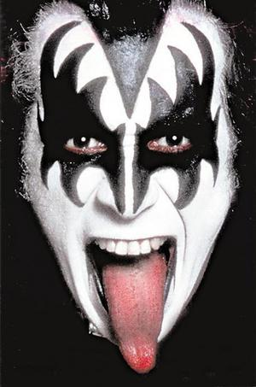
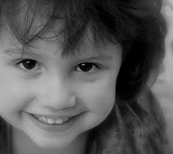
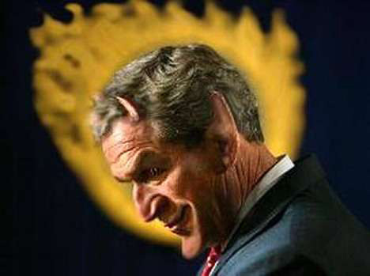
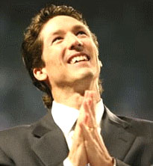
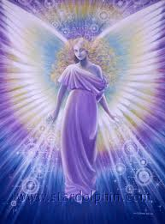
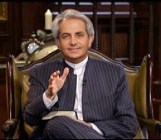
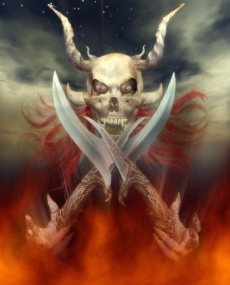
How Can We Spot Him?
^^

Slide 4
Here’s how the Holy Spirit describes him.
He is not a menacing goat-like creature with a pitchfork.
[2 Corinthians 11:13-15]
He can delude men into believing a lie. Just like Simon the sorcerer there are men today who claim to work miracles and do a lot of “good” to the recipients in the audience.
[2 Thessalonians 2:9-10]

Slide 5
[2 Corinthians 2:10-12]
He seems to take pleasure in getting brethren upset and fussing with one another to a point where they can’t be civil.
[Ephesians 4:25-27]

Slide 6
Listen how the Holy Spirit describes him.
2 Corinthians 4:4
Satan likes people to feel religious. He likes them going to a place to worship something that resembles Christ.
[Romans 10:1-3]

Slide 7
Galatians 3:26-29
Watch out when you are IN Jesus!
That is when Satan gets angry!
Now the gloves come off and you are in for a fight.
[1 Peter 5:8-9]
Look how he dealt with the early church.

Slide 8
It Starts with external intimidation
Acts 2:46-47

Slide 9
Then Peter heals a lame man that gets a LOT of attention.
That good deed can’t be allowed to go unpunished. That takes us to Chapter 4.
[Acts 4:1-5]
Even though the perceived leaders were in jail, the church has grown to 5,000 men?
Satan has to go to “Plan B”.

Slide 10
Create some kind of internal scandal
Annanias & Sapphira Acts 5

Slide 11
If Satan can’t win from without he will try to tear it apart from within.
Let’s get someone lying and just see what happens next.
Did people become indignant when discipline was applied?
Did they quit because this discipline was too harsh?
Instead of losing a couple of members, the church becomes even stronger.
Time for another strategy.

Slide 12
External Persecution
Acts 5:17-42

Slide 13
The apostles are thrown in prison and an angel sets them free.
Satan knows that when the going gets tough some people bail.
This was the reason for Jesus’ warning:
[Mark 8:34-38]

Slide 14
Internal Strife
Acts 6:1-7

Slide 15
Start internal squabbles so that the members will forget about evangelism and focus on disputes.
Acts 6: Satan starts infighting among the Jewish and the Greek brethren.
What stopped it? Selecting a group of men to take leadership roles, just as we did.
Now we even have the priests obeying the gospel.
Satan certainly can’t have this! Now it is WAR!

Slide 16
Full blown persecution
Starts with martyrdom of Stephen
[Acts 8:1-4]

Slide 17
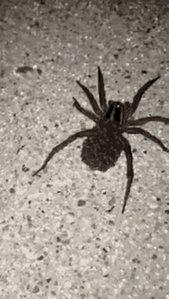
This looks like it’s working. Christians are turning tail and running away.
But wait – they don’t stop teaching and preaching.
In fact the work seems to have multiplied.
It’s like stepping on a pregnant spider and a swarm of little spiders scatter everywhere.

Slide 18
Nothing seems to be working for Satan as recorded in Acts
Every time he takes an active part in trying to destroy the church he come out on the losing side.
Maybe that is why he will use this final tactic.

Slide 19
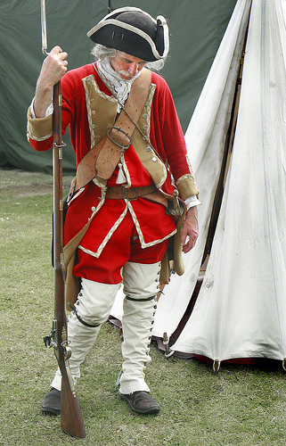
Lull the church into complacency
[Revelation 2:1-7]

Slide 20
It starts with people losing the fire for their first love.
We can lose our fervor for evangelism and concentrate on “Standing Against” all of the “issues” that are out there to the point that we do not go forward.
Anyone with a dictionary knows that standing is not the same thing as going.

Slide 21
Let’s not fall for the same lie that Satan told Eve when he said, “You won’t surely die!”
We need to take heed to the warning of the Holy Spirit -- 1 Timothy 4:1 - Now the Spirit expressly says that in latter times some will depart from the faith, giving heed to deceiving spirits and doctrines of demons.

Slide 22
Are You Ready To Contend?
Let’s Take The Fight to the REAL Enemy!

