Slide 1
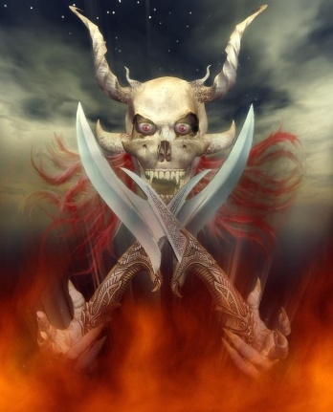
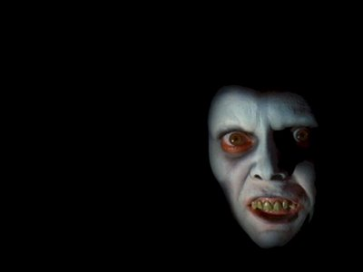
Demonic Activity –Yesterday & Today
Reading – 1 Timothy 4:1-8

Slide 2
Is It Still Happening?
Are Demons merely imaginary Creatures?
If they once existed, then when did they cease to be active?
When writing to Timothy, the apostle Paul warned him of the time coming when men will "depart from the faith, giving heed to deceiving spirits and doctrines of demons"
(1 Timothy 4:1).

Slide 3
Verse 3 of our Text
Identifies two of the coming doctrines of demons.
Apostates would forbid marriage
Command people to not eat meats.
In spite of this clear passage, some religious groups still forbid their priests and nuns to marry and claim that to eat certain foods is sinful.

Slide 4
Possession is not their forte -- Doctrines are.
Matthew 16:12 - doctrine of the Pharisees and Sadducees.
2 John 9 - transgresses and does not abide in the doctrine of Christ
Revelation 2:14 - doctrine of Balaam
Revelation 2:15 - doctrine of the Nicolaitans

Slide 5
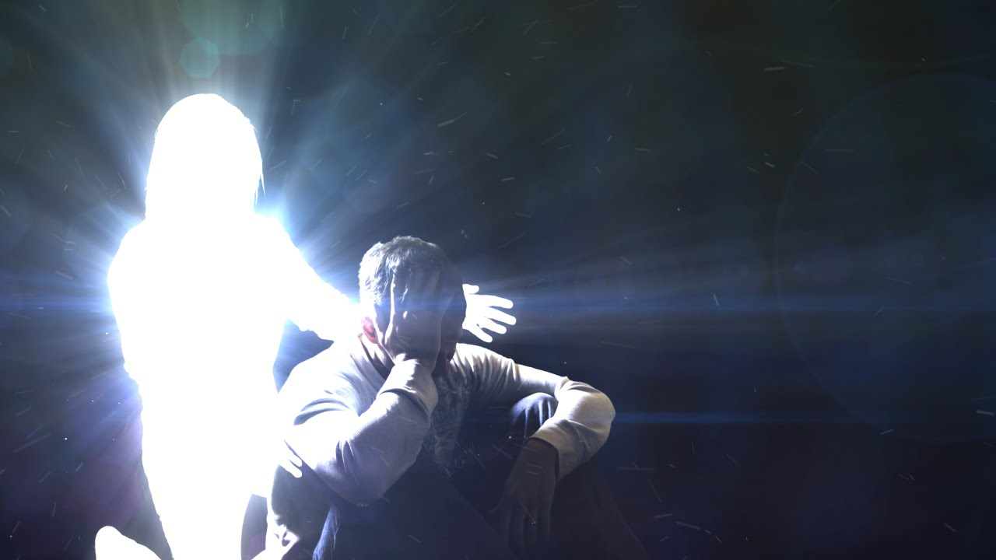
We Are Involved In A Spiritual Struggle
2 Corinthians 4:4

Slide 6
Service To Demons?
The Bible identifies several different practices as actually being service to demons, whether the worshippers recognize it or not.
Psalm 106 is a historical psalm that gives a general history of the practices of Israel.
Psalm 106:34-37

Slide 7
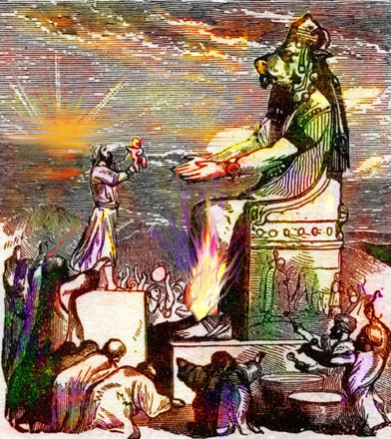
Service To Demons?
When did the Israel ever sacrifice their children to demons? The very next verse tells us. Psalm 106:38
Cross Reference Verses:
2 Kings 16:3
2 Kings 21:6
2 Kings 17:17
Jeremiah 32:35

Slide 8
A Spiritual Reality Behind the Idols
They were not serving stone, metal and wood, but the demons, who were the spiritual reality represented by the idols.
God commanded the Israelites to bring their sacrifices to the tabernacle instead of out in the open fields. The reason is found in…
Leviticus 17:6-7

Slide 9
A Spiritual Reality Behind the Idols
Moses foretold the future of the nation of Israel when they would offer sacrifices, "to demons”
Deuteronomy 32:17
Jeroboam led the northern tribes of Israel into apostasy after Solomon’s death.
2 Chronicles 11:15

Slide 10
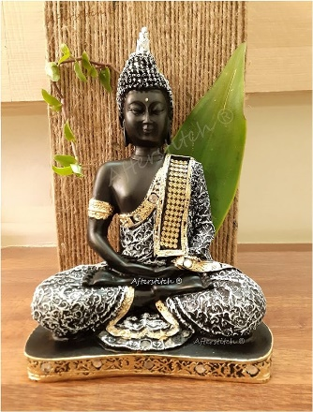
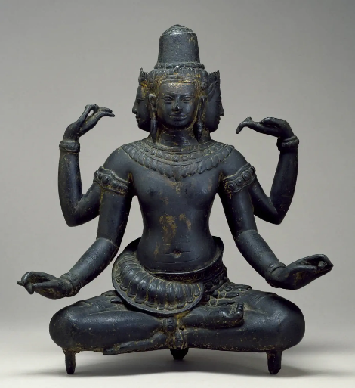
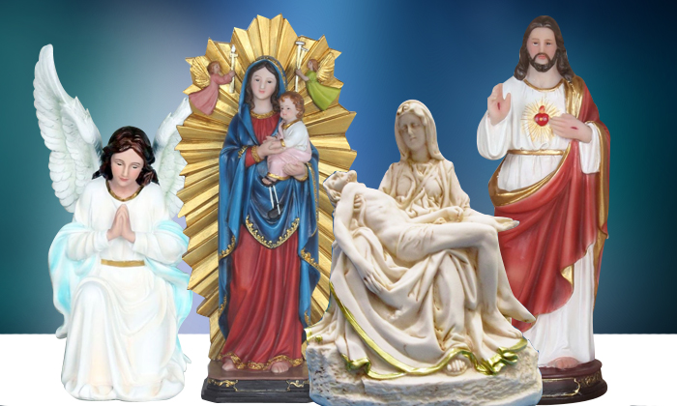
An Idol is Nothing 1 Corinthians 8:4
Understand the spiritual reality that was represented by idols.
They were physical representations of the forces of spiritual darkness.
1 Corinthians 10:19-20
The warning exists in having fellowship with demons. --- Why?

Slide 11
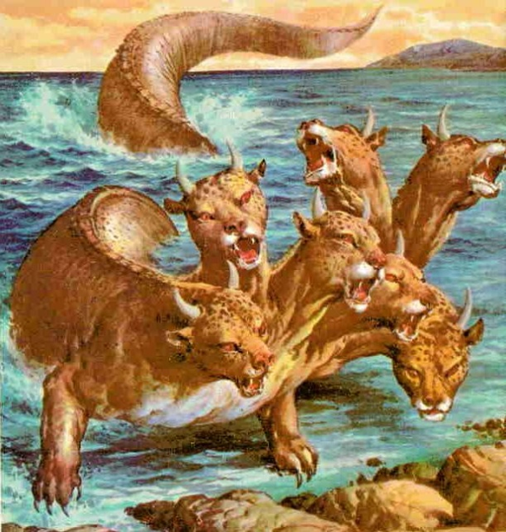
Demons Are The Force Behind the Doctrines
Revelation 13:2 & 4

Slide 12
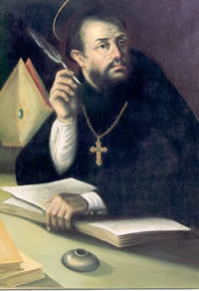
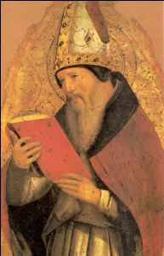
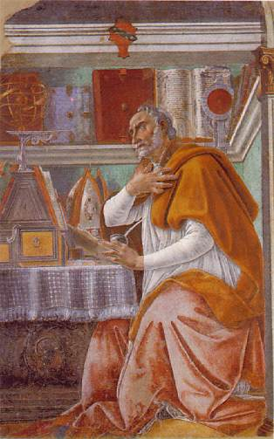
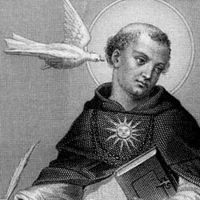
Maybe These Are More Accurate Pictures
Revelation 13:2 & 4

Slide 13
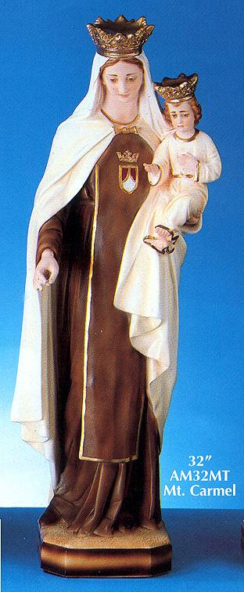
Deception
Some who follow doctrines of demons are not deliberately bowing down to demons.
Instead, they are deceived into participating in a false religion.
These false religious practices did not just originate from the imagination of men -- there were other spiritual forces at work ---

Slide 14
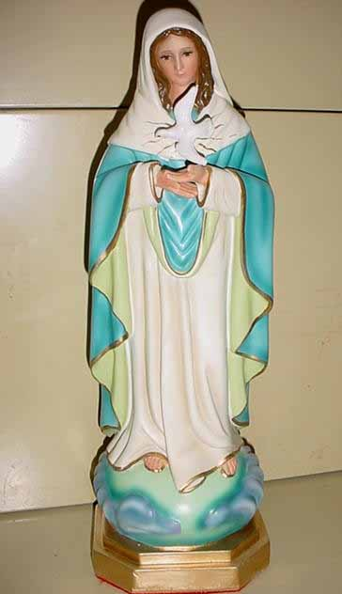
Ephesians 6:12
These "principalities and powers" are continually at work trying to draw people away from true worship (John 4:24).
They were behind the idolatry of the Canaanite religions, the idolatry of the Greeks and Romans, and the rise of the beast.
They are the reason for the Spirit’s warning in
1 Timothy 4:1

Slide 15
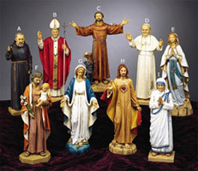
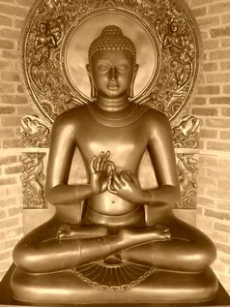
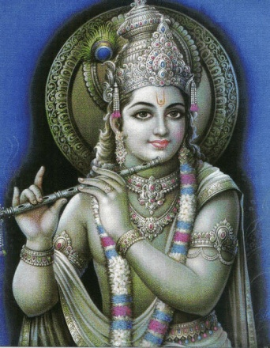
Deception
Doctrines of demons take on many forms and come in many varieties, but they all serve the same purpose.
They all turn people away from the truth and deceive them into believing a lie.
Satan is still having great success with the very first lie he ever told mankind ----

Slide 16
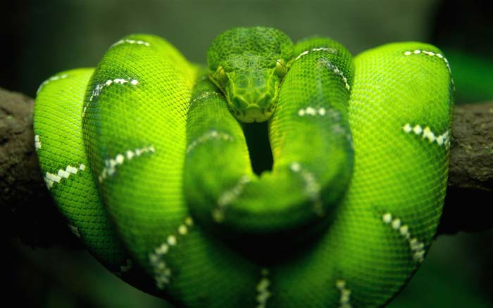
Original Sin And The Original Demon
Genesis 2:16-17
Genesis 3:1-4

Slide 17
Satan still speaking today thru men.
"Does a Christian's sins damn his soul? We take the position that a Christian's sins do not damn his soul.
The way a Christian lives, what he says, his character, his conduct, or his attitude toward other people have nothing whatever to do with the salvation of his soul…

Slide 18
Satan still speaks today.
“… All the prayers a man may pray, all the Bibles he may read, all the churches he may belong to, all the services he may attend, all the sermons he may practice, all the debts he may pay, all the ordinances he may observe, all the laws he may keep, all the benevolent acts he may perform, will not make his soul one whit safer…

Slide 19
Satan still speaks today.
“… and all the sins he may commit, from idolatry to murder will not make his soul in any more danger.
The way a man lives has nothing whatever to do with the salvation of his soul."
Quoted in "What is the Church of Christ" by V. E. Howard, Central Printers & Publishers, pg. 335.

Slide 20
Quoted from: Pastor Sam Morris.
Can you hear the hiss of the serpent as he says, "Go ahead and sin, you will not surely die!"

Slide 21
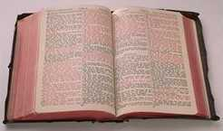
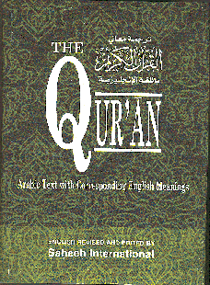
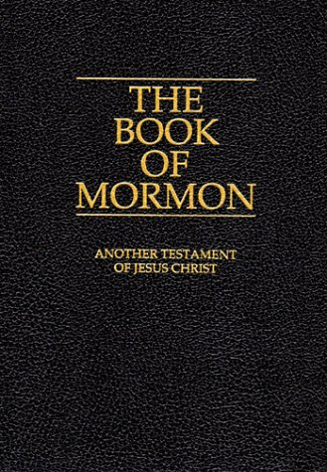
The Word of God and REAL Salvation
These may all sound good

Slide 22
Don’t Fall For Something That Just “Sounds” Good
Investigate and Accept that which truly IS good!

