Slide 1
Our Plans and God’s Plans for Us
Readings – Matthew 5:31-37 & Acts 16:6-10

Slide 2
Resolve To Be Flexible
Sometimes we have an unforeseen change of plan.
We can find a VERY fortunate surprise.
We want Bithynia, but get Macedonia.

Slide 3
Paul’s Plan
Bithynia was a coastal mountainous resort area, well watered and with a fertile plain sloping toward the Black Sea.
Macedonia had nothing quite so romantic or attractive.

Slide 4
God’s Plan
X

Slide 5
God’s Plan
Was the first step in taking the word into Europe (Text: vs. 9-10).
There will always be more second choices in life realized than first choices
There are lots of second choices [God’s Plans] that are better for us.

Slide 6
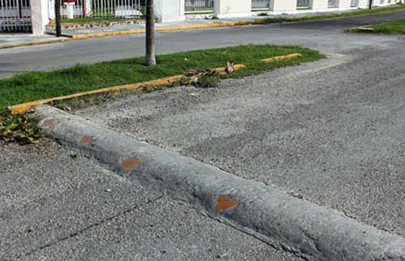
Bumps In The Road
It is very important for each of us to know how to deal with them.
Here are a few suggestions.

Slide 7
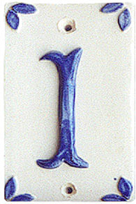
Have Full Faith in God
(Hebrews 10:22)
(Romans 4:19-20)
Hebrews 13:6
(Job 13:15)

Slide 8
Men Who Had a Full Faith in God
Matthew suffered martyrdom by being slain with a sword at a distant city of Ethiopia.
Mark expired at Alexandria, after having been cruelly dragged through the streets of that city.
Luke was hanged upon an olive tree in the classic land of Greece.

Slide 9
Men Who Had a Full Faith in God
John was put into a cauldron of boiling oil, but escaped death in a miraculous manner, and was afterwards banished to Patmos.
Peter was crucified at Rome.
Paul was beheaded by The Emperor Nero in Rome.

Slide 10
(Luke 12:4-5) …. yes, I say to you, fear Him!
Deep faith accepts what happens to us in life as God's choice for us
(Romans 8:28)
(Psalms 16:8)
Paul's experience in prison illustrates that what we want and what we get are always what’s best:
(Philippians 1:12-14;19)

Slide 11
Have A Deep Commitment to Do What Is Right [not always what is easy]
(2 Timothy 1:12)
Esther 4:16
A Strong ally when tempted
(Ephesians 4:14)
Those without commitment
(Luke 8:13)
X

Slide 12
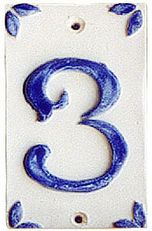
Concern For People
(Leviticus 19:34)
(Philippians 2:4)

Slide 13
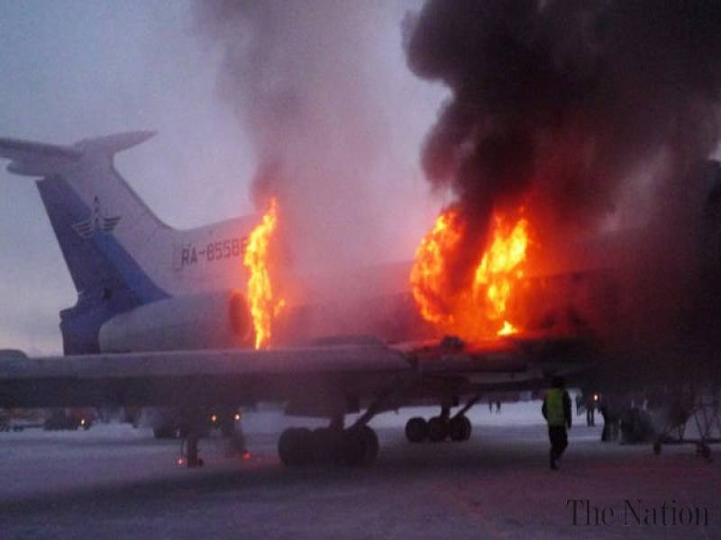
Concern For People
“She Could Have Jumped”
(1 John 3:16)
(John 15:13)

Slide 14
Paul’s Failed Plan to go to Bithynia turned out best for others.
(2 Corinthians 2:12)
Turns out that Paul spent a lot of time there.
(2 Timothy 4:13)

Slide 15
The World’s religions follow a Plan, but do they fall into the scope of God’s Plan for you?
The wrong Plan at the end of life is a choice that results in eternal loss and ruin!

