Slide 1
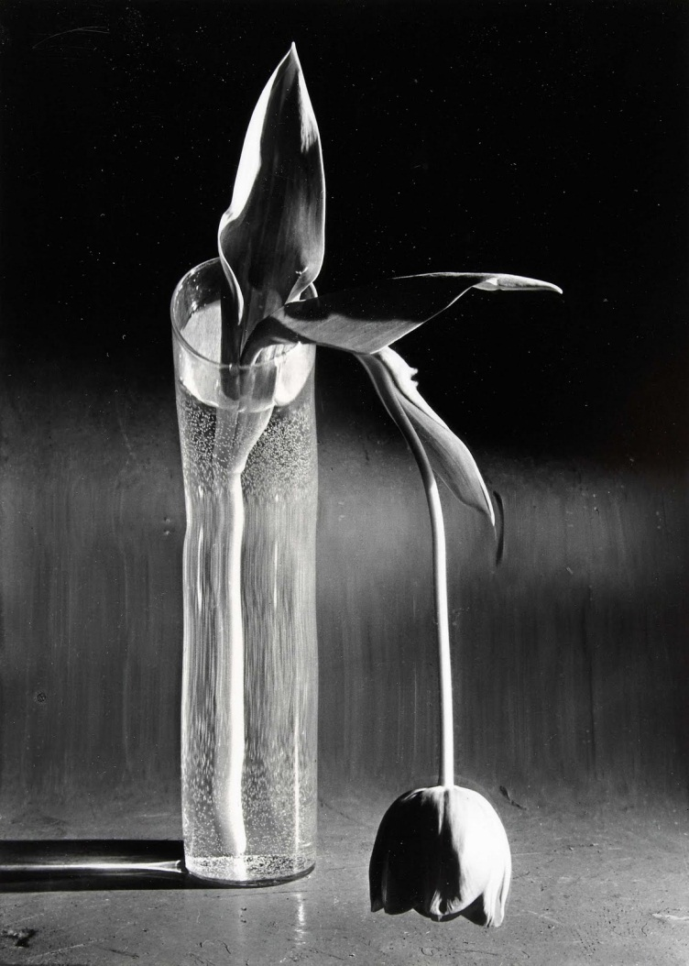
Predestined To Sin [A.K.A. The Wilted Tulip]
Reading: Jude 1-7

Slide 2
Tenets of Calvinism [TULIP]
Total Depravity
Unconditional Election
Limited Atonement
Irresistible Grace
Perseverance of the Saints
[A.K.A. Eternal Security]

Slide 3
“Contend earnestly for the faith"
In verse 4 Jude introduces the reason for them to take such as stand...
"Certain men" have crept in unnoticed
They were "ungodly men", guilty of:
a. Turning the grace of God into lewdness
b. Denying the Lord God and the Lord Jesus Christ

Slide 4
"long ago marked out for this condemnation"
What is ordained is their punishment
Any who turn from God will not escape His righteous condemnation!

Slide 5
To reinforce the point
Jude reminds his readers of three examples in which the ungodly did not escape God's righteous condemnation - [Jude 5-7]
1. Israel in the wilderness
2. The angels who sinned
3. The cities of Sodom and Gomorra

Slide 6
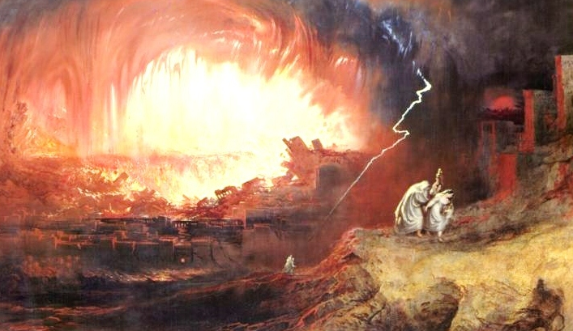
2 Peter 2:4-6
If you feel a sense of “Deja vu”, it may be because Jude follows a pattern set by Peter
Jude is warning against the very presence of those Peter had warned would one day come

Slide 7
ISRAEL IN THE WILDERNESS (vs.5)
God "saved" the nation by bringing them out of the land of Egypt
Yet despite being recipients of His wonderful grace, God "destroyed" those who did not believe
(Hebrews 3:12-19)

Slide 8
The Bible does teaches "the security of the believer" BUT...
It warns against the believer developing a heart of unbelief
It also teaches "the insecurity of the unbeliever"
Why do you suppose we are warned
...let him who thinks he stands take heed lest he fall."
1 Corinthians 10:12

Slide 9
The Bible does teach "the security of the believer" BUT...
A recurring theme throughout the New Testament is this: "Remember what happened to Israel!"
Jude reminds us that the example of Israel shows the possibility of "once saved, but destroyed"

Slide 10
THE ANGELS WHO SINNED (vs.6)
(2 Peter 2:4)
God has them "in everlasting chains under darkness for the judgment of the great day"
Just as He had a place prepared for the angels who sinned, so He has a place prepared for the wicked and unbelievers!
(Revelation 21:8)

Slide 11
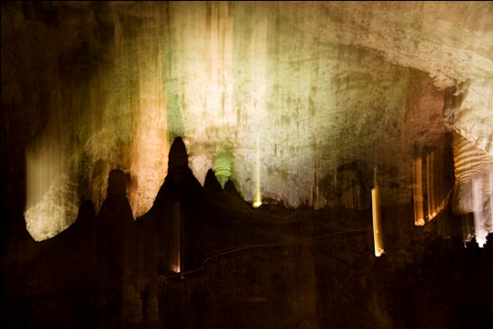
Ex. Luray Caverns, VA
“Be quiet for a moment and feel the darkness!"

Slide 12
THE CITIES OF SODOM AND GOMORRA (vs.7)

Slide 13
Judgment against these cities is vividly described in Genesis 19:24-28
Why this terrible judgment?
The LORD said it was because their sin is very grievous - vs.18
Jude says that they had given themselves over to sexual immorality and gone after strange flesh

Slide 14
Sodom and Gomorra are an "example"
Peter, an example "to those who afterward would live ungodly" - 2 Peter 2:6
(Jude 1:7) as Sodom and Gomorra, and the cities around them in a similar manner to these, having given themselves over to sexual immorality and gone after strange flesh, are set forth as an example, suffering the vengeance of eternal fire.
Eternal fire awaiting the subjects of His righteous vengeance!

Slide 15
Take seriously:
The warnings about those who would lead us astray!
The admonitions designed to keep us preserved in Jesus Christ!

Slide 16
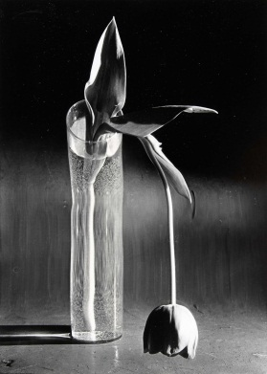
Act Now while you still can!
Are you letting these examples serve their intended purpose?
Will you let them motivate you to make whatever changes need to be made in your life?
The "judgment of the great day" is drawing nearer & nearer.

