Slide 1
“Serve Us”
Reading: Matthew 25: 31-45
Song: “Each Day I’ll Do A Golden Deed”

Slide 2
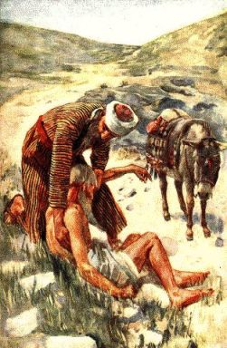
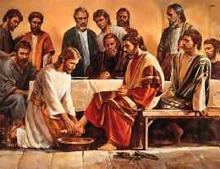
Read (Mark 10:35-45)
Now Read (Luke 10:25-37)
Now Read (John 13:1-17)

Slide 3
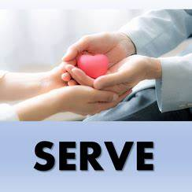
What do all 4 passages have in common?
They are not companion passages.
They all have the same message to the hearer
The theme that Jesus is delivering to us is SERVICE.

Slide 4
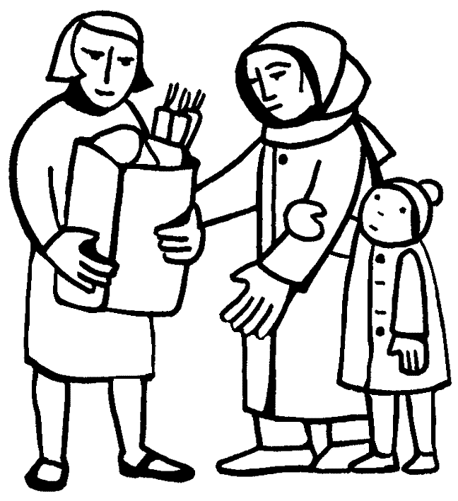
Service is Where You Least expect it
Matthew 25: 31-45

Slide 5
Serving Him takes more than Lip Service.
Christ expects us to practice what we preach. [Titus 2:14] …. a peculiar people, zealous of good works.
Don’t guilty of serving God with your mouth, but denying Him in your actions.

Slide 6
The context of Matthew 25 is found in Matthew 23
Jesus was condemning the Lawyers, Scribes & Pharisees for their hypocrisy.
Instead of serving the people they wanted to be served.
They expected & demanded they be addresses as “Rabbi” [vs. 7] AKA: “Spiritual Father or Holy Father” today’s term “Reverend”.
Who am I serving when I want someone to call me Father?

Slide 7
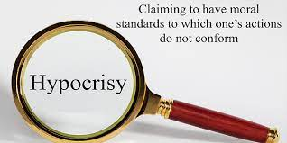
Jesus is addressing religious minded people and asking them to give account for how they served.
Were they religious?..... You bet!
Did they know the law? ... Better than anyone else
As far as defining Sabbath work or tithing you could say they were almost fanatical.

Slide 8
What did the Scribes & Pharisees do wrong?
The answer is “nothing”
You cannot separate true religion from service to your fellow man.
[James 1:27]
The Pharisees majored in the keeping themselves unspotted area while ignoring the weightier matters of the law [Matthew 23:23]

Slide 9
How about us in judgment?
We may be faithful in remembering Jesus as commanded in [Hebrews 10:25]
We may be faithful in Bible study. As commanded in [2 Timothy 2:15]
If all we do is worship and study, are we any better than the Pharisees?
Those who were praised in Matthew 25 didn’t realize that what they did had any bearing on their final judgment. [Vs. 37-39]

Slide 10
The Key to Greatness
Mark 10

Slide 11
Jesus, “Will you do us a favor?” [vs. 35]
Wanting to be #1 is not wrong in and of itself.
We should strive to be the best we can, but not to the detriment of others.
{43} "Yet it shall not be so among you; but whoever desires to become great among you shall be your servant. {44} "And whoever of you desires to be first shall be slave of all. {45} "For even the Son of Man did not come to be served, but to serve….

Slide 12
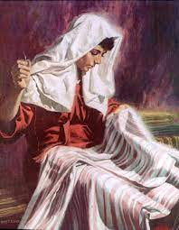
A Great Woman Named Tabitha
Acts 9:36-40
Her service to her fellow man warranted the respect of all.
Greatness is not given; it is earned!
The church has many Tabithas today, but it could certainly use even more.

Slide 13
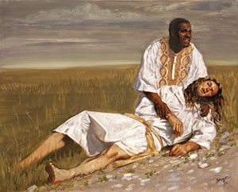
Our Neighbor Defined
Luke 10

Slide 14
Notice who was asking the question... A religious person. A lawyer.
He had to have been an older & respected man.
He wasn’t practicing what he preached or else he would have no need to “justify himself”.
His ‘law’ had a very narrow and convenient definition of a neighbor.
In his case as in every case, Knowledge of the law is not Service.

Slide 15
“Charity begins at home”
Yes it BEGINS at home and then EXTENDS to others.
[Ephesians 4:28] Let him that stole, steal no more, but rather let him work with his hands the thing which is good, (WHY) so that he can give to them that are in need.

Slide 16
A Servant of Others
John 13

Slide 17
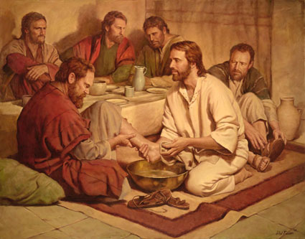
Jesus shows us graphically what service is by example.
When Jesus finishes serving his apostles he says in [vs 17] If you know these things, happy are you if you do them.
Serving will make you happier than being served.
Do you feel terrible when you neglect to serve your brethren?

Slide 18
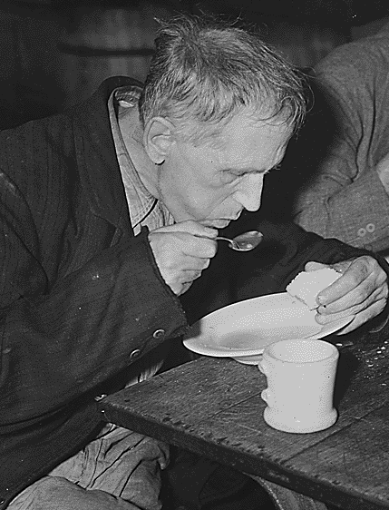
A misconception of the Social Gospel.
Billboard in Orlando “Come Here & Get Filled Up!”
It makes the church sound like a full-service gas station.
“If you come to this place we’ll take care of all your problems.”

Slide 19
Biblical Service falls down!
When we pay ministers & ministries to do the things we should be doing ourselves.
Some people go “Shopping” for a church like they do for choosing a health club.
“What can you do for me?” should be replaced with,
“What can I do to serve?”

Slide 20
Service Will Make us Like Jesus
We have taken the name Christian when we obeyed the Gospel.
We prove our Christianity when we act Like Jesus

