Slide 1
Sub-Standards
Reading – John 12:42-50

Slide 2
All Scripture Is “God Breathed”
Everything Else Falls Short In One Way Or Another

Slide 3
Jeremiah 10:23
I Like It
---But Does God Like It?
Your Social Media Friends Don’t Influence God.

Slide 4
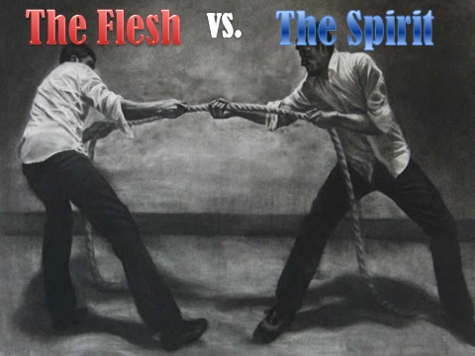
Galatians 5:15-17
Sometimes someone who is brutally honest relishes the BRUTALITY
“It makes me feel good to blow off steam!”

Slide 5
Acts 8:18-24
I Want It!

Slide 6
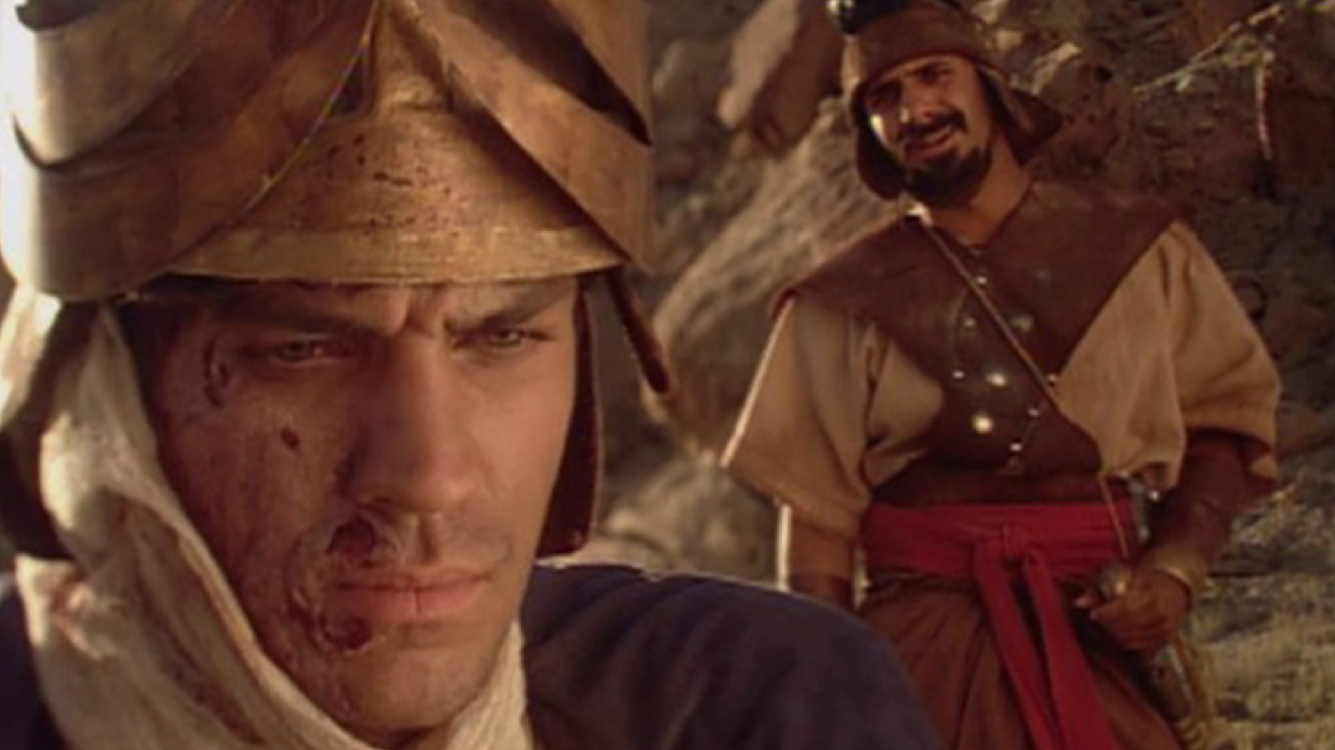
2 Kings 5:11-14
I Think

Slide 7
Proverbs 14:12
A Lot of Fatal incidents started with,
“Hey Y’All, Watch This…”

Slide 8
Matthew 7:21-23
Sometimes the biggest lies we tell is to ourselves.

Slide 9
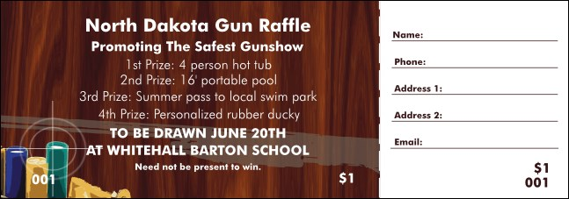
Romans 3:8
It’s For A “Good Cause”
The “End” is justified by the “Means”
Where is gambling ever encouraged in the Bible?

Slide 10
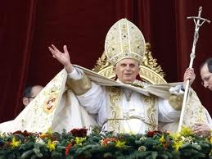
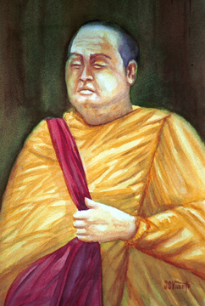
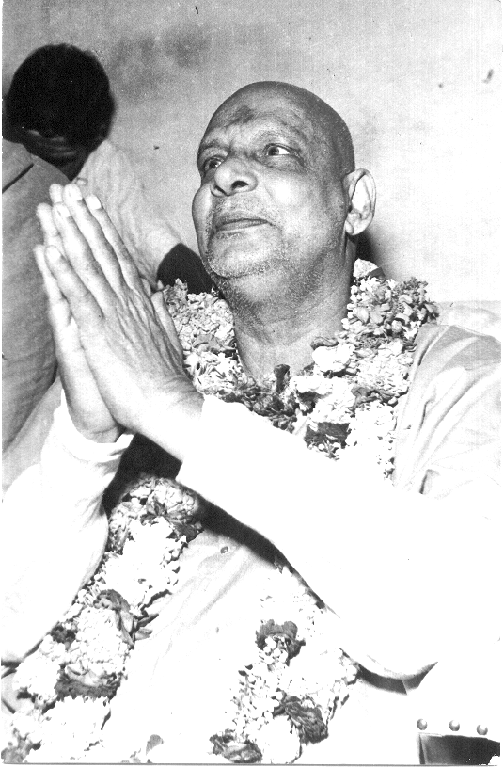
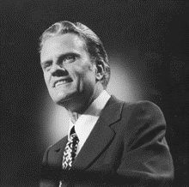
Galatians 1:6-9
The Preacher Said So

Slide 11
Proverbs 15:3
No One Will See
No One Will Know
No one can hide from God!

Slide 12
Leviticus 10:1-2
It Doesn’t Make A Difference.
God is not interested in details.

Slide 13
1 Corinthians 8:11-12
I Only Need To Do What’s
Best For Me
”They can just deal with it!”

Slide 14
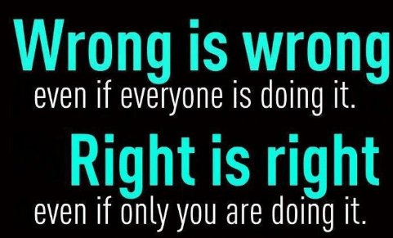
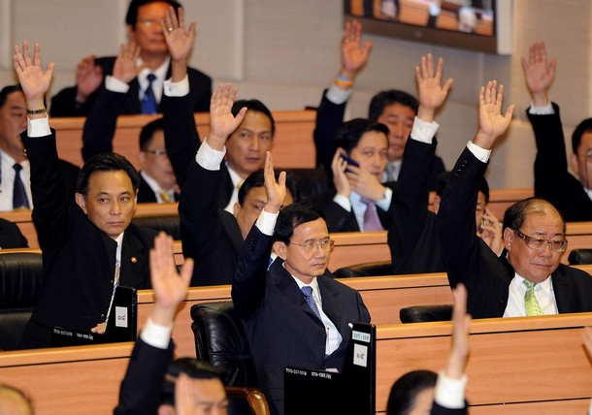
1 Samuel 8:4-20
Everyone Else IS Doing It.
How Can The Majority Be Wrong?
Matthew 7:13-14

Slide 15
What is the Common Element in All of these Sub-standards?
Selfishness!
Repent
Start Doing things the Lord’s way
Make your “calling & election sure”
Start Now

Slide 16
Key Issues

