Slide 1
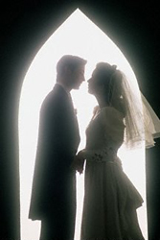
Evangelistic Marriages
Reading: 1 Peter 3:1-7

Slide 2
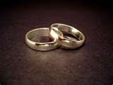
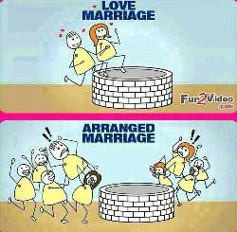
Back in the Day
Most marriages were arranged – Sometimes as a Business Deal
The Betrothed were considered “pre-married”
Love usually grew AFTER the wedding
Titus 2:3-5
Most of the epistles that give instruction in marriage was “after the fact”
Arranged marriages are still being practiced today in the USA.

Slide 3
Evangelistic Marriages?
It is a marriage today where a Christian marries someone who is not a Christian with the hopes that they will become a Christian through positive influence.
1 Peter 3:1-5
Romans 12:21
There are some great examples of this kind of evangelism.

Slide 4
Instructions for today
Even today many marriages are “arranged” by Christian families – Informally
We have warnings about being unequally yoked. We don’t want to go into a life-long commitment blindly.
The young Christian sometimes cannot see the dangers of carelessly falling in love.
Feelings can be strong and deceptive. Lust usually is mistaken for Love.
The biggest lie is this, “If he/she loves me, then they will change!”
Statistics prove that when two STRONG Christians get married, the probability of divorce goes way down.

Slide 5
But What Happens ???? Slim Pickins
The world seems to have so few men who are “Christians” who are good looking, unmarried, athletic, talented, have a steady job and a sexy car or truck.
Bonus points for the guy who owns his own house!!!!!
After high school and /or college that number starts to decrease with each passing year.
“OK, maybe they don’t have to be a Christians yet, but I can fix that”
1 Peter 3 gives holds out some hope.

Slide 6
Making Concessions & Still Waiting For The Perfect Man
Well, maybe they don’t have to have all items on the checklist. The first guy who has MOST of those items may be just the ticket out of her small town of losers.
Over time the losers in the world don’t seem to be really THAT bad.
The family they marry into has a negative influence on her and she falls away.
1 Corinthians 15:33-34
What’s missing? God’s instructions. Ephesians 5:8-11
It is time to add “Christian” to the top of the list.

Slide 7
“Righteous Lot” is an example of Negative Evangelism
2 Peter 2:7-8 | When we're introduced to Lot, he is a tent dweller like his uncle Abram. He left his comfortable home to dwell as a sojourner in a foreign land, trusting in the promises God made to his uncle.
Genesis 13:1-6 | He was a very wealthy man. He had God’s instructions from his uncle Abram in righteousness.
He was a tent dweller and a sojourner | But by the time we come to chapter 19 in Genesis, Lot is no longer a tent dweller. In chapter 13 he pitched his tent toward Sodom (not in Sodom).

Slide 8
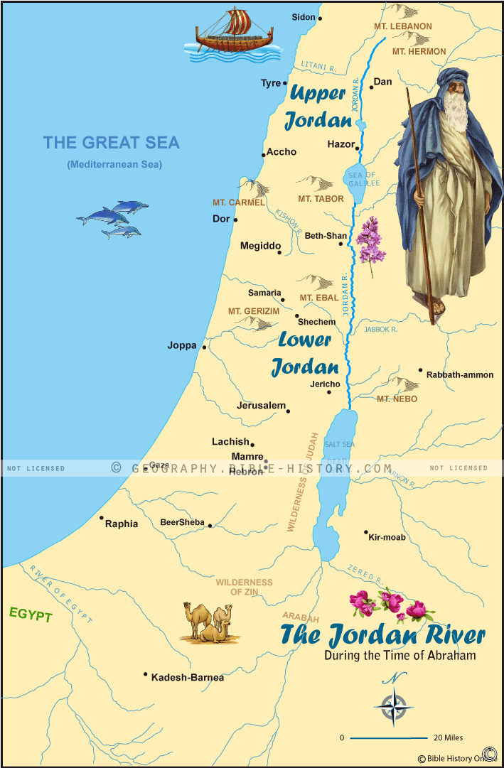
Jordan River Of Abraham’s Journeys
Genesis 13:10-12 And Lot lifted up his eyes and saw that the Jordan Valley was well watered everywhere like the garden of the Lord, like the land of Egypt, in the direction of Zoar. (This was before the Lord destroyed Sodom and Gomorrah.) So Lot chose for himself all the Jordan Valley, and Lot journeyed east. Thus they separated from each other. Abram settled in the land of Canaan, while Lot settled among the cities of the valley and pitched his tent toward Sodom.

Slide 9
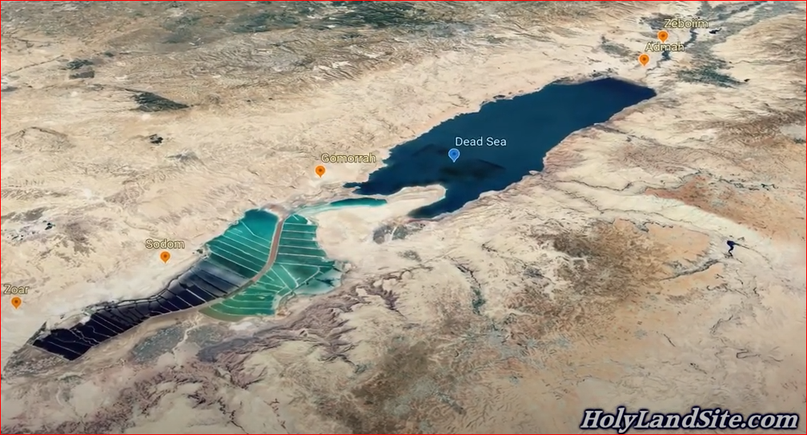
Jordan River site of the Location of Sodom

Slide 10
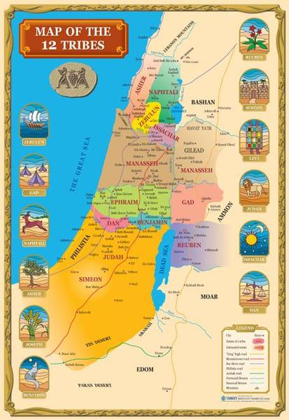
After the Destruction of Sodom & Gomorrah
As you can see, the Jordan River no longer flows through but it is stopped up so that it is now known as the :Dead Sea”
But let’s get to our story----------

Slide 11
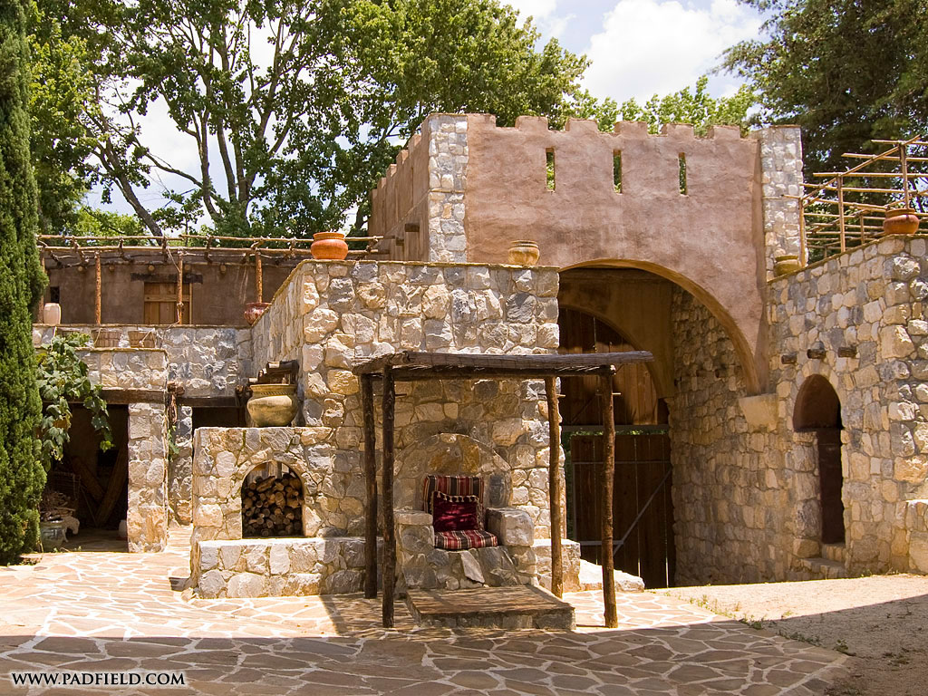
By Chapter 19 Lot & His family are living in a HOUSE inside the City Gates
You can imagine him telling his wife and daughters to be careful whenever they go to that evil, wicked city.
You can even imagine him telling them to not go there at all; that he would be the only one going to town for necessary supplies.
Lot has either packed away or sold the tent. The same goes for his servants and herds.
He could have been a VERY wealthy man living in a VERY nice house.

Slide 12
How did he get there?
We don't know. But we must believe that it was surely made with some reservations.
Lot is a righteous man.
He doesn't want to lose his wife or daughters to a wicked place like that.
But perhaps he had grown more comfortable with some of the things he had been exposed to.
Perhaps he had been desensitized just like we can become desensitized to sin.
1 Timothy 4:1-2

Slide 13
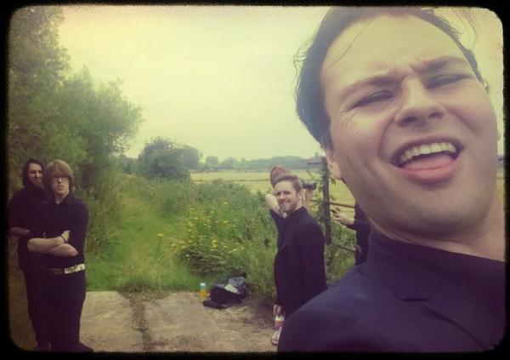
Genesis 19:14
Living in Sodom, his daughters were betrothed in marriage to two of the men of Sodom! How did he justify that decision?
His uncle Abram would never have allowed something like that to happen (see Genesis 24).
Perhaps they were not such bad men.
Perhaps, by Sodomite standards, they were pretty good.
And maybe he even thought they could be influenced for good; converted to fear and worship the only true God.
But if this was what he was thinking, he was wrong. He was wrong in the worst way

Slide 14
Lot’s effectiveness is compromised
He can't save them.
He has no more pull on them than anyone else in the city of Sodom.
Those young men weren't saved by Lot.
They weren't saved by his wife or his daughters.
They perished along with the rest of the wicked city of Sodom.
Jude 1:18
2 Peter 3:3-4

Slide 15
Consequences- Lot Lost Everything!
Lot lost his sons-in-law in the destruction of Sodom
Lot lost his wife when she looked back at Sodom (contrary to the explicit warning to not do that by the angels)
His daughters did an unspeakable thing and brought forth two children by their own father!
Where did they learn that kind of behavior? Where did they possibly get that idea that sleeping with your father is okay? Where have they been living? – Say no more!!
It wasn't from their uncle Abram. It wasn't from living as sojourners in tents.
At the end, he didn’t even have a tent. We find him living in a cave.

Slide 16
Pray for our Families! We Have Pitched our tents toward Sodom!
We live in a wicked & dark generation.
The majority of voters elected legislators who are in favor for aborting/murdering/killing babies.
Sexual immorality of all kinds are open & rampant
Violence in the cities that are going unpunished.
Philippians 2:15
1 Timothy 2:1-4

