Slide 1
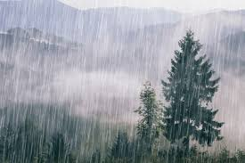
Sunshine And Rain
Reading – Matthew 5:38-48

Slide 2
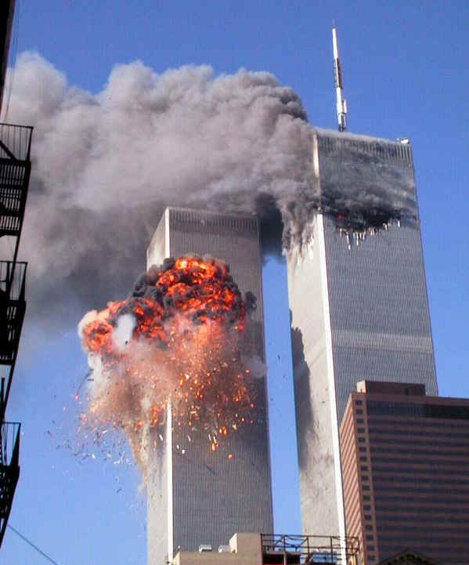
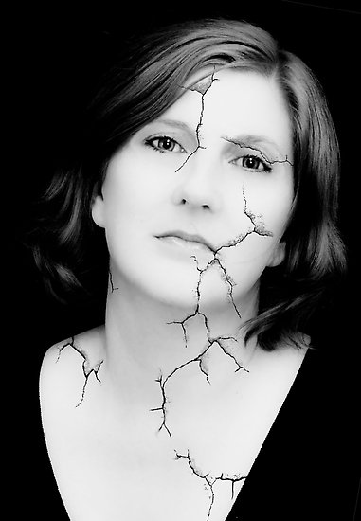
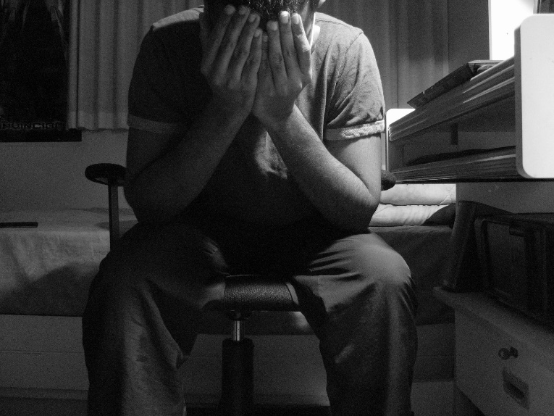
Main Argument of the Atheist:
"If there is an omnipotent God, one who is characterized by love, why does He allow suffering in the world?“
Men see the ravages of war, famine, and other natural disasters and question if God exists.
It’s bad enough when it is in the world, but when it comes home…

Slide 3
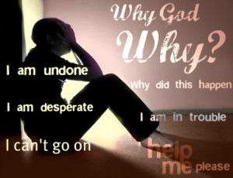
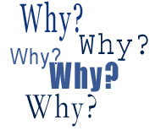
Job 4:2-5
"If God is characterized by love, why does He allow ME to suffer in the world?“
Sunshine & Rain have been in the world since the beginning of recorded history.
It is easier to understand why bad things happen to bad people.
It is harder to understand why bad things happen to those trying to be good.

Slide 4
An Unfair Paradox
Whoever said life was FAIR??

Slide 5
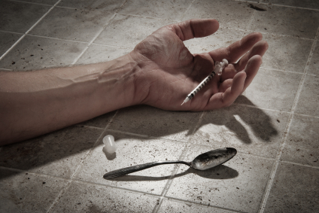
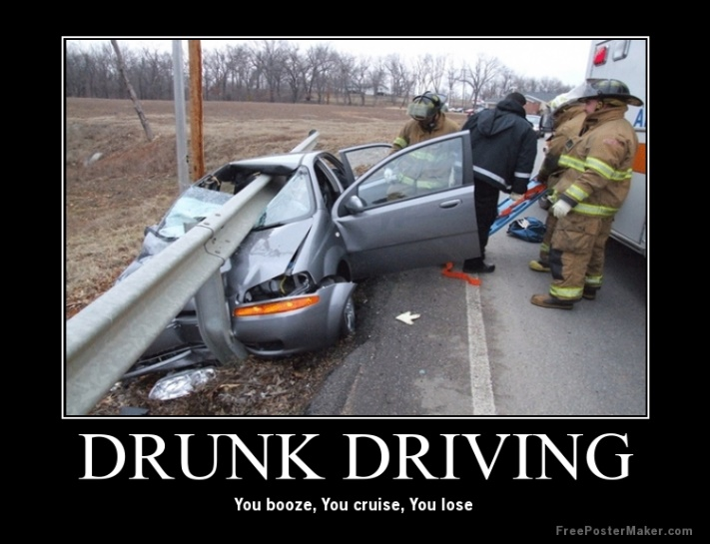
Evil practices bring on much suffering.
The drunk driver
The drug user
Diseases of the unrighteous - AIDS
Gambling & Poverty –
(2 Thessalonians 3:10)
At the same time we are completely at a loss to explain how a Christian can fall on hard times.
We may surmise that maybe he wasn’t a praying man.

Slide 6
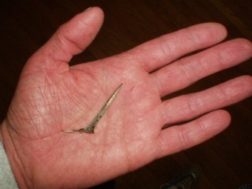
At times, God answers prayers of good people by saying "NO”
God's "No" is not an indication of His disfavor.
God said "NO" to His own Son.
(Matthew 26:39)
He said "NO" to Paul.
(2 Corinthians 12:7-8)
We shouldn’t be upset or surprised when He says "NO" to our requests, or when we are allowed to suffer. This is not an indication of His disfavor.
(1 Peter 4:12-19)

Slide 7
To Accomplish His Will
Sunshine & Rain is used

Slide 8
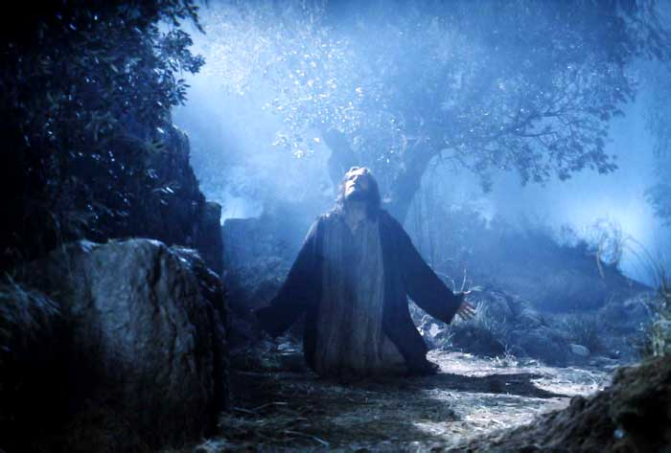
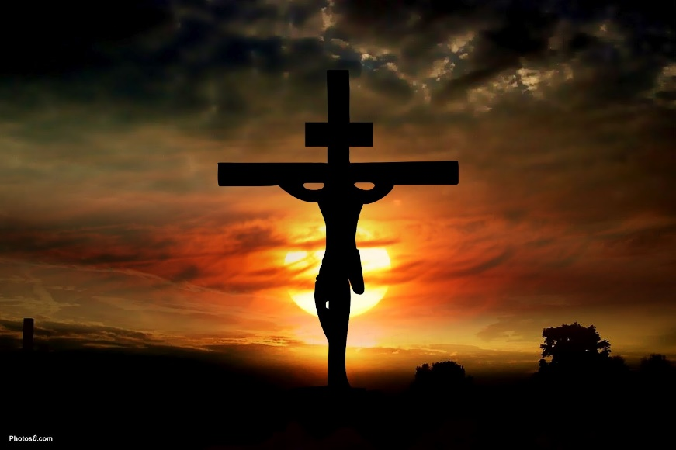
Romans 3:25
He allowed Jesus to suffer so He could be just in dealing with sin.
God allowed Jesus to suffer to perfect Him. (Hebrews 5:7-9)
Are you perfect yet or could you stand a little more perfecting?

Slide 9
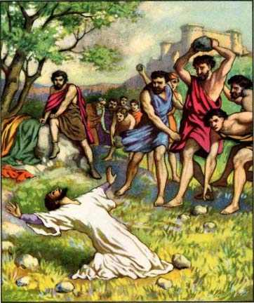
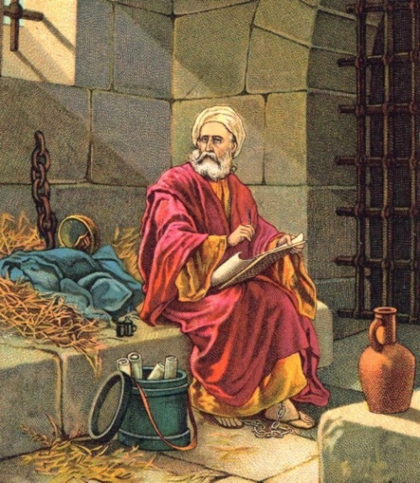
Acts 7:54&58
Did Stephen suffer because of his sin?
(Acts 8:1-4)
This persecution the disciples scattered them to "uttermost parts of the earth."
This “bad” happening was ultimately a good thing.
Why was Paul in prison? How could he accomplish more in prison than being free? (Philippians 1:12-14)
We know now that the bulk of the writings we have today originated from a prison cell.
He might not have had the time to write these things if he were actively preaching & teaching.

Slide 10
To Keep One Humble
Sunshine & Rain Serves

Slide 11
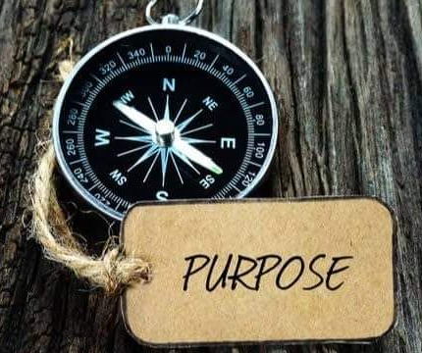
Paul Serves as Our Example
He was highly educated, intellectual, socially prominent & zealous. You might say he “had it all.”
Then he was privileged with actually being handpicked & taught by Jesus.
He was permitted to see visions (2 Corinthians 12):
Wrote 13 NT epistles.
He established more churches than anyone else that we know of.
If any had opportunity to boast, he could.
(2 Corinthians 11:21-28)

Slide 12
Paul Serves as Our Example
Everything that happened to him seemed to improve to his spiritual advantage.
So how does God respond?
(2 Corinthians 12:7-9)
This thorn accomplished God's purpose.
That’s why Paul said; Therefore I take pleasure in infirmities, in reproaches, in needs, in persecutions, in distresses, for Christ's sake. (v. 10).
What attitude do we show toward infirmities? Complain? Cry? Or do we draw nearer to God in prayer?

Slide 13
To Correct God’s Children
Sunshine & Rain Serves

Slide 14
(Hebrews 12:5-9)
Parents chasten children whom they love...
(Proverbs 22:15)
Parents can make mistakes but what God does is for our good.
(Hebrews 12:10-11)
The Psalmist said that suffering is used to bring about such good.
(Psalms 119:67 & 71)
Hear what the Bible has to say to us..
(1 Corinthians 11:32)
Chastened is not the same as being condemned.

Slide 15
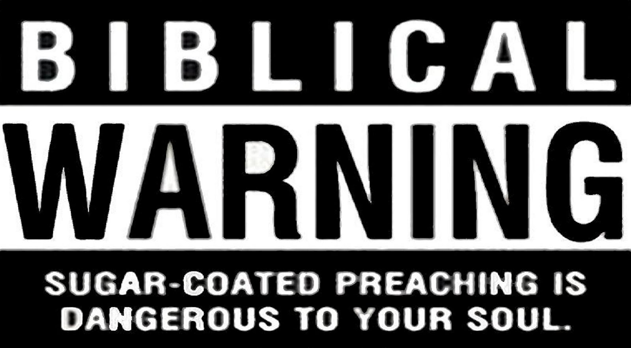
(2 Timothy 3:16-17)
When the word of reproof From God's word comes to from other faithful brethren to bring correction in your life, how do you respond?
Do you resent it and go elsewhere?
Are you one of those described in (2 Timothy 4:2-4) ?

Slide 16
To Remind Us Of Our Dual Nature
Sunshine & Rain Serves

Slide 17
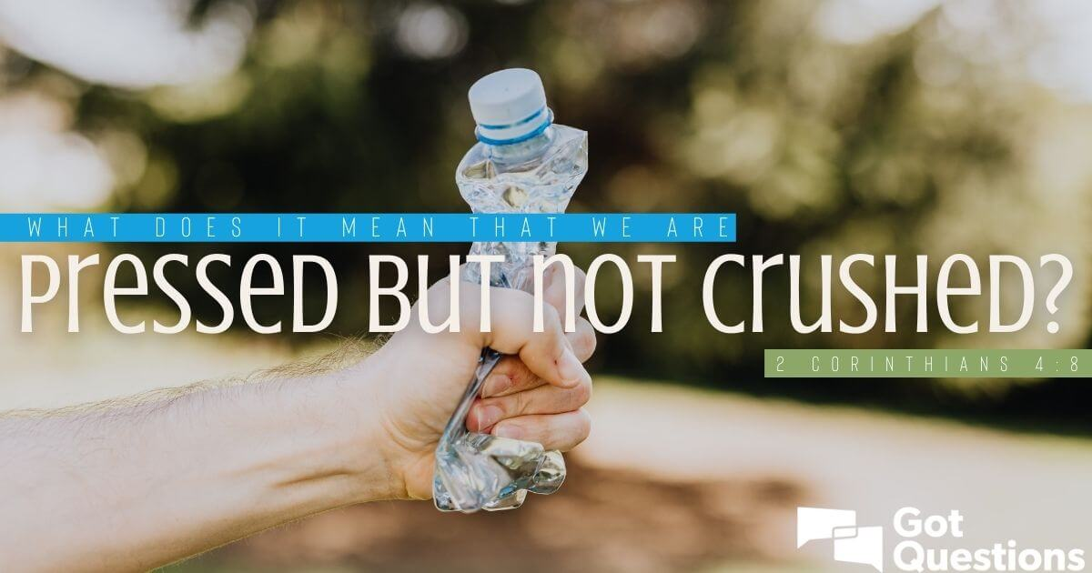
(2 Corinthians 4:8)
They were "Down, but not out." (2 Corinthians 4:16)
Our aches & pains if taken in the proper perspective should help us set mind on heaven.
In all things, God is "trying" or testing us to “strengthen” us. It is the Devil who “tempts" to destroy us.
Temptation to do evil is not from God: His purpose is to improve us and make us stronger.
(1 Peter 1:7)

Slide 18
What attitude do you have toward the "bad things"?
“Curse God And Die”

Slide 19
Thank God for Everything!

