Slide 1
The Spirit & The Understanding Part 36
Reading -- 1Corinthians 14:1-15

Slide 2
Singing Is Not An Afterthought
Exodus recalls the song of freedom
The Psalms were all meant to be sung.
Isaiah has 17 references to singing in various ways.
Ephesians 5:17-20 Therefore do not be unwise, but understand what the will of the Lord is. And do not be drunk with wine, in which is dissipation; but be filled with the Spirit, speaking to one another in psalms and hymns and spiritual songs, singing and making melody in your heart to the Lord, giving thanks always for all things to God the Father in the name of our Lord Jesus Christ,
See also Colossians 3:16

Slide 3
Let’s Examine 5 Songs We Sing
Amazing Grace # 128
Once For All # 495
Grace! ‘Tis a Charming Sound # 124
My Faith Has Found A Resting Place # 582
Nothing But The Blood # 902

Slide 4
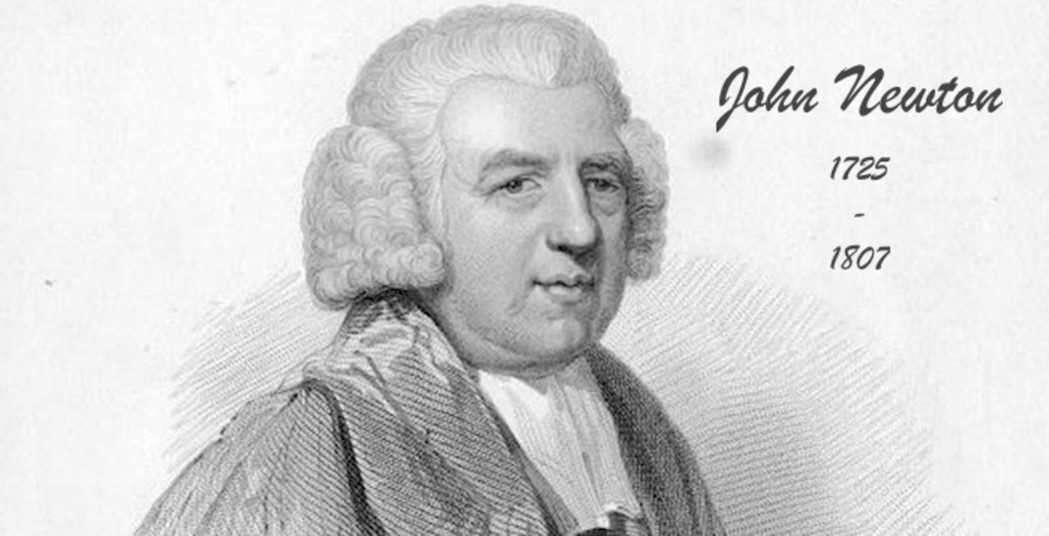
Amazing Grace - 129
Words By John Newton (1779)
Music is Early American Melody
Scriptures:
John 1:16-17; Romans 5:20-21;Ephesians 2:6-9

Slide 5
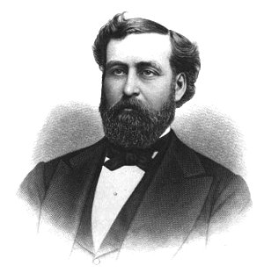
Once For All -- 495
Words & Music By Phillip P Bliss (1873)
Scriptures:
Romans 5:15; Romans 8:1; Hebrews 10:10

Slide 6
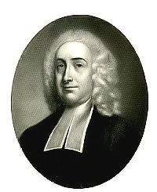
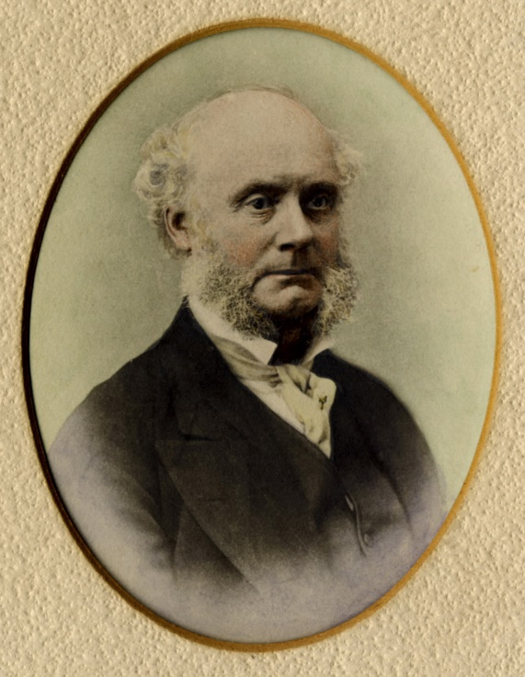
Grace! ‘Tis a Charming Sound -- 124
Words by Philip Doddridge (1740)
Music by Thomas Clark (1804)
Scriptures:
Ephesians 2:8-10; Hebrews 4:16;1 Peter 5:10

Slide 7
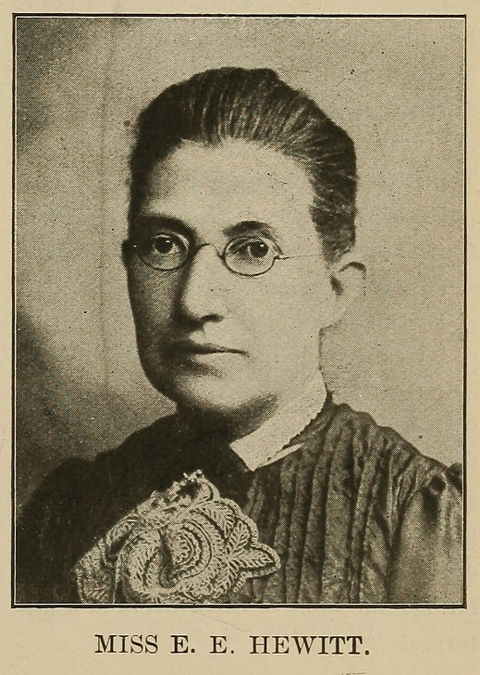
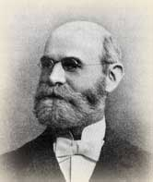
My Faith Has Found a Resting Place – 582
Words by “Lidie” Edmunds Hewitt (1891)
Music: Norwegian Melody arr. by William Kirkpatrick (1891)
Scriptures:
John 6:37-39; Titus 3:4-7; 1 John 5:13

Slide 8
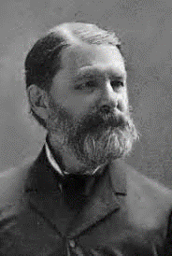
Nothing But the Blood -- 902
Words & Music by Robert Lowry (1876)
Scriptures:
Matthew 26:28; Romans 5:9; Hebrews 9:22

