Slide 1
Why The Church Needs Qualified Leaders
Reading – Titus 1:1-11

Slide 2
That’s what God commanded and expects. [Acts 14:23]
Everything should be done decently and in order. (1 Corinthians 14:40)
(Titus 1:5) For this reason I left you in Crete, that you should set in order the things that are lacking, and appoint elders in every city as I commanded you;
The church needs mature & godly men who have a good working knowledge of the kingdom.
(Hebrews 5:12-14)
Why do you suppose one of the characteristics of an elder that he is not a novice [a babe in Christ]?

Slide 3
Knowledge of the Scriptures
One of the things that separate an elder from the rest of the group is his ability to teach.
{10} For there are many insubordinate, both idle talkers and deceivers, especially those of the circumcision, {11} whose mouths must be stopped, (Titus 1:9-11)
Appointing a man to the eldership is not based upon a popularity contest. We need someone who cannot only recognize error, but who can use the scriptures to exhort and convince the gainsayers. [KJV]

Slide 4
Nevertheless, He Has a Good Report From Without
Selection of leaders is a quest for character.
That’s why instead of “qualifications” we should be looking at general “Characteristics” of a man.
Most of the characteristics that are found should be found in EVERY Christian. He should be blameless, but shouldn’t you be blameless too?
A leader should be orderly and of good behavior, but that doesn’t give you an excuse not to be.
He should not be social drinker, a drunkard or given to wine, but then again who of us should be?
What Christian should ever be greedy, covetous or a lover of money?

Slide 5
Hospitality
We all should be a lover of good men and one who is given to hospitality because that is how we grow in love and fellowship.
You can learn volumes about folks by just having an informal chat with them over a cup of coffee.
(Hebrews 13:1-2) & (Romans 12:9-13)

Slide 6
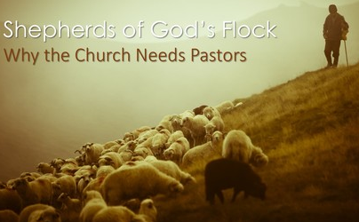
The Flock Needs Shepherds
Isaiah 40:11

Slide 7
Willing – - -
The Lords needs men who are willing [desires] to take on the position of a bishop.
God’s work IS His people (Romans 14:15, 20) Yet if your brother is grieved because of your food, you are no longer walking in love. Do not destroy with your food the one for whom Christ died… {20} Do not destroy the work of God for the sake of food.
Therefore His elders are in the people business.

Slide 8
Willing = Desire = Sacrifice
This word desire takes on the connotation of sacrifice just as Christ desired to be nailed to the cross.
(Matthew 16:24) Then Jesus said to His disciples, "If anyone desires to come after Me, let him deny himself, and take up his cross, and follow Me.
(Luke 12:48) For everyone to whom much is given, from him much will be required; and to whom much has been committed, of him they will ask the more.

Slide 9
Not Self-Willed
When the Bible says he is not self-willed, it means that he is not one who must have his own way, but makes sacrifices for those in his care.
Do you think that a shepherd always wants to be out in the rain rounding up strays?
Do you think he finds it fun to get up early or stay out late to feed them?
With that in mind who is doing the serving and who is being served? That’s why the Bible calls him the steward of God.
But most importantly, he must be vigilant and willing to protect the flock from wolves.
We need men in the church who can recognize the wolves even when we can’t.

Slide 10
The Church Needs Good Examples To Follow
Matthew 5:16

Slide 11
We Need Good Examples to Follow
Give me somebody I can look up to.
Give me a man who has a good reputation from those in the community.
Give me a man who has self-control so I’ll know how to handle myself in a similar situation.
I need to know when certain behavior is appropriate and when it is not. The Bible tells us that there is a time to laugh and a time to weep. A sober-minded man knows when that time is.
An elder can show us faithfulness to the Lord because he has shown us faithfulness to his wife. He has been the husband of one wife because he has been faithful to her for richer or poorer; in sickness & in health; till death separates them.

Slide 12
Raising a Family
The church needs older men that the younger can go to when it comes to raising their children.
They have already proved a certain degree of that success by the way they ruled their own house well.
Their children aren’t riotous and unruly but who respect his authority
They have led children who are faithful to the Lord

Slide 13
Unrealistic Expectations
We’re not talking about a man who is overlooking sin in his life -
We’re talking about a man who has repented of sin in his life.
There is always room for growth in the life of an elder.
You see a man who is 45 years old and what do you see? A man who is temperate, gentle, patient, just & knowledgeable.
20 years later you see the same man and he is more temperate, more gentle, more patient, more just & more knowledgeable.

Slide 14
So why don’t we look at his characteristics [the overall picture] rather than focus on the minuscule incidents
Most of the things we agonize over when considering an elder can be answered with a simple “yes” or “no” answer.
Is he a novice? yes or no
Is he known to get in fights [brawler]? yes or no
Is he fair [just]? “Well he not as just as I think he should be.. Is he just? yes or no
Is he soon angry? “Well, I remember one time…” Overall, is the answer yes or no?
I remember one time when a man denied the Lord 3 times and then again when he was guilty of prejudice…and yet he was an elder. {the Apostle Peter}
Does he have children? yes or no… and move on!

Slide 15
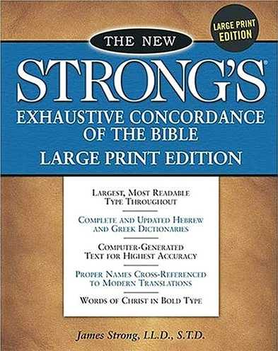
What About The Children?
Is a man able to keep them from being out of control not accused of dissipation or insubordination?
Did this man run his children or did they run him? That’s seems to be the context.
The Greek word Teknon is found numerous times in the New Testament and is used in 1 Timothy 3:4 and Titus 1:6 From Strong’s Concordance & dictionary: 5043. Teknon, tek'-non; from the base of G5088; a child (as produced):--child, daughter, son.
Luke 20:28-33
See also Colossians 3:20-21 and 1 Timothy 5:4

Slide 16
Unwilling to Submit (1 Peter 5:5)
This matter of submission is consistent with a king and a kingdom.
The Lord’s church is not a democracy and thanks be to God for that.
The elders do not make up any rules for us to follow, they merely have the responsibility of being our “Big Brother” who is answerable to our Father in heaven for how well they watched out for our well-being.
Good leadership involves listening to the group and considers their well-being before making some decisions.
Sometimes the mark of good leadership is not listening to or caving in to the desires of the group that are not scriptural

Slide 17
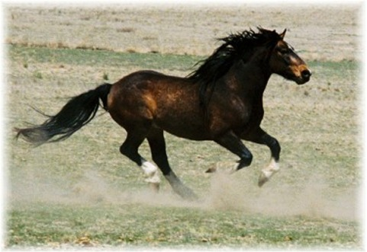
Maverick: One that refuses to abide by the dictates of or resists adherence to a group; a dissenter.
The Maverick does not want to be under anyone’s oversight.
He will buck at any consideration of appointing overseers.

