Slide 1
A Disciple's Speech
James 3:1-12

Slide 2
What can a person’s speech reveal about a them?
It can reveal where you are from and who you spend time with.
Matthew 26:73
It could be a sign of your intelligence or maturity. Proverbs 15:2,4 17:28
It can reveal a lot about your character. Proverbs 10:31-32, 26:28
Ephesians 4:29
Let no unwholesome word proceed from your mouth, but only such a word as is good for edification according to the need of the moment, so that it will give grace to those who hear.
Notes:
Our speech can be one of the biggest disqualifiers when sharing the gospel. The type of thins we say and how we say them can pull or push someone away form the gospel.

Slide 3
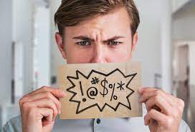
“let no unwholesome word”
Unwholesome – sapros (sap-ros’)
Meaning: rotten, putrefied, unfit for use.
Ephesians 4:25 Lying
Proverbs 12:22 6:16-19
Ephesians 5:4 Filthiness (obscenity), Foolish talk, coarse jesting
Curse words: &%#$
Euphemism: a mild or indirect word or expression substituted for one considered to be too harsh or blunt when referring to something unpleasant or embarrassing.
OMG
Notes:
There are over 170,000 words in our dictionary,
Most people have a vocabulary or 20,000 to 30,000
There are about 4 that society deems inappropriate.

Slide 4
“a word good for edification” (building up)
Ephesians 4:14-16
Speaking the truth in love
Honesty always (no little white lies)
Colossians 3:16
Are the words of Christ dwelling within you?
Did you find it edifying from the songs sang this morning?
1 Thessalonians 5:11
Psalm 37:30-31
Those that are righteous can spread wisdom.

Slide 5
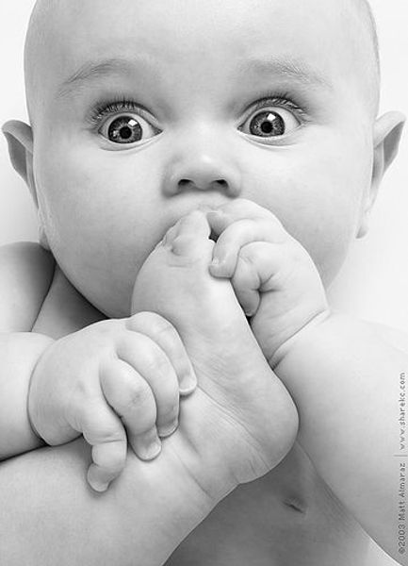
“need of the moment” (Proper)
Peter’s example “putting his foot in his mouth”
Matthew 16:21-23
Matthew 17:1-8
John 13:5-11
Peter’s examples “need of the moment”
Luke 9:20
Acts 1 and 2
Proverbs 17:28, 18:13
Notes:
ESV “as fits the occasion,

Slide 6
“give grace”
Proverbs 15:1
Colossians 4:6
Speech seasoned with salt.
Is grace present when difficult conversations arise?
Constructive criticism vs pointing out our flaws.
James 1:19
Matthew 12:33-37
“every careless word”
Notes:
We must remember what comes out of our mouth reflects our heart.
Matthew 15:18-20

