Slide 1
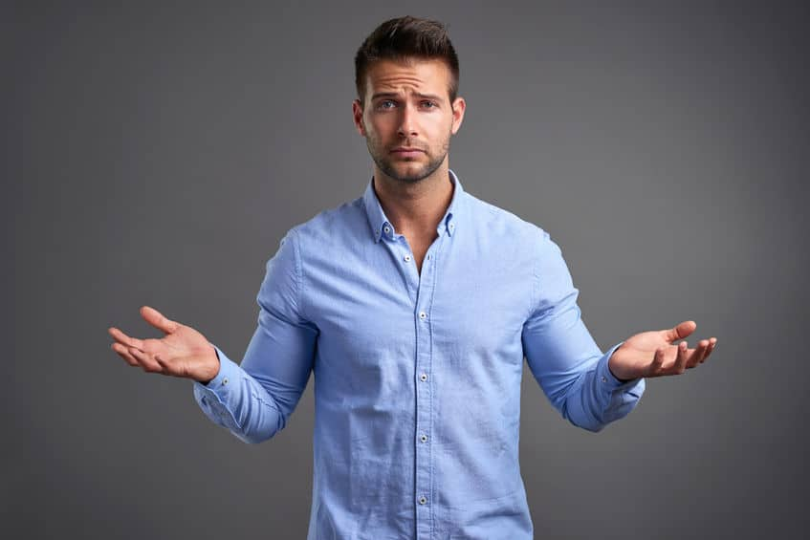
“It Is Good”
Readings -- Titus 2:11-14 & John 5:28-29
What Is Good?

Slide 2
“Good” Is A Matter Of Opinion!
Music
Food
Movies, etc.

Slide 3
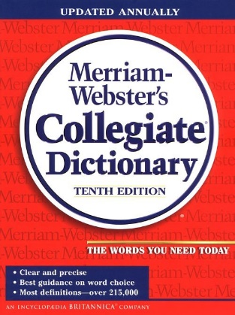
Definition of Good
Good – (something that is) suitable to a
purpose, beneficial, valid, genuine, real,
enjoyable, dependable, reliable, satisfying,
morally sound or excellent.

Slide 4
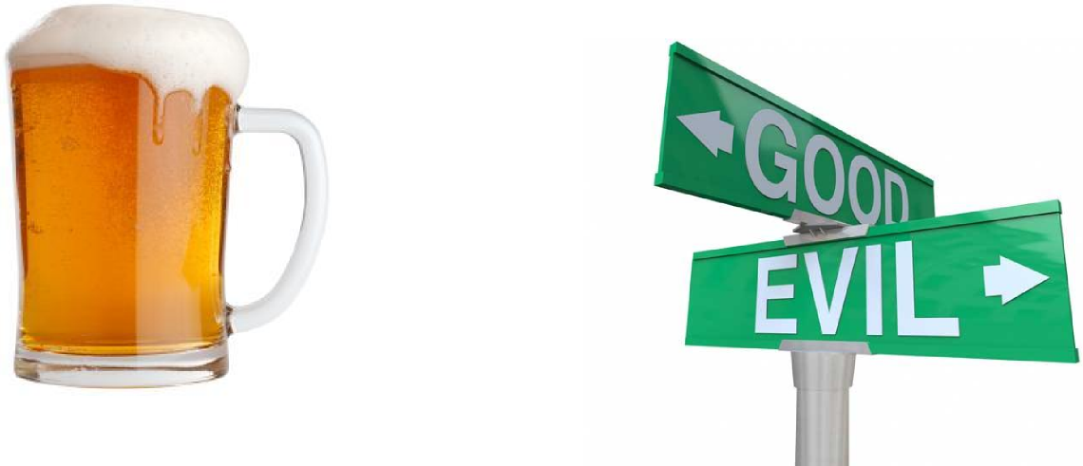
Is it Good?
Good – (something that is) suitable to a
purpose, beneficial, valid, genuine, real,
enjoyable, dependable, reliable, satisfying,
morally sound or excellent.

Slide 5
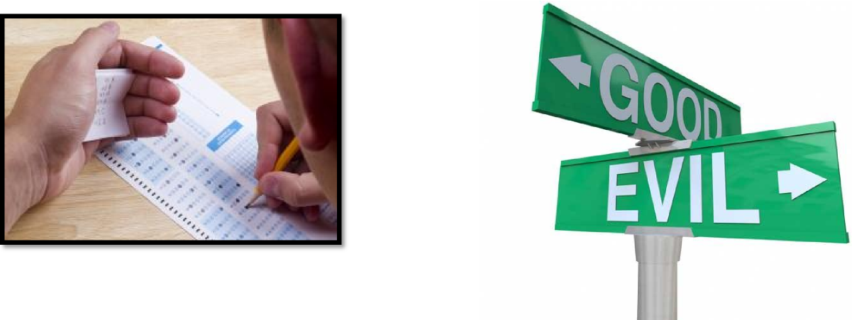
Is it Good?
Good – (something that is) suitable to a
purpose, beneficial, valid, genuine, real,
enjoyable, dependable, reliable, satisfying,
morally sound or excellent.

Slide 6
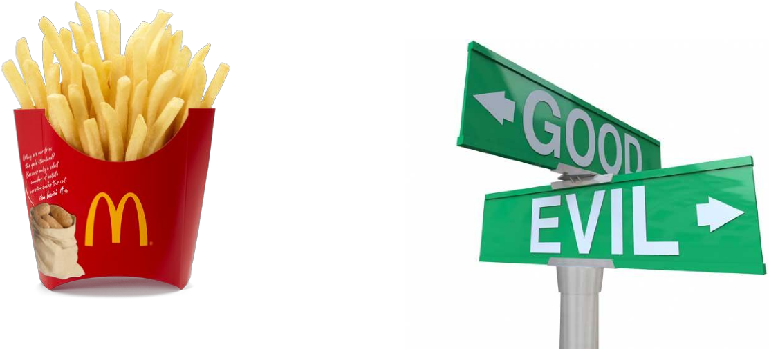
Is it Good?
Good – (something that is) suitable to a
purpose, beneficial, valid, genuine, real,
enjoyable, dependable, reliable, satisfying,
morally sound or excellent.

Slide 7
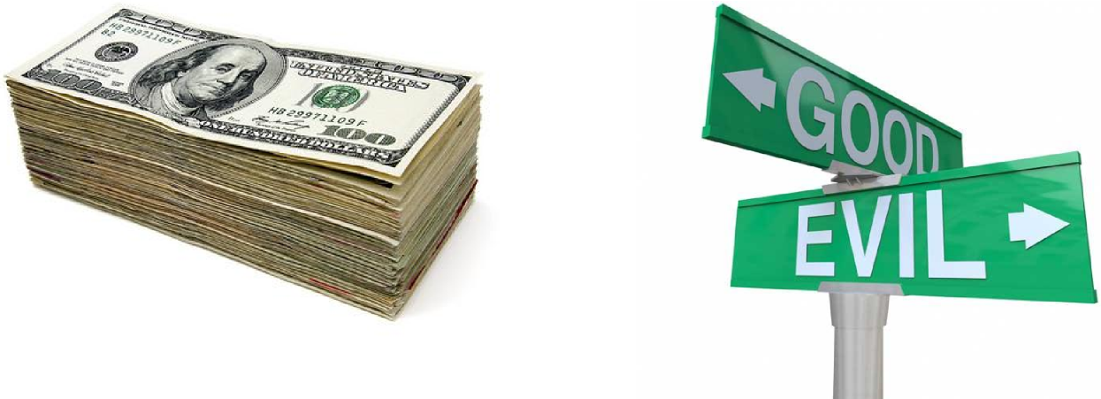
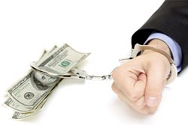
Is it Good?
Good – (something that is) suitable to a
purpose, beneficial, valid, genuine, real,
enjoyable, dependable, reliable, satisfying,
morally sound or excellent.

Slide 8
Isaiah 5:20
God defines what is good
Matthew 19:16-17
Genesis 1:31
James 1:17
2 Timothy 3:16-17

Slide 9
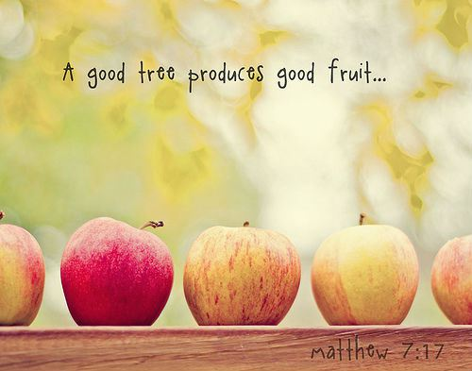
“Good” Produces “Good”
Matthew 7:17-19
Luke 6:45
Luke 8:15

Slide 10
“Good” Needs A Solid Foundation
1 Timothy 6:17-19
Matthew 7:24-27

Slide 11
What Is Your Desire?
Proverbs 11:23
1 Thessalonians 5:15 & 21
Romans 12:9
1 Corinthians 15:33
Romans 12:21

Slide 12
This Is Good
Proverbs 22:1

Slide 13
Your Thoughts - Are They Good?
Philippians 4:8

Slide 14
Good Is As Good Does
3 John 11
How “GOOD” Are You?

