Slide 1
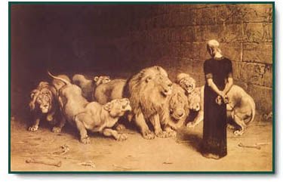
Religious Disobedience
Reading: Daniel 6:14-24
“He Is Able To Deliver Thee”

Slide 2
(Daniel 6:1-3)
It pleased Darius to set over the kingdom 120 satraps, to be throughout the whole kingdom; ²and over them three presidents, of whom Daniel was one, to whom these satraps should give account, so that the king might suffer no loss. ³Then this Daniel became distinguished above all the other presidents and satraps, because an excellent spirit was in him. And the king planned to set him over the whole kingdom.

Slide 3
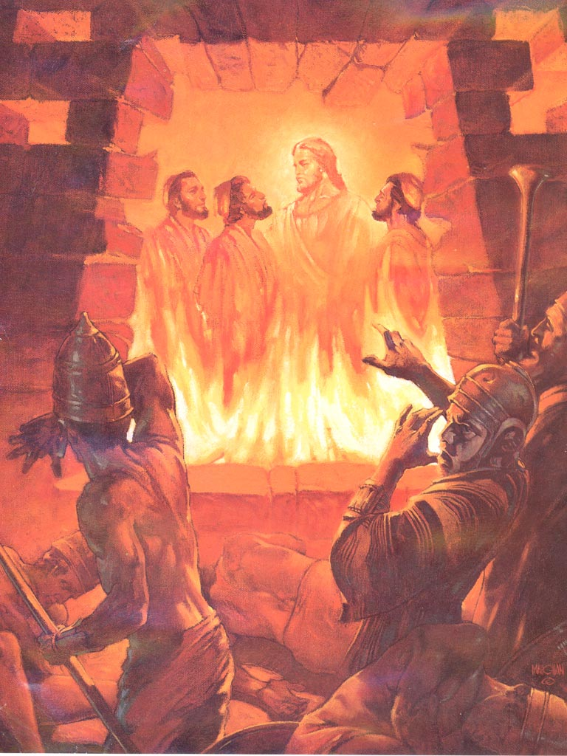
Daniel 6:1-3 -- How old do you think Daniel is now?
He was a child [Chapter 1: 10] about 6 when he was taken to Babylon in 607 BC.
4 years later [10 yr. old] he interprets Nebuchadnezzar’s dream
23 years later [33 yr. old] Daniel witnesses the Deliverance of Shadrach, Meshach, and Abednego from the fiery furnace.

Slide 4
How old do you think Daniel is now?
Ten years later [43 yr. old] Daniel is called to interpret another dream of the king.
Belshazzar is the king 32 years later when Daniel interprets the writing on the wall. By now he’s [75 yr. old].
Within one year Darius is now king of the Medo-Persian Empire.
By this time Daniel is not a young man, but an old & wise man of much experience.

Slide 5
Daniel is the most qualified man for his position.
Every ruler, including our president, surrounds himself with a group of advisors.
By this time Daniel was an expert on every aspect of the Babylonian culture and government.
Daniel would also be a neutral judge because he was neither a Persian nor a Babylonian. [Vs. 3] Then this Daniel was preferred above the presidents and princes, because an excellent spirit was in him; and the king thought to set him over the whole realm.
A good comparison to Joseph as he worked his way to the top. He rose through righteousness, not by trickery, deceit or compromise.

Slide 6
Daniel 6:4-9
You can see that politics and politicians have not changed substantially in over 2000 years.
Jealous and ambitious [as well as less qualified] politicians plot to get Daniel out of the way.

Slide 7
Step #1 Dig Up As Much Dirt As You Can.
(Vs.4) Then the presidents and princes sought to find occasion against Daniel concerning the kingdom; but they could find none occasion nor fault; Forasmuch as he was faithful, neither was there any error or fault found in him.
Let’s hope that the same can be said about us.
They could find no treachery in Daniel because being a good citizen is consistent with God’s will.
Romans 13:1-7

Slide 8
Step #2 Force Him Act Upon Principle To His Detriment
[Vs 5] Then said these men, We shall not find any occasion against this Daniel, except we find it against him concerning the law of his God.
They knew the only way to get Daniel to lose was to force him into acting upon principle.
As much as we hate to admit it, there are people who will use your faith against you for their own gain.

Slide 9
Step #3: Lay A Carefully Planned Diversion
They decided to use Daniel’s faithfulness and Darius’ pride.
The plan was under the disguise of national policy.
They make an appeal to Darius’ desire for increased power & control.

Slide 10
Step #4 Get It Signed It Into Law NOW!
[Vs 7] They made it a law that indirectly banned prayer.
Did anyone ask Daniel’s opinion of this law?
Look how much 11th Hour Legislation gets passed when key personnel are missing!

Slide 11
Daniel 6:10-17 Notice how Daniel broke the law the very day it was signed.
(Daniel 6:10) Now when Daniel knew that the writing was signed, he went into his house... he kneeled upon his knees three times a day, and prayed.
He could not claim ignorance.
He practiced the principle of “Civil Disobedience”
We should be thankful that we don’t have laws that require us to play the lottery or abort our children.

Slide 12
A man of Daniel’s position had alternatives.
Argue that he was framed or that the law was unfair.
Just like our Congressmen he could have taken a 30-day junket.
He could comply with the law. --- Besides, it was only temporary.
Obey & Serve God just as he always did [Vs 10]

Slide 13
[Vs. 10] Daniel gave thanks before his God, as he always had.
Why would he thank God for allowing this terrible law to pass?
Because no matter what happened, he had a million reasons to be thankful

Slide 14
[Vs 12 & 13] The princes came in the very next day accusing Daniel.
How did they know he prayed?
It never was a secret that Daniel prayed
They all probably knew Daniel’s prayer schedule
Just as your neighbors know your worship schedule

Slide 15
[Vs 14] Darius is very displeased.
He is not angry with Daniel but with himself for being duped into signing this ridiculous law.
He tries with all his might to change Daniel’s fate.
The others were quick to point out that this was HIS law.

Slide 16
Notice Darius’ faith in Daniel’s God.
(Vs. 16) Then the king commanded, and they brought Daniel, and cast him into the den of lions. Now the king spoke and said unto Daniel, Your God whom thou serve continually, he will deliver you.
Was he trying to cheer Daniel up when he knows his true fate?
Or did he possibly know about Shadrach, Meshach, and Abednego?

Slide 17
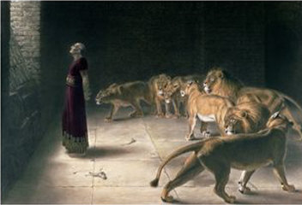
Can you read any assurances from God that shows us Daniel was to be spared?
NO!

Slide 18
(Daniel 6:17-24)
Then a stone was brought and laid on the mouth of the den, and the king sealed it with his own signet ring and with the signets of his lords, that the purpose concerning Daniel might not be changed. {18} Now the king went to his palace and spent the night fasting; and no musicians were brought before him. Also his sleep went from him. {19} Then the king arose very early in the morning and went in haste to the den of lions. {20} And when he came to the den, he cried out with a lamenting voice to Daniel. The king spoke, saying to Daniel, "Daniel, servant of the living God, has your God, whom you serve continually, been able to deliver you from the lions?” ------

Slide 19
(Daniel 6:17-24)
{21} Then Daniel said to the king, "O king, live forever! {22} "My God sent His angel and shut the lions' mouths, so that they have not hurt me, because I was found innocent before Him; and also, O king, I have done no wrong before you." {23} Then the king was exceedingly glad for him, and commanded that they should take Daniel up out of the den. So Daniel was taken up out of the den, and no injury whatever was found on him, because he believed in his God. {24} And the king gave the command, and they brought those men who had accused Daniel, and they cast them into the den of lions; them, their children, and their wives; and the lions overpowered them, and broke all their bones in pieces before they ever came to the bottom of the den.

Slide 20
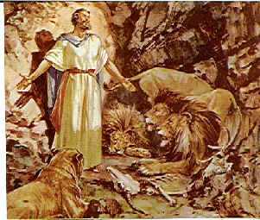
Pertinent Questions

Slide 21
Pertinent Questions
If God did not save Daniel from the Lions, would that make any difference to you?
What would it have proved if the lions had eaten Daniel?
Does that say anything about God’s faithfulness?
Didn’t God allow Christians to be mauled by lions in the Roman arenas?

Slide 22
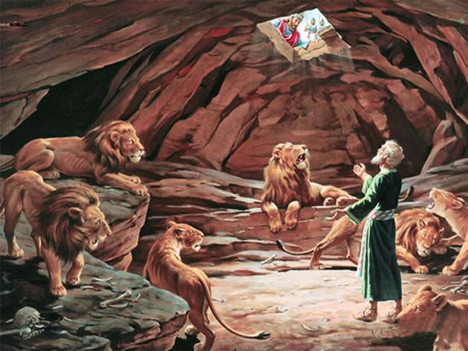
Does God always save everyone from the mouth of lions?
The answer is NO
Daniel did not base his faith on the fact that he would be delivered.
He probably thought he was a dead man.

Slide 23
Did God spare Jesus from the death on the cross, seeing that He was faithful?
We should learn this lesson:
Just because you are a faithful Christian, God will not necessarily spare you from the cruelties of life.

Slide 24
Even if Daniel were torn to pieces, it would not have affected his soul one bit.

Slide 25
Remember!
1. Don’t compromise what is right.
2. Stand your ground instead of running away
3. Be thankful regardless of your circumstances.

