Slide 1
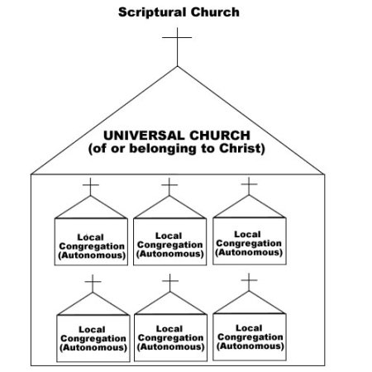
The Church, The Church and The Church
Reading – Romans 16:1-16

Slide 2
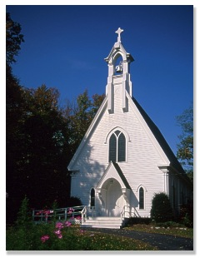
The nature of "The Church Jesus Built"
Considers the meaning of the word "church" itself
From the Greek word ekklesia, it means "an assembly“
It is not an assembly of wood, brick & mortar

Slide 3
Used most frequently in the New Testament in two senses:
The church "universal" - that company of souls redeemed by the blood of Christ
The church "local" - Christians in a geographical area that work and worship together as a congregation of God's people.

Slide 4
Other terms which enhance our view of the "church"--
These expressions reveal different aspects of the Lord's great assembly!
1) The "body" of Christ
2) The "household" of God
3) The "temple" of God
4) The "kingdom" of Christ
5) The "bride" of Christ

Slide 5
THE CHURCH "UNIVERSAL"
Composed of all Christians... Not Denominations
This is the church to which Jesus referred in Matthew 16:18

Slide 6
It is made up all the saved, both living and dead
Hebrews 12:22 – 23 But you have come to Mount Zion and to the city of the living God, the heavenly Jerusalem, to an innumerable company of angels, ²³to the general assembly and church of the firstborn who are registered in heaven, to God the Judge of all, to the spirits of just men made perfect,

Slide 7
There is only "one" church...
The universal church is called the "body" of Christ – Ephesians 1:22-23
There is only one "body" (Ephesians 4:4); therefore, only one church!
It Began on the day of Pentecost in Jerusalem, following the death, resurrection and ascension of Christ –
Acts 2:1-47

Slide 8
“Added" by the Lord...
People cannot "join" the universal church
Rather, they are "added" by the Lord Himself when saved Acts 2:41,47
The Lord keeps the books of membership...
There is no agency on earth that keeps the registry of true members
Enrollment is in heaven; 2 Timothy 2:19 Nevertheless the solid foundation of God stands, having this seal: “The Lord knows those who are His,”

Slide 9
Consists of all the saved...
The Lord is presenting to Himself a church holy and without blemish Ephesians 5:25 – 27 Husbands, love your wives, just as Christ also loved the church and gave Himself for her, ²⁶that He might sanctify and cleanse her with the washing of water by the word, ²⁷that He might present her to Himself a glorious church, not having spot or wrinkle or any such thing, but that she should be holy and without blemish.

Slide 10
Those in the church who are sinning and refuse to repent are "cut off", "cast out",
John 15:2 – 6 Every branch in Me that does not bear fruit He takes away; and every branch that bears fruit He prunes, that it may bear more fruit… ⁶If anyone does not abide in Me, he is cast out as a branch and is withered; and they gather them and throw them into the fire, and they are burned.

Slide 11
Those in the church who are sinning and refuse to repent are "cut off", "cast out",
Romans 11:19 - 22 You will say then, “Branches were broken off that I might be grafted in.” ²⁰Well said. Because of unbelief they were broken off, and you stand by faith. Do not be haughty, but fear. ²¹For if God did not spare the natural branches, He may not spare you either. ²²Therefore consider the goodness and severity of God: on those who fell, severity; but toward you, goodness, if you continue in His goodness. Otherwise you also will be cut off.

Slide 12
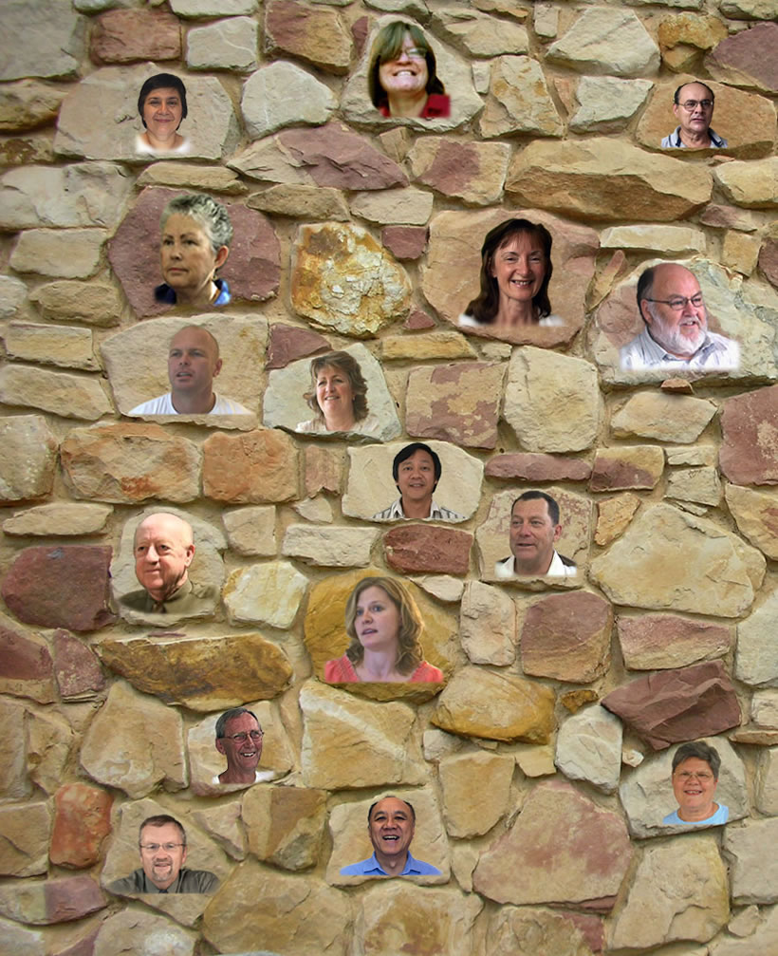
Has no "earthly" organization...
The church "universal" does have organization - cf. Ephesians 2:19-22;
It is spiritual in nature
Christ as the cornerstone and all Christians as "living stones“ [1 Peter 2:5]
No earthly headquarters

Slide 13
Death doesn't affect membership...
The church "universal" is made up of the saved, both present and past – [Hebrews 12:22-23]
When one dies, they are still with Christ! Philippians 1:21 – 23 For to me, to live is Christ, and to die is gain… ²³For I am hard-pressed between the two, having a desire to depart and be with Christ, which is far better.
1 Thessalonians 5:10 that whether we wake or sleep, we should live together with Him.

Slide 14
Universal Church made up of local congregations & individuals Present & Past

Slide 15
There are "many" churches...
Paul had reference to local churches in Romans 16:16
And again when he wrote Galatians 1:2

Slide 16
Start with identifying a.k.a “joining” with a local church...
Such as Paul sought to do when he came to the church in Jerusalem –
(Acts 9:26-28)
Sometimes people are rejected when they should be received –
(3 John 5-9)

Slide 17
LOCAL: Consists of both saved and lost...
A local congregation may therefore have some that are nominal Christians –
(Revelation 3:1-4)
Hypocrites & wolves may become members of a local church; but they don't sneak by the Lord to become members of the universal church!

Slide 18
LOCAL: Has "earthly" organization...
A scripturally organized congregation will have bishops & deacons – Philippians 1:1
These bishops were also called "elders" and "pastors“ [never singular], whose role was to oversee and feed the local congregation - Acts 14:23; 20:17,28

Slide 19
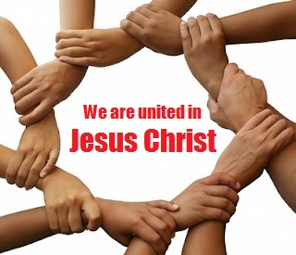
LOCAL: Can be divided...
Local congregations can be divided over doctrine or personalities
Such was the case with the church at Corinth - 1 Corinthians 1:10-13; 3:3,4
We can't divide the universal church!

Slide 20
The key difference between the two is this...
The church "universal" in essence concerns our relationship with Christ
The church "local" basically concerns our relationship with one another

Slide 21
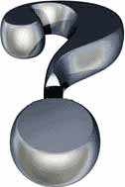
Is our relationship with Christ and each other what it should be?

