Slide 1
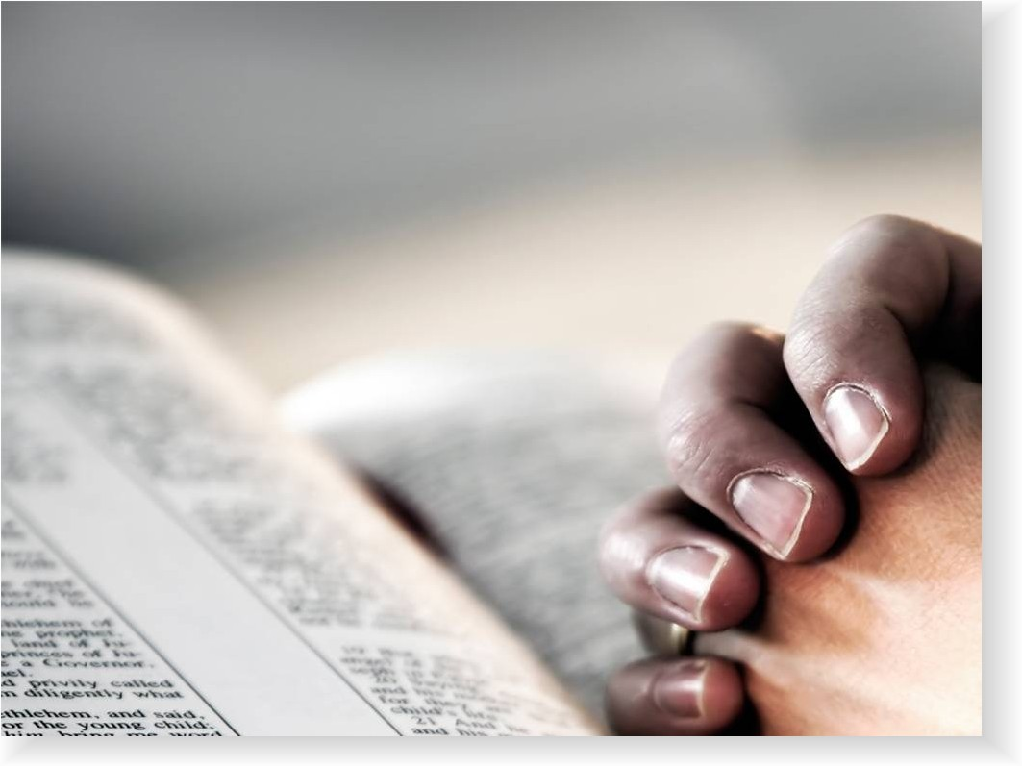
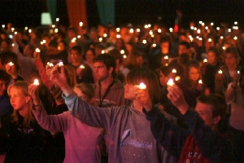
Who Do We Fellowship? in?
Reading: 1 John 1:1-10

Slide 2
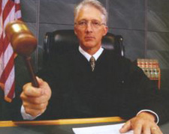
Are we the Judge?
Just what does it mean to have this fellowship?

Slide 3
How Can We Determine Who is IN and who is OUT of fellowship in prayer?
Can we pray in a general public gathering such as Memorial Day or a school event?
Does the person leading the prayer need to be sinless before we can pray?

Slide 4
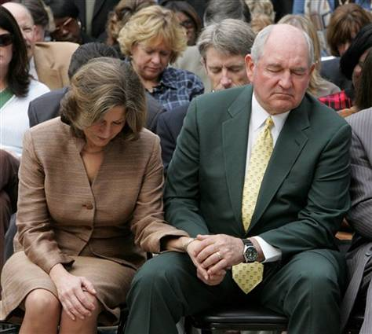
Example:
The Governor requested having prayer in front of the Capitol for relief from the drought. If we say “Amen” to the prayer are we now having fellowship with that person?

Slide 5
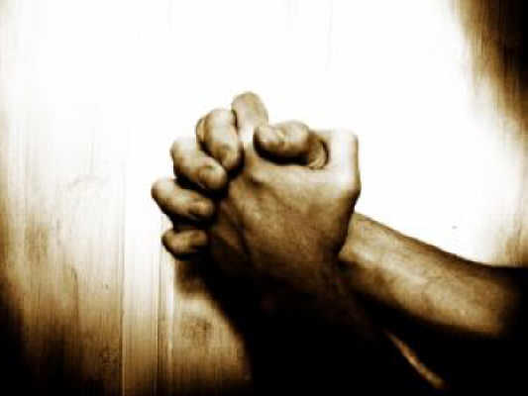
Prayer Is a dialogue between the individual and God
If you were not in tune with the prayers that we just had you were not in fellowship with God.
Saying “Amen” doesn’t validate a prayer that is not heartfelt.

Slide 6
Private Prayer Is Easy To Do – Public Prayer?
[Matthew 6:5 – 6]
“Pray without ceasing” [1 Thessalonians 5:17]

Slide 7
Public Prayer Is Harder To Handle
Prayers, Singing, and taking the Lord’s Supper are done communally --
However, they are still observed individually
1 Corinthians 11:26-29
2 Corinthians 5:10
Galatians 6:5

Slide 8
Public Prayer Is For God To Judge
[Matthew 23:14] Woe to you, scribes and Pharisees, hypocrites! For you devour widows’ houses, and for a pretense make long prayers. Therefore you will receive greater condemnation.
Did that mean the others who may have been trying hard to pray at the same time were deemed as hypocrites as well?
God knows the heart of the one doing the praying and judges accordingly.

Slide 9
1 John 3:20-22 – Value of Self Examination
For if our heart condemns us, God is greater than our heart, and knows all things. ²¹Beloved, if our heart does not condemn us, we have confidence toward God. ²²And whatever we ask we receive from Him, because we keep His commandments and do those things that are pleasing in His sight.
On top of this God helps us in our prayers……

Slide 10
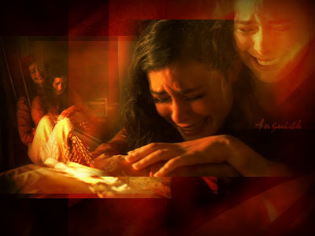
Romans 8:26-27
Likewise the Spirit also helps in our weaknesses…. but the Spirit Himself makes intercession for us with groanings which cannot be uttered…
When we are IN fellowship, God helps us to communicate with Him.

Slide 11
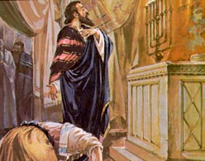
Luke 18:9-14
The Pharisee and the Publican both pray in the same location.
One goes home justified

Slide 12
James 5:13-16
What if that one or all of the elders have secret sins that you don’t know about?
Does that negate your request? Are you still in your sins?
The same scenario could be applied to someone being baptized by a “sinner” or someone offering the Lord’s Supper.

Slide 13
In Regard to Fellowship ---
They may have sinned or they could have been out of fellowship with God
But You were whole-heartedly seeking God’s fellowship
(Proverbs 24:29) “… I will render to the man according to his work.“
When All is said and done all we are sinners praying for other sinners and God sorting out who’s IN and who’s NOT!

Slide 14
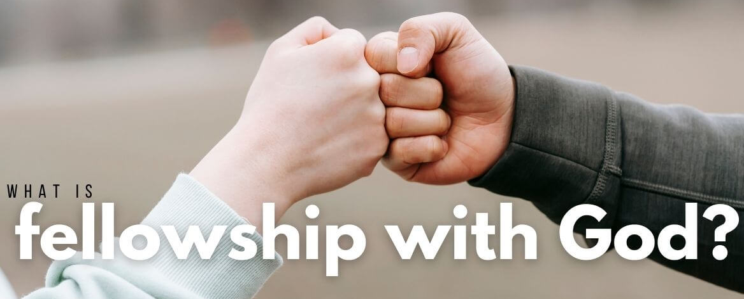
John 9:31 [ex. Cornelius in Acts 10]
Now we know that God does not hear sinners; but if anyone is a worshiper of God and does His will, He hears him.
We don’t determine who is in fellowship with God and who’s prayer is heard or not heard.
We need to be more concerned with OUR fellowship with God than with each other.

Slide 15
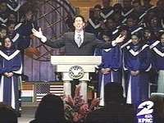
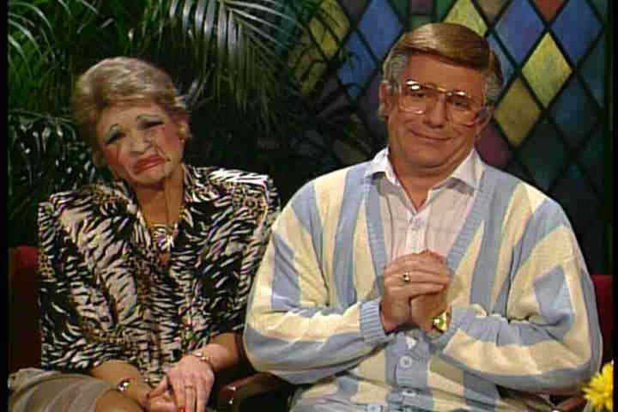
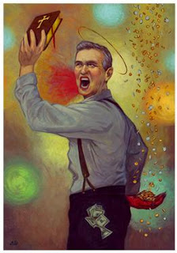
Philippians 1:15 - 16
Some indeed preach Christ even from envy and strife, and some also from goodwill: ¹⁶The former preach Christ from selfish ambition, not sincerely….

Slide 16
Can You Say “Amen” To These Statements?
“Faith comes by hearing the word of God”
“Unless you repent you will also likewise perish”
“For with the heart man believes unto righteousness; and with the mouth confession is made unto salvation.”
“He who believes and is baptized shall be saved”
“And why do you wait? Arise, and be baptized, and wash away your sins, calling on the name of the Lord.”

Slide 17
What if these were uttered by a denominational preacher?
“Faith comes by hearing the word of God”
“Unless you repent you will also likewise perish”
“For with the heart man believes unto righteousness; and with the mouth confession is made unto salvation.”
“He who believes and is baptized shall be saved”
“And why do you wait? Arise, and be baptized, and wash away your sins, calling on the name of the Lord.”

Slide 18
The Truth is still the Truth no matter who speaks it – regardless of their motives. Philippians 1:15 - 18
If we say “Amen” to any statement coming from God’s word we are not necessarily having fellowship with the one saying it because he may or may NOT be in fellowship with God.
We are in fellowship only if we are BOTH “walking in the light.” [1 John 1:7]

Slide 19
How Will You Be Judged?
We will all stand before the great tribunal one day.

Slide 20
Are You In Fellowship When You Pray? If not – Get Right Now!
1 John 1:1-10

