Slide 1
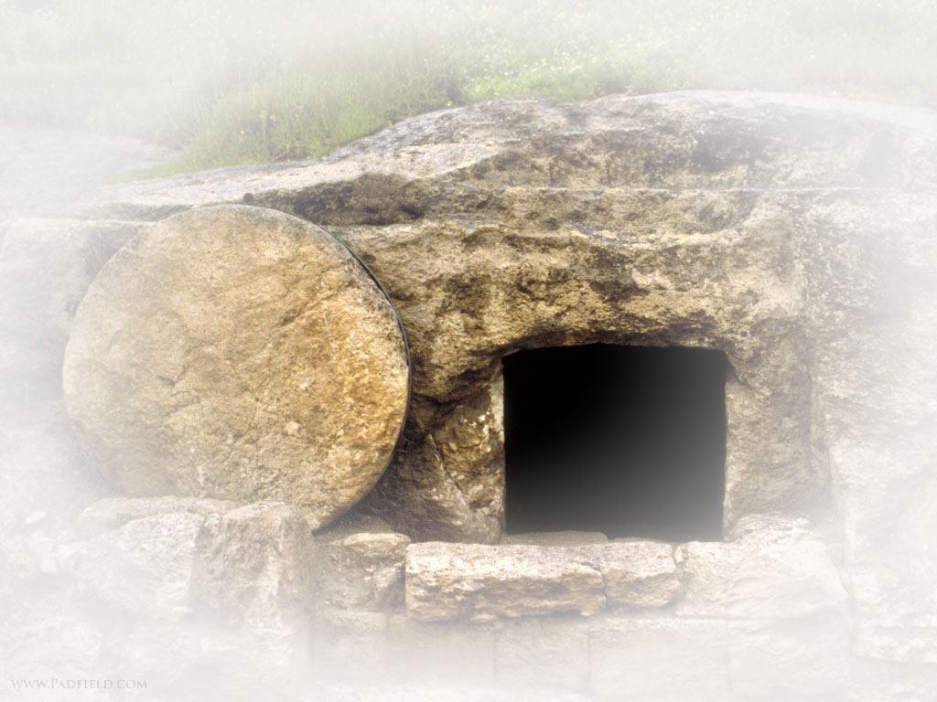
Easter Celebrations
Text - Galatians 4:1-11

Slide 2
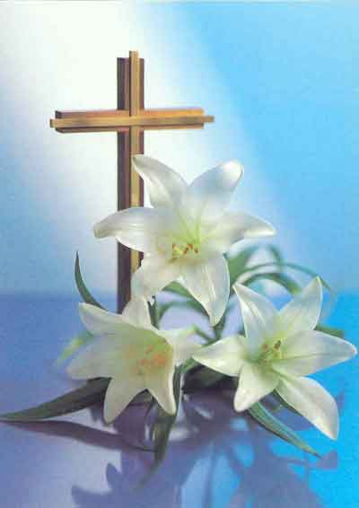
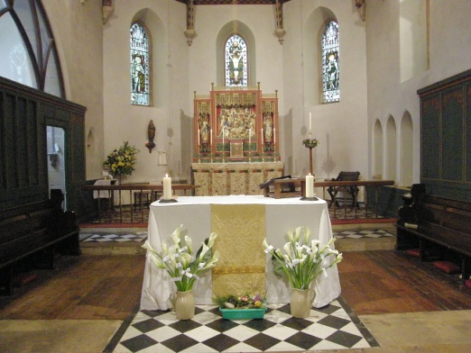
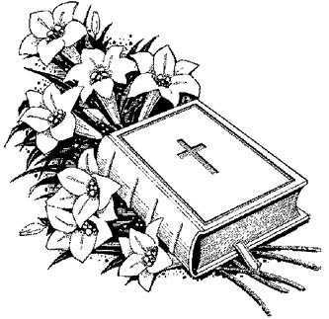
Much-ado about ``Lent'' and ``Easter.''
Have you stopped to investigate more fully just where all of it came from?

Slide 3
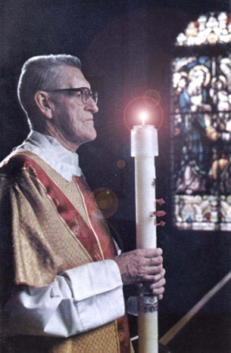
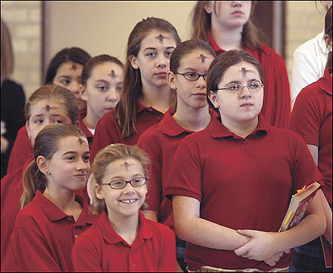
"Times'' and "Days" and "Seasons''
There are several times and days that are observed.
Where did they come from?
What is the Christian's relationship to them?
Are you fulfilling EASTER DUTY this week?

Slide 4
Misunderstanding
This lesson is to either confirm what you already know about Easter or to give you something to consider.

Slide 5
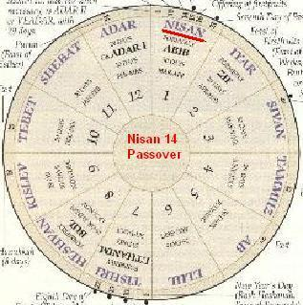
Convergence of 3 particular events.
1. The Hebrew Passover----celebrated during the month of NISAN (First of the month of the Hebrew calendar).

Slide 6
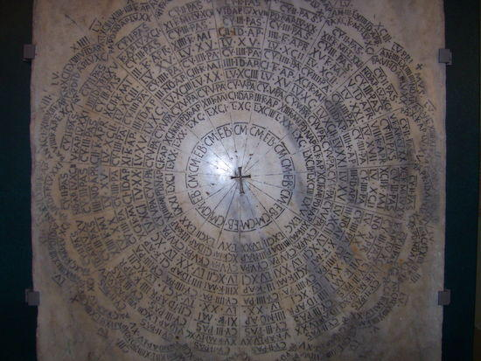
Convergence of 3 particular events.
1. The Hebrew Passover
2. The commemoration of the crucifixion and resurrection of Jesus the Christ, which took place at the feast of the Jewish Passover.

Slide 7
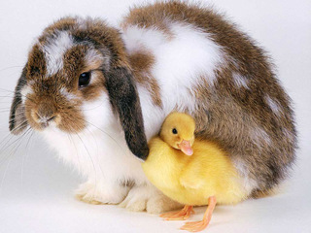
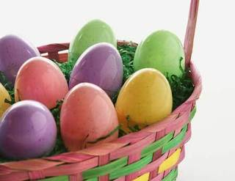
Convergence of 3 particular events.
1. The Hebrew Passover
2. The crucifixion & resurrection of the Christ
3. Pagan fertility festivals of Spring that fell at the vernal equinox on March 21.

Slide 8
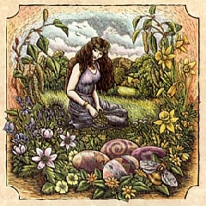
Convergence of 3 particular events.
1. The Hebrew Passover
2. The crucifixion & resurrection of the Christ
3. A pagan festival embodied the worship of the Saxon goddess Eostra.

Slide 9
disputed celebration date
The council of Nicaea (325 A.D.) decreed it should be on a Sunday but did not fix the particular Sunday.
Rule was finally set in the 7th century.
RULE: First Sunday after the first full moon following the first day of Spring which falls on March 21 of each year.
Simple!!

Slide 10
The Greatest Religious Event
So for that reason it is all right to forget God the rest of the year as long as you remember this one particular day!
Does that even sound logical to you?
1 Corinthians 11:23-26 For I received from the Lord that which I also delivered to you: that the Lord Jesus on the same night in which He was betrayed took bread; ²⁴and when He had given thanks, He broke it and said, “Take, eat; this is My body which is broken for you; do this in remembrance of Me.” ²⁵In the same manner He also took the cup after supper, saying, “This cup is the new covenant in My blood. This do, as often as you drink it, in remembrance of Me.” ²⁶For as often as you eat this bread and drink this cup, you proclaim the Lord’s death till He comes.

Slide 11
Current Religious Practices
LENT/ASH-WEDNESDAY is the first day of Lent.

Slide 12
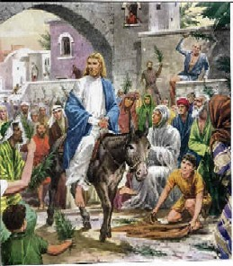
Current Religious Practices
LENT/ASH-WEDNESDAY is the first day of Lent.
PALM-SUNDAY is the last Sunday before Easter reflecting Jesus' triumphal entry into Jerusalem [John 12:12-15]

Slide 13
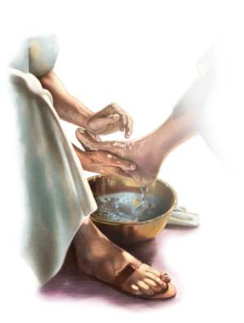
Current Religious Practices
LENT/ASH-WEDNESDAY is the first day of Lent.
PALM-SUNDAY
MAUNDAY-THURSDAY [foot washing]

Slide 14
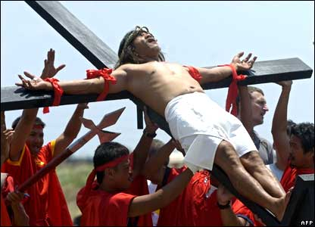
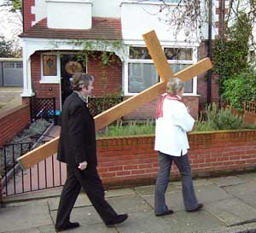
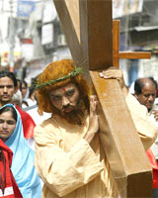
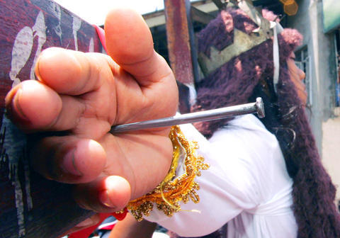
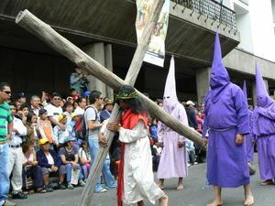
Current Religious Practices
LENT/ASH-WEDNESDAY is the first day of Lent.
PALM-SUNDAY
MAUNDAY-THURSDAY [foot washing]
GOOD FRIDAY

Slide 15
Current Religious Practices
LENT/ASH-WEDNESDAY is the first day of Lent.
PALM-SUNDAY
MAUNDAY-THURSDAY [foot washing]
GOOD FRIDAY
HOLY SATURDAY [the Easter Vigil]

Slide 16
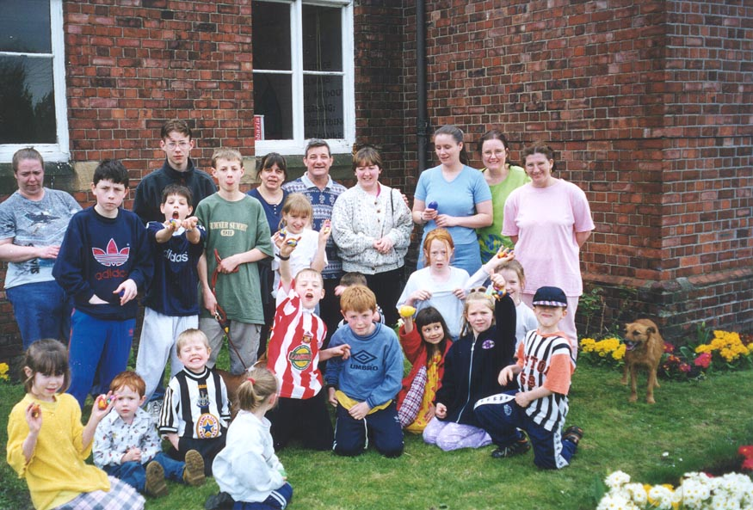
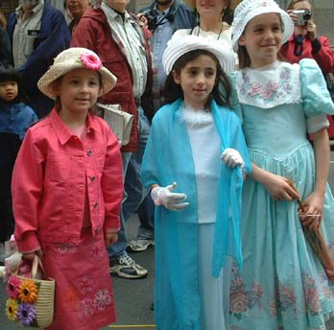
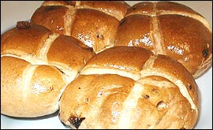
Non-Religious Practices
EASTER PARADE
EASTER EGGS HUNT
LENTEN PRETZELS
HOT CROSS BUNS

Slide 17
where’s the authority?
(2 John 1:9-11) Whoever transgresses and does not abide in the doctrine of Christ does not have God. He who abides in the doctrine of Christ has both the Father and the Son. {10} If anyone comes to you and does not bring this doctrine, do not receive him into your house nor greet him; {11} for he who greets him shares in his evil deeds.

Slide 18
Christians observe the Death & Resurrection of Jesus Christ every Lord's Day.
We can produce authority for that.
Acts 20:7 ``And upon the first day of the week, when the disciples came together to break bread……'‘
(1 Corinthians 11:23-26)

Slide 19
There is no authority to celebrate Easter or any other special time or day in a religious way.
Remember our text: Galatians 4:9-11
Colossians 2:16,21-22 ``Let no man therefore judge you in meat, or in drink, or in respect of an holyday, or of the new moon, or of the Sabbath days: 21(Touch not; taste not; handle not; 22 Which all are to perish with the using;) after the commandments and doctrines of men?''

Slide 20
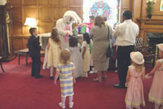
What Can It Hurt?
Why can’t the Easter Bunny come and give the kids candy on Sunday like they do everywhere else?
II Corinthians 6:17 Wherefore come out from among them, and be separate, says the Lord,

Slide 21
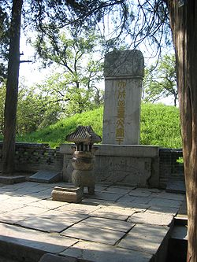
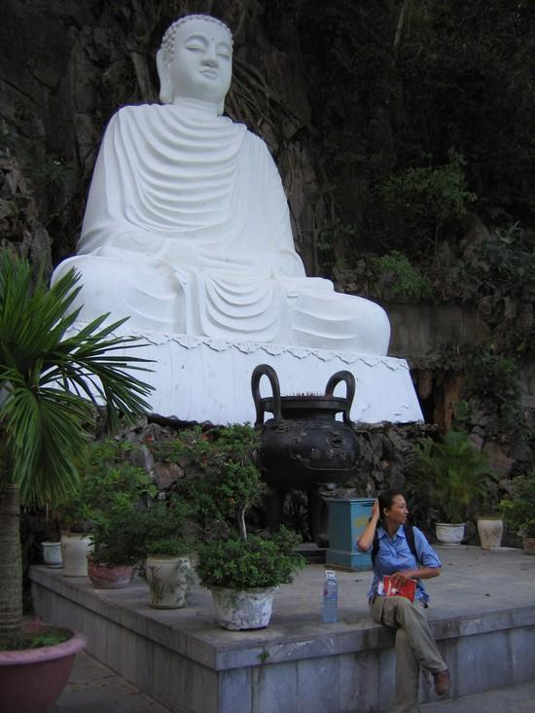
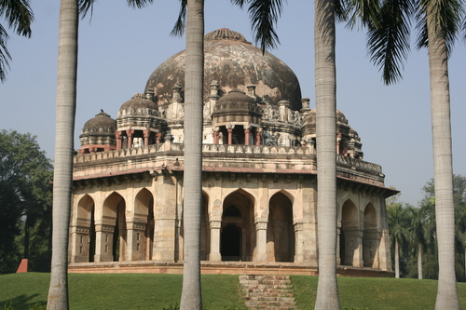
Has anyone cheated death and proved it?
Confucius' tomb
Buddha's tomb --
Mohammed's tomb --
Occupied
Occupied
Occupied

Slide 22
Jesus' tomb -- empty!

