Slide 1
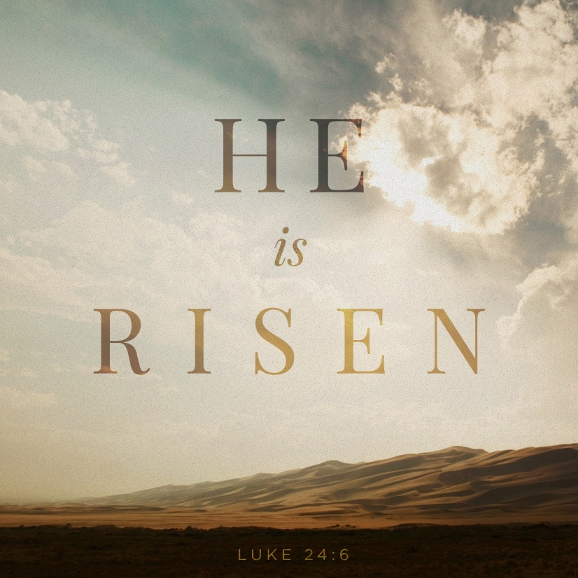
Events of The Lord's Resurrection “Six Days Before The Passover”
Readings– Matthew 12:38-40 and Luke 24:1-7

Slide 2
Important background information on the last week of Events Prior To The Resurrection
Three separate feasts were observed in Nisan = PASSOVER, PENTECOST and TABERNACLES.
The FIRST day of these feasts was “a holy convocation” - a “sabbath” on which no servile work was to be done. [Leviticus 23:7, 24, 35. Compare to Exodus 12:16]
That “Sabbath” and the “high day” of John 19:31 was the “holy convocation”, the FIRST day of the feast. This overshadowed the ordinary weekly sabbath.
This great Sabbath has been mistaken from the earliest times for the weekly sabbath. This has led to all of the confusion we have today.
This has naturally caused the further difficulty as to the Lord’s statement that “even as Jonah was in the belly of the fish three days and three nights, so shall the Son of man be in the heart of the earth three days and three nights.” [Matthew 12;40]

Slide 3
Facts Provided for Our Guidance
The ‘high day” of John 19:31 was the FIRST day of the feast.
The ‘first day of the feast” was on the 15th day of Nisan.
“Six days before the Passover” [John 12;1] takes us back to the 9th day of Nisan
“After two days is the Passover” [Matthew 26:2 & Mark 14:1] takes us to the 13th day of Nisan
Sunday, “The first day of the week” [Matthew 28:1] Jesus rose from the tomb
This fixes the days of the week with the days of Nisan.
Reckoning back from this, ‘three days and three nights” [Matthew 12:40] we arrive at the day of His burial which must have been before sunset on the 14th day of Nisan. WEDNESDAY
Wednesday, Nisan14, was the “preparation day” on which the crucifixion took place.
All four Gospels definitely say that this was the day on which the Lord was buried ”because it was the preparation day the bodies should not remain upon the cross on the sabbath day, for that day was a high day” not the ordinary Saturday sabbath.
The jews observe the Passover feast Nisan15 - Thursday

Slide 4
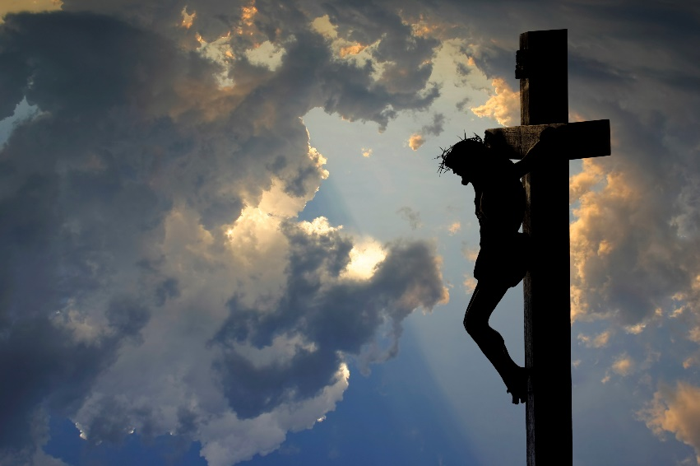
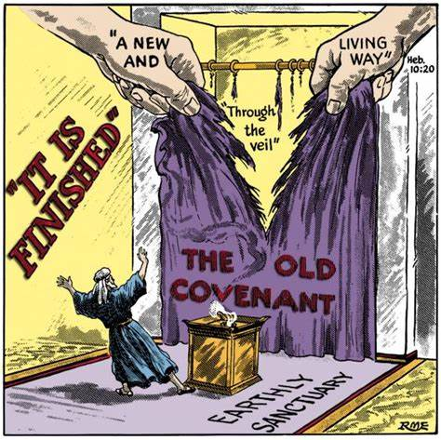
Conclusions:
The Lord was crucified on “the preparation day” meaning that Lord could not have eaten the Passover lamb.
Why? Because HE WAS the Passover Lamb!
He was hanging on the cross at noon [the 6th Hour] and he stated “It is Finished” [the 9th hour – 3 p.m.] when “He gave up the ghost”.
This was the “death of the testator” that ushered in a “New Covenant” [Hebrews 9:16-17]
The captives in the graves were freed from the bondage of sin!
[Matthew 27:51-52] Then, behold, the veil of the temple was torn in two from top to bottom; and the earth quaked, and the rocks were split, ⁵² and the graves were opened; and many bodies of the saints who had fallen asleep were raised;

Slide 5
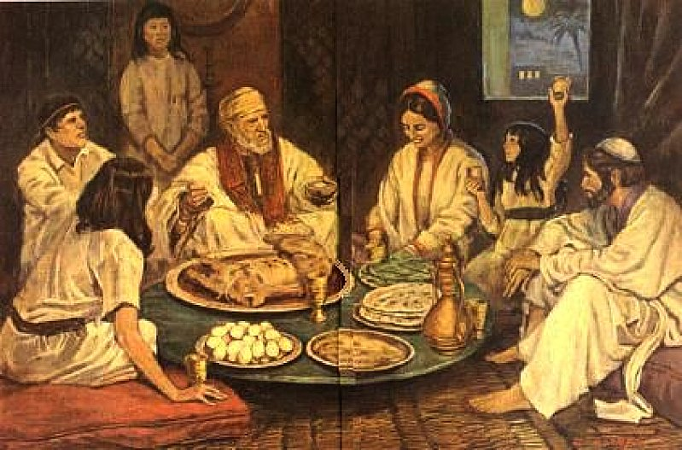
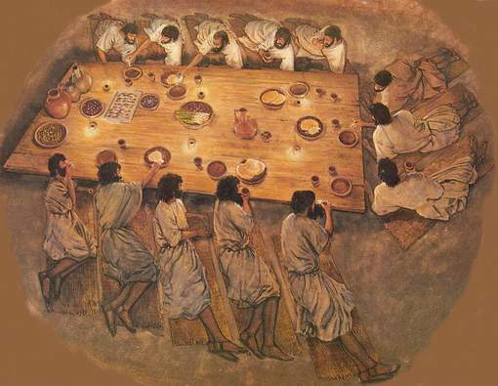
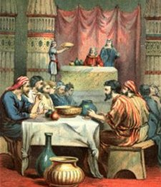
Nisan 15 Jewish Passover Observances
Jesus had his disciples “Prepare” for this observance
The Scriptures are silent as to if they observed it or not

Slide 6
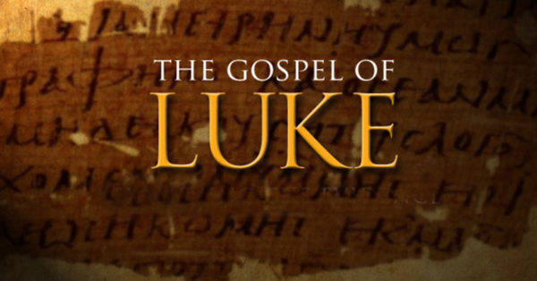
The 9th Day of Nisan-Sixth Day Before the Passover (Our Thursday sunset to Friday sunset)
The Lord approaches Jerusalem from Jericho [Luke 19:1-10]
He stays Thursday night at the house of Zacchaeus [Luke 19:15] And delivers the Parable of the Pounds [Luke 19:11-27]
He proceeds toward Jerusalem [Luke 19:28]
He sends two disciples to obtain two animals – a donkey & a colt [Matthew 21;1-7]
And makes His first entry from Bethphage (not Bethany) [Matthew 21:8-9]
He is unexpected and they ask “Who is this?” [Matthew 21:10-11]
He cleanses the Temple [Matthew 21:12-16]
He returns to Bethany [Matthew 21:17] [John 12:1]

Slide 7
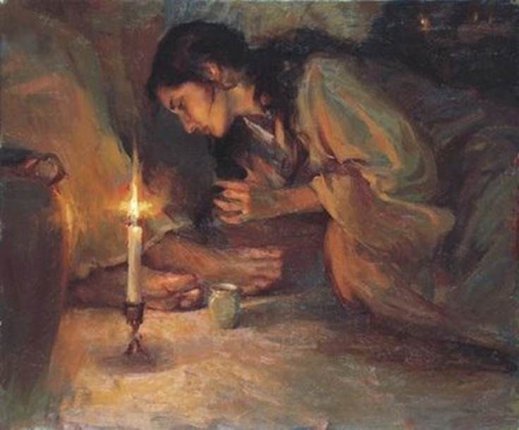
The 10th Day of Nisan- Five Days Before the Passover (Our Friday sunset to Saturday sunset)
The Lord passes the Sabbath day at Bethany with His Disciples; and sunset on Saturday, the first of three suppers was made, probably at the house of Lazarus in Bethany. [John 12:2]
At this supper the first of two anointings took place. [John 12:3-11]

Slide 8
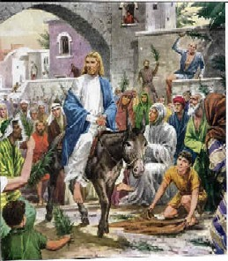
The 11th Day of Nisan-Four Days Before the Passover (Our Saturday sunset to Sunday sunset)
This is “Palm Sunday”
The 2nd Triumphal entry into Jerusalem. He sends two disciples for a colt (one animal) [Mark 11:1-7] [Luke 19:29-35] [John:12:12]
The Lord starts from Bethany and is met by multitudes from Jerusalem. [Mark 11:8-10] [Luke 19:36-40] [John 12:12-19]
He weeps over the city [Luke 19:41-44]
Enters the Temple and looks around & returns to Bethany [Mark 11:11]

Slide 9
The 12th Day of Nisan-Three Days Before the Passover (Our Sunday sunset to Monday sunset)
Monday morning the Lord returns to Jerusalem. [Matthew 21:18] [Mark 11:12]
The Fig Tree Cursed. [Matthew 21:19-22] [Mark 11:13-14]
The Temple Further Cleansed. [Mark 11:15-17] [Luke 19:45-46]
Teaching in the Temple “Certain Greeks” [Luke 19:47] [John12:20-50]
Opposition of Rulers [Mark 11:18] [Luke 19:47-48]
He leaves the city & back to Bethany. [Mark 11:19] [Luke 21:37-38]

Slide 10
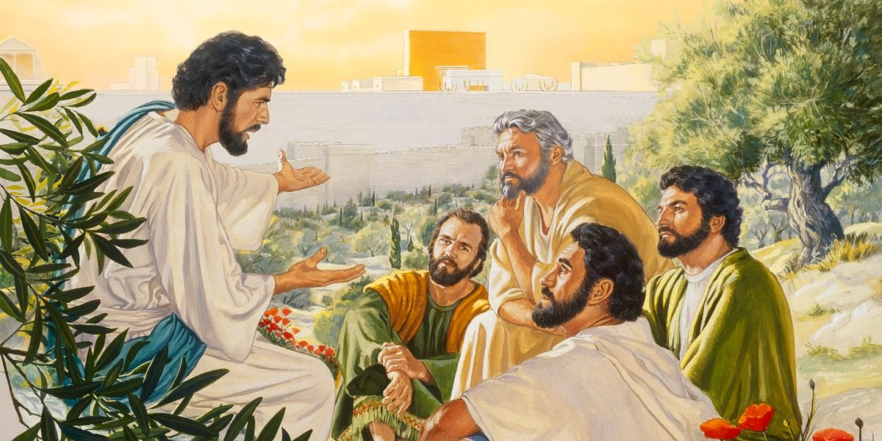
The 13th Day of Nisan-Two Days Before the Passover (Our Monday sunset to Tuesday sunset)
Tuesday morning on the way, the question of the disciples about the Fig Tree [Mark 11:20]
In the Temple in Jerusalem. [Matthew 21:23-27] [Mark 11:27-33] [Luke 20:1-8]
Teaching in Parables & questions. [Matthew 21:28-23:39] [Mark 12:1-44] [Luke 20:9 -21:4]
First great prophecy in the Temple [Luke 21:5-36]
Second great prophecy on the Mount of Olives. [Matthew 24:1-51 & 25:1-46] [Mark 1:31-37]

Slide 11
The 14th Day of Nisan- One Day Before the Passover (Our Tuesday sunset to Wednesday sunset)
“The Preparation Day” –The Day of The Crucifixion
Tuesday Evening
The plot of Judas Iscariot to betray the Lord [Matt26:14-16] [Mark 14:10-11] [Luke 22:1-6]
“Preparation” for the last supper. [Matthew 26:17-19] [Mark 14:12-16] [Luke 22:7-13]
“The even was come” (Tuesday after sunset) when the plot for betrayal was ripe for execution [Matthew 26:20] [Mark 14:17]
The last supper commencing with the washing of the feet [John 13:1-20]
Announcing the betrayal [Matthew 26:21-25] [Mark 14:18-21] [John 13:21-30]
Supper eaten, the New Covenant made [Jeremiah 31:31]. The lamb abolished, bread & fruit of the vine instituted in place. [Matthew 26:26-29] [Mark 14:22-25] [Luke 22:14-23]
First prophecy of Peter’s denials [John 13:31-38]

Slide 12
The 14th Day of Nisan- One Day Before the Passover (Our Tuesday sunset to Wednesday sunset)
Preparation Day” –The Day of The Crucifixion
Late Tuesday Evening thru Wednesday morning
The strife; who should be the greatest, etc. [Luke 22:24-30]
2nd prophecy of Peter’s denials [Luke 22:31-34]
The final appeal to His first commission of Luke 9:3. [Luke 22:35-38]
Last discourse to the eleven, followed by His prayer. [John 14:1 thru 17:26]
They go to Gethsemane [Matthew 26:30-35] [Mark 14:26-29] [Luke 22:39] [John 18:1]
3rd Prophecy of Peter’s denial [Mark 14:30-31]
The agony in the Garden. [Matthew 26:36-46] [Mark 14:32-42] [Luke 22:40-46]
Jesus apprehended, various trials, mocked, & beaten [Matthew 26:47-56] [Mark 14:43-50] [Luke 22:47-54] [John 18:2-11]
Before Pilate & the mob “Behold your king” [John 19:14-15]

Slide 13
The 14th Day of Nisan- One Day Before the Passover (Our Tuesday sunset to Wednesday sunset)
The Day of The Crucifixion - Wednesday
Jesus led away to be crucified [Matthew 2731-34] [Mark 15:20-23] [Luke 23:26-31] [John19:16-17]
Two malefactors led away with him [Luke 23:32-33] [John19:18]
Discussion with Pilate about the inscriptions [John19:19-22]
Dividing His garments [Matthew 27:35-37] [Mark 15:24] [Luke 23:34] [John 19:23-24]
Crucified at 9 a.m. – “the third hour” [Mark 15:25-26]
Two robbers crucified with Him [Matthew 27:38] [Mark 15:27-28]
Reviling of the rulers and robbers [Matthew 27:39-44] [Mark 15:29-32] [Luke 23:35-43]
The Lord speaks to Mary & John [John 19:25-27]
The sixth hour (noon) and the darkness [Matthew 27:45-49] [Mark 15:33] [Luke 23:44-45]
The ninth hour (3 p.m.) and the expiring cry [Matthew 27:50] [Mark 15:34-37] [Luke 23:46] [John 19:28-30]
Subsequent events [Matthew 27:51-56] [Mark15:34-37] [Luke 23:47-49] [John 19:31-37]
Buried in haste before sunset (approx. 6 p.m.) before the “high day” (the first day of the Feast began) [Matthew 27:57-66] [Mark 15:42-47] [Luke23:50-56] [John 19:38-42]

Slide 14
Nisan 15 -Passover Feast Commences
Nisan 15 -Thursday – 1st day & night in the tomb
Nisan 16 - Friday ---– 2nd day & night in the tomb
Nisan 17 - Saturday – 3rd day & night in the tomb

Slide 15
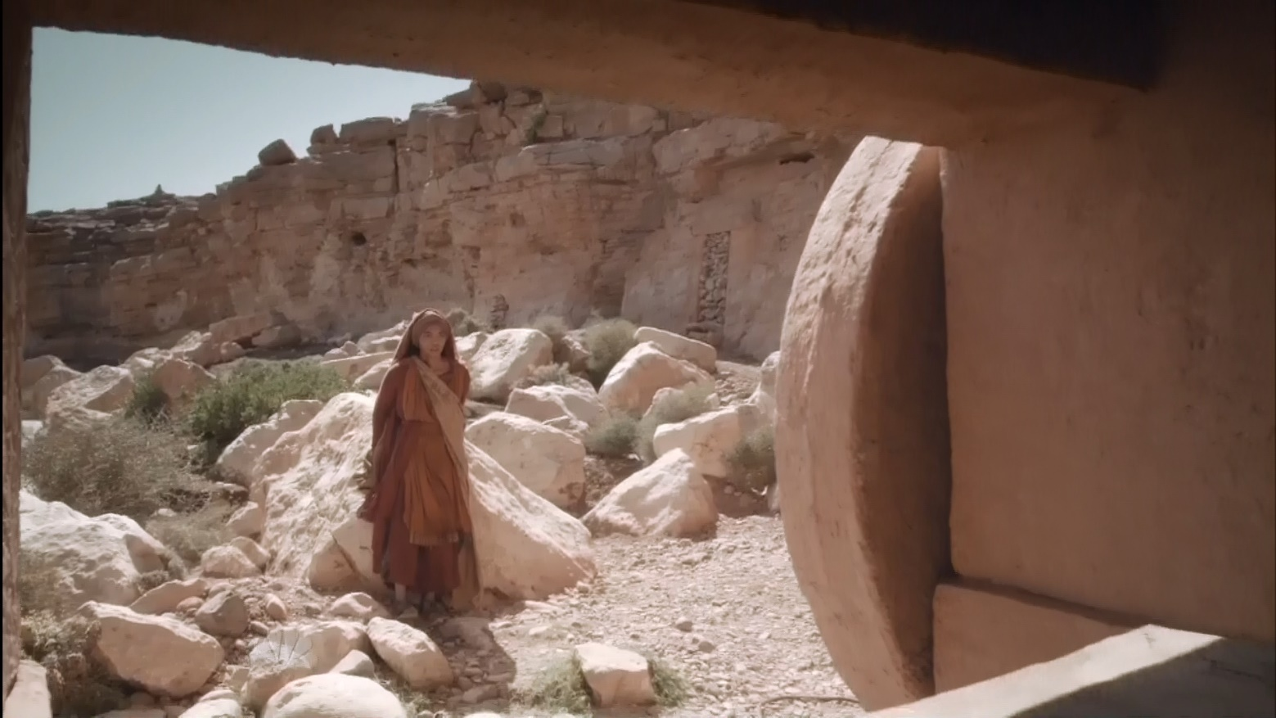
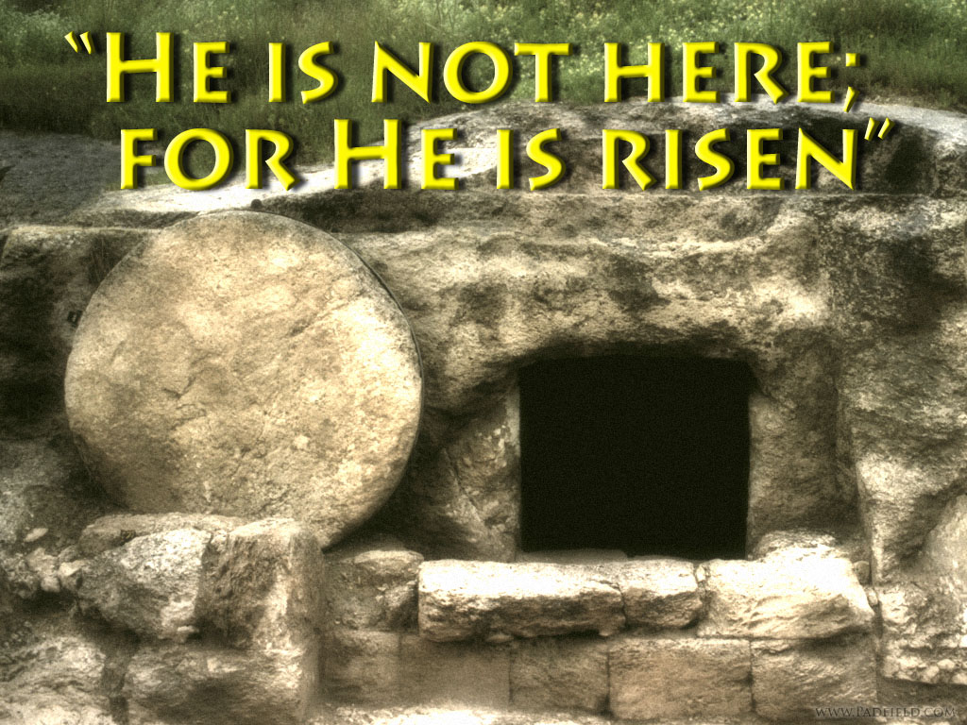
Nisan 18 - The First day of the week
SUNDAY - The Lord came forth from the grave.
He defeated death for us!
The church remembers Him thereafter on the first day of the week as He commanded.
The events after Jesus arose from the tomb are another story for another day.

Slide 16
The Gospel Message: He Is Alive! We can share in His Resurrection
Be diligent to make your “Calling & Election sure”

