Slide 1
The challenge to believe
“God is my salvation and my glory; the rock of my strength, and my refuge is in god.” Psalms 62:7
Scripture Reading – john 20: 19 -29

Slide 2
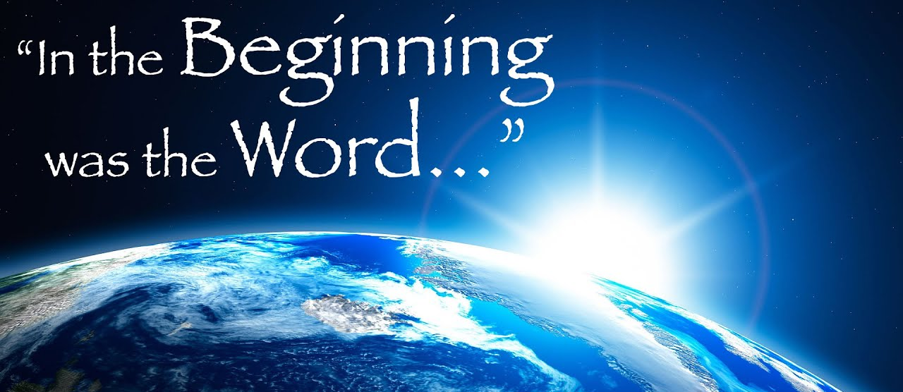
In The Beginning…
The Gospel of John was written to encourage faith.
The purpose was stated in the first sentence of John’s Gospel and at the end as well.
John 20:30-31
So many times things happen AFTER THE FACT that cause us to completely understand.
John 2:18-22
Thomas was not faithless as we can see in John 11.
John 11:5-16

Slide 3
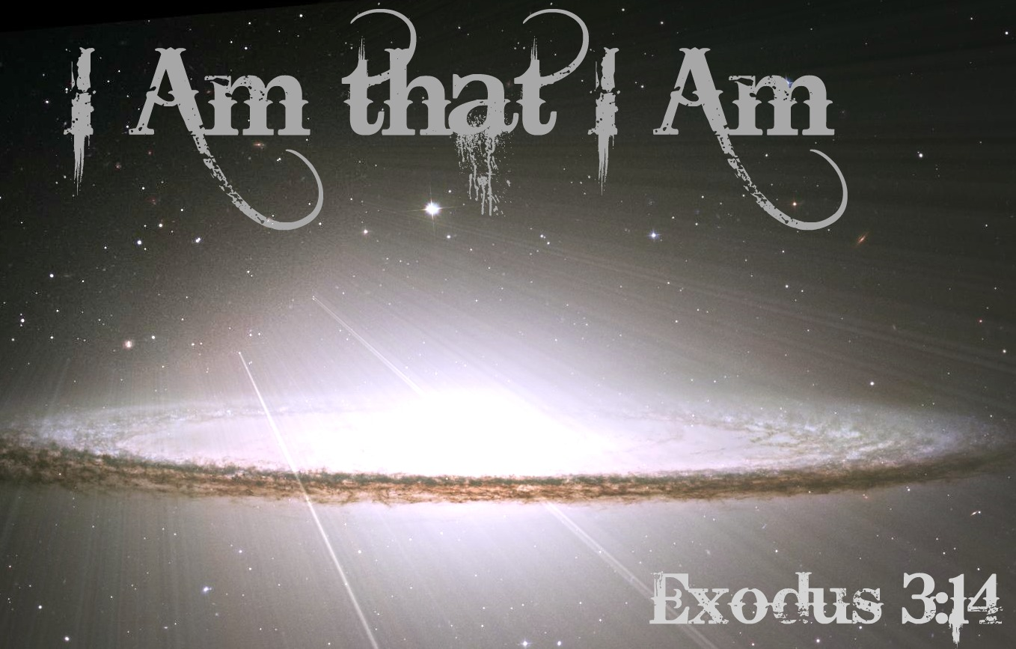
“I Am” Stories…
God [Elohim] was the “I AM’ from the Old Covenant at Sinai.

Slide 4
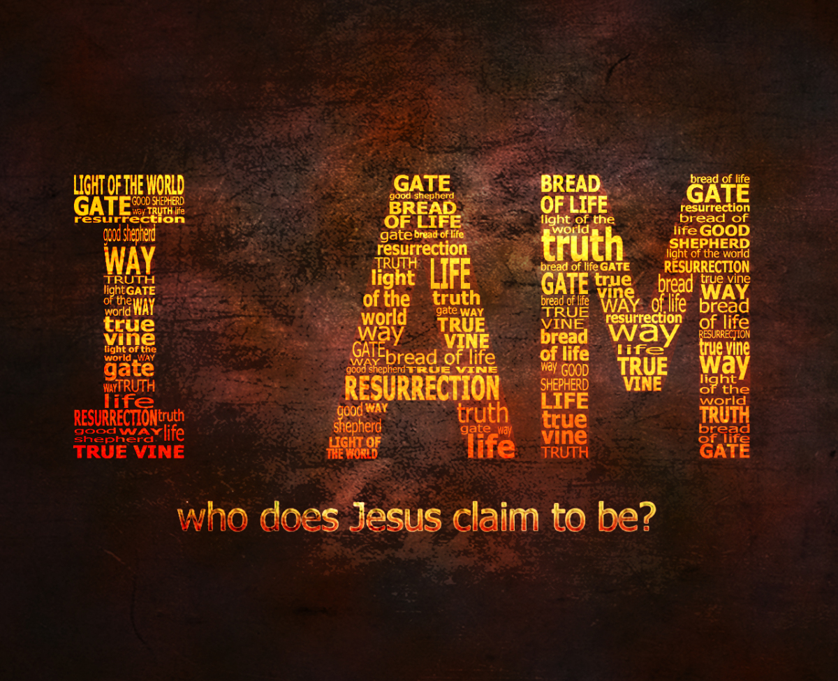
“I Am” Stories…
Jesus is the “I AM” of the New Covenant.
John 6:35
John 8:12
John 10:7-15
John 11:25
John 14:6
John 15:1

Slide 5
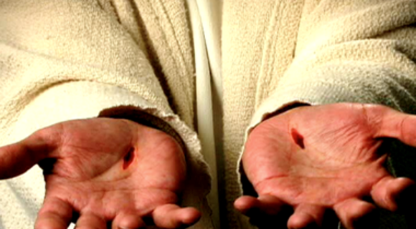
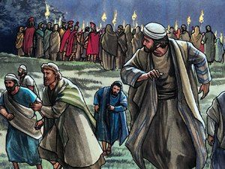
Doubting Thomas…
Was he the ONLY disciple who felt unsure abut the nature of Jesus’ claims?
Remember, in John 11:16 he was ready to go to Jerusalem and die with Jesus.
ALL of the disciples witnessed His miracles and heard His teachings.
ALL of the disciples deserted/betrayed Jesus when He was arrested in the Garden.

Slide 6
Doubting Thomas…
After Jesus arose Jesus appears to the ten.
Thomas refused to accept their testimony if he could not see for himself.
2 Corinthians 5:7
What is inexcusable is the fact he had been with Jesus for 3 years and witnessed countless miracles.
Jesus even said repeatedly that He would rise from the dead.
(Matthew 16:21-23; 20:17-19; etc.)

Slide 7
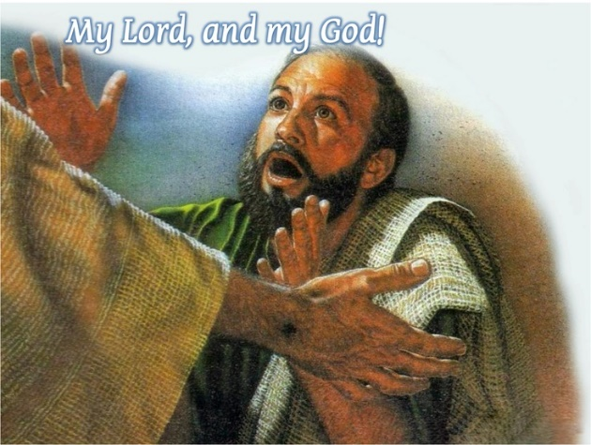
Confession of Thomas…
This is one of the last Confessions in the gospels.
It summarizes all that John intended to say about Jesus.
What was the reason for this confession of faith?

Slide 8
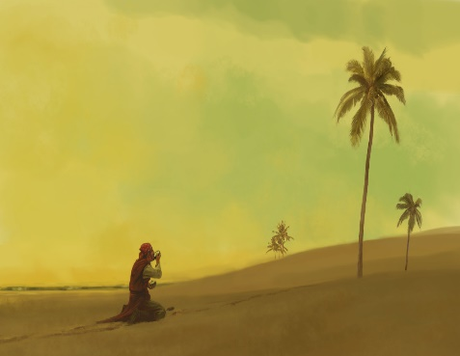
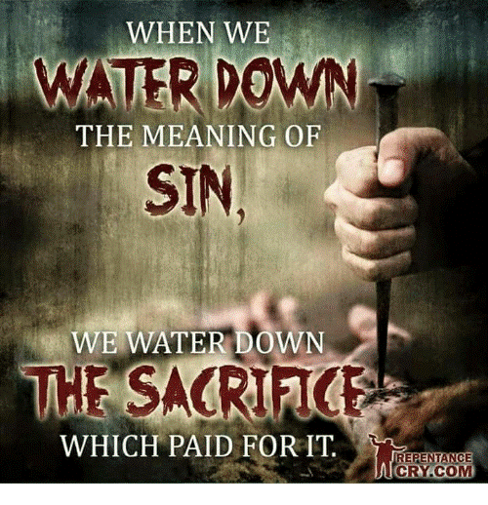
Marooned!
For whatever reason, he was in self-exile as he absented himself from his brethren.
Jesus was there and he WASN’T!
They had the privilege to be witnesses to their Lord’s resurrection from the grave.
Are WE any different today when we are not assembled with our brethren on the Lord’s Day?
Hebrews 10:24-27

Slide 9
Stop Doubting & Believe!
“Blessed are those who have not seen and yet believe.”
Jesus challenges everyone today to believe and confess Him without being physically present.
Yet all CAN see Him through the eye of faith.
By faith we can see Jesus and the heavenly realm.
The Scripture promises we will see Him
1 John 3:2-3
Revelation 1:7

Slide 10
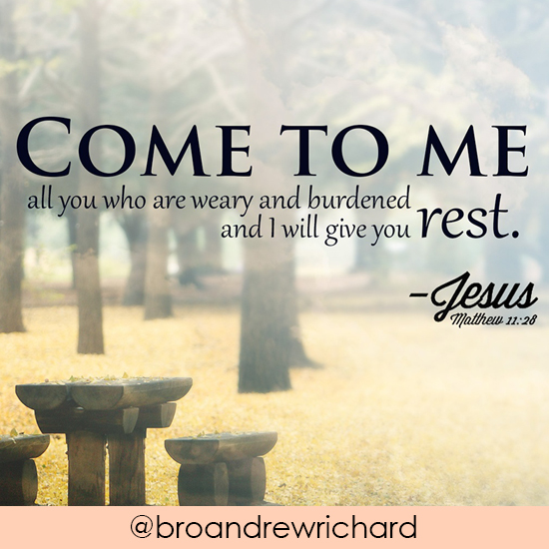
Invitation:
*

